Slide 1
Imperialism in the Middle East
The Arab World and European Imperialism

Slide 2
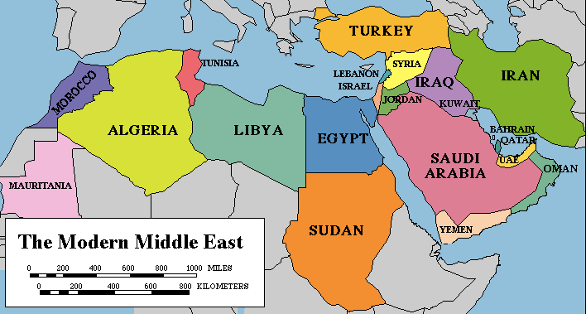
The Middle East
Before we begin today’s lesson, we are going to take a few minutes to familiarize ourselves with the geography of the middle east.
Climate
Hot and Dry (Desert)
Temperatures can reach 120f
Very little rain
Almost completely desert
Interactive Map

Slide 3
Ottoman Empire 1500’s

Slide 4
“Good Stuff” = Commodities
What is a commodity?
A raw material or primary agricultural product that can be bought and sold, such as copper or coffee.
What commodities are most important in the world?
Top Ten Most Traded Commodities

Slide 5
Ottoman Empire 1800’s

Slide 6
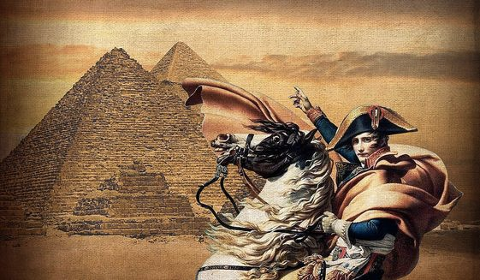
European Interest in the Middle East
European goes back a long time
Napoleon invaded Egypt and Syria in 1798-1801
Wanted to protect French trade interest ($$$$$)
Establish a base for scientific exploration
Napoleon was defeated in a series of naval battles and forced to retreat.

Slide 7
Suez Canal
This Photo by Unknown Author is licensed under CC BY

Slide 9
Now on with the assignment….
THIS IS A BIGGIE IN WORLD HISTORY.

