Slide 1
Lesson 46: Humor
….yes, this is a metaphysical subject. Philosophers have debated what made something funny. We do the same today.

Slide 2
What makes something funny?
Standard dictionary definition:
something is humorous if people cognitively appraise it as funny, if it creates, “the positive emotion of amusement,” or if it produces laughter. But while the average adult laughs 18 times a day, laughter isn’t a reliable indicator. Researchers found only 10 to 20 percent of remarks that prompted laughter to be remotely funny.
Sources: Martin and Kuiper, “Daily Occurrence of Laughter” (Humor, Jan. 1999) and Provine, Laughter: A Scientific Investigation (Viking, 2000)

Slide 3
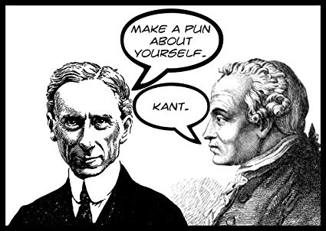
There are several forms of humor that we will investigate and find examples of.
Plato, Aristotle, Hobbes, Descartes, and Baudelaire, held that people are amused when they are made to feel superior to others. Freud, suggested that forbidden things are hilarious, because humor is a pressure valve for repressive energy. Kant and Schopenhauer and saw humor as arising from incongruity: When conventions are undermined by an absurd situation, we’re tickled.
.

Slide 4
Something is funny because……

Slide 5

1) It is expected to happen
We know what’s going to happen, and when it finally does, it makes some laugh.

Slide 6
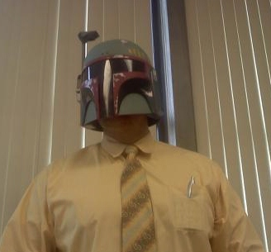
2) It’s not expected to happen
When something happens that it totally unexpected it makes some laugh

Slide 7

3) It is familiar
When something happens that is laughable because it is predictable.
IT’S A GREAT DAY TO BE A CLARENCEVILLE TROJAN….

Slide 8
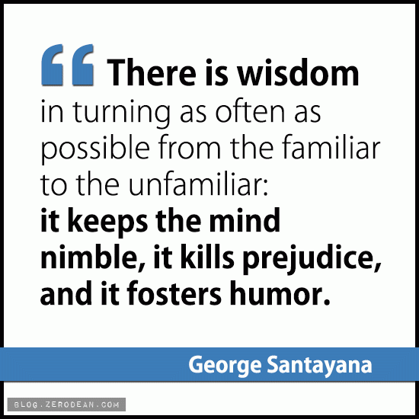
4) It is unfamiliar
When something is new and strange, it creates a humorous effect in some people.

Slide 9
The various types of humor are:

Slide 10
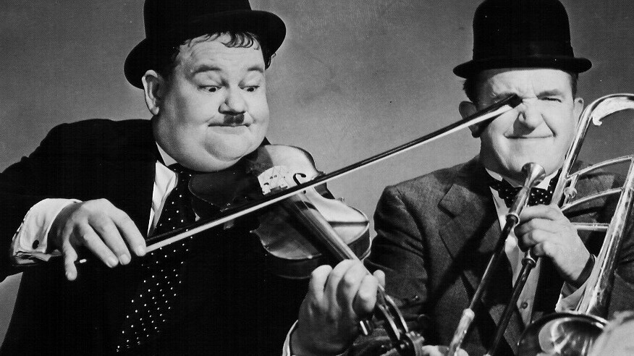
5) Slapstick
This humor stems from people getting hit, falling, and generally being hurt….in a fun way.

Slide 11

6) Parody
A work that mimics someone. Lighter than satire.

Slide 12

7) spoof
Spoof- A humorous imitation of something. It’s different than parody. parody takes a specific literary work and exaggerates its form and language, often replacing serious subjects with silly ones. Spoof is where a writer takes the conventions of a well-known genre and pokes fun at them.

Slide 13

8) Satire-
Making fun of people to get a rise out of them and show the flaws in their ways.
.

Slide 14
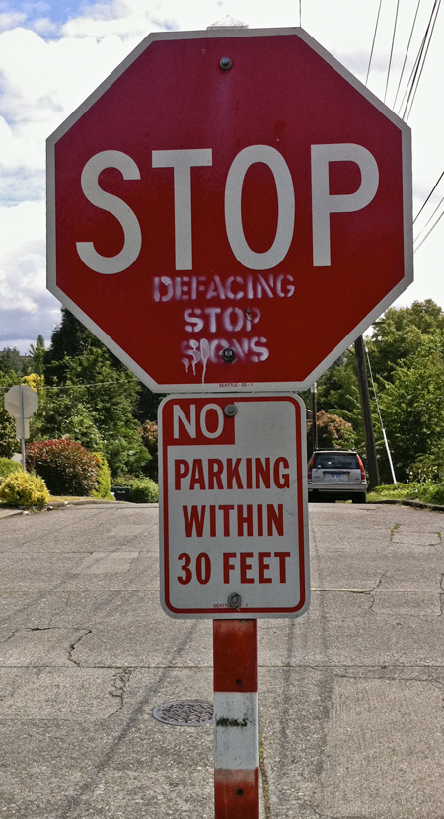
9) Irony-
When the exact opposite of what you think will happen happens.

Slide 15
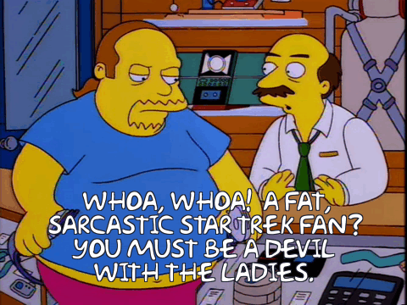
10) sarcasm
Sarcasm- like you people are smart enough to grasp it….whatever.

Slide 16
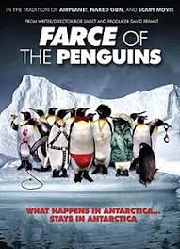
11) Farce
Exaggerated humor to illuminate how ridiculous or wrong something is.

Slide 17
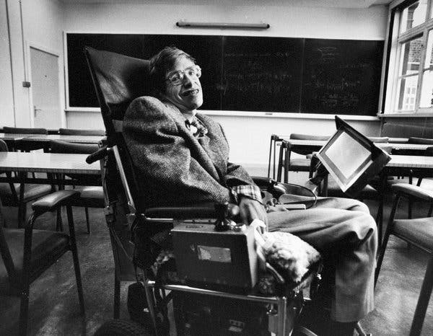
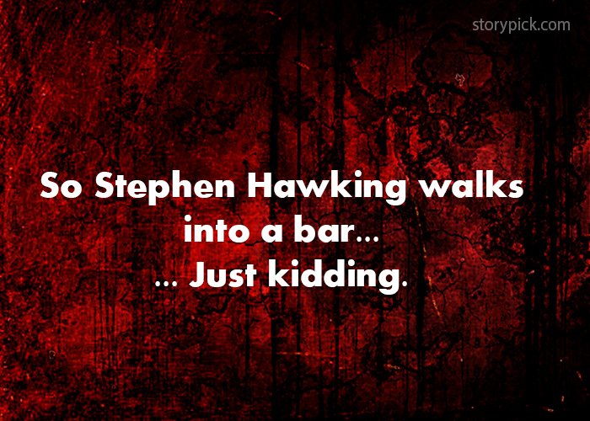
12) dark Comedy-
humor that tries to ease the pain of a difficult subject

Slide 18
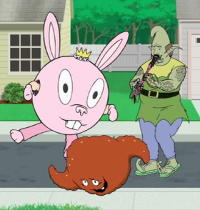
13) Surrealism-
.
Completely random and disjointed concepts thrown together for comic effect. Often you’ll be exclaiming, “what the….?”

Slide 19
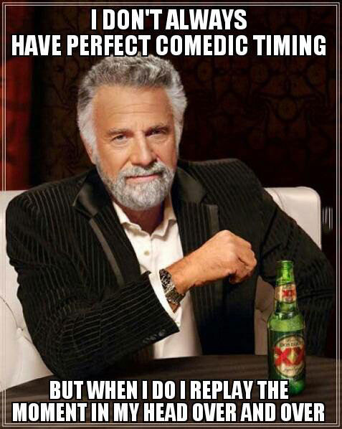
14) Comedic Timing
Pauses used to create comedic effect. We refer to these as beats, and pregnant pauses.

Slide 20
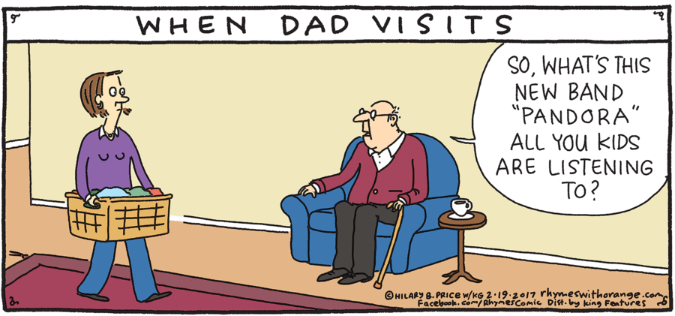
15) Misunderstanding
Comical failure in communication. The root of many sit-coms.

Slide 21

16) Pun and wordplay
.
Using language to create humor. Usually clean, rated-G-type Dad jokes.

Slide 22
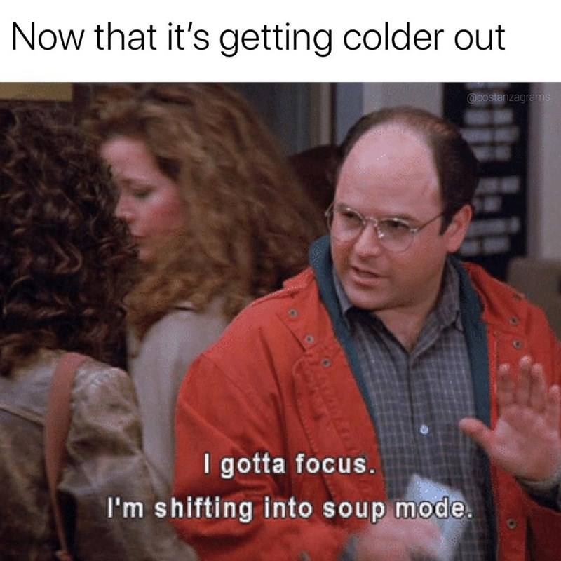
17) Mock Epic and Travesty
trivial things become big things. Using literary model of an epic, but in a humorous way

Slide 23
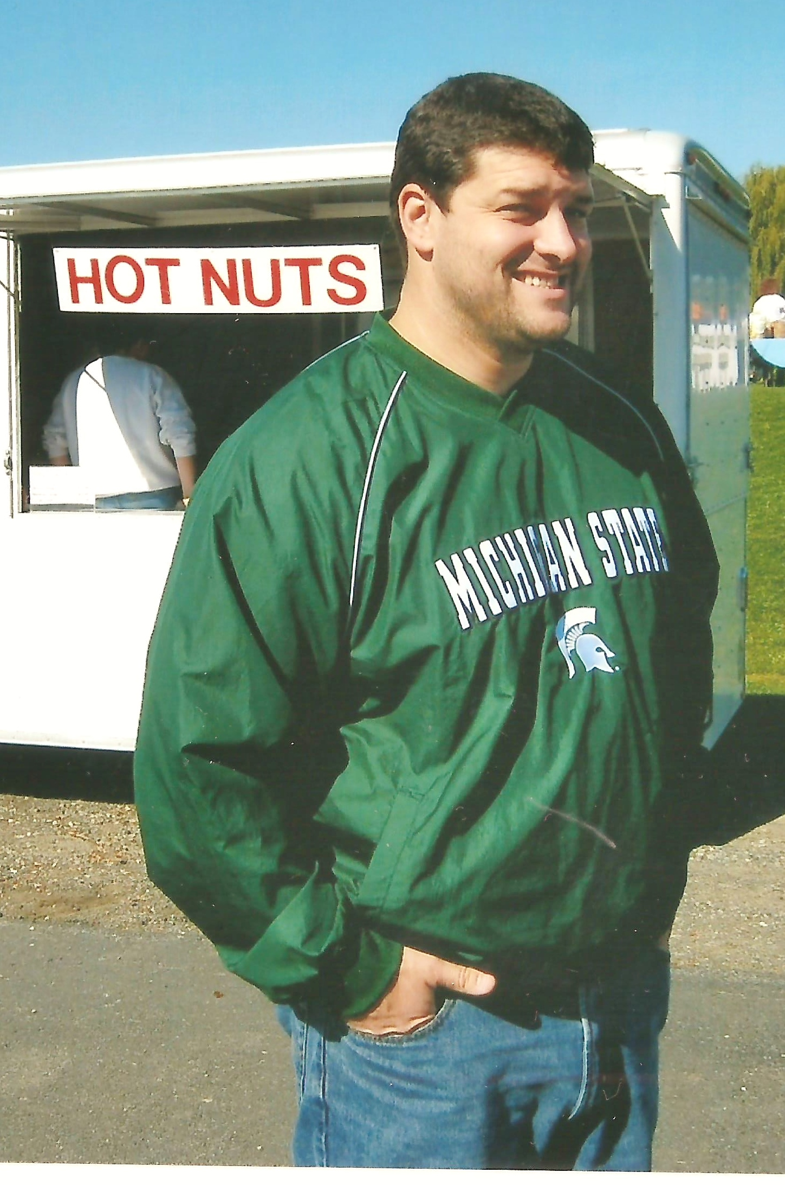
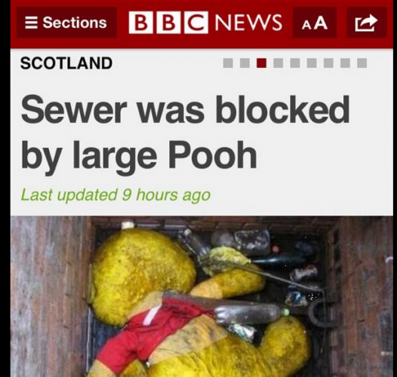
18) Double Entendre-
Comical wordplay of two meanings in words, often dirty.

Slide 24
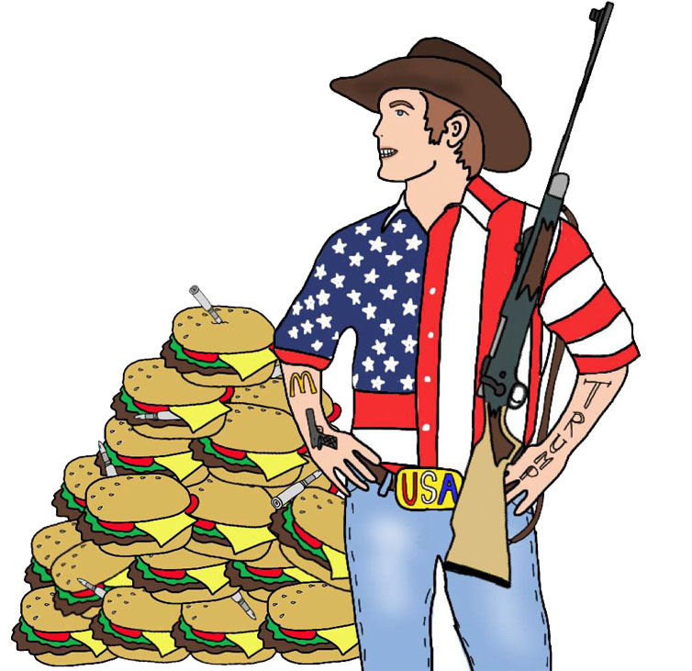
19) Stereotype
An oversimplified and common belief about a group of people. These often border, or cross into ethnic, gender, and racial insensitivity.

Slide 25
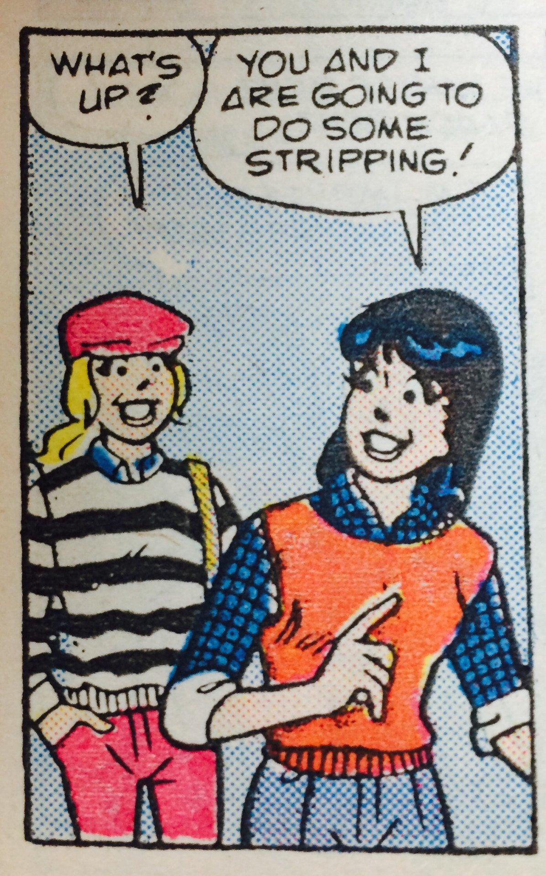
20) Taking something Out of Context
When there is a comical event caused by failure to know fuller construct.

Slide 26
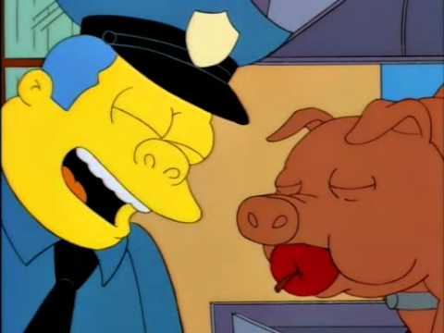
21) Characteristic Swap-
Giving animal qualities to humans.

Slide 27
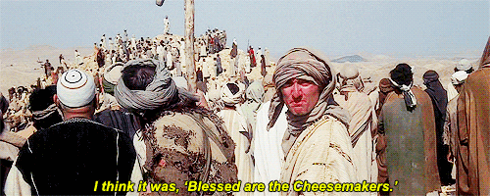
22) The Infectious Wisdom of the Fool
A fool gets wrong information and it spreads.

Slide 28
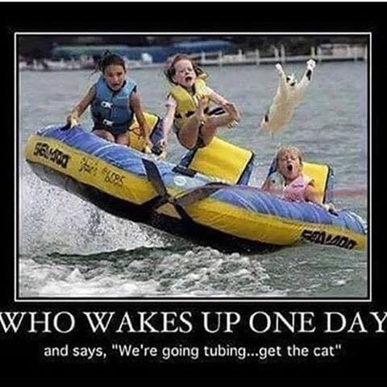
23) The Flawed Plan
Audience watches the impending failure of a silly plan.

Slide 29
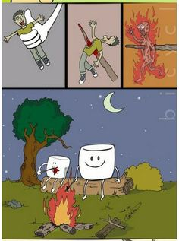
24) Paralleling reality
Having a common situation but switching all the elements involved.

Slide 30
Two things I need from you:
2) Journal entry
1) Contribute to our shared class google slide of humor
YouTube clips, memes, images, your own material?
“What is humor, how is humor created?” What do you consider the highest forms of humor, what do you consider the lowest forms?

