Slide 1
“Democracies die behind closed doors….When government begins closing doors, it selectively controls information rightfully belonging to the people. Selective information is misinformation” – judge damon j. keith
“A GALLERY WALK THROUGH HISTORY”

Slide 2
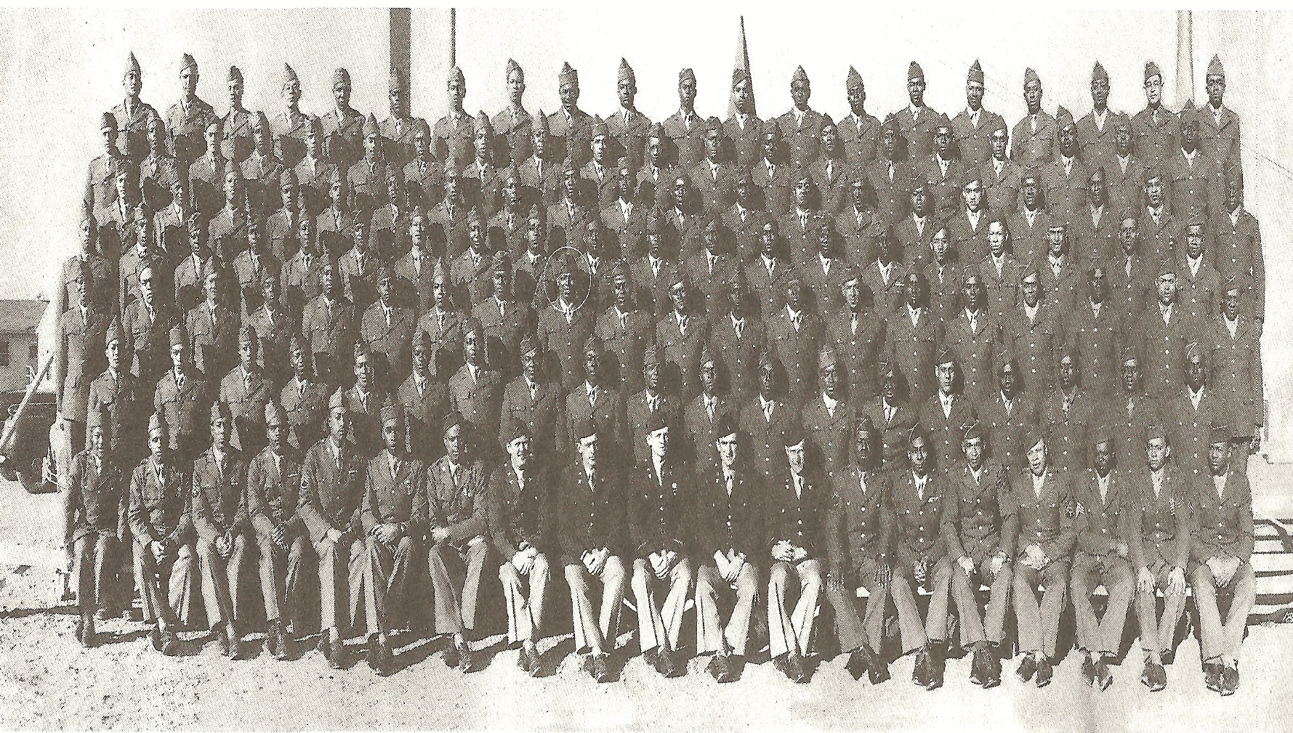
Image “A”

Slide 3
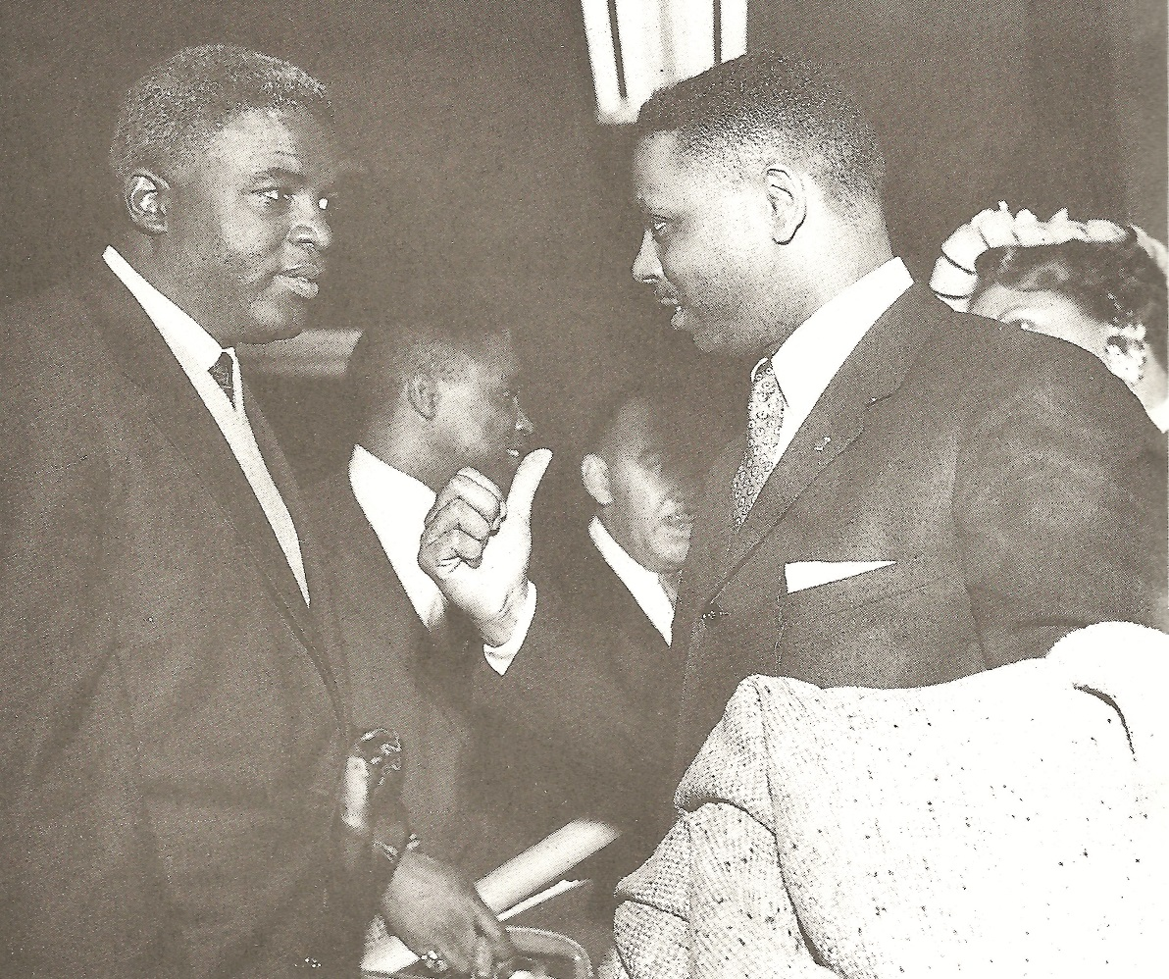
Image “B”

Slide 4
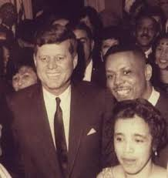
Image “C”

Slide 5
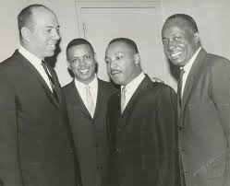
Image “D”

Slide 6
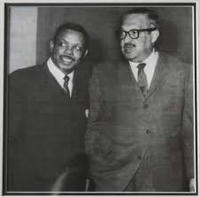
Image “E”

Slide 7
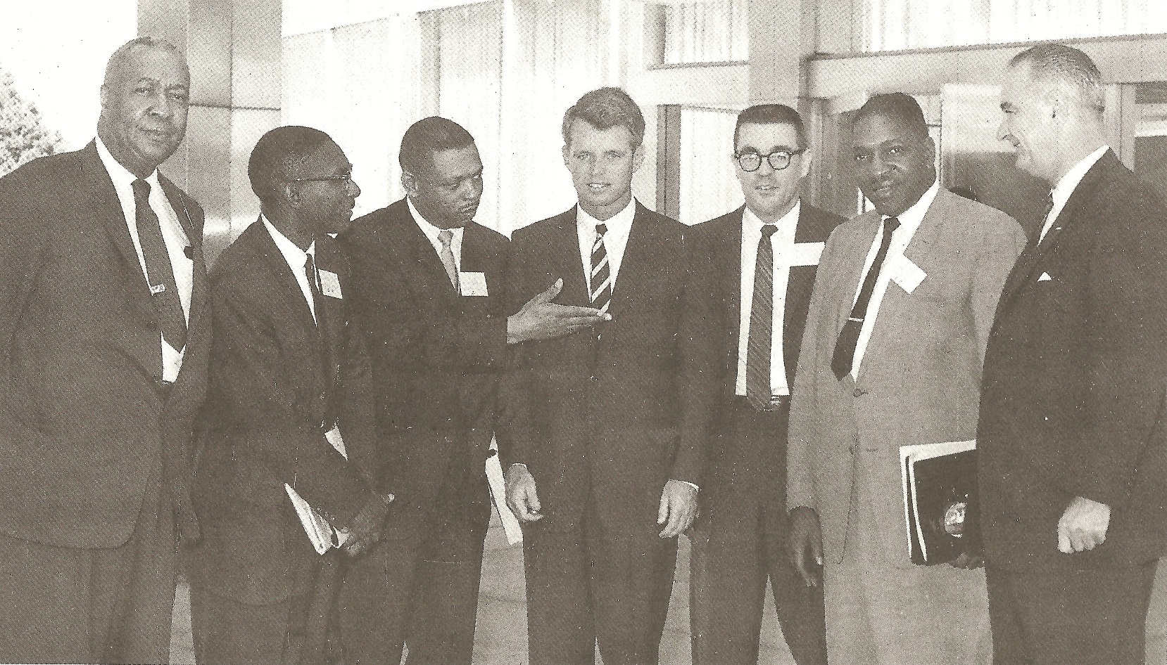
Image “F”

Slide 8
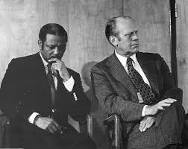
Image “G”

Slide 9
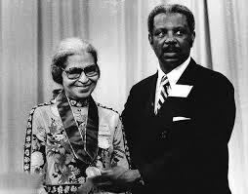
Image “H”

Slide 10
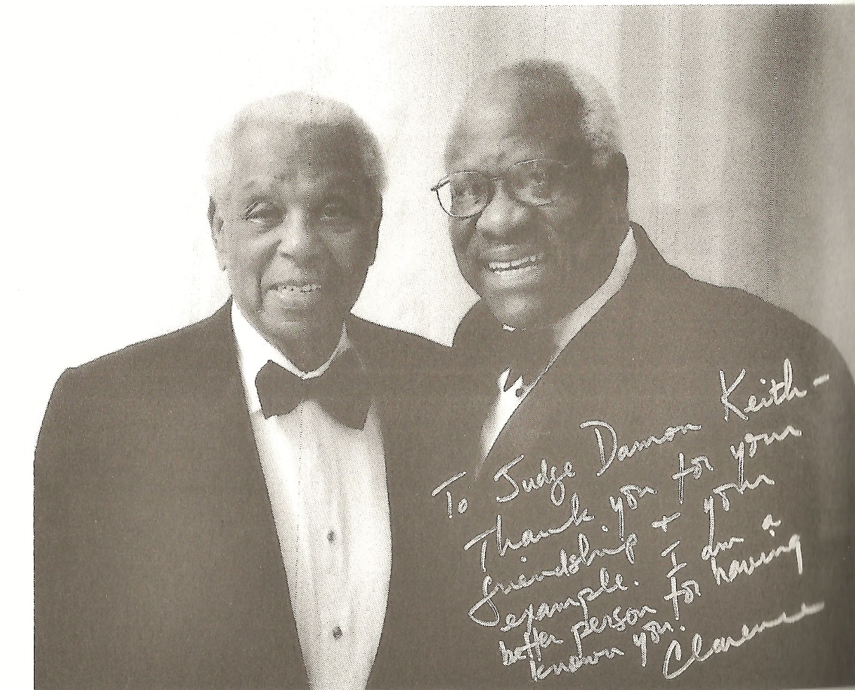
Image “I”

Slide 11
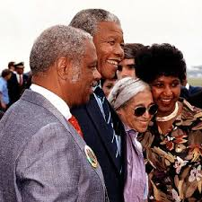
Image “J”

Slide 12
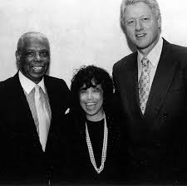
Image “K”

Slide 13
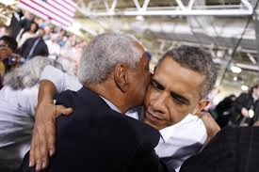
Image “L”

