Slide 1
Day 152: Key Events and Concepts of the Cold War
1945-1991:

Slide 2
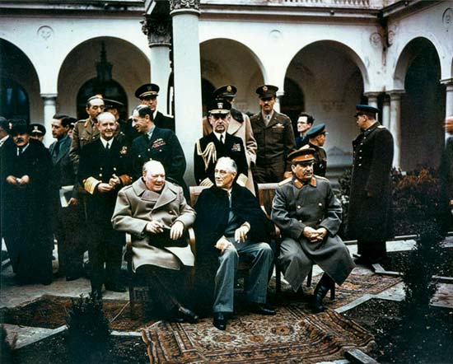
Yalta Conference: February 1945
Meeting of Winston Churchill, Josef Stalin and President Roosevelt.
During the conference, the three leaders agreed to demand Germany’s unconditional surrender and began plans for a post-war world.
Stalin also agreed to permit free elections in Eastern Europe and to enter the Asian war against Japan, for which he was promised the return of lands lost to Japan in the Russo-Japanese War of 1904-05.
This didn’t work out and disintegrated into the Cold War
.

Slide 3
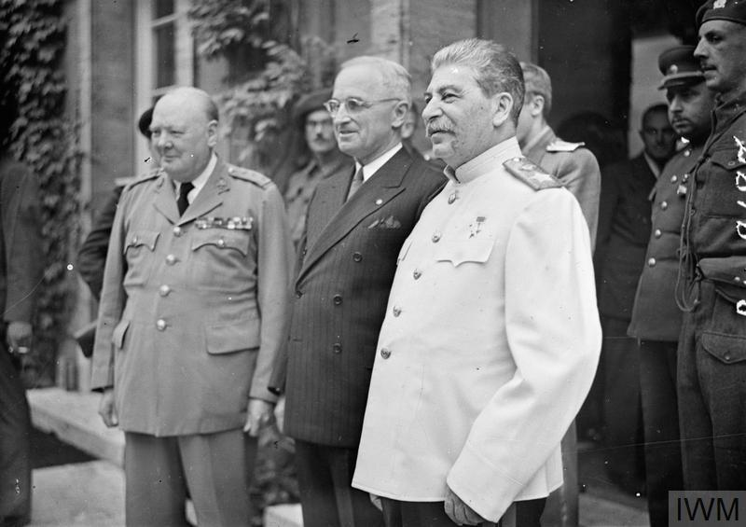
Potsdam Conference: July-August, 1945
President Truman, Prime Minister Churchill and Soviet Premier Joseph Stalin attended.
They established a Council of Foreign Ministers and a central Allied Control Council for administration of Germany.
The leaders arrived at various agreements on the German economy, punishment for war criminals, land boundaries and reparations.
“The Big Three” also issued a declaration demanding “unconditional surrender” from Japan.
.

Slide 4
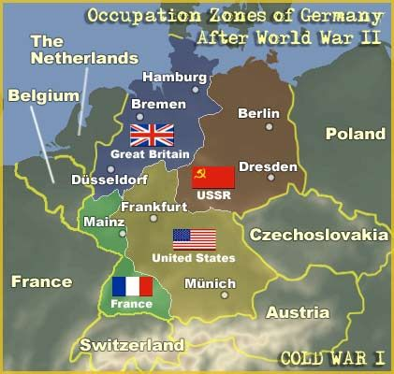
Germany After the Second World War

Slide 5
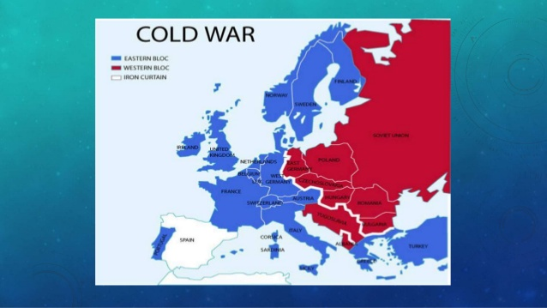
The Iron Curtain: March 1946
The Iron Curtain is a term that received prominence after Winston Churchill’s speech in which he said that an “iron curtain has descended” across Europe. He was referring to the boundary line that divided Europe in two different political areas: Western Europe had political freedom, while Eastern Europe was under communist Soviet rule. The term also symbolized the way in which the Soviet Union blocked its territories from open contact with the West.
.

Slide 6
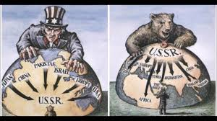
The Truman Doctrine: March 1947
With the Truman Doctrine, President Harry S. Truman established that the United States would provide political, military and economic assistance to all democratic nations under threat from external or internal authoritarian forces. The Truman Doctrine effectively reoriented U.S. foreign policy, away from its usual stance of withdrawal from regional conflicts not directly involving the United States, to one of possible intervention in far away conflicts.
.

Slide 7
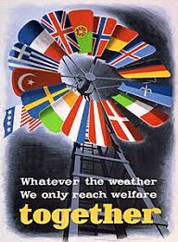
The Marshall Plan: April 1948- December 1951
The Marshall Plan, also known as the European Recovery Program, channeled over $13 billion to finance the economic recovery of Europe. The Marshall Plan successfully sparked economic recovery, meeting its objective of ‘restoring the confidence of the European people in the economic future of their own countries and of Europe as a whole.’
.

Slide 8
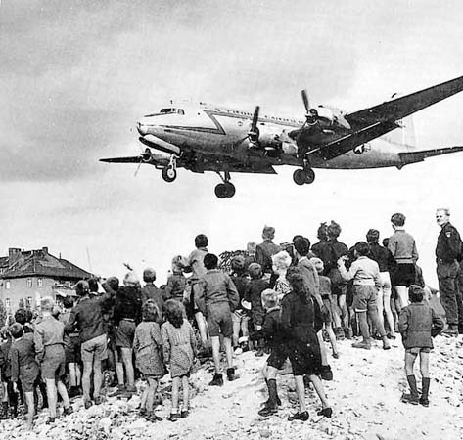
Berlin Blockade and Airlift: June 1948
After World War II, the Allies partitioned the defeated Germany into four zones
Berlin, the German capital city, was located deep in the Soviet zone, but it was also divided into four sections.
The Russians–who wanted Berlin all for themselves–closed all highways, railroads and canals to Berlin
They believed it would make it impossible for the people who lived there to get food or any other supplies and would eventually drive the other three out of the city for good.
Instead of retreating from West Berlin, however, the U.S. and its allies decided to supply their sectors of the city from the air. This effort, known as the “Berlin Airlift,” lasted for more than a year and carried more than 2.3 million tons of cargo into West Berlin.
.

Slide 9
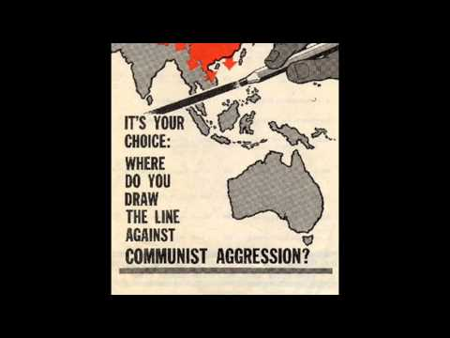
Containment Policy
Containment is a geopolitical strategy to stop the expansion of an enemy.
It is best known as a Cold War foreign policy of the United States and its allies to prevent the spread of communism.
As a component of the Cold War, this policy was a response to a series of moves by the Soviet Union to increase communist influence in Eastern Europe, China, Korea, Africa, Vietnam, and Latin America.
Containment represented a middle-ground position between detente and rollback.
.

Slide 10
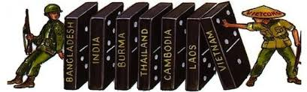
Domino Theory
The domino theory was a Cold War policy that suggested a communist government in one nation would quickly lead to communist takeovers in neighboring states, each falling like a perfectly aligned row of dominos.
In Southeast Asia, the U.S. government used the now-discredited domino theory to justify its involvement in the Vietnam War and its support for a non-communist dictator in South Vietnam.
In fact, the American failure to prevent a communist victory in Vietnam had much less of an impact than had been assumed by proponents of the domino theory. With the exception of Laos and Cambodia, communism failed to spread throughout Southeast Asia.
.

