Slide 1

Day 150: Unit 6 Introduction
1945-Today

Slide 2
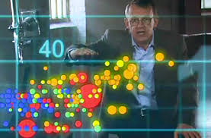
Hans Rosling 1948-2017
https://www.youtube.com/watch?v=jbkSRLYSojo
How can one man fit so much learning into four minutes?

Slide 3
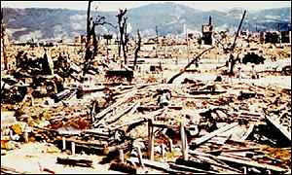
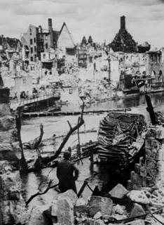

The World in 1945:
50 million people killed during WW II
Parts of Europe, Asia, and North Africa in ruins
World trade severely damaged
Much of the world looked pretty bleak.
Notes:
http://www.archives.gov/research_room/research_topics/world_war_2_photos/images/ww2_185.jpg
http://news.bbc.co.uk/1/hi/world/asia-pacific/1475764.stm

Slide 4
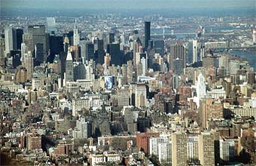
Many European economies in shambles
European Colonial empires crumbling
Growing nationalist movements in Africa and Asia
U.S. the major industrial and atomic power
The world entered a new era.
Notes:
http://www.freefoto.com/preview.jsp?id=1210-14-12

Slide 5
Cold War policies developed:
The Soviet Union occupied Eastern Europe and part of Germany.
The U.S. moves to encircle the Soviet Union with a system of alliances and military aid.
U.S. offers Marshal plan to rebuild Europe and gives $13 billion in aid.
The U.S. adopted a policy of “Containment” of the Soviet Union with military bases around the world.
An “Iron Curtain” of tense relations separated the Western allies from the U.S.S.R. and its allies.
Notes:
1945: The Soviet Union and the U.S. each have 12 million troops. Soviets maintain army.
Get date of Marshal.

Slide 6
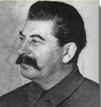
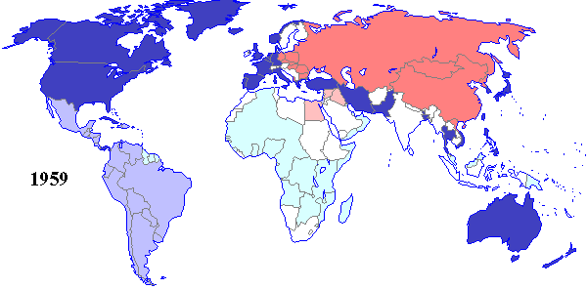
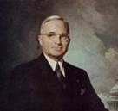

The World became divided into two hostile camps: The U.S.S.R. and the U.S.
Joseph Stalin
Pres. Harry
Truman
1946-60
Notes:
http://en.wikipedia.org/wiki/Image:HarryTruman.jpg
http://www.fatherryan.org/holocaust/russian/stalin.htm

Slide 7

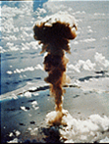
During the Cold War, the U.S.S.R and the U.S. followed a policy of Mutual Assured Destruction (MAD).
I guess it made sense at the time.
Mutual Assured Destruction is a military deterrence strategy in which a full scale use of nuclear weapons by one of the opposing powers would result in the destruction of both.
The U.S. and U.S.S.R had enough nuclear bombs to destroy the world about 400 times.
Notes:
Nuclear Bomb: Library of Congress Reproduction Number: LC-USZC2-727 (color film copy transparency)
Call Number: Unprocessed [item] [P&P]
Attack drill: Http://www.reaganfoundation.org/reagan/photographs/photos_rr.asp?ItemID=48

Slide 8
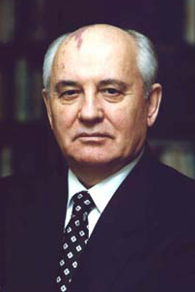


The forty years of the Cold War were costly in resources.
We spent 3.5 trillion, and for what?
We spent 5.5 trillion dollars on nuclear arms, and we won!
How much is a trillion dollars?
Michail Gorbachev
George H.W. Bush
A trillion dollars is enough to give each family in the U.S. $100,000.
Notes:
http://bushlibrary.tamu.edu/research/find/Doncol1/bushpaps.html
http://en.wikipedia.org/wiki/Gorbachev

Slide 9
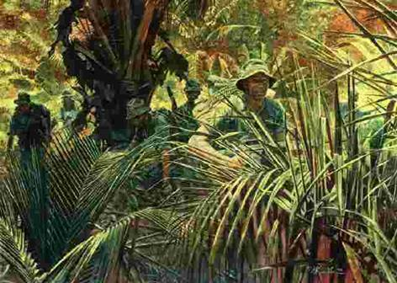
The Cold War was very costly
in lives.
1950-53 - A divided Korea led to war, separated family members, and cost a million lives, including 48,000 Americans.
1963-1972 - Three million people died in the Vietnam War, including 58,000 Americans.
Notes:
http://images.google.ca/imgres?imgurl=www.delawarenationalguard.com/history/images/vietnam.jpg&imgrefurl=http://www.delawarenationalguard.com/history/vietnamn.html&h=456&w=640&sz=24&tbnid=Ynw2MzsxBCoJ:&tbnh=96&tbnw=134&prev=/images%3Fq%3Dvietnam%2Bwar%26start%3D40%26hl%3Den%26lr%3D%26ie%3DUTF-8%26sa%3DN

Slide 10
During the cold war many former colonized peoples created new nations.
India gained independence from Britain in 1947.
Indonesia gained independence from the Dutch in 1949.
Ghana gained independence from Great Britain in 1957.
By 1965 most former European colonies had become newly created independent nation-states.
.
The U.S. and the U.S.S.R. competed for the loyalties of these new nations.
Notes:
Sukarno: http://www.hawaii.edu/cseas/outreach/10.html
Nehru: http://en.wikipedia.org/wiki/Image:Pm_nehru.jpg#file

Slide 11
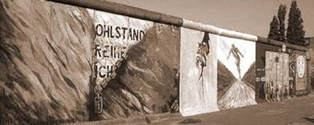
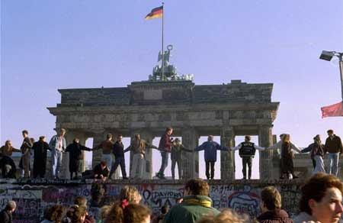
In 1989, the Berlin Wall came down and the Cold War ended. Eastern European countries broke away from Soviet control. The Soviet Union itself broke into more than a dozen new states.
The Berlin Wall was built in August 1961
The Wall was
destroyed
on November 9, 1989
Notes:
Berlin Wall. http://www.berlin-tourist-information.de/english/berlin-infos/e_bi_mauer.html
Fall of Berlin Wall.http://en.wikipedia.org/wiki/Image:Berlin-wall-dancing.jpg

Slide 12
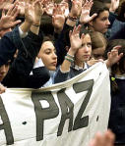
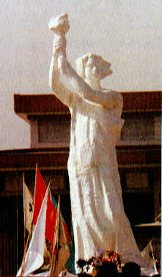
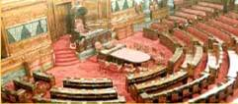
Democratic ideas have spread to more countries than ever before.
India
Korea
Japan
Taiwan
Malaysia
Qatar
Mali
Brazil
South Africa
Notes:
Statue: http://community-2.webtv.net/TerMcC/Liberty/
India Council of States: http://www.parliamentofindia.nic.in/
http://www.ironorchid.com/anti_war_03/index.htm
Paz: http://www.guardian.co.uk/gall/0,8542,1167149,00.html

Slide 13
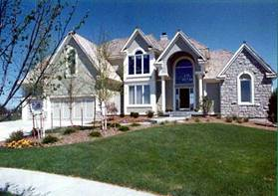
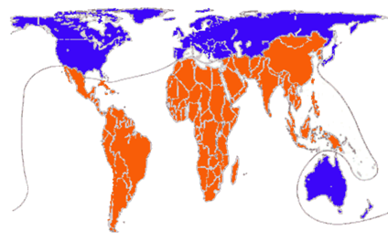
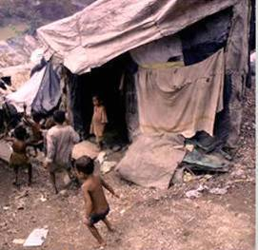
In the 1960s, as the colonized people gained independence, the world-wide split between the North –rich industrial nations—and the South – poor “third world” nations—grew wider.
Notes:
Poverty: International Gaming Industry. Poverty Relief Project. http://images.google.ca/imgres?imgurl=www.thepavilionskc.com/images/pool2.jpg&imgrefurl=http://www.thepavilionskc.com/community_info.htm&h=238&w=400&sz=19&tbnid=G6h71VzZAvMJ:&tbnh=71&tbnw=119&prev=/images%3Fq%3Drich%2Bestate%26start%3D40%26hl%3Den%26lr%3D%26ie%3DUTF-8%26sa%3DNslums.jpg&imgrefurl=http://www.igiprp.com/contact/contact.asp&h=350&w=350&sz=26&tbnid=cSR9QYCMLtEJ:&tbnh=116&tbnw=116&prev=/images%3Fq%3Dslums%26hl%3Den%26lr%3D%26ie%3DUTF-8%26sa%3DG

Slide 14
Country | Average Life Expectancy
Sweden | 79.2
France | 78
United States | 73.1
Bangladesh | 62.8
Botswana | 40.1
Zimbabwe | 39.2
Life expectancy is rising,
but it varies world wide.
Average life
expectancy
for the world
is 70 years.

Slide 15

World population has been
rapidly increasing.
Wow! More than 7.5
billion
people
now alive.
billions
7
6
5
4
3
2
1
1803 - 124 yrs 1927- 33 yrs 1960 - 14 yrs 1974 - 12 yrs 1986 – 13 yrs
The time it takes to add a billion people grows shorter.

Slide 16

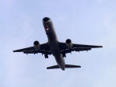

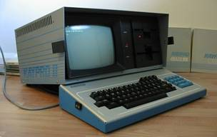
Speed of travel has increased dramatically.
1957
1981
World wide communication is almost instantaneous
Look at this antique computer. It doesn’t even have a hard drive!
1962
1977
1982
Notes:
Space shuttle: www.stanford.edu/.../ Space%20Shuttle(72).jpg
Computer: http://koti.mbnet.fi/~oju/retro/Kaypro_eng.html

Slide 17

What is Globalization?
Increasing global connectedness through rapid communication and transport.
Rapid intensification of worldwide social relations.
Swift and free flow of capital, people, and ideas across national borders.

Slide 18
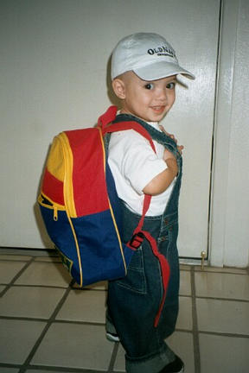
But what does globalization have to do with me?
Cap from Bangladesh
Jeans from
Malaysia
Shirt from Mexico
Video game
from Japan
Backpack
from China
Sneakers from
Indonesia
Soccer ball from
Pakistan
Notes:
Photo by Don Johnson

Slide 19
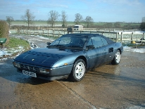

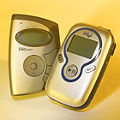
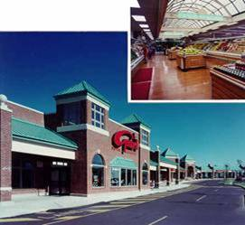

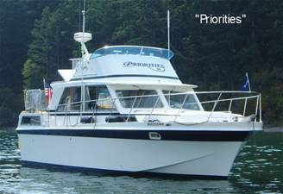

More goods are being produced, bought, and sold worldwide than ever before.
What shall I buy next?
Notes:
http://www.classicdriver.com/uk/find/4100_coop_results.asp?sorderby=tblManufacturers%2EsName+ASC%2C+tblModels%2EsModel+ASC%2C+bOfficial+DESC%2C+tblCars%2EsType+ASC&action=simple%5Fsearch&coopid=56&lmanufacturer=10042&lcurrency=6&next=4100%5Fcoop%5Fresults%2Easp&whatbutton.x=0&dealerid=0&bsubmit=true&lmodelflag=12278&bclicked=false&bshowstock=False&page=0&lCarID=1699736
http://www.landsend.com/cd/fp/prod/0,,1_2_1930_50458_98069_76516_5:view=-1,00.html?sid=4771039419157161000
http://www.unifliteworld.com/models/36double.html
http://membrane.com/philanet/berks/projects/nbvsq.html
http://www.target.com/gp/detail.html/602-1788130-0438231?asin=B00008Y1AD

Slide 20


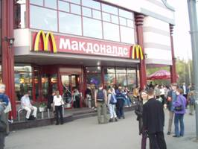


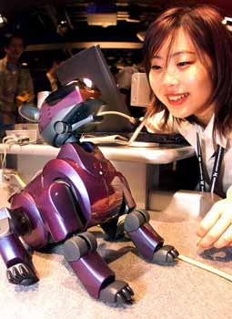
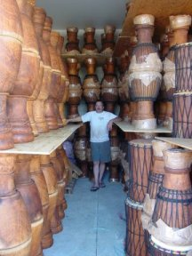
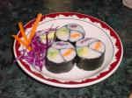
Globalization also spreads ideas and values.
Notes:
MacDonalds Moscow: Photo by R. Dunn
Coca Cola Arabic: Photo by R. Dunn
Bollywood: http://images.google.ca/images?hl=en&lr=&ie=ISO-8859-1&q=indian+cinema&btnG=Google+Search
Soccer: http://www.svcn.com/archives/wgresident/05.23.01/cover-0121.html.Photo by Jacqueline Ramseyer
Mickey Mouse Club: http://images.google.ca/images?hl=en&ie=UTF-8&q=annette+funicello+mickey+mouse&spell=1
Yoga: http://images.google.ca/images?hl=en&ie=ISO-8859-1&q=Yoga&sa=N&tab=wi&me
Tai chi: http://images.google.ca/images?hl=en&ie=ISO-8859-1&q=tai+chi&sa=N&tab=wi&meta=ta=
http://www.punjabilok.com/infotech/images/pet_aibo.jpg
http://images.google.com/images?svnum=10&hl=en&lr=&q=Sushi&btnG=Search
http://p-a-k-i-s-t-a-n.net/koran%5B1%5D.jpg
http://www.livingchi.com.au/%5EImages%20&%20Downloads/Shop/Tai%20Chi%20for%20stress%20control.jpg

Slide 21
But globalization brings high human costs.
20% get most of the wealth.
The U.S. owns 11 trillion dollars of this wealth.
2 billion of the world’s people live on less than $2 a day.
Peasants are forced to leave the land as money and wage economies spread.
Workers without education and skills are often left behind.

Slide 22
Notes:
Chart data adapted from David Held and Anthony McGrew, Globalization/Anti Globalization (Malden, MA: Blackwell, 2002).

Slide 23
Ranking | GDP/value added | $trillion
1 | United States | 9.9
2 | Japan | 4.7
 |  | $billion
40 | Malaysia | 89.7
41 | Colombia | 81.3
42 | Philippines | 74.7
43 | Chile | 70.5
44 | Wal-Mart Stores | 67.7
45 | Pakistan | 61.6
46 | Peru | 53.5
47 | Algeria | 53.3
48 | Exxon | 57.6
49 | Czech Republic | 50.8
50 | New Zealand | 50
51 | Bangladesh | 47.1
52 | United Arab Emirates | 46.5
53 | General Motors | 46.2
54 | Hungary | 45.6
55 | Ford Motor | 45.1
56 | Mitsubishi | 44.3
57 | Mitsui | 41.3
58 | Nigeria | 41.1
59 | Citigroup | 39.1
60 | Itachu | 38.4
Gross Domestic
Product (GDP)
of Selected
Countries and
Corporations
2002
Corporations in bold face
Some big multinational corporations have more wealth than many nations.
Notes:
Adapted from Wolf, 2002: 7. Based on World Bank and Fortune magazine data.

Slide 24
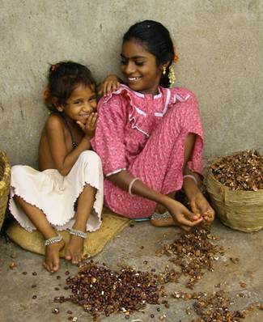
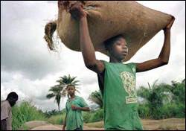
In poor countries child labor is widespread. Some 212 million children of ages 5-14 are working instead of going to school.
These young girls work 12 hours a day, 6 days a week, earning $2-3 per week.
Most child labor involves
high energy work.
Notes:
Two girls: Photo by Don Johnson,
Child worker: http://www.globalexchange.org/campaigns/fairtrade/cocoa/EdWeekChildLaborLessons.doc

Slide 25
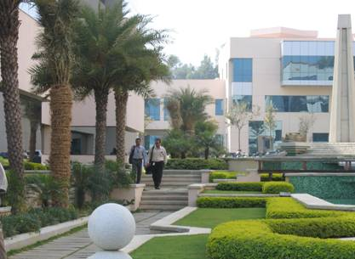
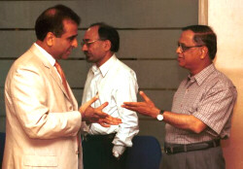
Outsourcing is increasing.
In 2003, the U.S. lost 234,000 information technology jobs. An estimated 14 million more jobs may move overseas. But the U.S. loss is a gain for India, China, Ireland, Korea and other nations
Narayana Murthy (right) and his Infosys Information Technology complex in Bangalore, India.
Notes:
Three men: http://www.thehindubusinessline.com/businessline/2001/05/11/stories/1411398k.htm. Photo by Ramesh Sharma
Infosys campus: http://www.econ.ucdavis.edu/faculty/fzfeens/photo/08_Campus%20of%20Infosys.JPG

Slide 26
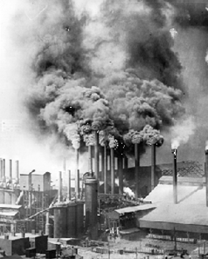
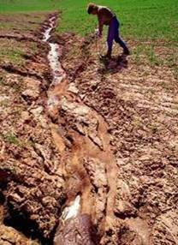
The speed of globalization results in more pollution and global warming caused by
over-cutting forests.
burning fossil fuels.
producing more industrial and consumer waste.
Notes:
classes.colgate.edu/.../ ecopain/copy/air.htm
home.howstuffworks.com/ irrigation6.htm

Slide 27
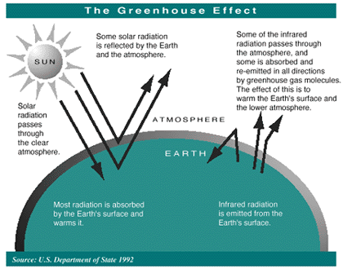
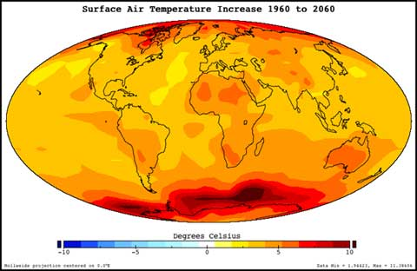
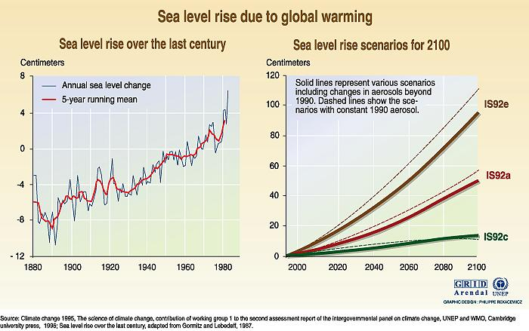
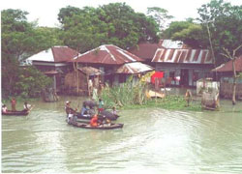
Growing threats to the environment affect all people
Global warming lead to major floods.
Notes:
http://www.grida.no/climate/vital/graphics/large/18.jpg
http://www.epa.gov/air/airtrends/aqtrnd95/image19b.gif
http://www.nasa.gov/images/content/105583main1_GlobalWarming_2060_t.jpg
http://www.riverside.com/projects/marketing_flyers/pix%5Cbangladesh_ofda_8(1).jpg

Slide 28


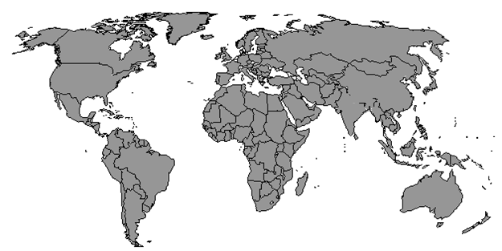

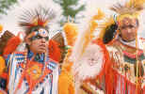

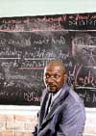
Lots of people question globalization.
Globalization is forcing my child to work.
.
Free trade is destroying us farmers.
Hollywood is ruining
our
children.
Development is destroying our rain forest.
We have 50 million people living in poverty.
Industrial countries are leaving us out of Globalization.

Slide 29
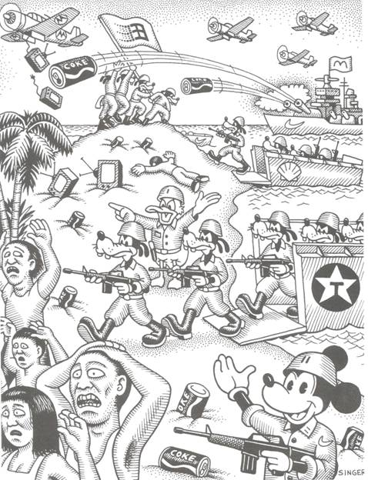
Some people believe that
globalization is
“cultural imperialism”.
Can you interpret how this cartoon depicts the idea of “cultural imperialism?”
Notes:
From Teaching About Globalization

