Slide 1
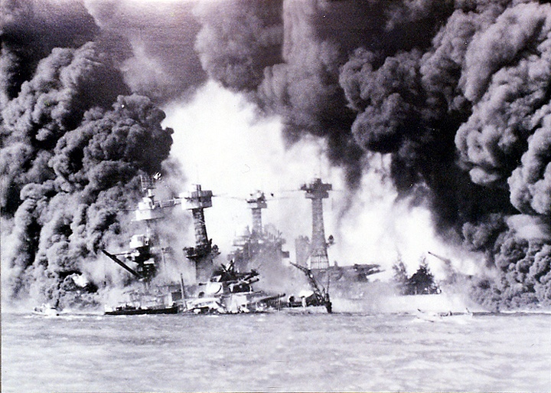

Slide 2
Historical Perspectives on Pearl Harbor
The United States:
  An act of treachery
  Part of a deep-seated “conspiracy against peace”
Japan
  A tactical blunder
  Wrong response to a collapsing world order
  Thought they had the momentum

Slide 3

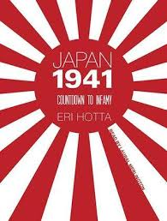
Setting aside dominant national views…these are too simplistic

Slide 4
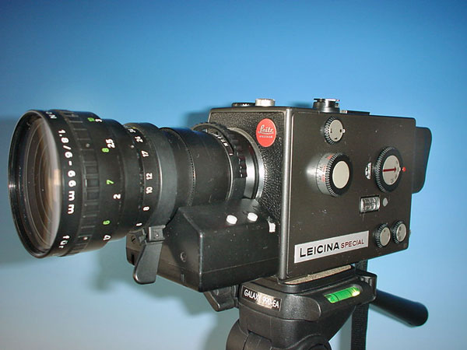
Historical Persepctives on 3 different scales
1. Close-up views (at the point history happened)
2. Mid-range views (a few years prior)
3. Distant panoramas (many years prior)

Slide 5
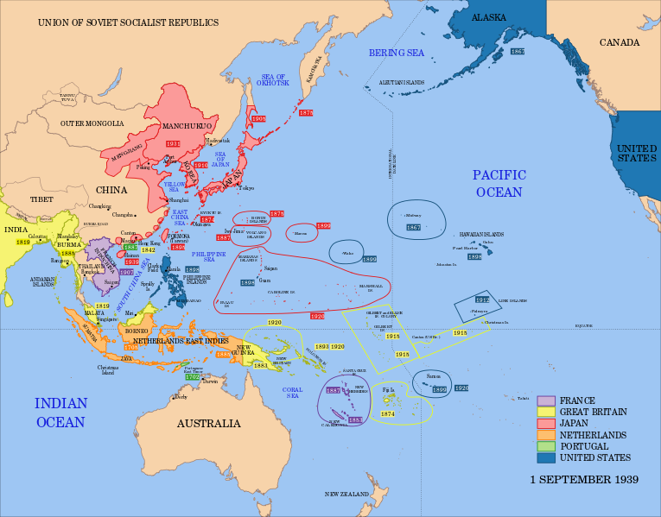
Close-up Scale:
Last minute failures of diplomacy and political decision-making
Diplomatic Talks (March-November 1941)
  Nomura Hull, U.S. Secretary of State and Nomura Kichisaburô, Japan’s Ambassador to the U.S. meet in Washington
  What does this map reveal?
  Body language reveals quite a bit. Looking at these photos, how do you feel Japan and the United States are feeling?

Slide 6
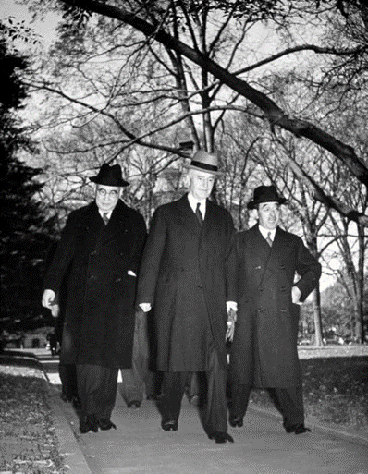
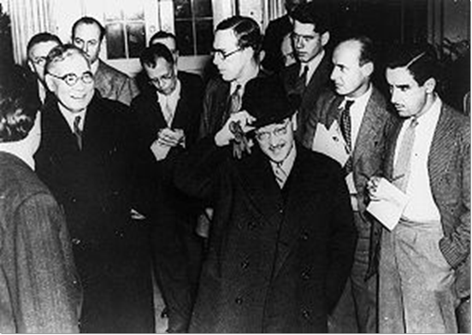
Pictures say 1,000 words….

Slide 7
Irresolvable Differences?
“From the outset, the Americans were as unresponsive to Japanese overtures as the Japanese were uncomprehending of American goals.
--Peter Duus, Modern Japan
United States
  Moved by moral idealism
  Unified by threat of other nations fighting in WWII
  Hull’s “Four Principles” moral idealism set the tone
  Demanded Japan’s full withdrawal from China
Japan
  Seeking practical solutions to the “China Problem”
    Supplying Japanese troops
    Cutting off aid to Chinese Nationalists
  Did offer a small compromise
    However, they refused to give up control of China

Slide 8
“The Hull Memo”: Four Points
1. Respect for the territorial integrity and the sovereignty of each and all nations.
2. Support of the principle of non-interference in the internal affairs of other countries.
3. Support of the principle of equality, including equality of commercial opportunity.
4. Non-disturbance of the status quo in the Pacific except as the status quo may be altered by peaceful means.

Slide 9
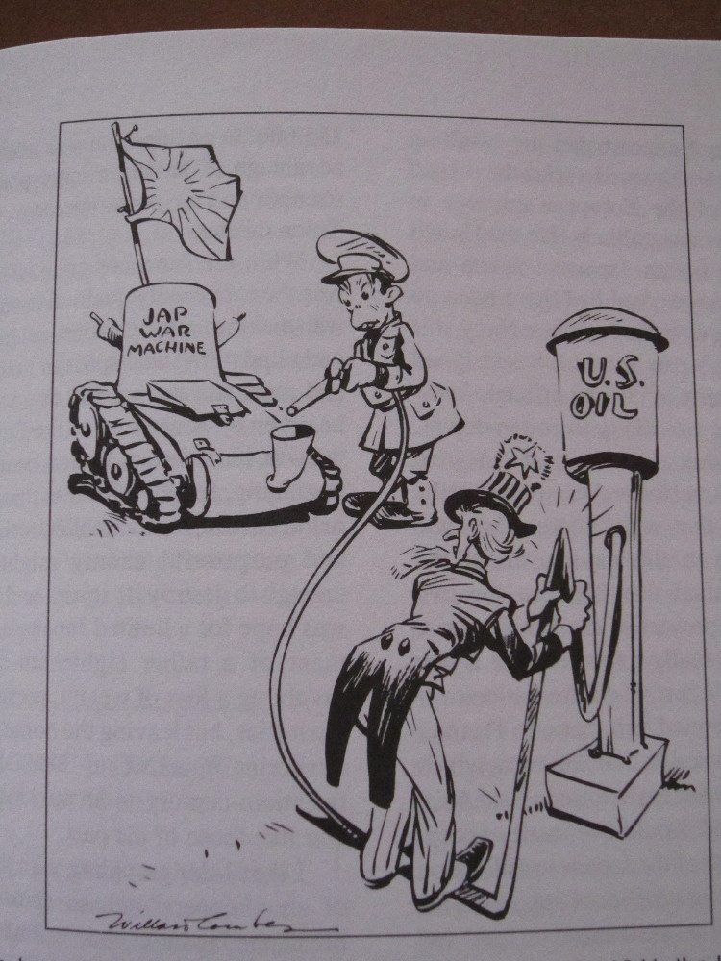
Mid-range views:
U.S.-Japan Conflict gets intense: 1937-1941
Japan’s expanding war in China
U.S. economic sanctions against Japan (1938-1941)
Japan’s vulnerability as an island nation
What story does this cartoon tell? →→→

Slide 10
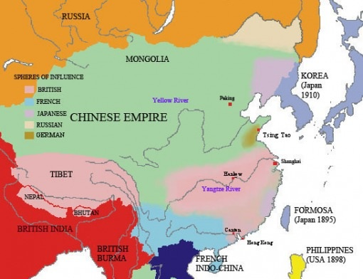
Imperial Powers and Spheres of Influence in China
IF YOU WERE JAPAN, YOU HAVE ENGLAND, FRANCE, RUSSIA, AND GERMANY TO THE WEST AND THE U.S.A. TO THE EAST.

Slide 11
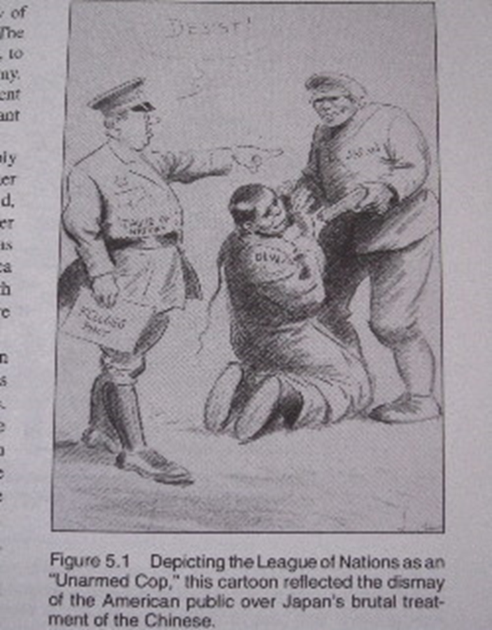
WHAT DOES THIS CARTOON MEAN?
HULL MEMO?

Slide 12
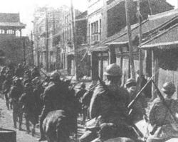
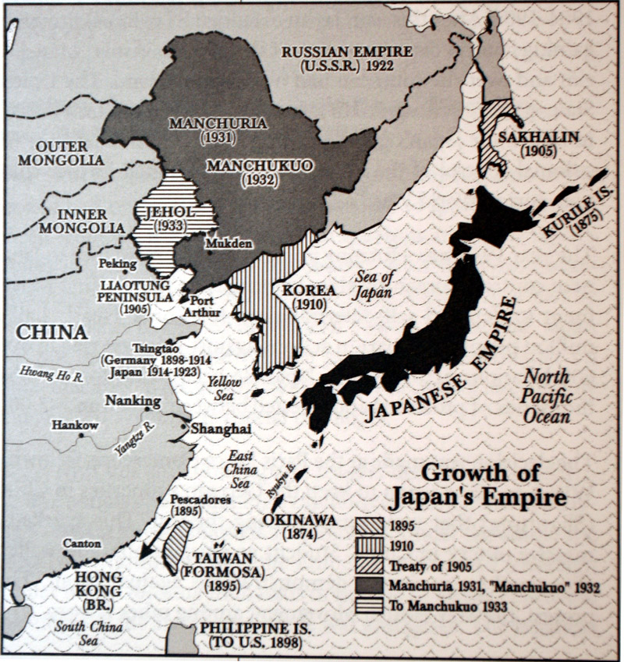
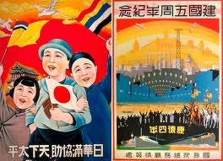
Japan’s Invasion and Occupation of Manchuria
Japanese troops march into Shengyang
Japan invasion of Manchuria, 1931

Slide 13
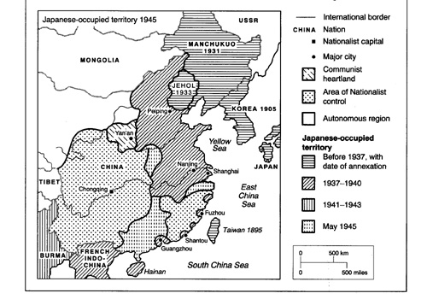
Japan’s Occupation of China

Slide 14
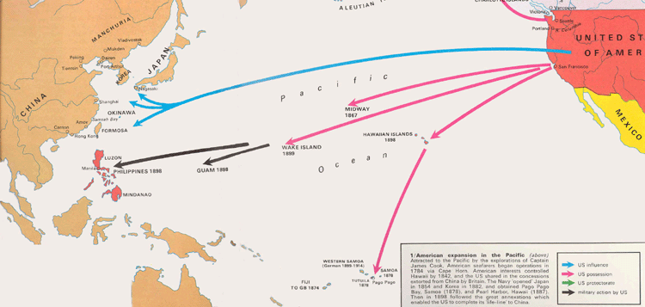
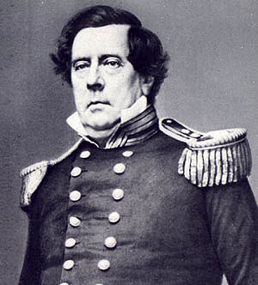
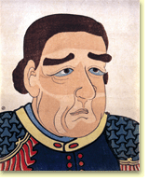
Distant Panorama: “Opening” of Japan beginning in 1853
America’s “Manifest Destiny” extends into the Pacific
Commodore Matthew C. Perry (U.S. Navy): a message backed by force
“Unequal Treaties”
Main cause of Japan’s Meiji Restoration Revolution
USA PERSPECTIVE JAPANESE PERSPECTIVE

Slide 15
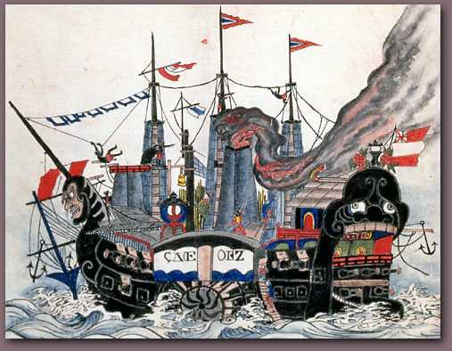
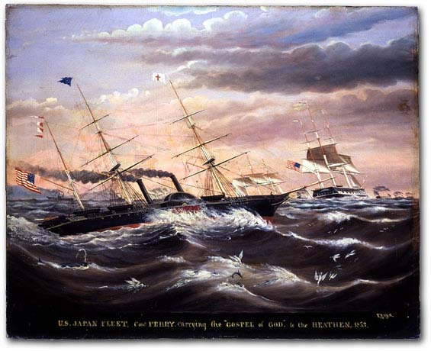
Monstrous “Black Ships” or Vanguard of Civilization?

Slide 16
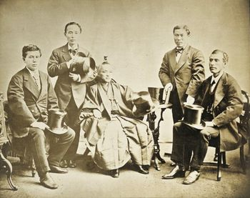
Japan sees the West as a model . . . and a threat
Iwakura Mission to Europe & U.S. (1871-73)
  “. . . to discover the great principles which are to be our guide in the future”
  “Most of the countries in Europe shine with the light of civilization and abound in wealth and power. Their trade is prosperous, their technology is superior, and they greatly enjoy the pleasures and comforts of life”
Foreign experts come to Japan
Study tours to the West
“Civilization and Enlightenment”
Iwakura Mission members including Iwakura Tomomi,
Okubo Toshimichi,
Kido Koin

Slide 17
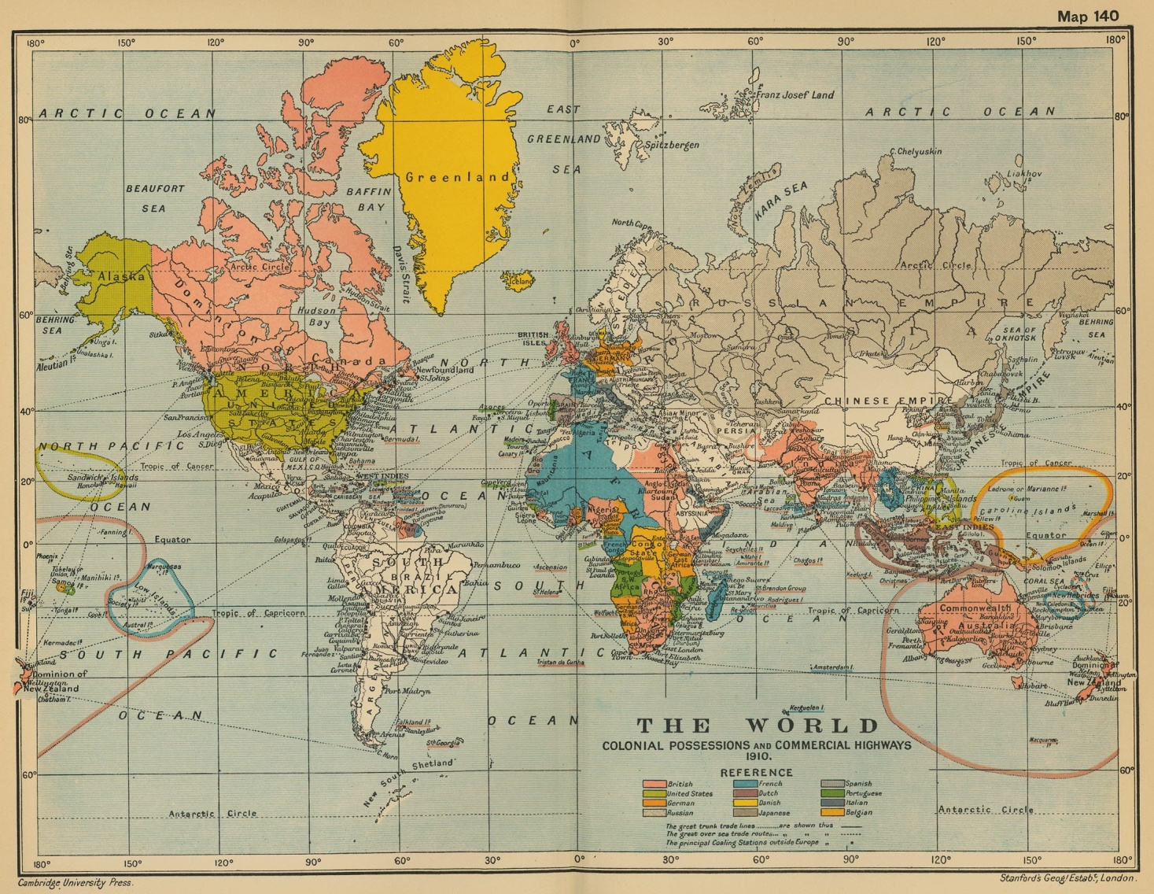
Once change happened, so did industrialism and imperialism
Backed by industrial power
Intense competition for empire, formal & informal
Supported by new national publics
Measure of international prestige & power

Slide 18
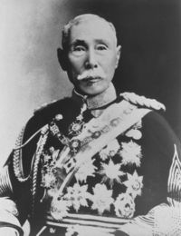
Japan’s Logic of Empire
Prime Minister Yamagata’s policy statement in Japan’s first Diet session (1890):
If we wish to maintain the nations independence among the powers of the world, it is not enough to guard only the line of sovereignty; we must also defend the line of advantage.
Yamagata Aritomo
1838-1922

Slide 19
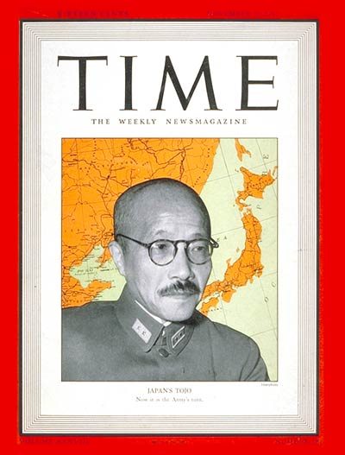
Was it a total surprise. This was written in Time on Nov. 5, 1941. . .
How can we let the United States continue to do as it pleases, even though there is some uneasiness. Two years from now, we will have no petroleum for military use; ships will stop moving, When I think about the strengthening of American defenses in the southwestern Pacific, the expansion of the U.S. fleet, the unfinished China Incident, and so on, I see no end of difficulties. We can talk about suffering and austerity, but can our people endure such a life for long . . .I fear that we would become a third-class nation after two or three years if we merely sat tight.
Tojo Hideki

Slide 20
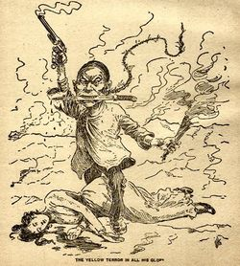
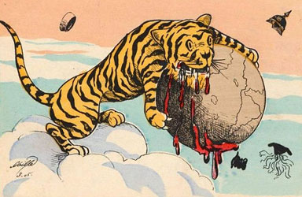
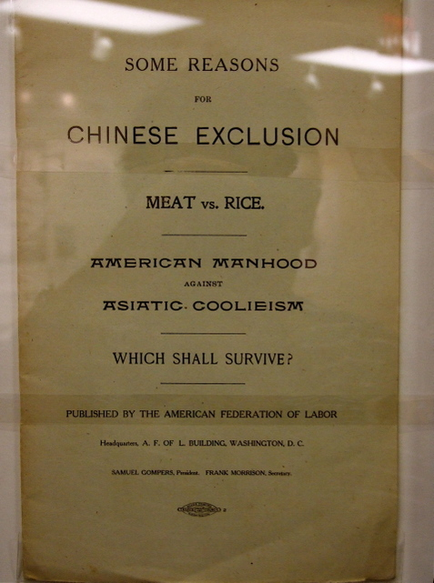
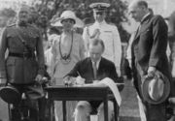
Propaganda and Racism

Slide 21
TO SUM UP…..ANSWER
1) EXPLAIN WHY PEARL HARBOR HAPPENED USING THREE ON THREE SCALES.
2) ATTEMPTING TO LOSE HISTORICAL BIAS, HOW WOULD YOU DESCRIBE PEARL HARBOR IN A MANNER BOTH AMERICAN AND JAPANESE STUDENTS WOULD AGREE WITH.

