Slide 1
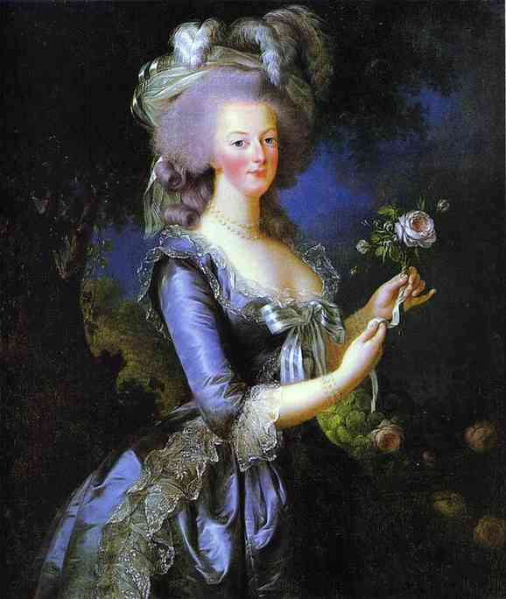
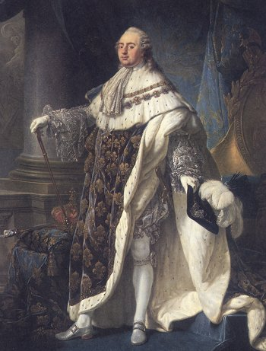
The French Monarchy:
1775 - 1793
Marie Antoinette & Louis XVI

Slide 2
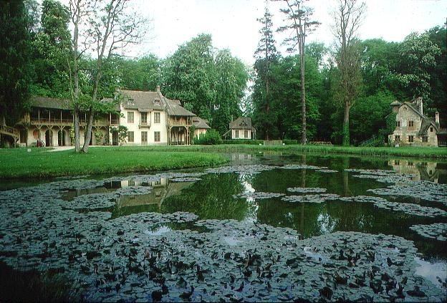
Marie Antoinette’s
“Peasant Cottage”

Slide 3
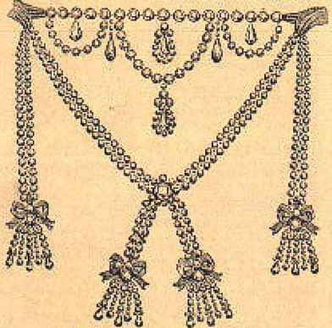
The Necklace Scandal
1,600,000 livres
[$100 million today]
Cardinal Louis René Édouard de Rohan
The Countess de LaMotte

Slide 4
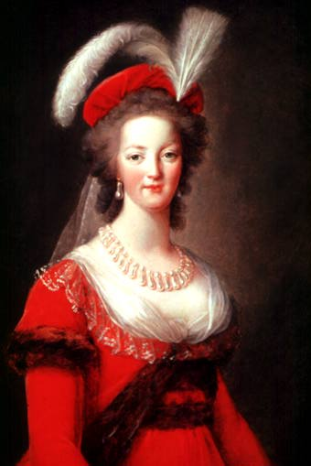
Let Them Eat Cake!
Marie Antoinette NEVER said that!
“Madame Deficit”
“The Austrian Whore”

Slide 5
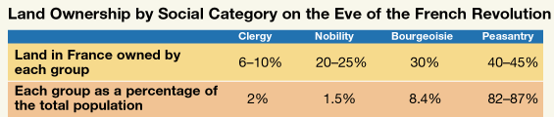
Socio-Economic Data, 1789

Slide 6
The French Urban Poor

Slide 7
Financial Problems
in France, 1789
Urban Commoner’s
Budget:
  Food 80%
  Rent 25%
  Tithe 10%
  Taxes 35%
  Clothing 20%
  TOTAL 170%
King’s Budget:
  Interest 50%
  Army 25%
  Versailles 25%
  Coronation 10%
  Loans 25%
  Admin. 25%
  TOTAL 160%

Slide 8
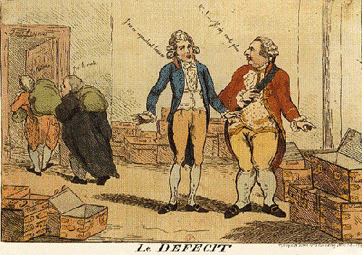
Where is the tax money?

Slide 9
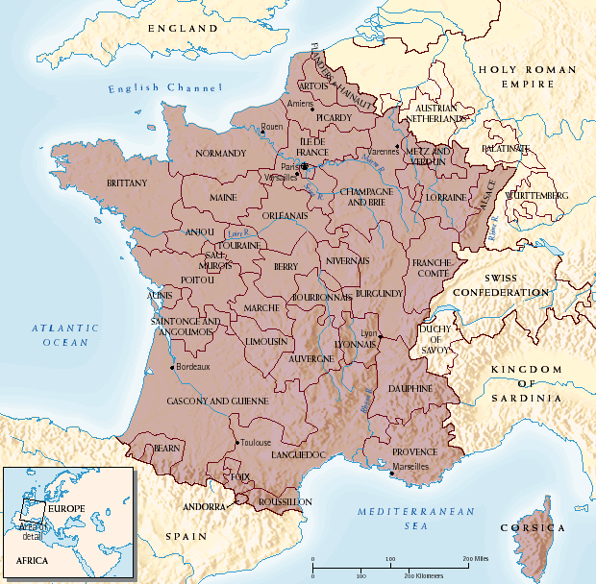
Ancien Regime Map, 1789

Slide 10
The Suggested Voting Pattern:
Voting by Estates
Clergy
1st Estate
1
Aristocracy
2nd Estate
1
1
Commoners
3rd Estate
Louis XIV insisted that the ancient distinction of the three orders be conserved in its entirety.

Slide 11
The Number of Representatives
in the Estates General: Vote by Head!
Clergy
1st Estate
300
Aristocracy
2nd Estate
300
648
Commoners
3rd Estate

Slide 12
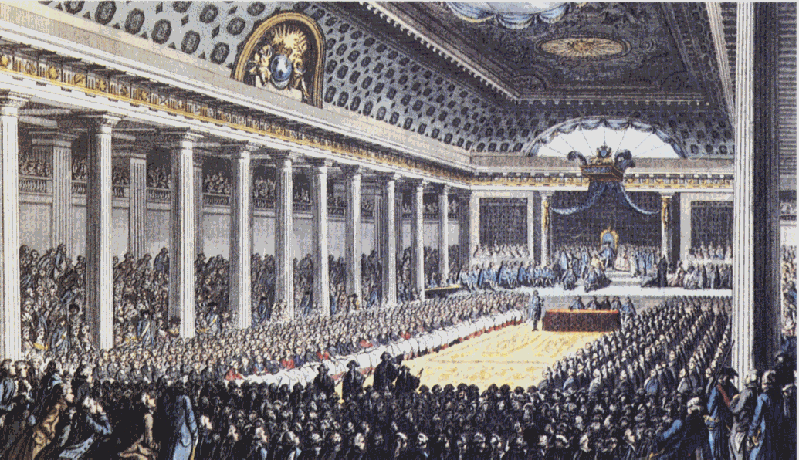
Convening the Estates General
May, 1789
Last time it was called into session was 1614!

Slide 13
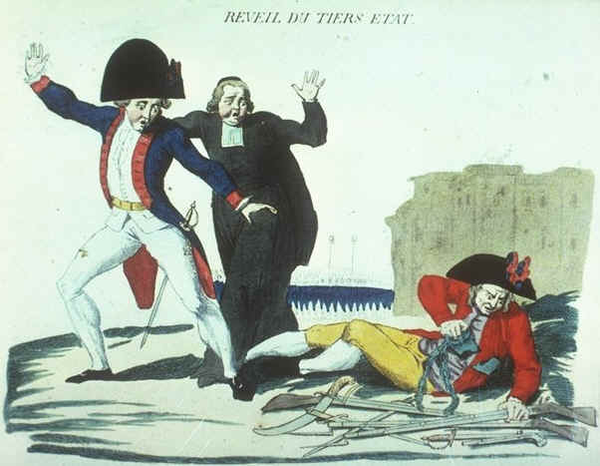
“The Third Estate Awakens”
The commoners finally presented their credentials not as delegates of the Third Estate, but as “representatives of the nation.”
They proclaimed themselves the “National Assembly” of France.

Slide 14
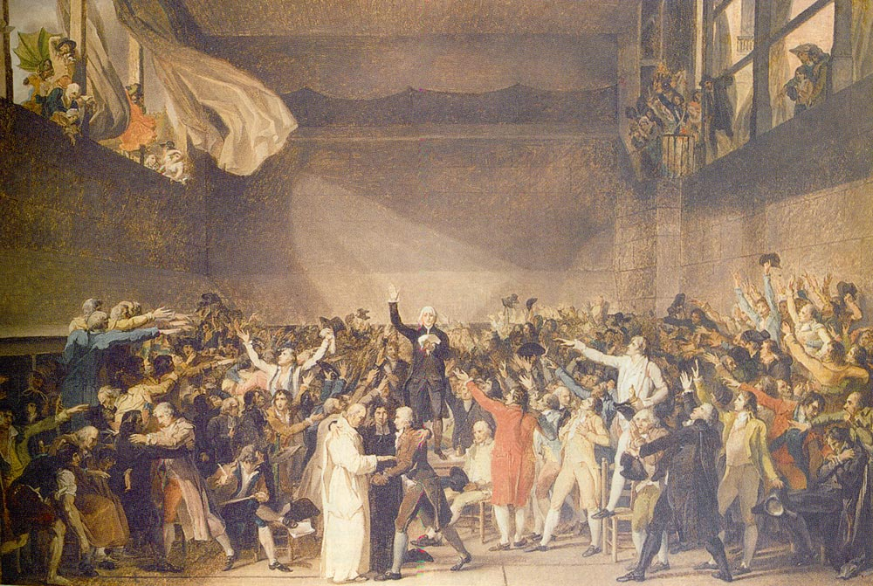
“The Tennis Court Oath”
by Jacques Louis David
June 20, 1789

Slide 15
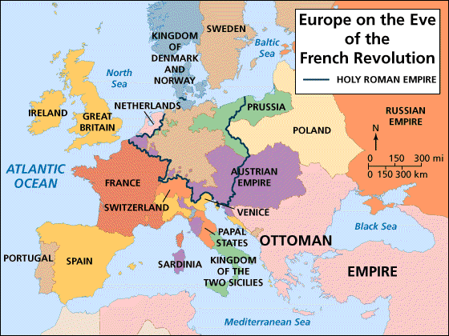
Europe on the Eve of the
French Revolution

Slide 16
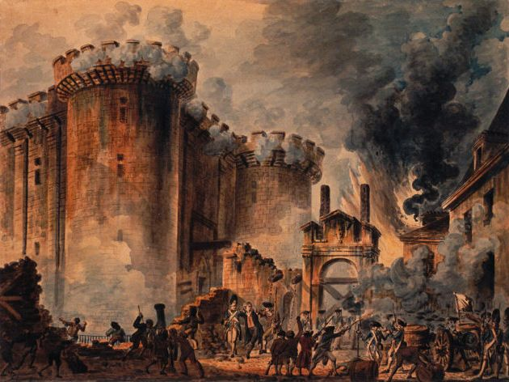
Storming the Bastille, July 14, 1789
A rumor that the king was planning a military coup against the National Assembly.
18 died.
73 wounded.
7 guards killed.
It held 7 prisoners
[5 ordinary criminals & 2 madmen].

Slide 17
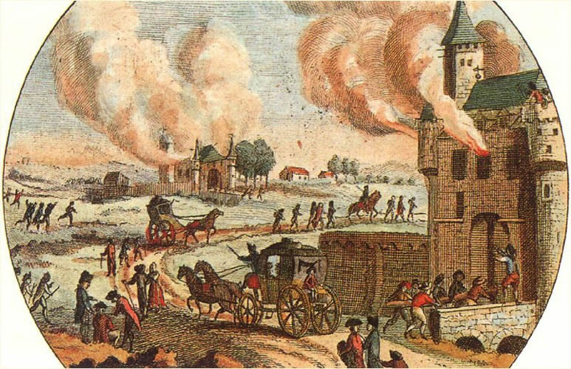
The Great Fear: Peasant Revolt
(July 20, 1789)
Rumors that the feudal aristocracy [the aristos] were sending hired brigands to attack peasants and pillage their land.

Slide 18
Night Session of August 4, 1789
Before the night was over:
  The feudal regime in France had been abolished.
  All Frenchmen were, at least in principle, subject to the same laws and the same taxes and eligible for the same offices.
Equality & Meritocracy!

Slide 19
National Constituent Assembly
1789 - 1791
Liberté!
Egalité!
Fraternité!
August Decrees
August 4-11, 1789
(A renunciation of aristocratic privileges!)

Slide 20


The Tricolor (1789)
The WHITE of the Bourbons + the RED & BLUE of Paris.
Citizen!

Slide 21

The “Liberty Cap”: Bonne Rouge

Slide 22
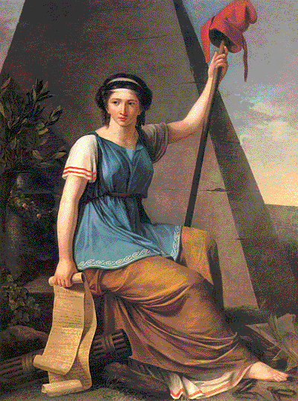

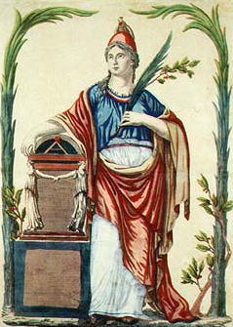
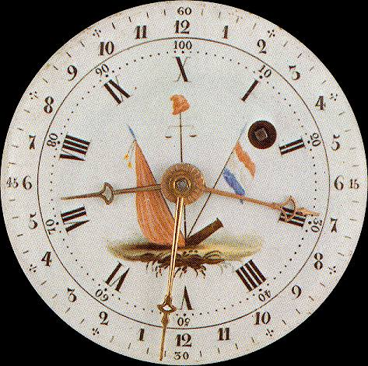

Revolutionary Symbols
Cockade
Liberté
La Republic
Revolutionary Clock

Slide 23
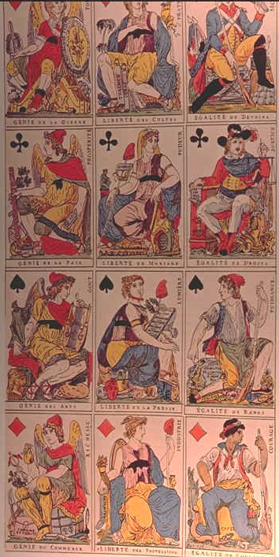
Revolutionary Playing Cards

Slide 24
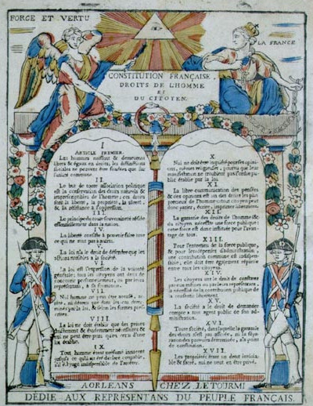
The Declaration of the Rights of Man and of the Citizen
August 26,
1789
Liberty!
Property!
Resistance to oppression!
Thomas Jefferson was in Paris at this time.

Slide 25
The Declaration of the Rights of Man and of the Citizen
Posed New Dilemmas
Did women have equal rights with men?
What about free blacks in the colonies?
How could slavery be justified if all men were born free?
Did religious toleration of Protestants and Jews include equal political rights?

Slide 26
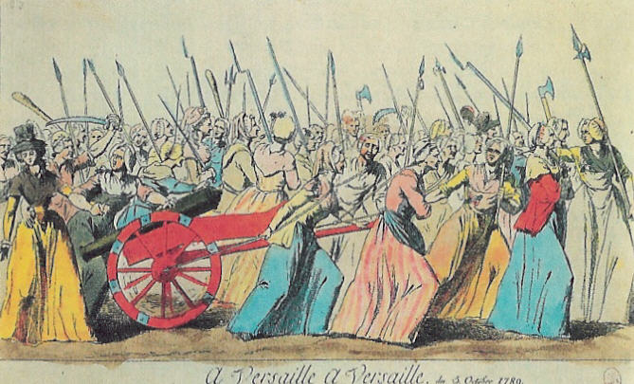
March of the Women,
October 5-6, 1789
A spontaneous demonstration of Parisian women for bread.
We want the baker, the baker’s wife
and the baker’s boy!

Slide 27
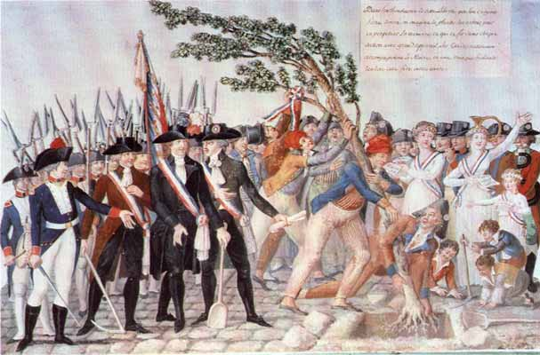
Planting the Tree of Liberty
1790

Slide 28
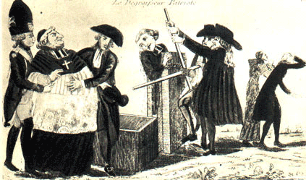
How to Finance the New Govt.?
1. Confiscate Church Lands (1790)
One of the most controversial decisions of the entire revolutionary period.

Slide 29
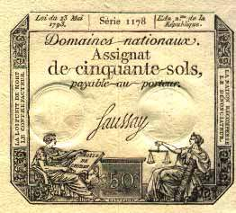
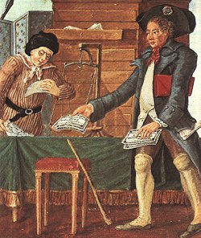
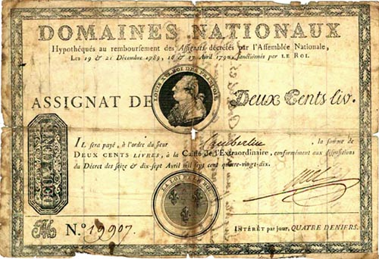
2. Print Assignats
Issued by the National Constituent Assembly.
Interest-bearing notes which had the church lands as security.

Slide 30
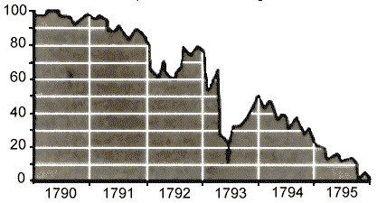
Depreciation of the Assignat
Whoever acquired them were entitled to certain privileges in the purchase of church land.
The state would retire the notes as the land was sold.
They began circulating as paper currency.
  Government printed more → INFLATION [they lost 99% of their value ultimately].
  Therefore, future governments paid off their creditors with cheap money.

Slide 31
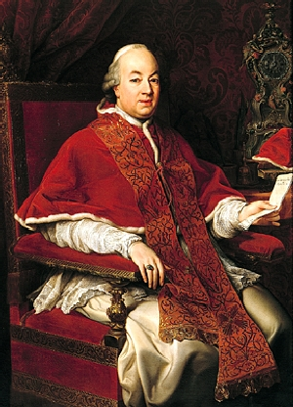
New Relations Between Church & State
Government paid the salaries of the French clergy and maintained the churches.
The church was reorganized:
  Parish priests → elected by the district assemblies.
  Bishops → named by the
  department assemblies.
  The pope had NO
  voice in the
  appointment of
  the French clergy.
It transformed France’s
Roman Catholic Church
into a branch of the state!!
Pope Pius VI
[1775-1799]

Slide 32
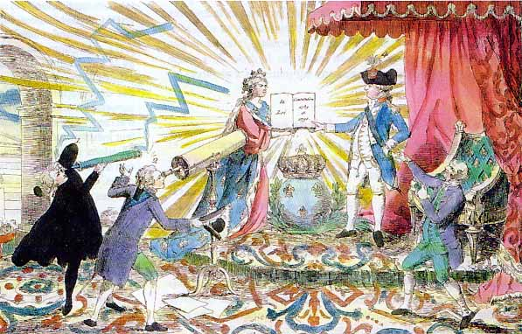
Louis XVI “Accepts” the Constitution
& the National Assembly. 1791

Slide 33
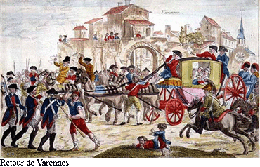
The Royal Family Attempts
to Flee
June, 1791
Helped by the Swedish Count Hans Axel von Fusen [Marie Antoinette’s lover].
Headed toward the
Luxembourg
border.
The King was
recognized at
Varennes, near
the border

Slide 34
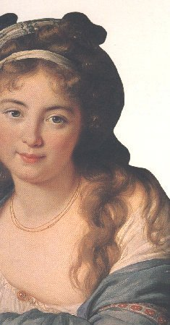
Olympe de Gouges (1745-1793)
Women played a vital role in the Revolution.
But, The Declaration of the Rights of Man did NOT extend the rights and protections of citizenship to women.
Declaration of the Rights of Woman
and of the Citizen (1791)

Slide 35
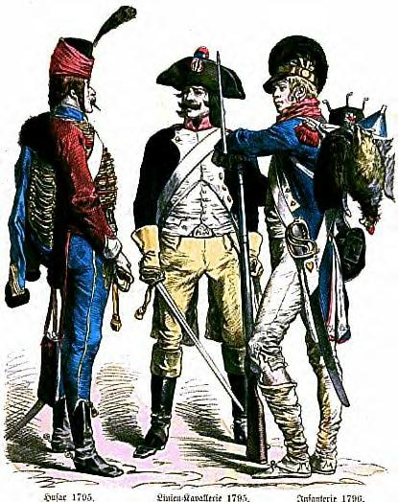
French Soldiers & the Tricolor:
Vive Le Patrie!
The French armies
were ill-prepared for the conflict.
½ of the officer corps had emigrated.
Many men disserted.
New recruits were enthusiastic, but
ill-trained.
French troops often broke ranks and fled in disorder.

Slide 36
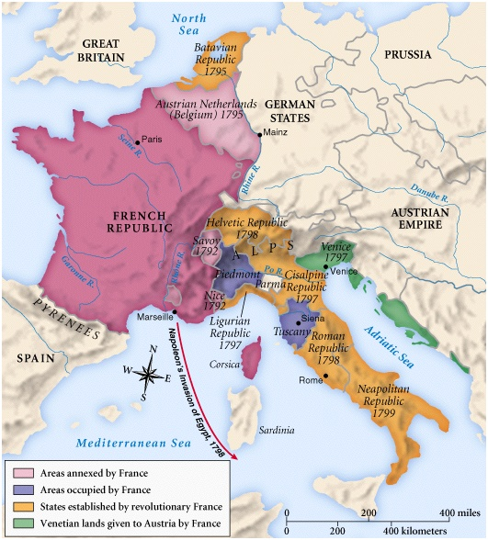
French Expansion: 1791-1799

Slide 37
Sources
“Hist210—Europe in the Age of Revolutions.”
http://www.ucl.ac.uk/history/courses/europe1/chron/rch5.htm
“Liberty, Fraternity, Equality: Exploring the French Revolution.” http://chnm.gmu.edu/revolution/
Matthews, Andrew. Revolution and Reaction: Europe, 1789-1849. Cambridge
University Press, 2001.
“The Napoleonic Guide.”
http://www.napoleonguide.com/index.htm

