Slide 1
DAY 98: UNIT IV KEY CONCEPTS
A schematic for the unit ahead.

Slide 2
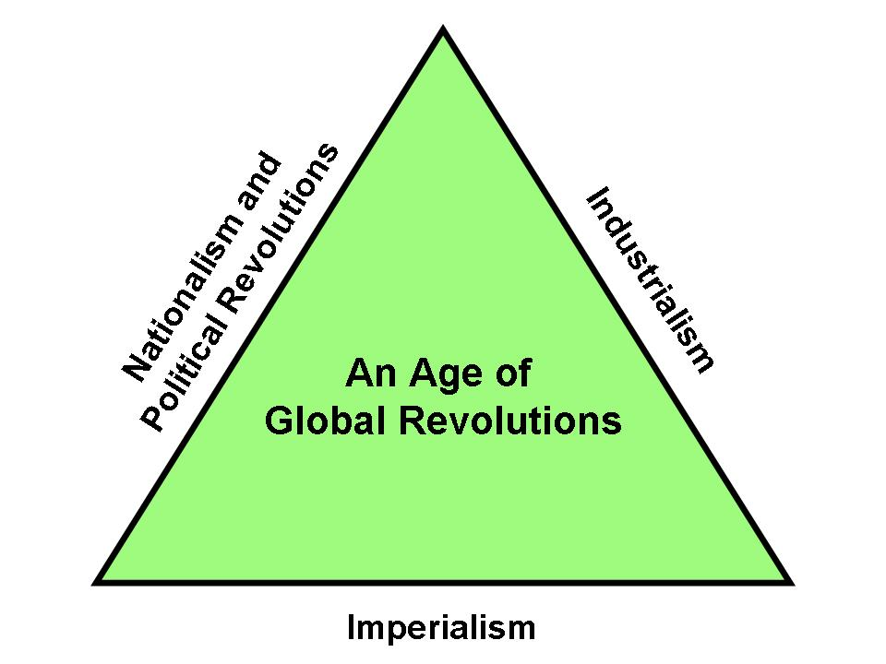
Unit IV- “The Age of Global Revolutions:1750-1914

Slide 3
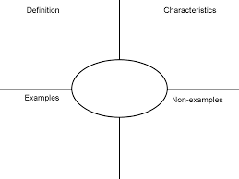
Using Frayer Squares
Definition
Characteristics
Examples
Non-examples
*5 times to commit to memory

Slide 4
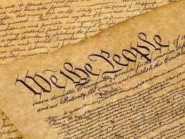
CONSTITUTIONALISM
This was when nations adopted Constitutions to serve as, “rule books” for running nations

Slide 5
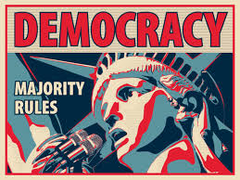
DEMOCRACY
The word 'democracy' has its origins in the Greek language. It combines two shorter words: 'demos' meaning whole citizen living within a particular city-state and 'kratos' meaning power or rule. In short, it is a system where the majority rules.

Slide 6
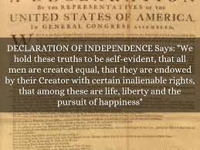
INALIENABLE RIGHTS
These are rights that are indelible and cannot be taken away.
For us, these are stated in the first Ten Amendments of our Constitution known as the Bill of Rights

Slide 7
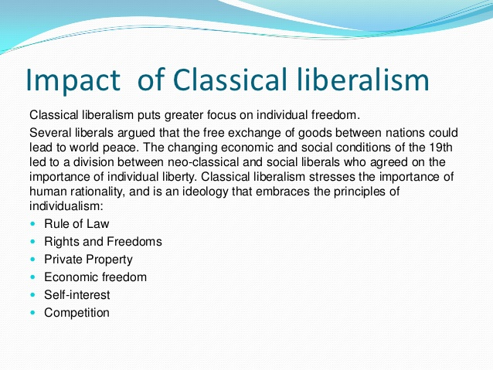
CLASSICAL LIBERALISM

Slide 8
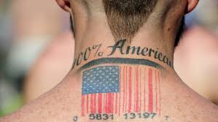
NATIONALISM
The strong belief that the interests of a particular nation-state are of primary importance. Also, the belief that a people who share a common language, history, and culture should constitute an independent nation, free of foreign domination.

Slide 9
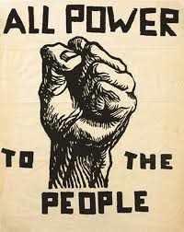
POPULAR SOVEREIGNTY
It’s the idea that the power of this government comes from "We the People", that the American government, our government, is ruled by its people through their votes.

Slide 10
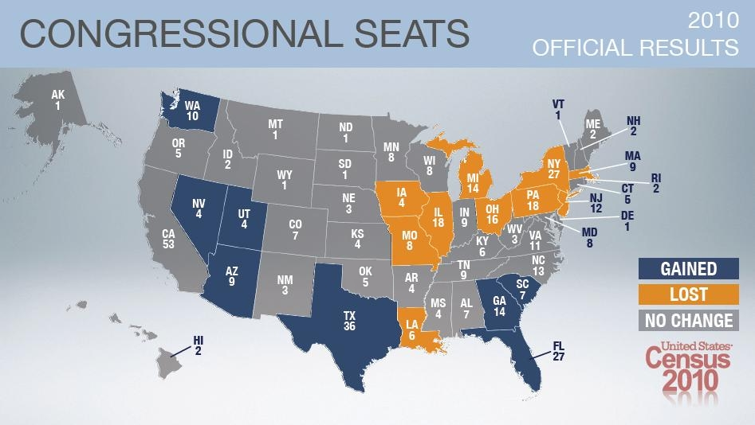
REPUBLICANISM
Republicanism is a system of government where people vote for people to speak
on their behalf. Here is where our 435 seats are in the United States

Slide 11
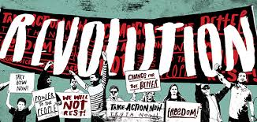
REVOLUTION
This is the idea of eliminating an old way of doing things and replacing it with another. It can apply to politics, culture, economies, and technology.

Slide 12
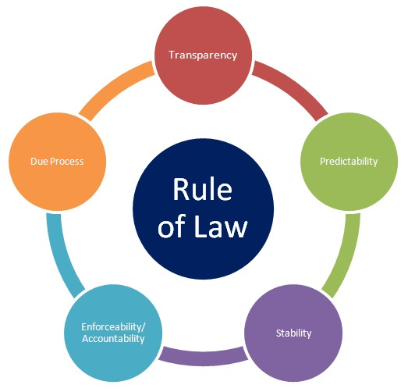
RULE OF LAW
This is an idea that began with the Magna Carta in 1215 and increased over time.
All people follow the law.
People will come and go, but the laws remain the same.

Slide 13
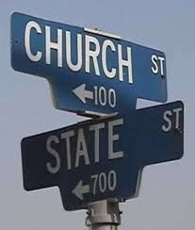
SECULARISM
Secularism is the principle of the separation of government institutions and people.

Slide 14
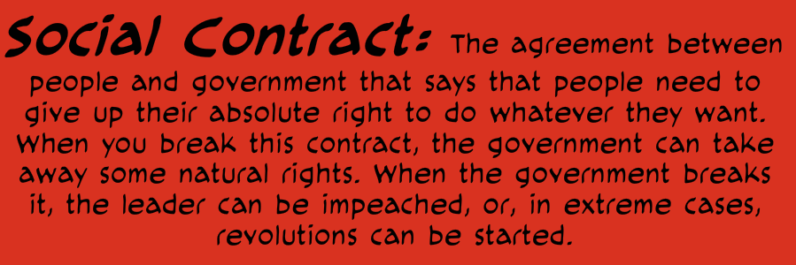
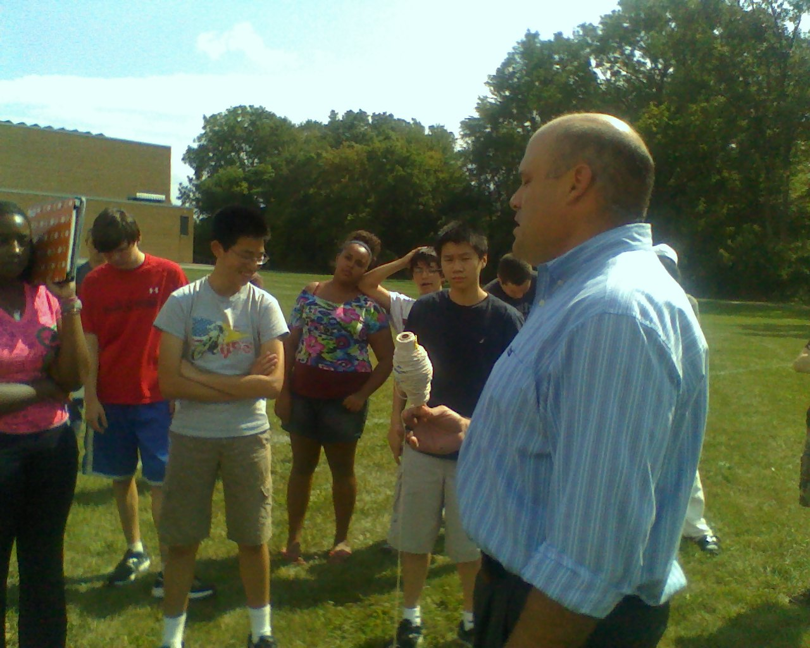
SOCIAL CONTRACT
On a smaller scale, the teacher and student relationship demonstrates that mutual
sacrifices result in mutual benefits.

Slide 15
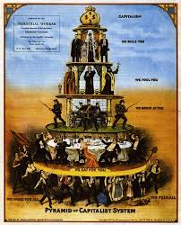
CAPITALISM
An economic and political system in which a country's trade and industry are controlled by private owners for profit, rather than by the state.

Slide 16
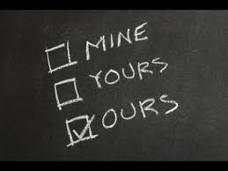
COMMUNISM
The political and economic doctrine that aims to replace private property and a profit based economy with public ownership and communal control. In short, everyone shares the collective resources.

Slide 17
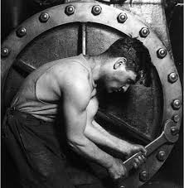
INDUSTRIALISM
When economies switched from agriculture to factories.
This created large cities and major global changes in regards to economy, culture, and hegemony.

Slide 18
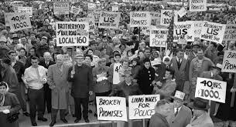
LABOR UNIONS
These are groups of workers that band together in solidarity in order to create better working conditions for themselves.

Slide 19
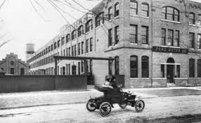
URBANIZATION
This is the process of people abandoning their rural roots and moving into cities.
In Detroit, immigrants from Southern and Eastern Europe, Blacks from the south (Great Migration)and whites from Appalachia moved here to work in factories.

Slide 20
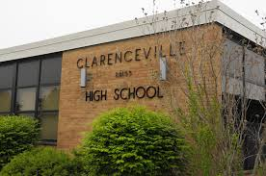
WORKING CLASS
This class emerged during this time. The working class are the people employed for wages, especially in manual-labor occupations and in skilled, industrial work. Working-class occupations include blue-collar jobs, some white-collar jobs, and most service-work jobs.

Slide 21
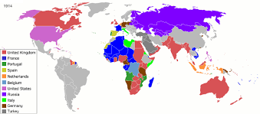
IMPERIALISM
This was the process of a large, well-armed nation going to a smaller, militarily weaker nation and imposing their economic and social will.

Slide 22
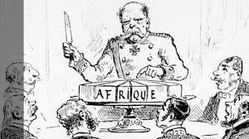
RACISM
European imperial nations demonstrated significant racism during this time.
People of color throughout the world were subjugated by European nations

