Slide 1



Key Values For an Ideal World
Respect for Human Life
Justice and Equality
Family
Social Responsibility
Education
Peace and Harmony
Notes:
Rome powerfully shaped Western law, government, administration and engineering.
http://www.aish.com/seminars/worldperfect/wp01n00.htm

Slide 2



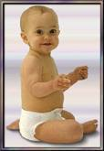
Life is Sacred- Thou Shall Not Murder
One of the basic tenets of ancient Israel is that human life is sacred. This is considered a SHARED Judeo-Christian value because this tenet was later picked up by Christianity due to its Jewish heritage.
The sanctity of life was an idea that was considered RADICAL in the ancient world. Ancient civilizations killed people as a form of religious worship and sport.
INFANTICIDE, the killing of infants who were deformed, disabled or didn’t meet a certain standard of beauty was considered NORMAL in the Greek and Roman cultures while the ancient Israelite Law of NOT killing one’s child was considered perverse or strange.

Slide 3

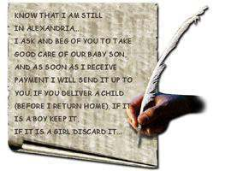
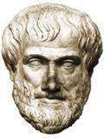
Infanticide in Roman Times
Here is a 2,000 year old letter from a Roman named Hilarion to his pregnant wife, Alis.
Infanticide was justified intellectually by some of the greatest minds in antiquity including Aristotle.
“There must be a law so that no imperfect or maimed child should be brought up. And to avoid excess in population, some children must be exposed. .. . Aristotle-Politics: Book VII: Ch.16.

Slide 4

HOW DID ETHICAL MONOTHEISM CHANGE THE WORLD?
Notes:
Pagan religions- gods had sex to create the world, temple orgies, sexual rites, etc.
they created units of soldiers comprised of older men together with their younger boy-lovers

Slide 5
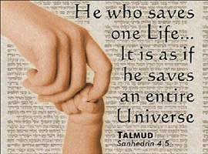
L’Chaim-to Life!
The ancient Israelites believed that all humanity should follow one universal moral standard because all of humanity was created in the image of God.
God is goodness and justice so we should be good and just.
A spiritual god is served by walking in his ways, not by engaging in pagan rituals-
human sacrifice and fertility rites were abolished.
One God led to a vision of one world, living in peace as brothers and sisters.
Life is sacred.
This saying is from the Talmud. What do you think it means?
Can You Think Of Any Modern Innovations That Save Lives?
Notes:
This is a famous saying from the Talmud, an ancient book of Jewish traditions and laws, written almost 2,000 years ago
Peace-

Slide 6
Rule of Law

Slide 7
The Ten Commandments
The Ten Commandments and the Torah form the cornerstone of our laws and provide the moral basis for all Western Civilization.

Slide 8
The Ten Commandments
You shall have no other gods before me
You shall not make for yourself an idol
You shall not take the name of the LORD thy God in vain
Remember the Sabbath day, to keep it holy
Honor your father and your mother
You shall not murder
You shall not commit adultery
You shall not steal
You shall not give false testimony against your neighbor
You shall not covet your neighbor’s house, your neighbor’s wife, or his manservant or maidservant, his ox or donkey, or anything that belongs to your neighbor

Slide 9
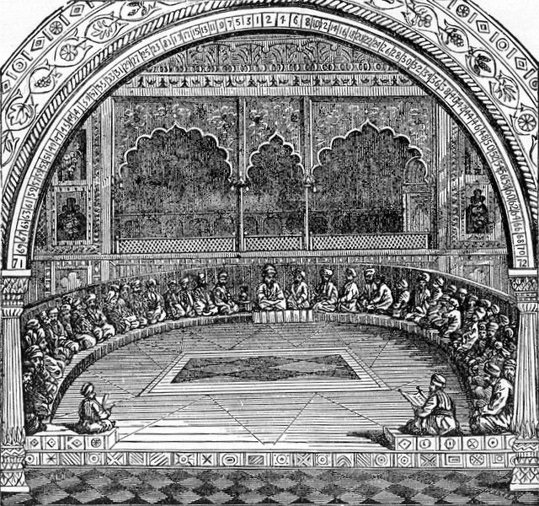
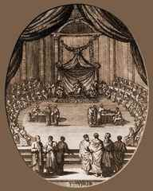
THE SANHEDRIN
Sanhedrin was the ancient Israelite system of courts that existed 2,000 years ago and consisted of 70 judges.
THE SANHEDRIN
2,000 years ago,
It was a very sophisticated system of government with checks and balances.
There was a King (executive branch), priest (Cohen Gadol-religious branch) and the Sanhedrin (judicial branch and legislative branch).

Slide 10
Ancient Take on Women
" Marriage brings a man only two happy days: the day he takes his bride to bed and the day he lays her in her grave."
Greek poet Palladus
“. .Yet a wife is a necessary evil because without her a man cannot have a son to inherit his property.”
Hesiod, a Greek
"And so our rabbis decreed that a man should honor his wife more than himself and love her as much as he loves himself."
MAIMONIDES. MISHNA TORAH,"Laws of Marriage." 15:19

Slide 11
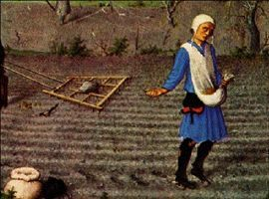

Ancient Take on Education
In Rome and Greek societies there was no such thing as a free public educational system- only the wealthy could afford to send their children to elementary schools.
“. . It should be obvious in Greece and to an even greater extent in the Roman Empire the illiteracy of the masses contributed to the stability of political order. . .” William V. Harris, “Ancient Literacy”
“Appoint teachers for children in every country, province and city.”
Maimonides, Misna Torah, “Laws of Learning Torah”, 2:1 in Quote 22

Slide 12

By the 1st century B.C.E., all Jewish male children regardless of social status were educated to read the Hebrew Scriptures. The Hebrew Scriptures are also known as the Old Testament or the. . .
T A N A K H
TORAH
Writings
Prophets

Slide 13
The Tanakh touched on all aspects of daily life:
Relationships
Diet
Environment
Charity
Health
Finances
Legal Issues

Slide 14
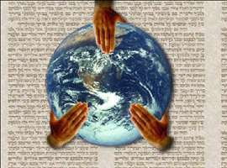
Social Responsibility
“Love your neighbor as yourself." LEVITICUS 19:18
Social consciousness is a mitzvah, a legal obligation in the Torah.

Slide 15


Judaism is…
“A 4000 year old tradition with ideas about what it means to be human and how to make the world a holy place”
  (Rabbi Harold Kushner, To Life)
A “covenant relationship” between God and the Hebrew people
A celebration and sanctification of life
A faith, a people, a way of life…

Slide 16
As a people, Jews are…
A nation in Diaspora (dispersed)
15 – 16 million in worldwide population
United by a common heritage (an “ethnic” religion), divided in contemporary practice:
  Orthodox:
    Modern
    Chasidic (Ultra Orthodox)
  Reformed (18th century Germany)
  Conservative – moderates, response to reform
    Reconstructionalism (20th century America)

Slide 17


As a way of life, Judaism is based on…
613 commandments found in Torah (“Written Law”)
Talmud (“Oral Law”) – commentary of ancient rabbis that elaborates on how to apply God’s Law in everyday life through:
  Dietary rules (Kashrut/Kosher)
  Dress and other symbols
  Prayer and devotion to the one God
  The Temple and Temple rites
  Observance of Holy days
  Proper social relations between male and female, in business, judicial rulings, etc.
Thus sanctifying life, blessing it in every way

Slide 18



How does Judaism sanctify life?
Life cycle celebrations:
Bris – ritual circumcision, sign of the covenant
Bar/Bat Mitzvah – full adult status and responsibility within the religion
Marriage - "Be fruitful and multiply" (Gen. 1:22)
Death – funerals, mourning (sitting “Shiva”), and memorials (“Yartzeits”)

Slide 19



How does Judaism sanctify time?
The Jewish Holidays:
High Holidays:
  Rosh Hashanah (Jewish New Year)
  Yom Kippur (Day of Atonement)
Sukkot, the “Festival of Booths” (fall harvest festival)
Simchat Torah – celebrating Torah
Chanukah, the “Festival of Lights”

Slide 20

How is Judaism related to Christianity?
Judaism predates Christianity – it is the foundation of Christianity but is not a part of it
Jesus was Jewish, as were his followers and the Apostles
Jews do not believe that Jesus was anything more than a good and wise man who lived and died 2000 years ago – Jews still await their messiah
The Jewish messiah would not be divine. He would be a political figure who restores the Hebrew monarchy and causes peace to reign on Earth
Jews are not concerned about salvation and the “world to come”

Slide 21
What are Jews really concerned about?
Tikkun Olam - “repairing this world” through justice and righteousness; through “deed, not creed”
The heart of Judaism is in the home and family, social responsibility and doing Mitzvot (“good deeds” based on God’s commandments)
Through education and hard work we make our lives, the lives of others, and the world, what God intended it to be – Holy!

Slide 22
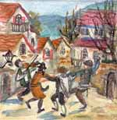

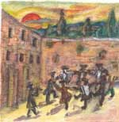
To Life!
To Life!
L’Chaim!

