Slide 1
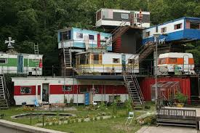
Aesthetics in Home Styles
What makes one dwelling more aesthetically more pleasing using our aesthetics criteria….

Slide 2
HERE’S HOW WE’LL LOOK AT ARCHITECTURE PHILOSOPHICALLY:
1) Architecture as an artform- What is the artistic merit of the creation?
2) Architectural objects—what sorts of things did architect choose and how are they differ from other sorts of objects.
3) Special architectural properties- The standard trio in architecture is A) structural integrity(firmitas) B) beauty, and C) utility
4) Architectural types—Knowing different types allows you to compare and contrast in order to create your aesthetic.
5) Meaning and other language-What is architect trying to express in his/her’s architecture and its objects?
6) Social and moral features of architectural objects How did the architect better society and make an ethical/moral statement?

Slide 3
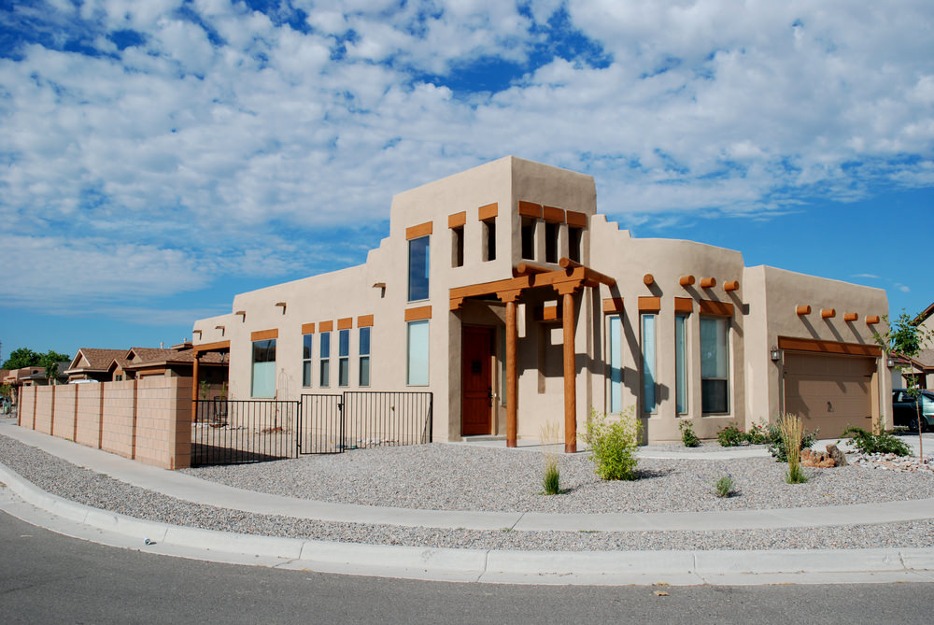
Adobe Revival

Slide 4
Beach

Slide 5
Bungalow

Slide 6
Cape Cod

Slide 7
Colonial

Slide 8
Contemporary

Slide 9
Contemporary Craftsman

Slide 10
Country

Slide 11
Craftsman

Slide 12
English Cottage

Slide 13
Farmhouse

Slide 14
Federal Colonial

Slide 15
Florida

Slide 16
French

Slide 17
Geodesic Dome

Slide 18
Georgian

Slide 19
Greek Revival

Slide 20
Log Home

Slide 21
Mediterranean

Slide 22
Mid-Century Modern

Slide 23
Modern

Slide 24
Mountain

Slide 25
Northwest

Slide 26
Prairie

Slide 27
Ranch

Slide 28
Shingle

Slide 29
Spanish

Slide 30
Southern

Slide 31
Southwest

Slide 32
Traditional

Slide 33
Tudor

Slide 34
Tuscan

Slide 35
Victorian

