Slide 1
Day 40: The Parthians and Kushan
The Middlemen of the Silk Road

Slide 2
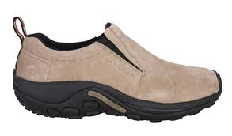
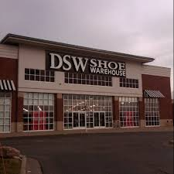
My Shoes and the Silk Road……

Slide 3
Raw Materials
Rubber
Leather
Polyester
Foam

Slide 4
…..Once shipped to Vietnam
Sew
Glue
Quality Control

Slide 5
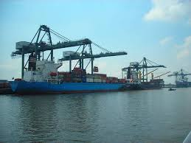
Then packaged and driven to a port where….

Slide 6
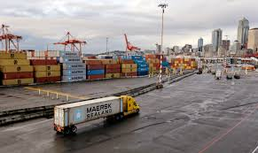
…..where it arrives at a Western American port

Slide 7
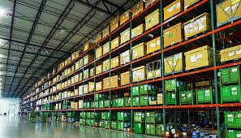
….and trucked to a distribution center.

Slide 8
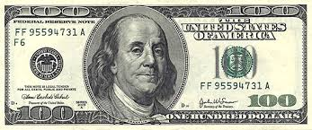
Where they are shipped to the store I purched them.
Of the $100 I spent, who gets what? Everyone needs their cut.

Slide 9
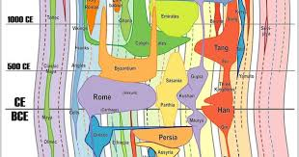
The Middlemen of 2,000 years ago….

Slide 10
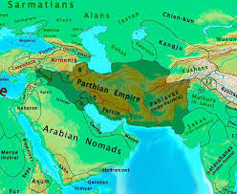
Parthian Empire
Areas of Old Persian Empire and served as an intermediary along the Silk Road

Slide 11
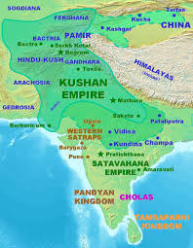
Kushan Empire
Under the rule of the Kushans, present-day Afghanistan, Pakistan and western India participated both in seagoing trade and in commerce along the Silk Road

Slide 12
THE SILK ROAD WAS THE CATALYST FOR A NEW ERA,
THE ERA OF EXPANDING HEMISPHERIC INTERACTIONS.

