Slide 1
Chapter 19: Methods of Therapy
Case Study: Virtual Therapy
Section 1: What Therapy Is and Does
Section 2: The Psychoanalytic and Humanistic Approaches
Section 3: Cognitive Therapy and Behavior Therapy
Section 4: Biological Therapy
Simulation: Applying What You’ve Learned

Slide 2
Case Study: Virtual Therapy
In order to learn to cope with stressful situations, many people confront the fear they feel by recreating the situation in a virtual environment. To experience a virtual scene, a person wears a helmet with screens over the eyes to create a 3-D effect. Virtual therapy can tackle stage fright, fear of elevators, fear of heights, fear of flying, and fear of bad weather. Virtual Iraq is an experimental treatment program for returning veterans, and further development may make this the standard treatment for PTSD in Iraq War veterans.
Notes:
–

Slide 3
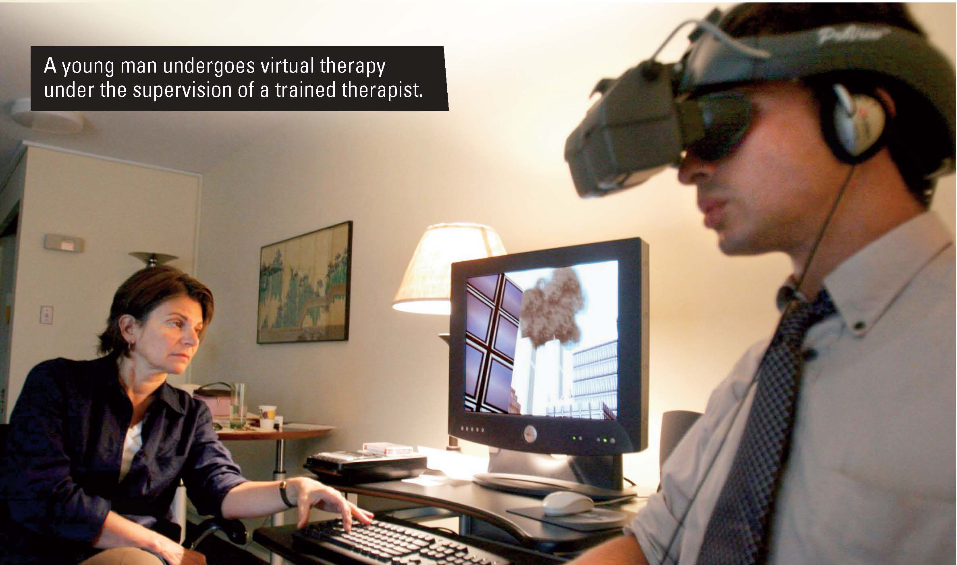
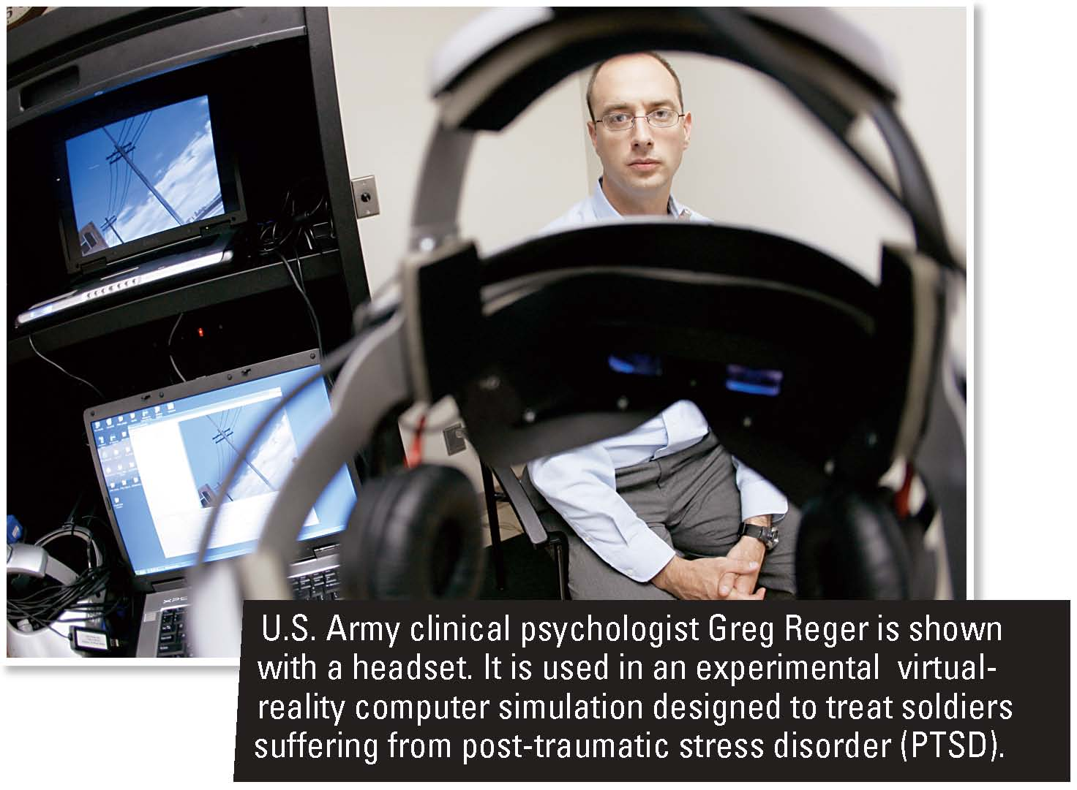

Slide 4
What do you think?
Why might virtual therapy have some limitations to its usefulness?
Why might people be more willing to face their fears in a virtual setting than in a real one?

Slide 5
Section 1 at a Glance
What Therapy Is and Does
The various methods of psychotherapy seek to help troubled individuals.
There are a variety of methods and types of professionals involved in psychotherapy.
Individual therapy and group therapy both have advantages.

Slide 6
What Therapy Is and Does
Main Idea
Therapy falls into two basic categories: psychologically based therapy and biologically based therapy. Both forms of therapy can help people increase awareness and change behavior.
Reading Focus
What are the main goals of psychotherapy?
What are the three main categories of professionals who practice psychotherapy?
How do individual and group therapy compare?

Slide 7
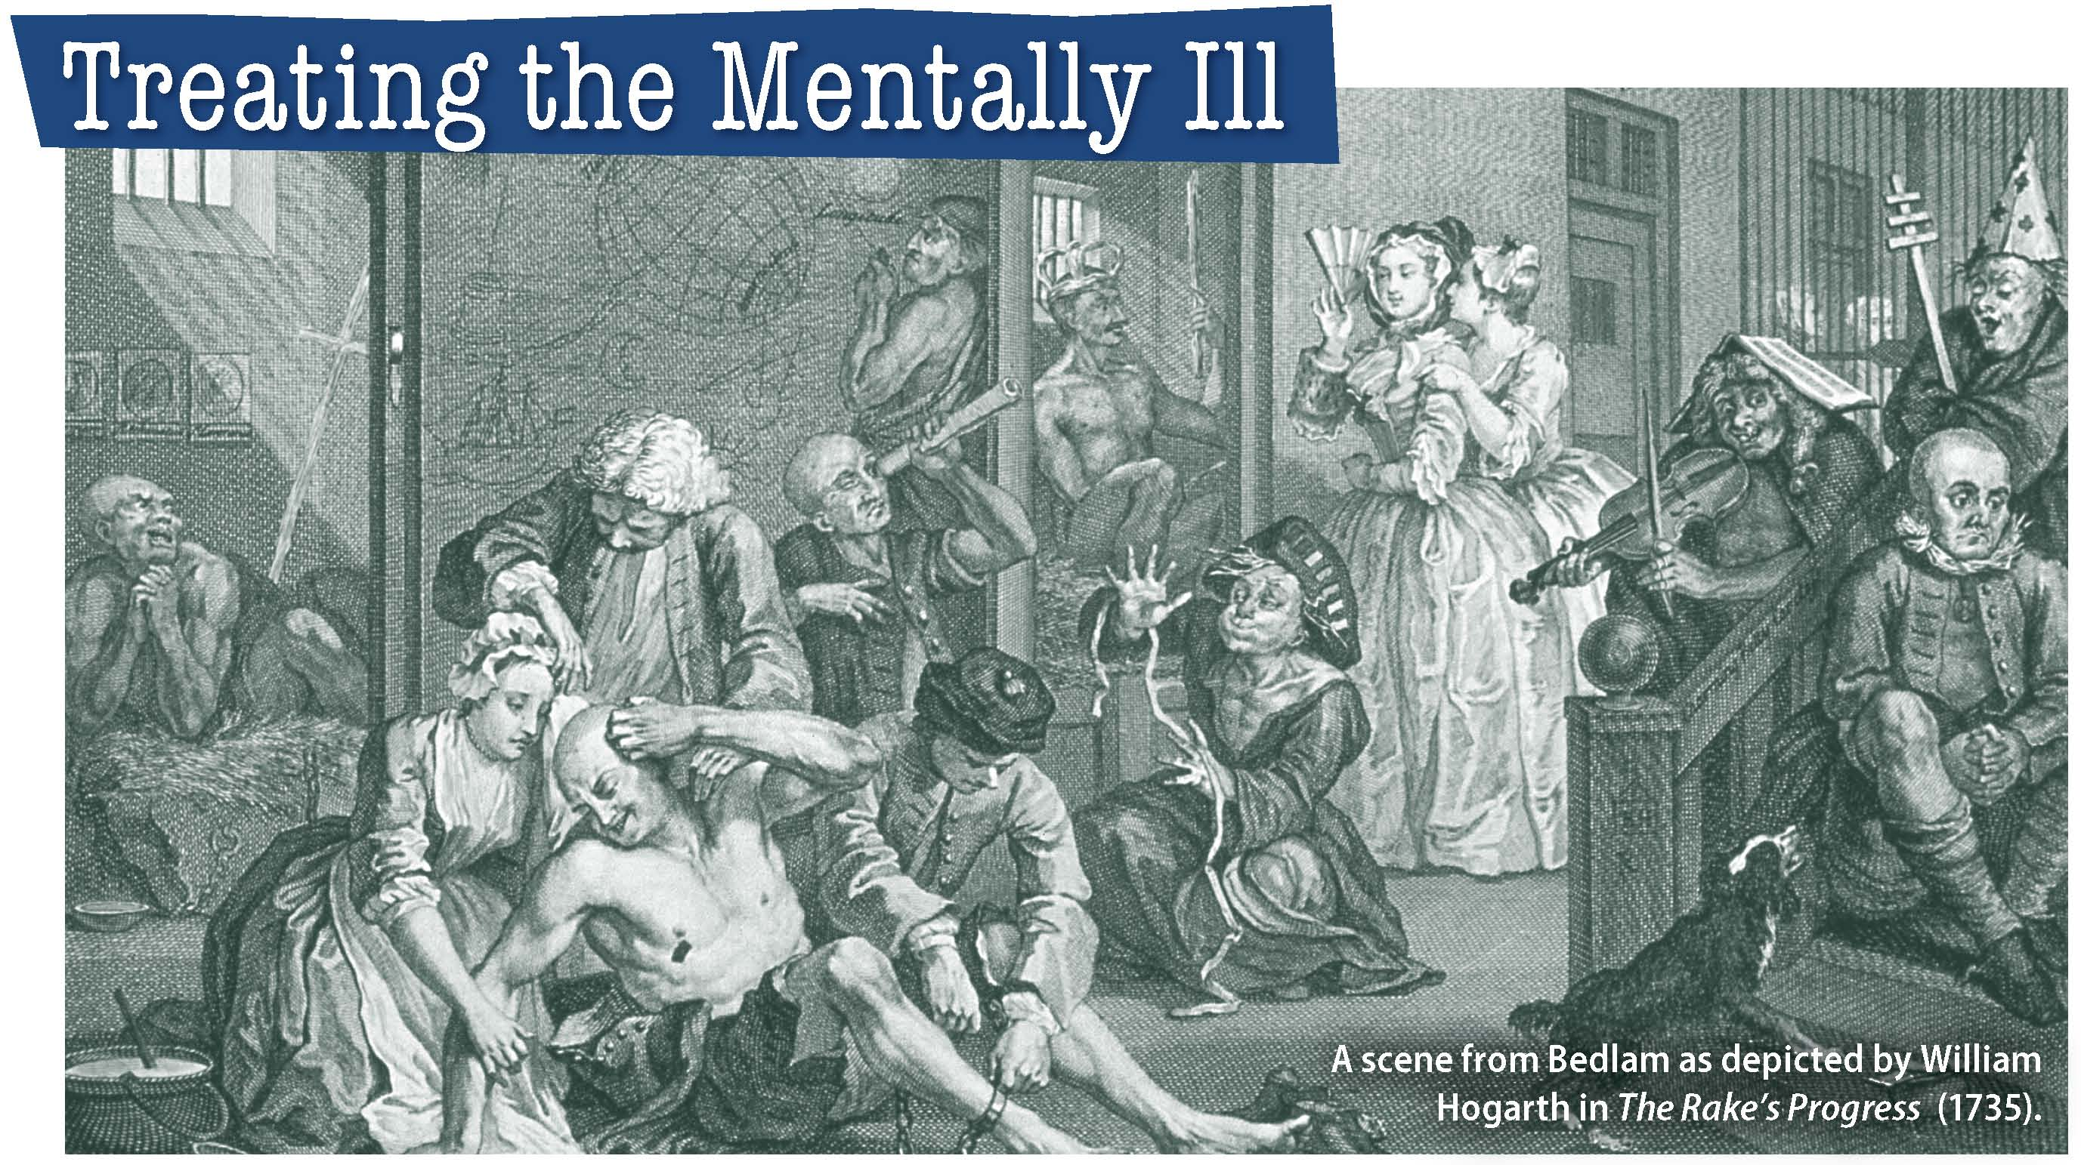
How did the name of a hospital become a synonym for uproar and disorder?

Slide 8
Achieving the Goals of Psychotherapy
Methods for treating psychological problems and disorders fall into two general categories: psychological and biological.
Psychotherapy is psychologically based therapy that involves verbal interactions between a trained professional and a person (the client or patient) who is seeking help for a psychological problem.
Biologically based therapies involve using drugs or other medical procedures.
Helping the individual gain insight or a new perspective is important because many psychological problems are the result of negative outlooks and misinterpretations.
The most commonly used methods of psychotherapy are psychoanalysis, humanistic therapy, cognitive therapy, and behavior therapy.

Slide 9
Reading Check
Find the Main Idea
What is one of the key goals of psychotherapy?
Answer: to help troubled individuals by providing hope for recovery

Slide 10
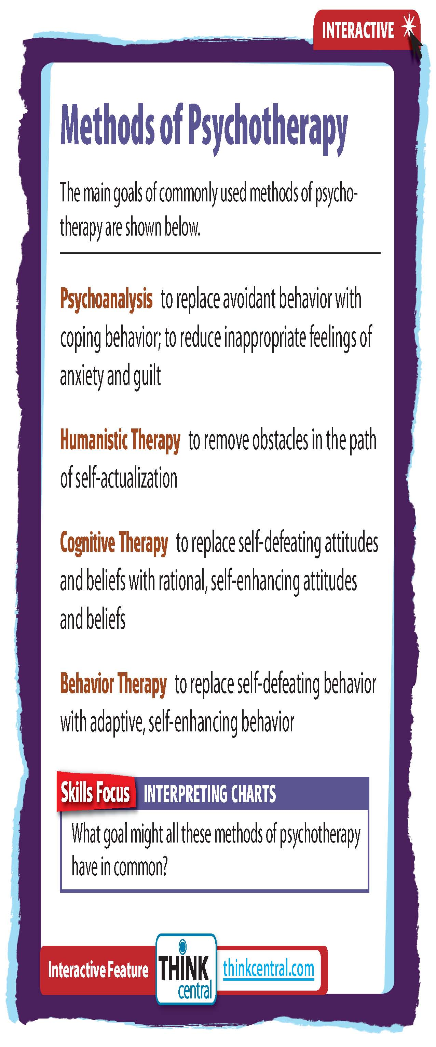
Click on the image to play the Interactive.

Slide 11
Psychotherapy in Practice
Types of Mental Health Professionals
Counseling psychologists treat people with less serious psychological problems and often work in educational institutions.
Clinical psychologists work in hospitals, clinics, or health centers.
Psychiatrists are medical doctors and can prescribe medicines.
Nurses and social workers also help people with problems.
Selecting the Right Professional
What is the professional’s field?
What degrees does the professional hold?
Is the professional licensed by the state?
What are the therapist’s plans for treatment, and how long will treatment likely take?
What is the estimated cost of treatment?

Slide 12
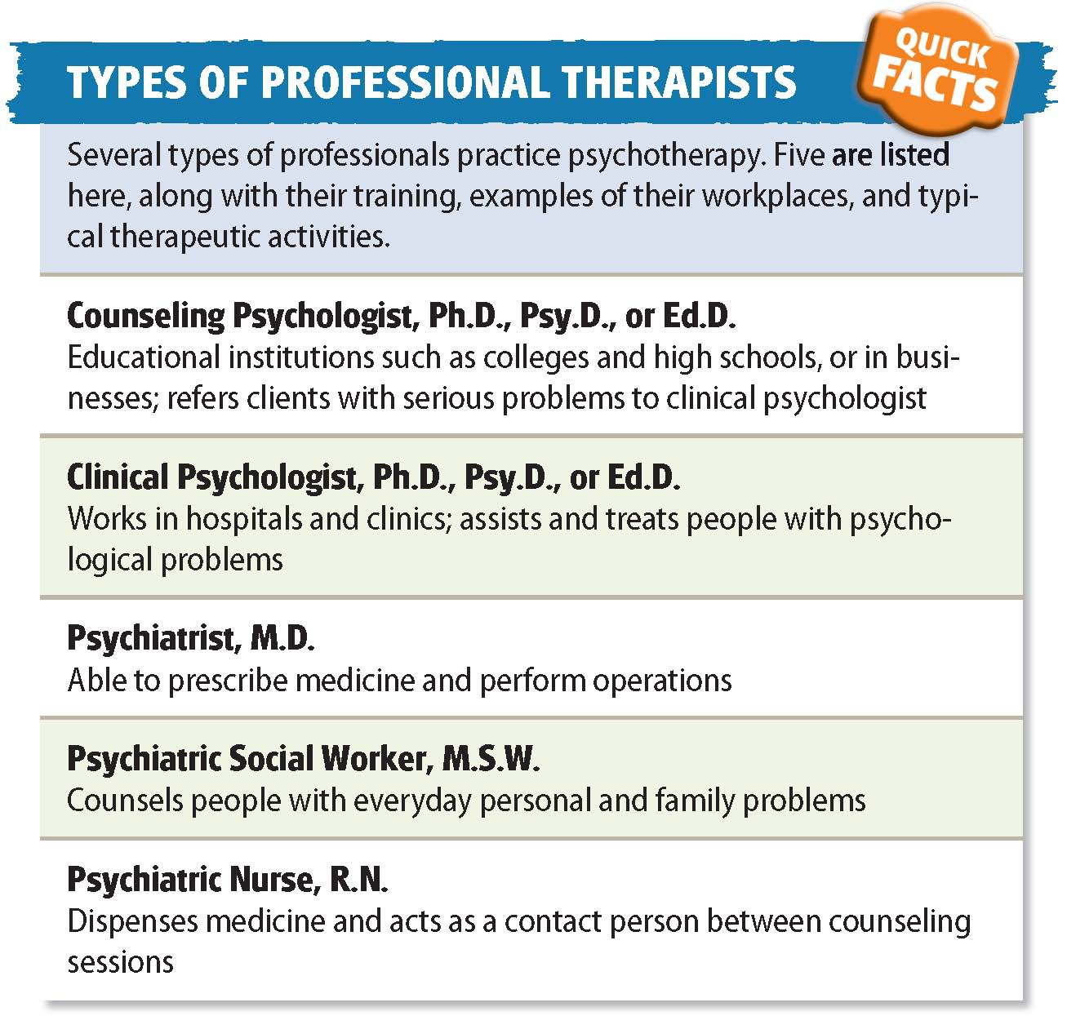

Slide 13
Reading Check
Identify Supporting Details
Why must psychiatrists also be physicians?
Answer: They can prescribe medications and so must have a medical degree.

Slide 14
Individual Versus Group Therapy
Frequently, people who seek help for psychological problems have a choice between individual and group therapy. Both types have advantages.
Advantages of Individual Therapy
It is better for people who need more personal attention or who feel uncomfortable talking about their problems in front of a group.
Advantages of Group Therapy
Group therapy helps individuals realize they are not alone.
Members can gain insight and receive support from people who have experienced the same struggles.
Types of Group Therapy
Couples, family, and shared-problem therapy
Self-help groups are composed of people who share the same problem. They often meet without the presence of a therapist.

Slide 15
Reading Check
Identify
What are the advantages of a self-help group?
Answer: people have same problem, share solutions, give and receive support

Slide 16
Section 2 at a Glance
The Psychoanalytic and Humanistic Approaches
Psychoanalysis is a method of therapy that was developed by Sigmund Freud.
Some of the techniques of psychoanalysis include free association, dream analysis, and transference.
The primary goal of humanistic therapy is to help individuals reach their full potential.

Slide 17
The Psychoanalytic and Humanistic Approaches
Main Idea
Psychoanalysis and humanistic therapy are two important methods of treatment.
Reading Focus
How did Freud view the role of psychoanalysis?
What are some of the methods of psychoanalysis?
What is the goal of humanistic therapy?

Slide 18
What do dreams mean?

Slide 19
Freud and Psychoanalysis
Psychoanalysis
Developed by Sigmund Freud
Literally means “analysis of the psyche (mind)”
First method used in Western countries
Has become less popular in recent years
Freud believed most problems originate in childhood experiences and conflicts.
Psychoanalysts try to reduce anxiety and guilt by helping clients become aware of the unconscious thoughts and feelings at the root of their problems.
This self-awareness is called insight.

Slide 20
Reading Check
Find the Main Idea
For Freud, what was the source of most psychological problems?
Answer: childhood experiences, inner conflicts

Slide 21
Methods of Psychoanalysis
Free Association
Free association: the analyst asks the client to relax and then to say whatever comes to mind
Tied to Freud’s use of hypnosis
Resistance: a client’s reluctance to discuss issues raised during free association
Allows patients to express troubling thoughts and feelings
Dream Analysis
Dream analysis: the analyst interprets the content of dreams to unlock thoughts and feelings
Manifest content: the actual content of the dream as remembered
Latent content: the hidden meaning in the dream

Slide 22
Transference
With time, many patients begin to view their relationship with a therapist as being similar to another relationship. They expect the therapist to act in the same way as the primary relationship, a process called transference.
Evaluation of Psychoanalysis
Many psychologists believe that Freud put too much emphasis on sexual and aggressive urges and underestimated the importance of conscious ideas and behaviors.
It is not useful for the treatment of major depression, bipolar, or schizophrenia.
Brief Psychoanalysis
Shorter terms have become more common in recent decades.
Brief psychoanalysis has a more limited focus, and focuses on fixing a specific problem.

Slide 23
Reading Check
Summarize
What main goal do the techniques of psychoanalysis serve?
Answer: examine client’s personality; fix specific problem

Slide 25
Humanistic Therapy
Primary goal of humanistic therapy is to help individuals develop self-awareness and self-acceptance. The method assumes people are basically good and that people with psychological problems can heal using their inner resources.
Person-Centered Therapy
Evaluation of Humanistic Therapy
Talking openly about whatever may be troubling an individual is called nondirective therapy.
Active listening involves the listener repeating and rephrasing speaker’s statements.
Unconditional positive regard from the therapist.
Nearly three-fourths of people obtaining person-centered therapy showed greater well-being on average than those who did not.
It works best for people with anxiety, mild depression, or social problems.
Notes:
–

Slide 26
Reading Check
Summarize
What is nondirective therapy?
Answer: therapy that is directed by the patient rather than by the therapist

Slide 27
Psychology in Today’s World
Public Therapy
Guests on talk shows and troubled celebrities make their psychological problems the center of entertainment. Artists have shown that strangers enjoy discussing problems with strangers in public space.
Are the people who seek help on television shows really seeking help, or are they being exploited for entertainment?
One reason people may seek attention on their psychological problems is the isolation of modern society.
Where does the appeal of talking to a stranger, even one without counseling credentials, come from?
People go longer without a face-to-face conversation in the modern world.
Notes:
–

Slide 29
Thinking Critically
What are some of the hazards and possible benefits of public therapy?
Why do you think therapy has become public for many people?

Slide 30
Section 3 at a Glance
Cognitive Therapy and Behavior Therapy
The aim of cognitive therapy is to help people learn to think about their problems in more productive ways.
The goal of behavior therapy is to help people develop more adaptive behavior.

Slide 31
Cognitive Therapy and Behavior Therapy
Main Idea
Cognitive therapy and behavior therapy help people develop new ways of thinking and behaving.
Reading Focus
What is the aim of cognitive therapy?
What is the aim of behavior therapy?

Slide 32
How do people overcome their phobias?

Slide 33
Cognitive Therapy
Both cognitive and behavior therapists encourage clients to focus on their thoughts and actions.
The aim of cognitive therapy is to help people learn to think about their problems in more productive ways and change their ways of thinking.
Two common methods: rational-emotive and cognitive restructuring

Slide 34
Cognitive Therapy
Rational-Emotive Behavior Therapy
Rational-emotive behavior therapy is based on the belief that people are basically logical in their thinking and actions.
The assumptions upon which they base their thinking or actions are sometimes incorrect.
Goal of therapy is to identify and then change false assumptions.
Methods include role-playing and homework assignments.

Slide 35
Cognitive Therapy
Beck’s Cognitive Therapy
Aaron Beck identified several types of illogical thought processes that lead to emotional problems:
Arbitrary inference: drawing conclusions for which there is no evidence
Selective abstraction: drawing conclusions on a single detail while ignoring other details
Overgeneralization: drawing a conclusion from a single experience
Therapists guide clients to observe, identify, and then change their thought patterns.

Slide 36
Evaluation of Cognitive Therapy
Tends to be a short-term method
Studies show modifying irrational beliefs helps people with anxiety, depression, and personality disorders
Helpful for major depression in some people who were only responsive to medicine and other biological therapies
Provides coping skills that reduce the risk of recurrence

Slide 37
Reading Check
Find the Main Idea
Other than Beck’s model, what is the most widely used cognitive therapy method?
Answer: rational-emotive behavior therapy

Slide 38
Behavior Therapy
Goal is to help people develop more adaptive behavior.
To behaviorists, the reasons for unhealthy behavior is not important. Changing the behavior is what matters.
Two main categories: counterconditioning and operant conditioning

Slide 39
Counterconditioning
Pairs the stimulus that triggers an unwanted behavior (such as fear of spiders) with a new, more desirable behavior.
Systematic desensitization: therapist trains the client to relax in the presence of an anxiety-producing situation
Modeling: client observes and then imitates the therapist or another person coping with the feared object or situation.
Aversive conditioning: therapist replaces a positive response to a stimulus with a negative response
People who learn more desirable behavior increase their self-esteem and lead less restrictive lives.

Slide 40
Operant Conditioning
Operant conditioning is based on the assumption that behavior that is reinforced tends to be repeated, whereas behavior that is not reinforced tends to be extinguished.
Therapists teach clients to behave in a certain way to achieve a desired consequence.
It has sometimes proven effective in more severe cases that were resistant to other treatments.
Sometimes people find gradually changing to be easier.
Successive approximations: a series of behaviors that gradually become more similar to a target behavior

Slide 41
Evaluation of Behavior Therapy
Behavior therapy tends to be somewhat more effective overall than psychoanalysis or person-centered therapy
It is short-term therapy, so it can bring about lasting results in just a few months.
Cognitive-Behavior Therapy attempts to change the way a person both thinks and behaves.

Slide 43
Reading Check
Summarize
What are some of the techniques of counterconditioning?
Answer: systematic desensitization, modeling, aversive conditioning

Slide 44
Section 4 at a Glance
Biological Therapy
Biological therapy relies on medication, electric shock, and surgery to help people deal with psychological disorders.
Because these treatments are medical in nature, they must be administered by a physician.
Electroconvulsive therapy and psychosurgery are both controversial procedures.

Slide 45
Biological Therapy
Main Idea
Biological therapy relies on methods such as medication, electric shock, and surgery to help people with psychological disorders.
Reading Focus
How are the major categories of drugs used in drug therapy?
What is electroconvulsive therapy?
How would you define psychosurgery?

Slide 46
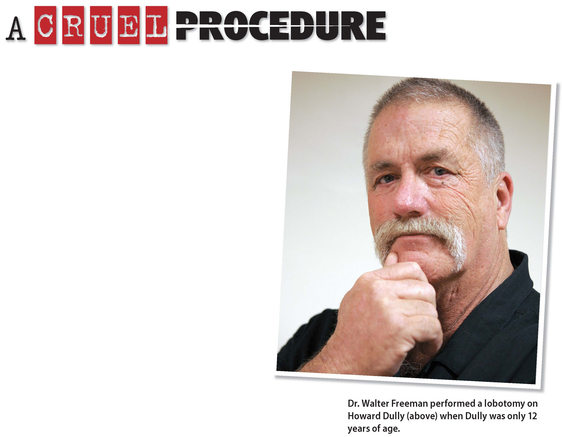
Why was an ice pick ever considered a surgical tool?

Slide 47
Drug Therapy
Biological therapy attempts to alleviate psychological problems by affecting the nervous system.
Because these treatments are medical in nature, they must be administered or prescribed by psychiatrists or other physicians.
Four major types of medication are commonly used: antianxiety drugs, antidepressant drugs, lithium, and antipsychotic drugs.

Slide 48
Antianxiety Drugs
Antidepressant drugs are also sometimes used in the treatment of such problems as eating disorders or panic disorders.
Work by depressing the activity of the nervous system
Common side-effects are fatigue and dependency
Antidepressant Drugs
Antidepressant drugs are also sometimes used in the treatment of such problems as eating disorders or panic disorders.
Work by increasing the amount of one or both neurotransmitters
Common side-effects are escalated heart rate and weight gain
Mood Stabilizing Drugs
Lithium: helps people with bipolar disorder
Common side-effects include shakiness, memory loss, and thirst
Antipsychotic Drugs
Antipsychotic drugs are prescribed to people with schizophrenia.
Work by lowering dopamine
Common side-effects are problems with balance and coordination

Slide 49
Reading Check
Find the Main Idea
What psychological disorder is lithium used to treat?
Answer: bipolar disorder

Slide 50
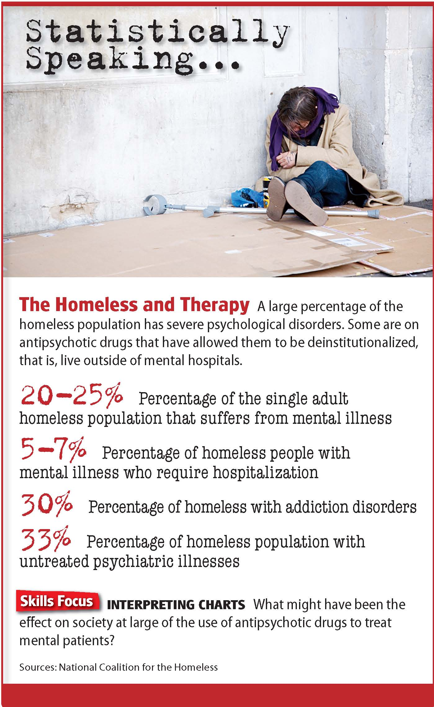

Slide 51
Electroconvulsive Therapy
Electroconvulsive therapy (ECT): commonly called electric-shock therapy; introduced in the 1930s
After anesthesia is administered, an electric current is passed through the person’s brain. The current causes convulsions (violent involuntary contractions of muscles).
Once antipsychotic drugs became available, ECT was used much less often.
Controversial for several reasons:
Many are uncomfortable causing convulsions in patients
Memory problems

Slide 52
Reading Check
Identify Cause and Effect
Why did the use of ECT drop off?
Answer: Antipsychotic drugs became available.

Slide 53
Pyschosurgery
Psychosurgery is brain surgery that is performed to treat psychological disorders.
Prefrontal lobotomy: used to reduce the agitation and violence of people with severe psychological disorders.
Involves cutting nerve pathways in the brain
Produces serious side effects such as reduced learning ability, overeating, and apathy
Even more controversial than ECT
Notes:
–

Slide 54
Reading Check
Summarize
What is the best-known technique of psychosurgery?
Answer: prefrontal lobotomy

Slide 55
Current Research in Psychology
The Over-Prescription of Drugs
Antipsychotic drugs are being prescribed at an increasingly high rate, even though the effects of these drugs, especially on the young, have not been studied as carefully as some would like.
One study found that children on Medicaid were more likely to be prescribed these drugs because the Medicaid program would approve them.
Pharmaceutical companies stand to make billions of dollars if their products become more widely used, even though they may harm patients.
Serious side effects can harm patients, especially children.
Children often react differently to medications than do adults.
There is a financial incentive to use drug therapy, even when the therapy is not the best treatment.
Notes:
–

Slide 57
Thinking Critically
What are some of the side effects of antipsychotic drugs in children?
How many commercials for drugs do you see on television, and what role might that play in the over-prescription of drugs?

Slide 58
Simulation: Applying What You’ve Learned
Identifying the Methods of Therapy
As you have seen in the chapter, there are many methods of therapy. Which approach do you think is best?
1. Introduction
2. Reviewing the Methods of Therapy
In this simulation, you will review the different approaches to therapy and the methods implemented by clinical psychologists.
Work in a group to write a therapy skit.
On your own, review the different approaches and methods of psychotherapy.
Include: name, psychological approach, important terms and concepts, and the goal of each therapy.
Notes:
–

Slide 59
Simulation (cont'd.)
3. Creating Your Simulation
4. Determining Methods of Therapy Being Simulated
Work in groups to write a skit that simulates a therapy session.
Review the content, decide who will take part in the skit, and then write your group’s skit.
Include: a clear identification of patient and therapist, the reason the patient is in therapy, and the terminology that indicates the method of therapy.
After watching each group’s skit, guess which therapy was being used. For each skit answer:
Which type of therapy?
From which approach?
What language was used and what does it indicate?
What was the goal of the session?
Notes:
–

Slide 60
Simulation (cont'd.)
5. Discussion
As a class, discuss the following:
How successful was the class at determining which method was being used?
Were some methods easy to determine? Why?
Were some methods hard to determine? Why?
Which method is most effective?
Notes:
–

