Slide 1
Chapter 20: Social Cognition
Case Study: Shaping the Black Experience
Section 1: Attitudes
Section 2: Persuasion
Section 3: Prejudice
Section 4: Social Perception
Section 5: Interpersonal Attraction
Experiment: Applying What You’ve Learned

Slide 2
Case Study: Shaping the Black Experience
W.E.B. Du Bois was an influential African American educator and writer who was born just five years after the Emancipation Proclamation. In 1903 Du Bois published a classic work titled The Souls of Black Folk. The book describes the experiences of Du Bois and others as they grew up in the segregated American society. Nearly 100 years later, Neil de Grasse Tyson wrote of his experiences as a leading expert in his field, and how that experience was shaped by being an African American. Both writers challenged stereotypes and proved that black scholars have much to contribute to American society.
Notes:
–

Slide 3
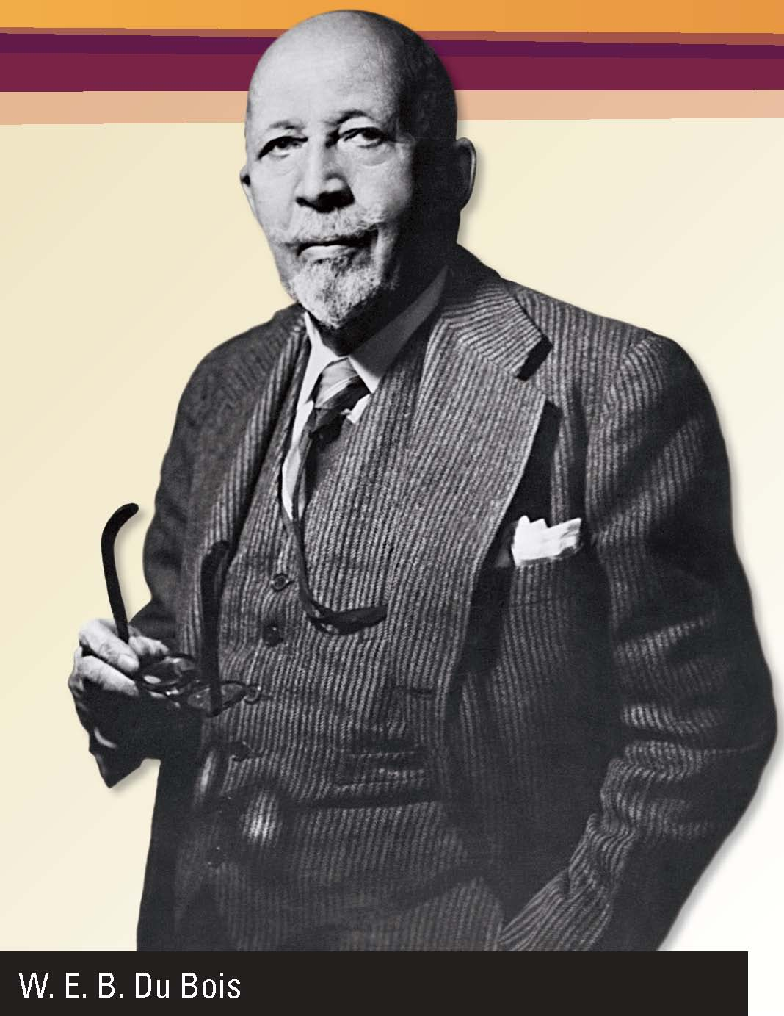
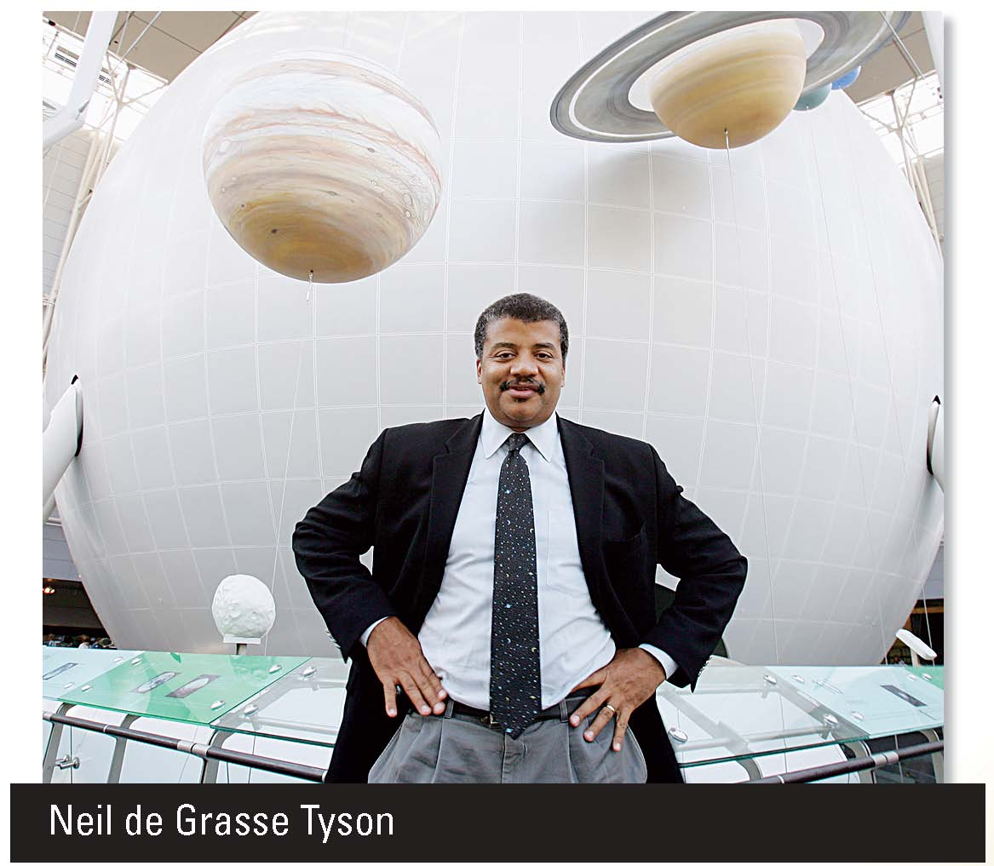

Slide 4
What do you think?
What do you think Du Bois meant when he said he was "shut out from their world by a vast veil"?
Do you feel there is still prejudice, like the attitude de Grasse Tyson faced, about people's intellectual abilities?

Slide 5
Section 1 at a Glance
Attitudes
Attitudes are beliefs and feelings that can affect how people behave in certain situations.
Attitudes develop in a number of ways throughout people’s lives. Sometimes behaviors follow attitudes, and sometimes attitudes follow behaviors.

Slide 6
Attitudes
Main Idea
Attitudes are an important aspect of our psychological lives because they are a major motivator for how we behave and view the world.
Reading Focus
What are some basic concepts in understanding attitudes?
How do attitudes develop?
How are attitudes and behaviors related?

Slide 7


Why might you ignore your own beliefs?

Slide 8
Understanding Attitudes
Attitudes: beliefs and feelings about objects, people, and events that can affect how people behave in certain situations
A major aspect of social cognition
May be the primary motivator for how we behave and how we view the world
Important because they foster strong emotions
Social psychology: studies human interactions

Slide 9
Reading Check
Define
What are attitudes?
Answer: beliefs and feelings about objects, people, and events that can affect how people behave in certain situations

Slide 10
How Attitudes Develop
Conditioning
Observational Learning
Learning by reinforcement
Parents who believe that it is important to share may praise, or reinforce, a child who shares a toy with a friend.
Child acquires an attitude about the importance of sharing.
Teens may observe that classmates who dress, talk, or act in certain ways seem to be admired by their peers.
Teen acquires attitude about these behaviors and may mimic them.
Commercial advertising often relies on observational learning in order to sell products.
Notes:
–

Slide 11
How Attitudes Develop
Cognitive Evaluation
Cognitive Anchors
Cognitive evaluation: evaluating evidence and forming beliefs on the basis of these evaluations.
Part of the process is to examine data carefully.
- Bias
- What is gained
People are especially likely to evaluate evidence when they will have to justify their choice.
Cognitive anchors: persistent beliefs that shape the ways in which a person sees the world and interprets events. Often they are the person’s earliest attitudes.
People who hold on to cognitive anchors for decades rarely adopt significantly new attitudes.
Notes:
–

Slide 12
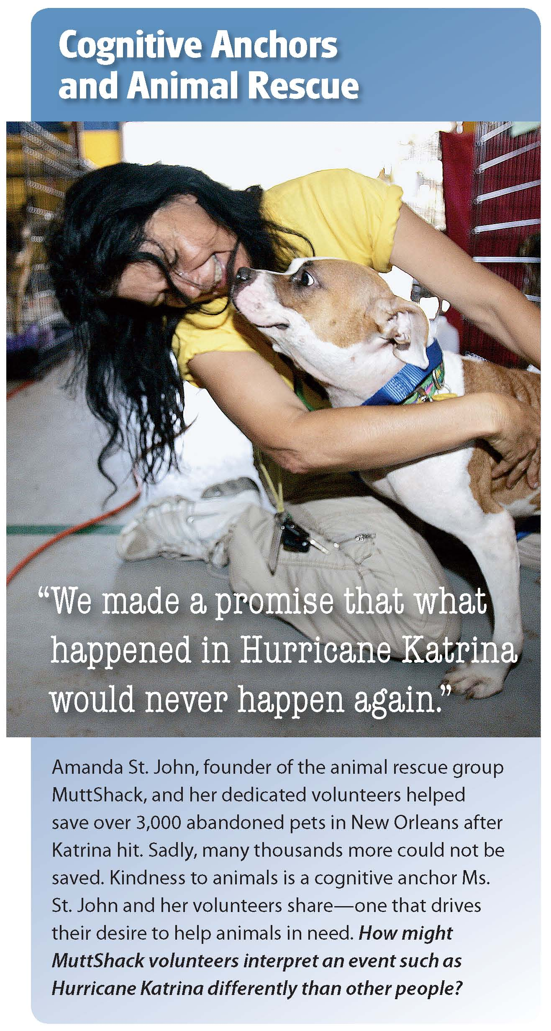

Slide 13
Reading Check
Identify Main Ideas
What are two of the four ways that people’s attitudes develop?
Answer: two of the following: conditioning, observational learning, cognitive evaluation, use of cognitive anchors

Slide 14
Attitudes and Behavior
Definition of attitudes suggests that people’s behaviors are always consistent with their attitudes.
However, people often behave in ways that contradict their attitudes.
When Behavior Follows Attitudes
When Attitudes Follow Behavior
Behavior in accordance with attitudes is more common if a behavior is tied to an attitude.
Strong attitudes are better predictors of behavior than weak.
More likely when people are aware of their attitudes.
Attitudes are likely to follow behavior when people begin to behave in ways that conflict with their attitudes.
Dissonance arises from conflict between attitudes and behavior.
Notes:
–

Slide 15
Reading Check
Recall
How do attitudes and behavior shape one another?
Answer: Attitudes often guide behaviors, but behaviors can contradict attitudes.

Slide 16
Current Research in Psychology
Attitudes and Achievement
How do you feel about school? According to a recent study, your attitude and behavior can have a direct impact on your academic achievement.
Researchers looked at students’ engagement in school, or their level of participation and interest, and at students’ own view of their academic success.
Study demonstrated that those who were more engaged and had a more positive view of their abilities achieved greater academic success.
These two traits are closely linked.
High expectations and clearly defined rules also help student achievement.
Activities that encourage interaction result in more engaged students.
Notes:
–

Slide 17
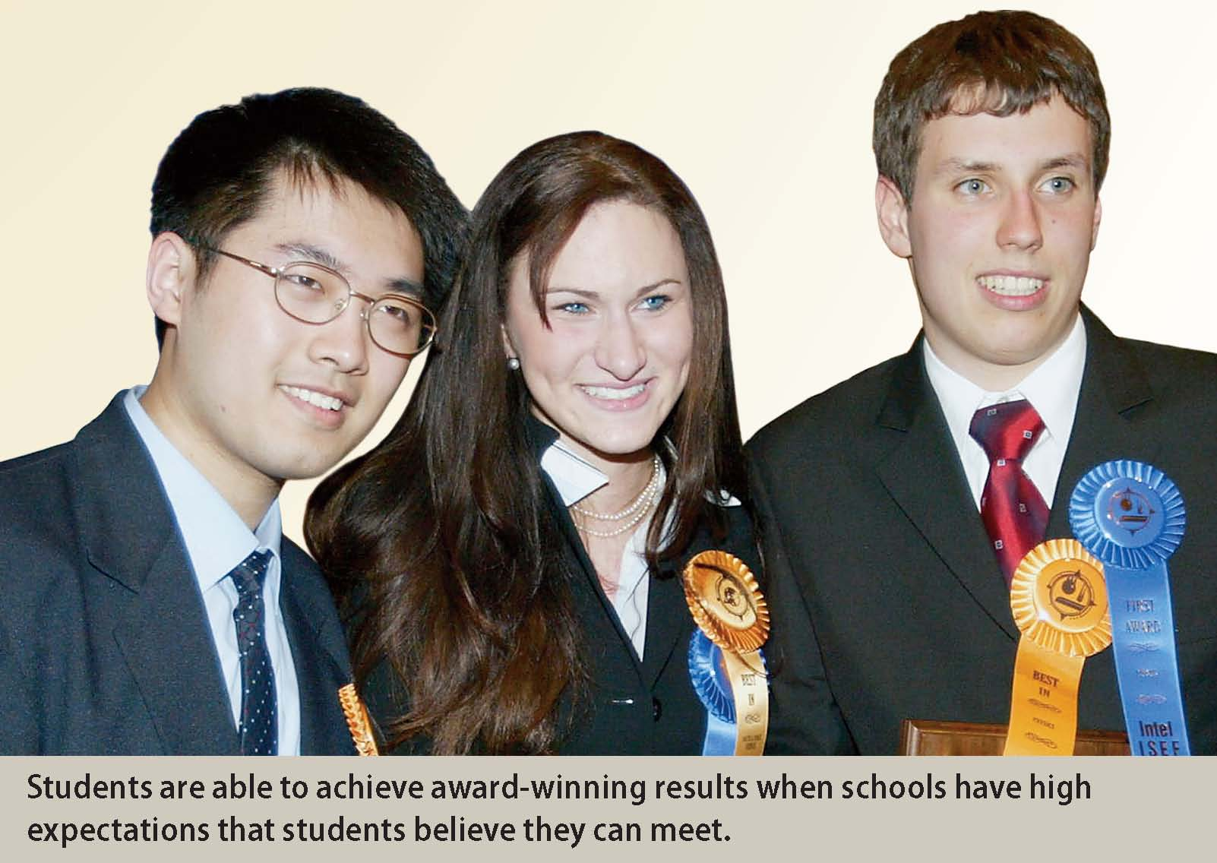

Slide 18
Thinking Critically
How can schools instill in students an attitude of belief in their academic abilities?
Which of the two factors examined in the study do you think is more important to academic achievement? Why?

Slide 19
Section 2 at a Glance
Persuasion
Persuasion is the direct attempt to influence others’ attitudes.
People can be persuaded via the central route, using evidence and logic, or via the peripheral route, using positive and negative associations and cues.

Slide 20
Persuasion
Main Idea
People use a range of persuasive techniques to try to change other people’s attitudes. These techniques can be direct, relying on logic or evidence, or indirect, relying on emotions or perception.
Reading Focus
What are the main methods of persuasion?
How do the message and the messenger relate to persuasion?
How do the situation and the audience affect persuasion?
How can one resist persuasive messages?

Slide 21
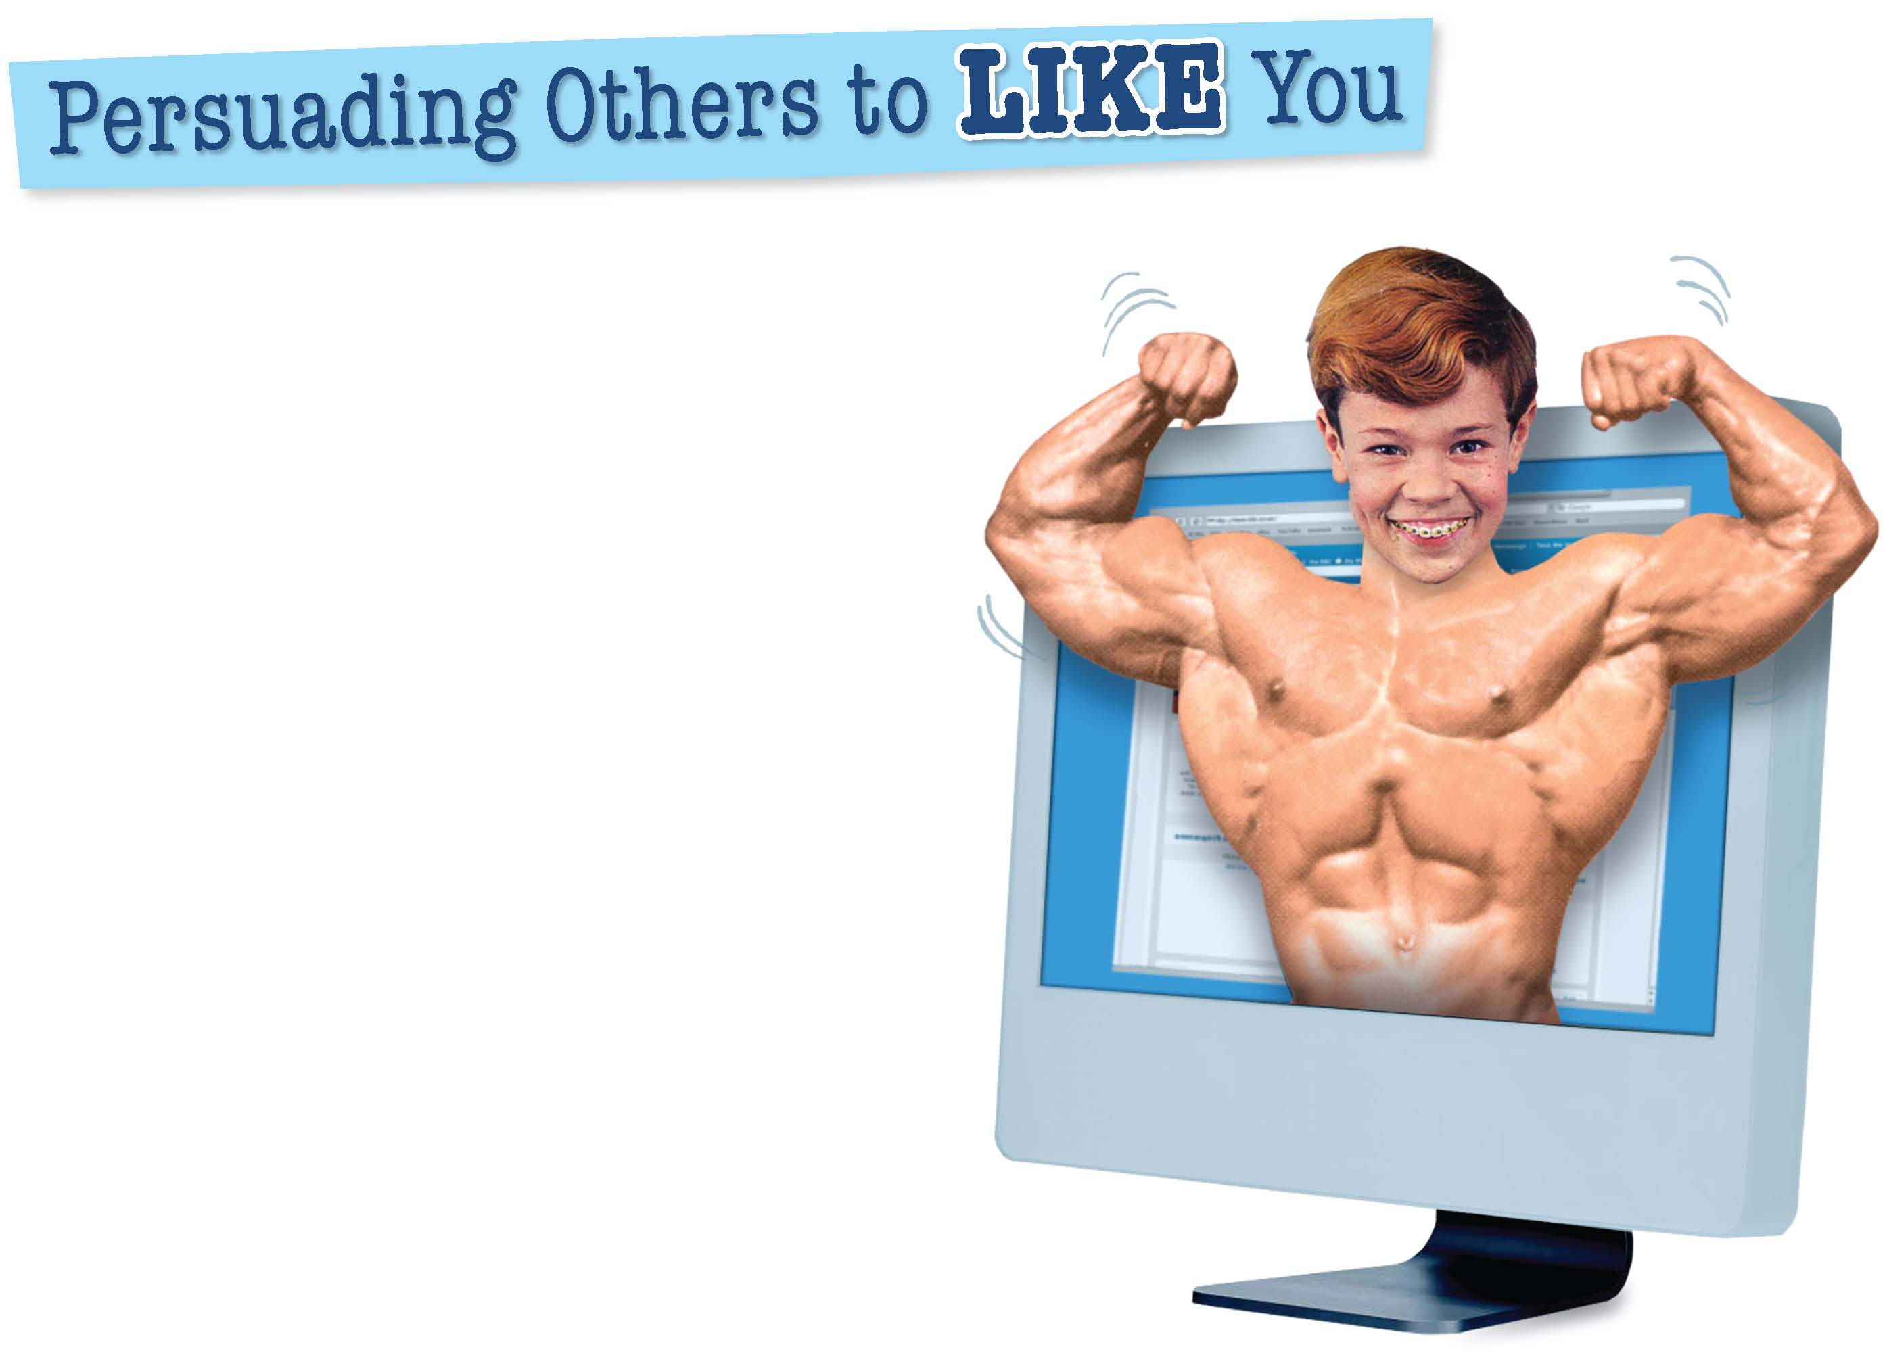
What face do you want the world to see?

Slide 22
Methods of Persuasion
Persuasion: a direct attempt to influence other people’s attitudes or views.
Two basic ways to persuade people:
  Central route: use evidence and logical arguments to persuade people
  Peripheral route: attempts to associate objects, people, or events with positive or negative cues
The most persuasive messages use both routes.

Slide 23
Reading Check
Recall
What are the two central routes of persuasion?
Answer: using evidence and logical arguments to persuade people

Slide 24
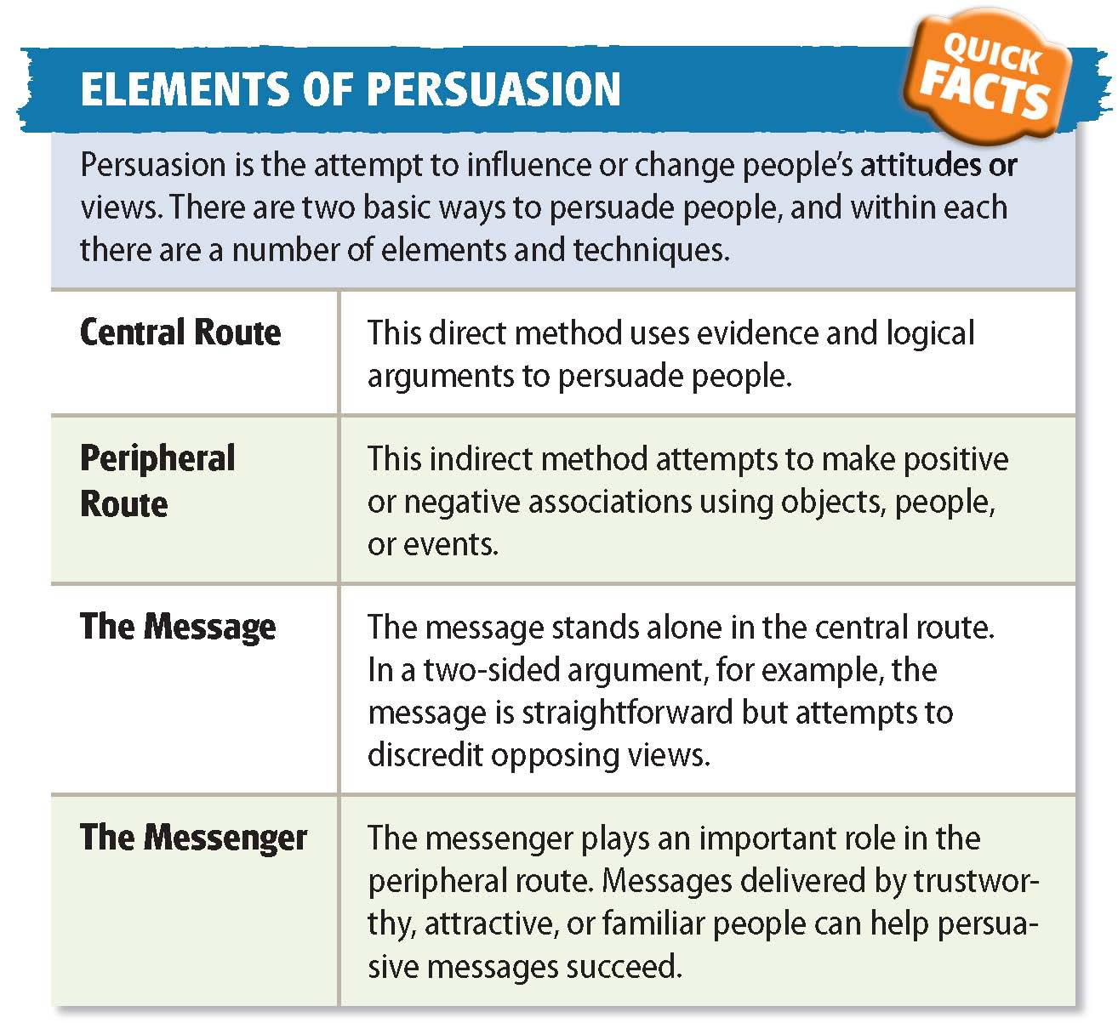

Slide 25
Message and Messenger
In the central route, the message itself is most important. In the peripheral route, the message is important, but it does not stand alone. The messenger also plays an important role.
Repetition
Two-Sided Arguments
Repeated exposure to a stimulus eventually results in a more favorable attitude toward that stimulus.
Advertisers and others use repetition to create positive reactions to their products.
Two-sided arguments: the messenger presents not only his or her side of the argument but also the opposition’s side to discredit the opposition’s view.
Admitting weakness can make an argument more believable.
Notes:
–

Slide 26
Emotional Appeals
Emotional appeals: arouse such feelings as loyalty, admiration, desire, jealousy, or fear rather than by convincing through evidence and logic.
A peripheral route
Glittering Generalities
Use of vaguely positive words and images without citing specific evidence or promises
Role of the Messenger
Some people are more persuasive: those who are experts, trustworthy, physically attractive, or similar to their audience in ethnicity, age, and other physical characteristics.
Messengers who stand to gain from the effort are less believable.

Slide 27
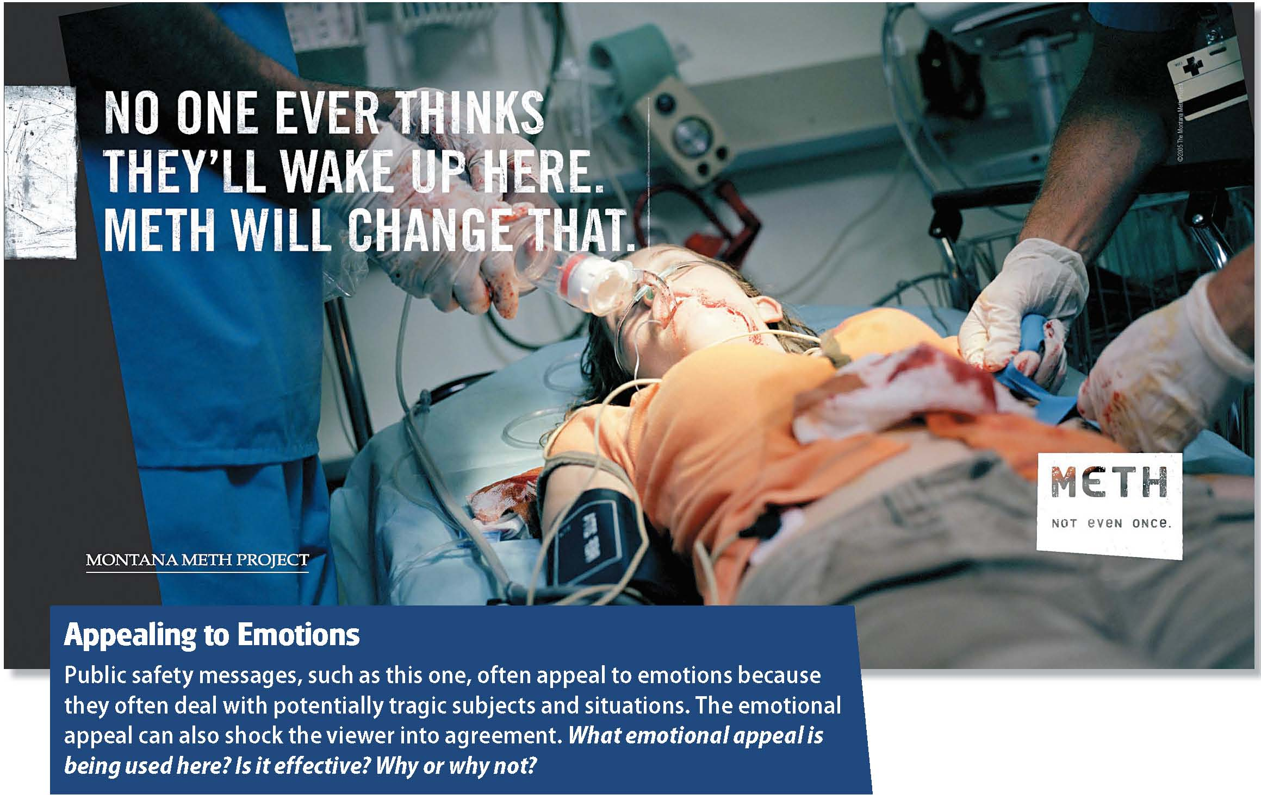

Slide 28
Reading Check
Describe
In what kind of persuasion is the messenger important?
Answer: peripheral route messages

Slide 29
Situation and Audience
When a person is in a good mood, he or she is less likely to evaluate messages carefully.
Most messages are aimed at a specific audience.
Differences in audience can affect the best way to deliver a message to be the most persuasive.

Slide 30
Reading Check
Describe
How might the use of the situation and the audience easily be combined to aid in persuasion?
Answer: messages tailored to audience more persuasive

Slide 31
Resisting Persuasive Messages
Sales resistance: having no trouble turning down requests to buy products or services.
People without sales resistance find it difficult to refuse a sales pitch or other types of requests.
Two factors may affect sales resistance: self-esteem and social anxiety.

Slide 32
Reading Check
Identify Main Ideas
How is self-esteem related to sales resistance?
Answer: People with low self-esteem find it difficult to say no.

Slide 33
Section 3 at a Glance
Prejudice
A prejudice is a generalized attitude toward a specific group of people. Prejudiced attitudes are based on stereotypes, which can then lead to discrimination.
People can overcome prejudice by learning about others and by speaking up when others communicate or behave in prejudicial ways.

Slide 34
Prejudice
Main Idea
Prejudice occurs when people prejudge and stereotype other groups, and it can result in discrimination. Prejudice has deep-seated social and psychological causes that can be overcome.
Reading Focus
What attitudes and actions are part of the prejudicial view?
What are some of the causes of prejudice?
What are some ways that individuals can help overcome prejudice?

Slide 35

Is there anything wrong with this picture?

Slide 36
The Prejudicial View
Prejudice: a generalized attitude toward a specific group of people. People who are prejudiced judge other people on the basis of their group membership rather than as individuals. Prejudices are based on stereotypes.
Stereotypes
People also assume that those who are different from themselves are similar to each other in many ways.
Stereotypes are harmful because they ignore people’s individual natures and assign traits by group membership.
Unchanging, oversimplified, and usually distorted beliefs about groups of people.
People tend to develop stereotypes as a way to organize information about their social world.
Notes:
–

Slide 37
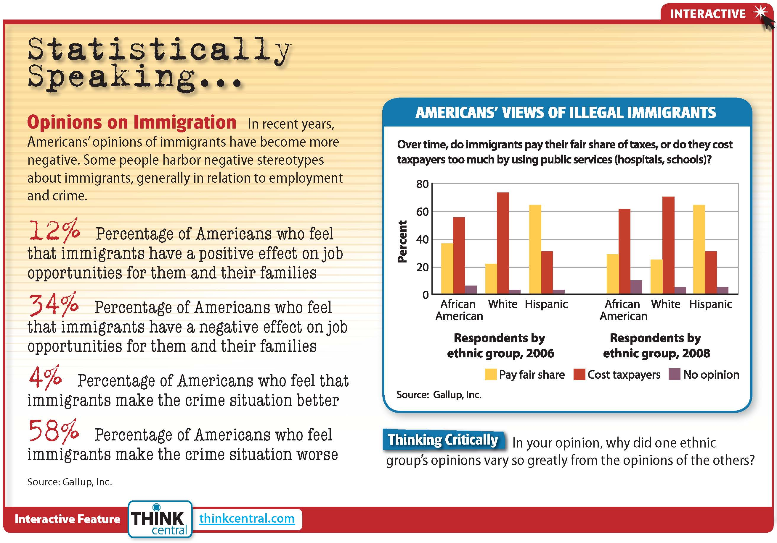
Click on the image to play the Interactive.

Slide 38
Stereotypes can also include positive traits.
Stereotype threat occurs when members of a group are aware of a stereotype that says they cannot perform a certain task, and perform worse at the task because of this assumption.
Stereotype threat occurs when members of a group are aware of a stereotype that says they cannot perform a certain task, and perform worse at the task because of this assumption.
Even positive stereotypes can be harmful.
Discrimination
Discrimination: the unfair treatment of individuals because they are members of a particular group.
Skin color, sex, religion, and even weight can be the basis of discrimination.
Victims of every type of discrimination often begin to see themselves as inferior and to have low self-esteem.

Slide 39
Reading Check
Compare
What is the connection between stereotyping and discrimination?
Answer: Discrimination is often based on stereotyping, which ignores people’s individual natures and assigns them traits on the basis of groups to which they belong.

Slide 40
Causes of Prejudice
Exaggerating Differences
Some are prejudiced because they exaggerate how different others are from themselves.
People tend to prefer those who are similar to themselves.
Justifying Economic Status
Some are prejudiced against those in a different economic group.
Such beliefs may be used as an excuse for injustices.
Social Learning
Children acquire the attitudes from parents.
Prejudices are passed from parents to children.
Victimization
Sometimes people who are the victims of prejudice feel empathy for others who are discriminated against, but some may come to discriminate against a third group in order to feel superiority.

Slide 41
Scapegoating
A scapegoat is an individual or group that is blamed for the problems of others because the real cause of the problems is either too complex, too powerful, or too remote to be confronted.
The term scapegoating refers to aggression against the targeted group.
A scapegoat group has characteristics that make it highly visible and safe to attack.
The most famous example is the Holocaust, in which millions of Jews were killed.

Slide 42
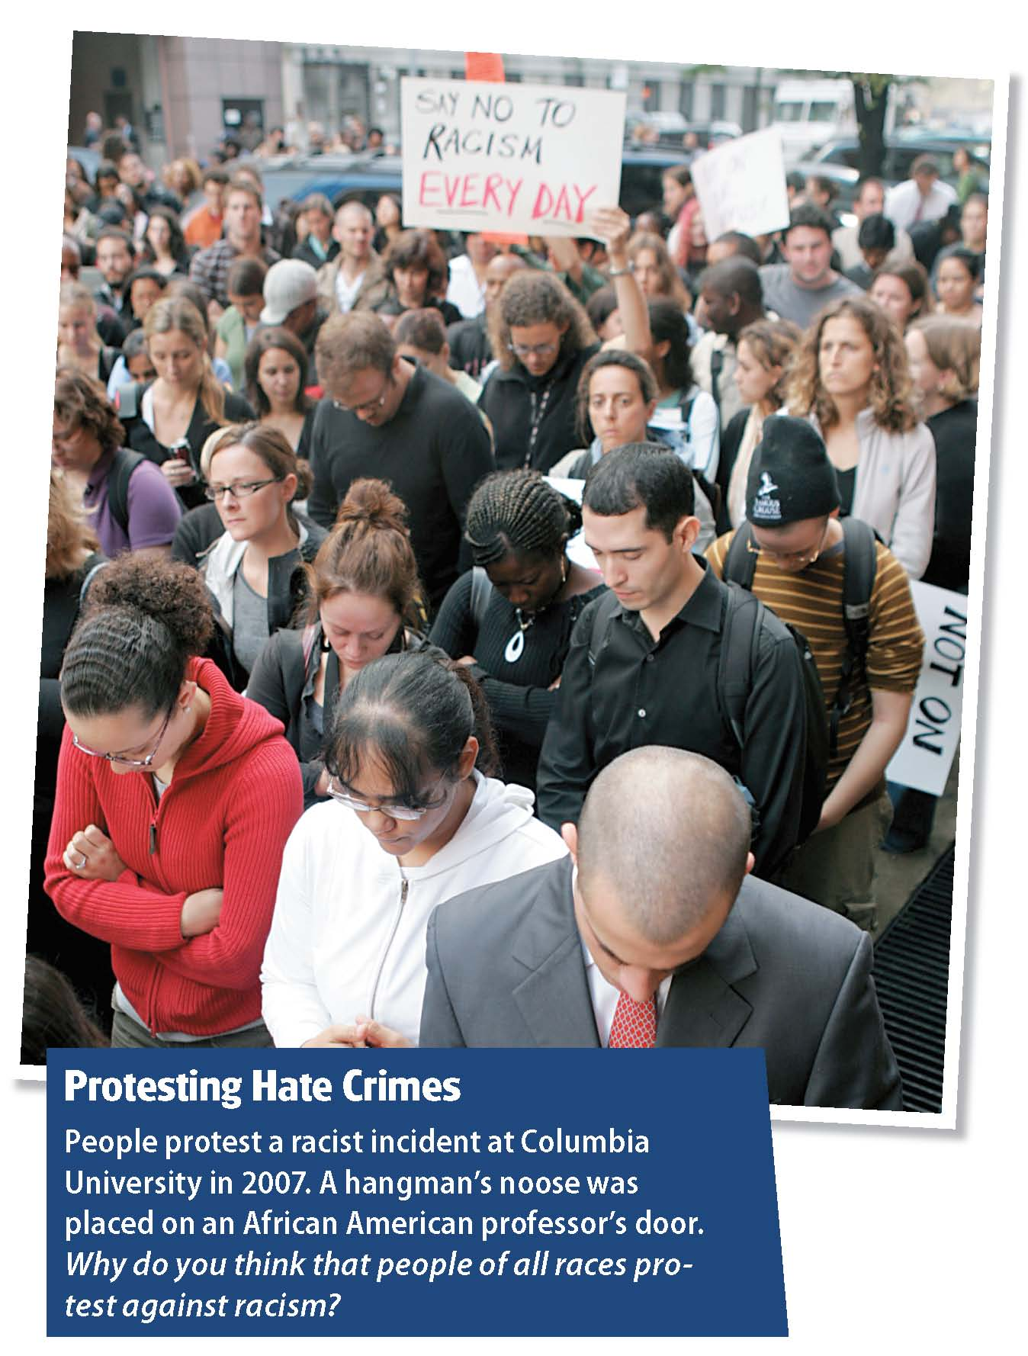

Slide 43
Reading Check
Identify
Name and describe three potential causes of prejudice.
Answer: Students should choose three of the following: exaggerating differences, justifying economic status, social learning, victimization, scapegoating.

Slide 44
Overcoming Prejudice
Although difficult to overcome, it is possible.
Increased contact among members of different groups
Speaking up when other people act or talk in ways that reveal prejudicial attitudes
Set an example with own words and actions

Slide 45
Reading Check
Recall
How can increased contact between groups help to lessen prejudice?
Answer: People learn about each other as individuals.

Slide 46
Psychology in Today’s World
Seeds of Peace
The organization Seeds of Peace believes the best way for people from around the world to change their attitudes about each other is to meet face to face.
Seeds of Peace began in 1994 as a way to bring youth from Israel, Egypt, and Palestine together to live and learn together.
Although the camp began with children from the Middle East, it eventually included teens from other major conflict regions, such as South Asia and the Balkans.
Main focus is to develop leadership skill required to advance reconciliation and coexistence in their troubled homelands.
Facing and interacting with the very people they are supposed to hate provides the teens with opportunities to view each other as individuals.
Notes:
–

Slide 47
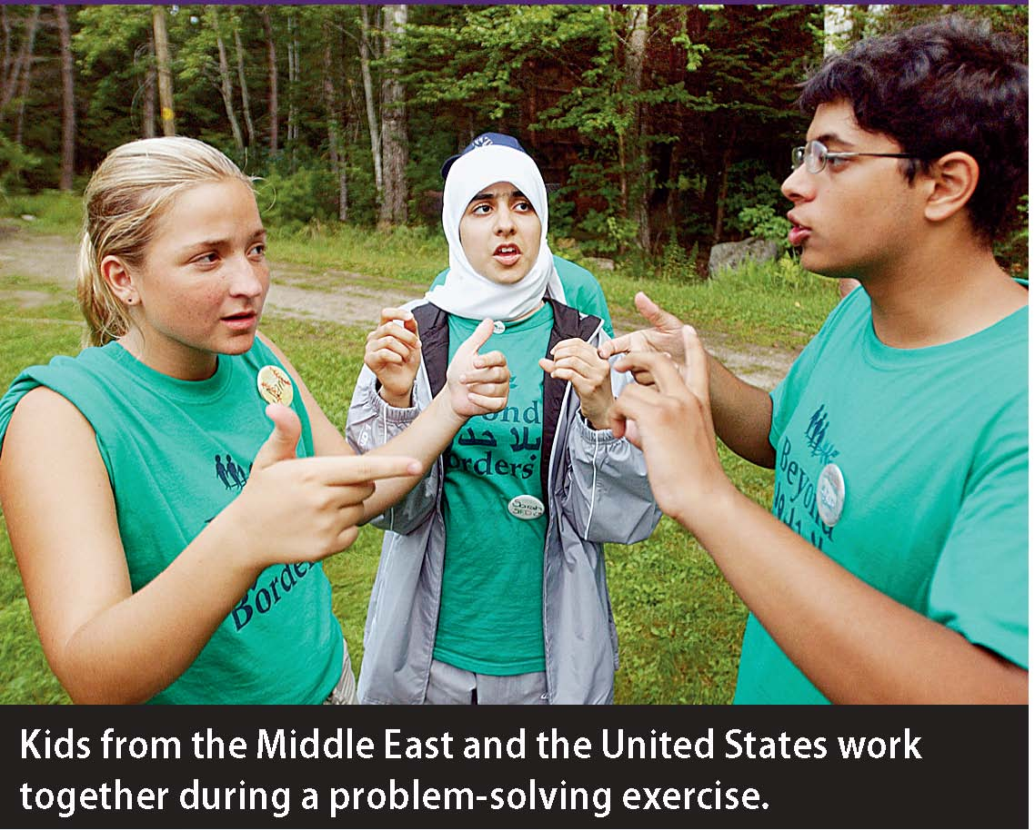
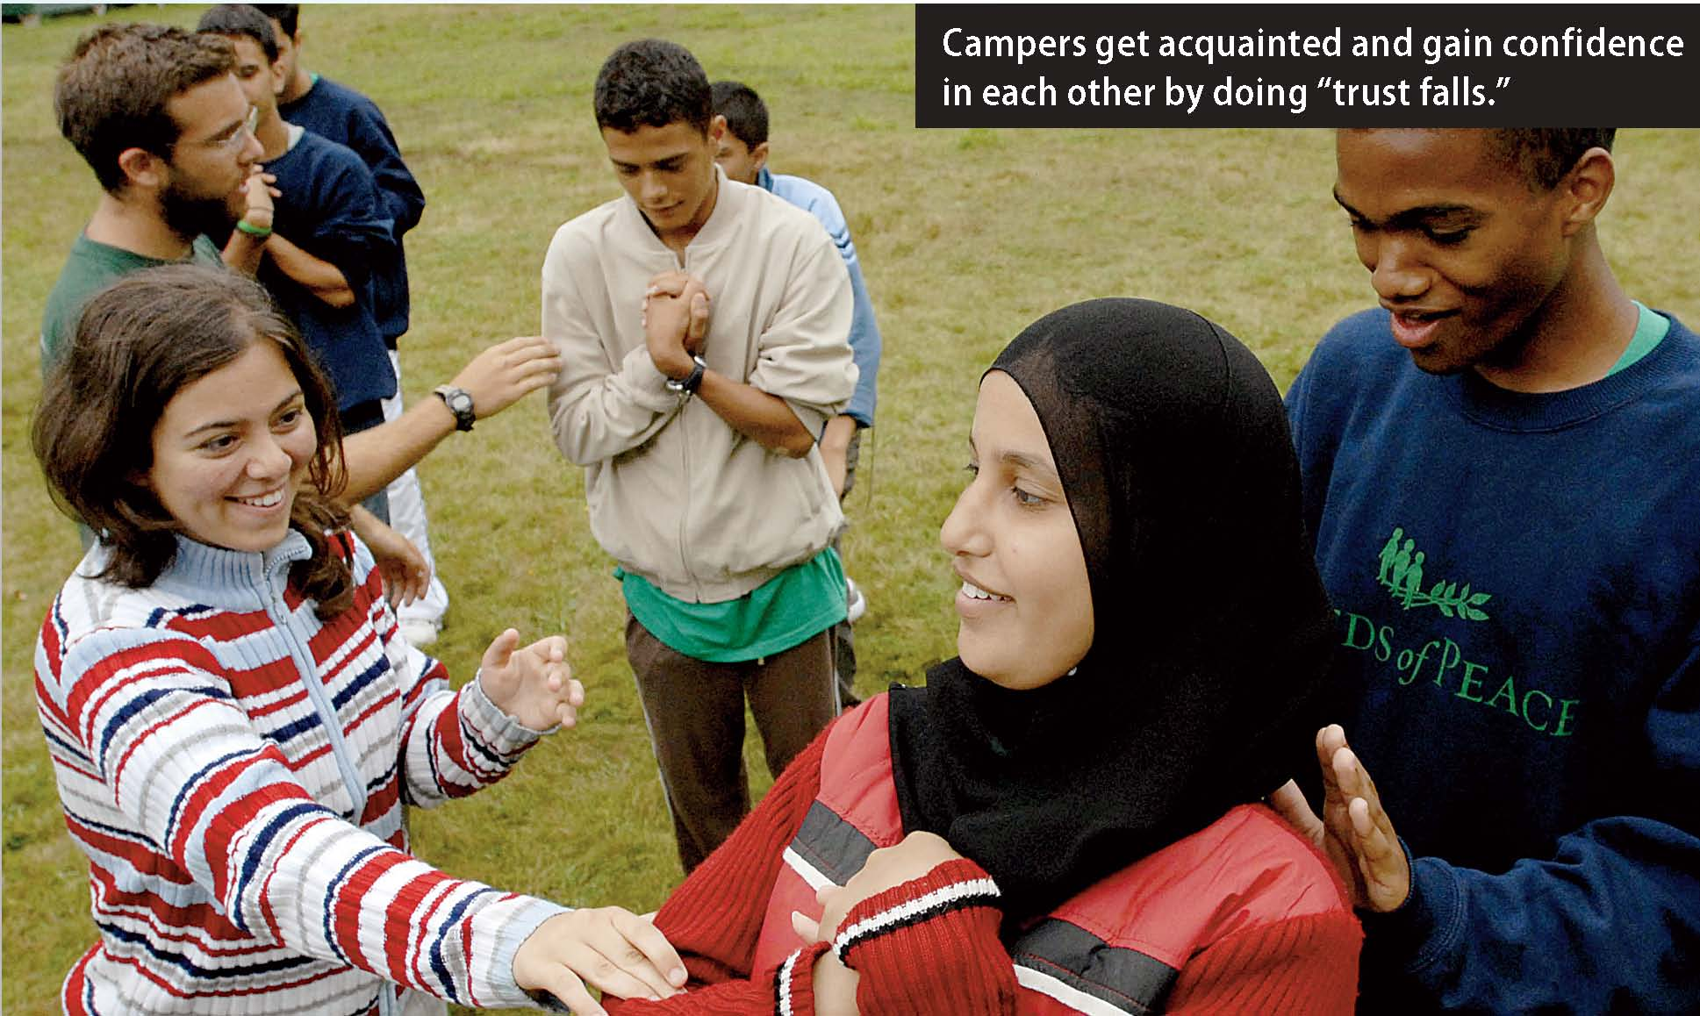

Slide 48
Thinking Critically
How do participants learn about one another as individuals?
Why do you think the Seeds of Peace summer camp helps participants dispel prejudicial attitudes?

Slide 49
Section 4 at a Glance
Social Perception
People form attitudes about one another based on their social perceptions. First impressions play a large role in this process.
In general, people tend to judge the behaviors of others more harshly than they do their own behavior. They also tend to attribute different motives to others than they do to themselves.
The multiple forms of nonverbal communication have important parts in social perception.

Slide 50
Social Perception
Main Idea
Social perception refers to how we see and what we feel about others. Social perception is heavily influenced by first impressions, differing vantage points, and nonverbal cues.
Reading Focus
To what extent do people form perceptions based on first impressions?
What does attribution theory say about how we perceive ourselves and others?
How does nonverbal communication influence our perceptions of others?

Slide 51

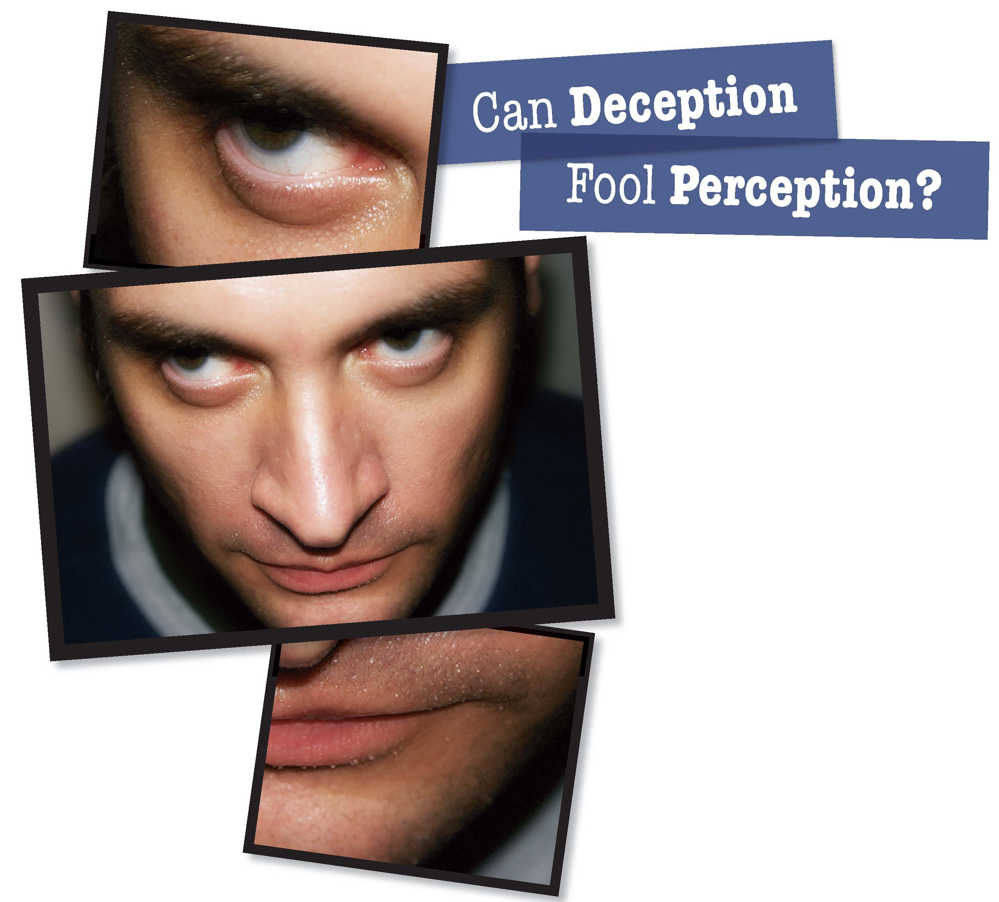
Can your face give you away?

Slide 52
Forming Perceptions
Social perception: the ways in which people perceive one another. It affects the attitudes people form toward one another.
People think that their first impressions of other people are accurate, and are often based on how a person looks.
Primacy effect: the tendency for people to form opinions of others on the basis of first impressions.
How people interpret later behavior of others is influenced by their first impressions.
Recency effect: people change their opinions of others on the basis of recent interactions instead of holding on to their first impressions.

Slide 53
Reading Check
Contrast
How are the primacy and recency effects different?
Answer: The primacy effect describes opinions based on first impressions; the recency effect describes opinions that change based on recent interactions.

Slide 54
Attribution Theory
Attribution theory: tendency to explain behavior in terms of either dispositional, or personality, factors or in terms of situational, or external, factors
Fundamental Attribution Error
Fundamental attribution error: the overestimation of the effect of dispositional causes for another person’s behavior and underestimation of situational causes
Actor-Observer Bias
Actor-observer bias: tendency to attribute the behavior of others to internal factors and the behavior of self to external factors
Self-Serving Bias
Self-serving bias: tendency to attribute own successes to dispositional factors and own failures to situational factors

Slide 55
Reading Check
Explain
What are dispositional factors and situational factors?
Answer: Dispositional factors are personality or internal factors that affect behavior; situational factors are external factors.

Slide 56
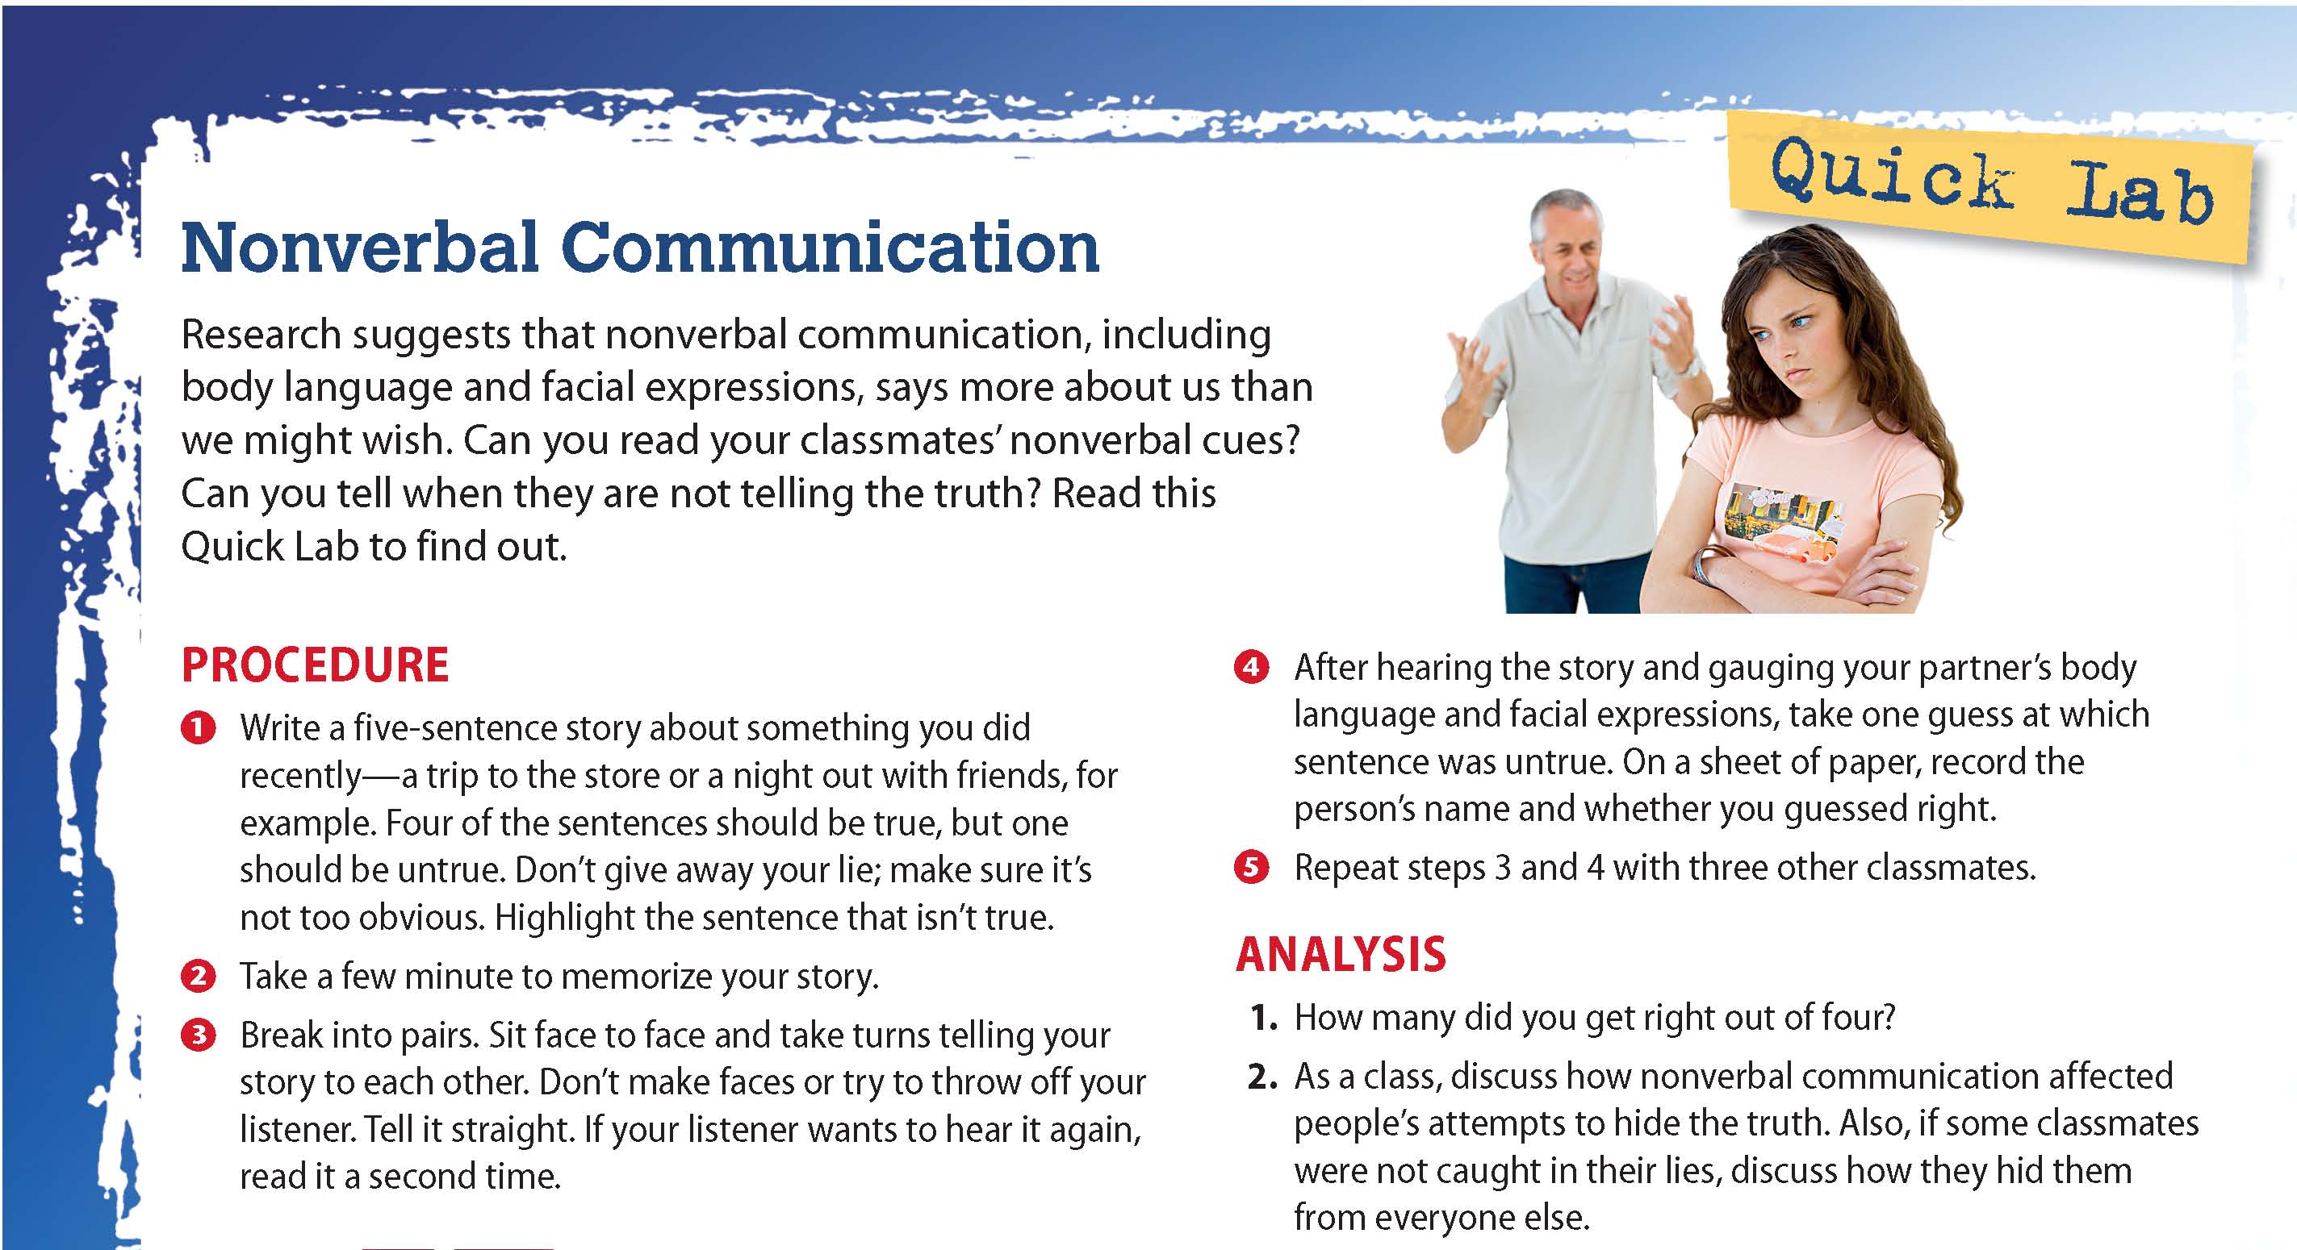

Slide 57
Nonverbal Communication
Forms of nonverbal, or unspoken, communication include facial expressions, gestures, posture, and the distance we keep from others.
“Body language” affects our perceptions of people, largely because it often indicates feelings.
Some nonverbal forms of communication are learned very early.
Physical Contact
Touching is one way to communicate nonverbally.
Studies have found that touch can affect willingness to help, the amount given in a tip, or favorable interactions.

Slide 58
Eye Contact
People can learn a great deal about the feelings of others from eye contact.
When a speaker is looking into the eyes of a listener, the speaker is usually telling the truth.
Gazing can greatly influence relationships.
Staring is usually interpreted as a sign of anger.
Cultural Considerations
There is considerable cultural variation in the use of nonverbal communication.
  Distance people keep from each other differs around the world.
Becoming more aware of nonverbal communication can increase our understanding of others.

Slide 59
Reading Check
Identify
What are three kinds of nonverbal communication that affect how people perceive one another?
Answer: Answers should include three of the following: facial expressions, gestures, posture, physical distance, eye contact.

Slide 60
Section 5 at a Glance
Interpersonal Attraction
Attraction is the process by which people are drawn to others who appeal to them in a number of ways.
People are attracted by physical appearance and by similarity in personal background and attitudes.
Attraction often leads to friendship or to romantic relationships.

Slide 61
Interpersonal Attraction
Main Idea
People are attracted to others for many reasons. Personal appearance and personality traits play significant roles, as do similarity and reciprocity.
Reading Focus
How do concepts of physical appearance vary?
Why are similarity and reciprocity essential to attraction?
What is the difference between friendship and love?

Slide 62
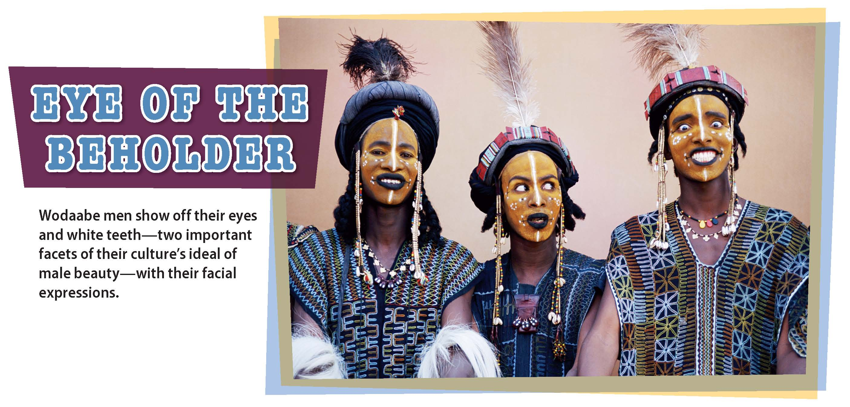
Is beauty really in the eye of the beholder?

Slide 63
Physical Appearance
Attraction: the process by which people are drawn to others who appeal to them in a number of ways. Factors of attraction include physical appearance, similarity to ourselves, and evidence that our attraction is returned.
Universals of Beauty
Differences in Body Shape Preference
Smiling is perceived as more attractive.
Large eyes, high cheekbones, and narrow jaws are more attractive in Britain and Japan.
Some evidence exists that we do not “learn” what is attractive.
Great deal of variation in people’s standard for attractive body shape.
Initial attraction one feels for another person may be based on the person’s physical appearance, but other traits become important with time.
Notes:
–

Slide 64
Reading Check
Describe
What part of attraction is more universal, and what parts are more particular to individual preferences?
Answer: Preferences for certain facial expressions and features are more universal, while preferences for body shape vary widely.

Slide 65
Similarity and Reciprocity
We are usually more attracted to people who are similar to us.
Similarity in Physical Attractiveness
Matching hypothesis: people tend to choose as friends and partners those who are similar to themselves in attractiveness
Similarity in Other Characteristics
Friends and partners tend to be similar in race, ethnicity, age, level of education, and religion.
Often have similar attitudes.
Reciprocity
Reciprocity: the mutual exchange of feelings or attitudes
Applies to situations in which the person we like likes us back

Slide 66
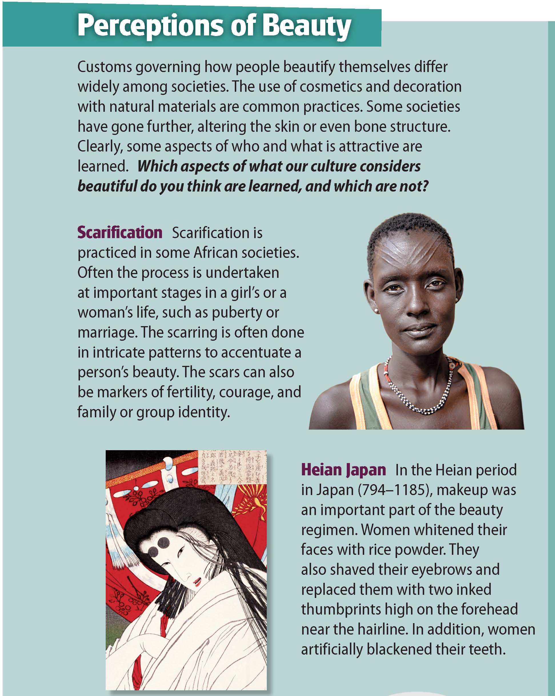
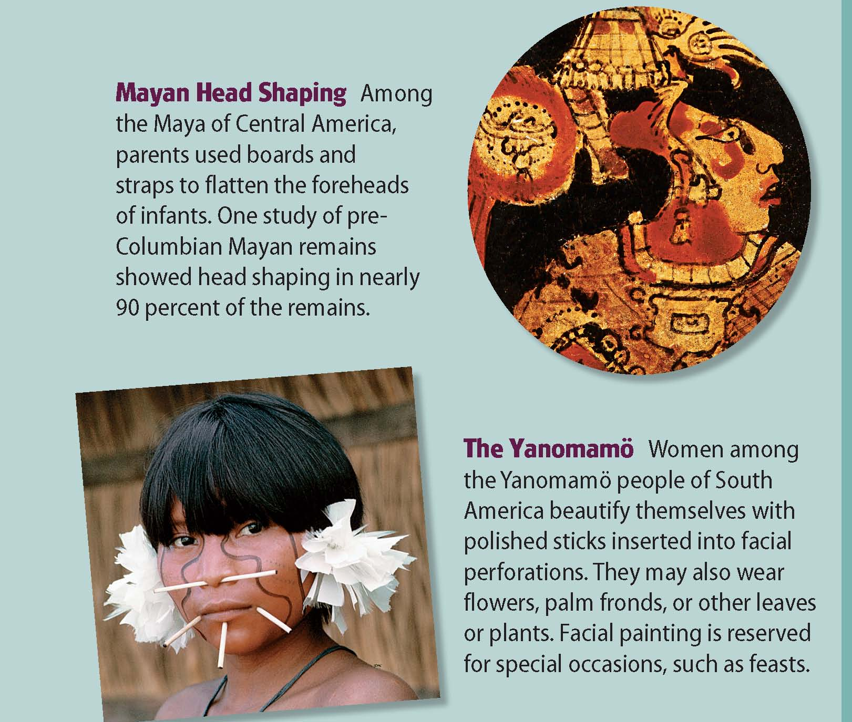

Slide 67
Reading Check
Describe
Why is similarity important in developing relationships?
Answer: Most people develop relationships with people who are similar to themselves in background and attitudes; those are the people with whom they have most frequent contact.

Slide 68
Friendship and Love
Friends are people for whom one has affection, respect, and trust.
The people we choose as friends tend to be people with whom we have frequent contact, such as a fellow student.
Love can refer to the feelings of attachment between children and parents, siblings, and other family members, as well as feelings of patriotism for one’s country or strongly held values.
Most commonly, however, love refers to the feelings of mutual attraction, affection, and attachment shared by people who are “in love.”
Triangular model of love: Sternbert identified seven types of love, each characterized by at least one of three components: intimacy, passion, or commitment.

Slide 69
Intimacy: closeness and caring
  Reflected by mutual concern, the sharing of feelings and resources
Passion: feelings of romantic and sexual attraction
  Reflected by verbal expressions of love, gazing, hugging, and kissing
Commitment: a couple’s recognition that they are “in love” and want to be together, “for better or for worse.”

Slide 70
Reading Check
Analyze
What are two ways in which friendship and love are related?
Answer: Answers should include two of the following: mutual attraction, affection, and attachment.

Slide 71
Experiment: Applying What You’ve Learned
Types of Persuasion
Can you correctly predict whether central or peripheral route persuasion is more effective?
1. Introduction
2. Creating the Ads
In this experiment, you will try to determine if the central or peripheral route is more effective. You may learn valuable lessons that you can use in your daily life.
Review the chapter material.
In groups, create two full-page ads for a certain product, one using the central route and one using the peripheral route.
Notes:
–

Slide 72
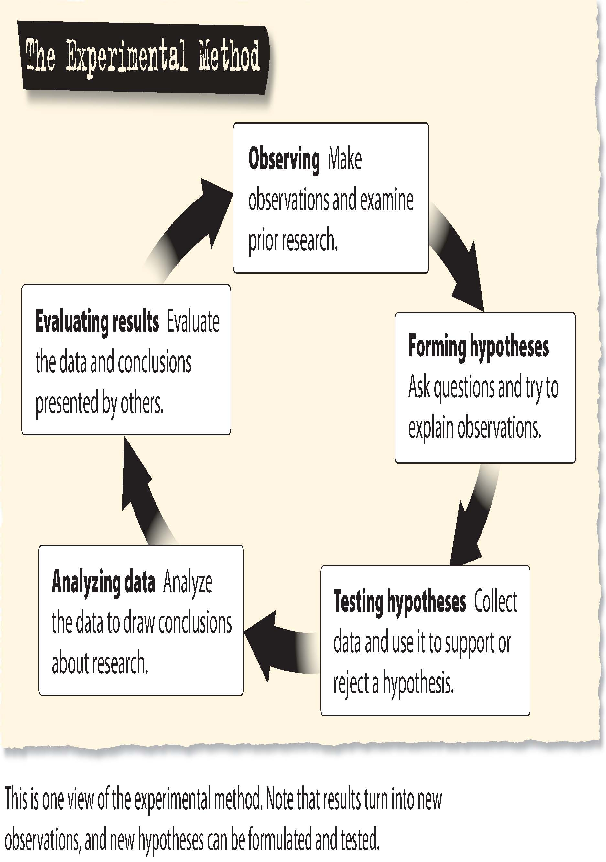

Slide 73
Experiment (cont'd.)
3. Forming and Testing Your Hypothesis
4. Analyzing Data and Evaluating Results
Which method will be more successful?
Develop a questionnaire that challenges the test participants to think about how the ad affects them.
What about the ad is appealing?
How do you feel about the product?
Does the ad speak to you?
As a class, discuss the exercise and these questions:
Which persuasive method was most effective?
How did the choice of product relate to each method’s effectiveness?
If you were to do this experiment again, how would you change the method to improve it?
Notes:
–

