Slide 1
Chapter 15: Psychological Tests
Case Study: Testing Your Work Personality Type
Section 1: Psychology and Testing
Section 2: Measuring Achievement, Abilities, and Interests
Section 3: Personality Tests
Section 4: Taking Tests
Lab: Applying What You’ve Learned

Slide 2
Case Study: Testing Your Work Personality Type
Have you ever wondered how you or someone else would classify your personality? Many people like to learn about themselves and others and to identify their personalities. The Myers-Briggs Type Indicator® (MBTI®) is one of the most popular personality tests. It was developed to help people find a job that they both enjoyed and excelled at. The test classifies people into one of 16 types based on factors such as introversion, intuition, and judging. The MBTI is just one kind of psychological test; there are many others.
Notes:
–

Slide 3
What do you think?
What are the four dimensions that MBTI measures?
How might being labeled as having a certain type of personality affect you on the job?

Slide 4
Section 1 at a Glance
Psychology and Testing
Psychological tests assess abilities, feelings, attitudes, and behavior.
For a psychological test to be useful and accurate, it has to be standardized, reliable, valid, and have norms for scoring.
Computers can be used to administer tests and help students prepare for tests.

Slide 5
Psychology and Testing
Main Idea
Psychological tests include achievement tests, aptitude tests, interest tests, and personality tests.
Reading Focus
What are some uses of psychological tests?
What are four important features of a psychological test?
How can computers be used in testing?

Slide 6
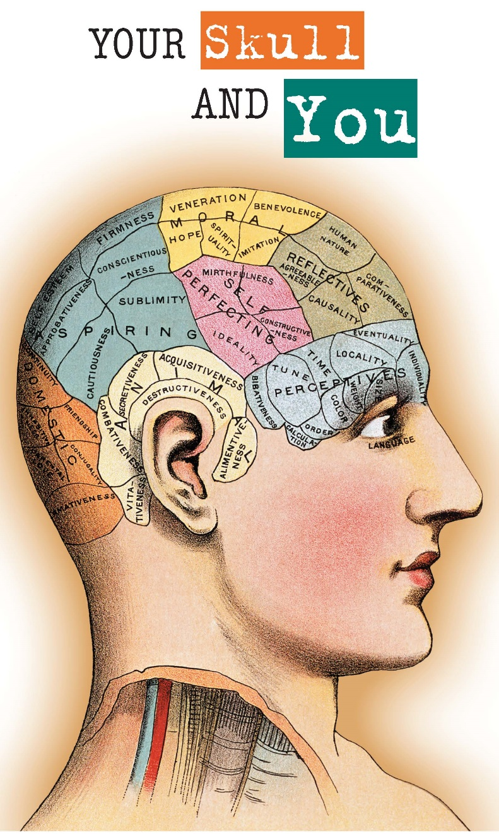
Do the bumps on your head say something about what is in your brain?

Slide 7
Uses of Psychological Tests
Achievement test: determines how much students have learned
Aptitude and interest tests: determine whether he or she is suited for certain occupations
Personality test: identify the psychological traits that make up a person’s personality
Tests claim to be able to predict a student’s future behavior, such as benefiting from certain educational experiences or succeeding in college.
Behavior-rating scales are used to measure behavior in such places as classrooms and hospitals.
Self-reports rely on answers from people about their feelings and experiences.

Slide 8
Reading Check
Analyze
What are behavior-rating scales used for?
Answer: to measure behavior in specific locations, such as classrooms or hospitals

Slide 9
Features of Psychological Tests
Standardization
Standardized test: administered and scored the same way every time
Some experts question the validity of these tests
Reliability and Validity
Reliability: a test’s consistency
Validity: the extent that the test measures and predicts accurately
Validity scales: questions that allow the scorer to know whether the test-taker is answering truthfully or not
Norms
Norms: established standards of performance that set averages
Norm group: a large group of test takers that are similar to those for whom the test is intended

Slide 10
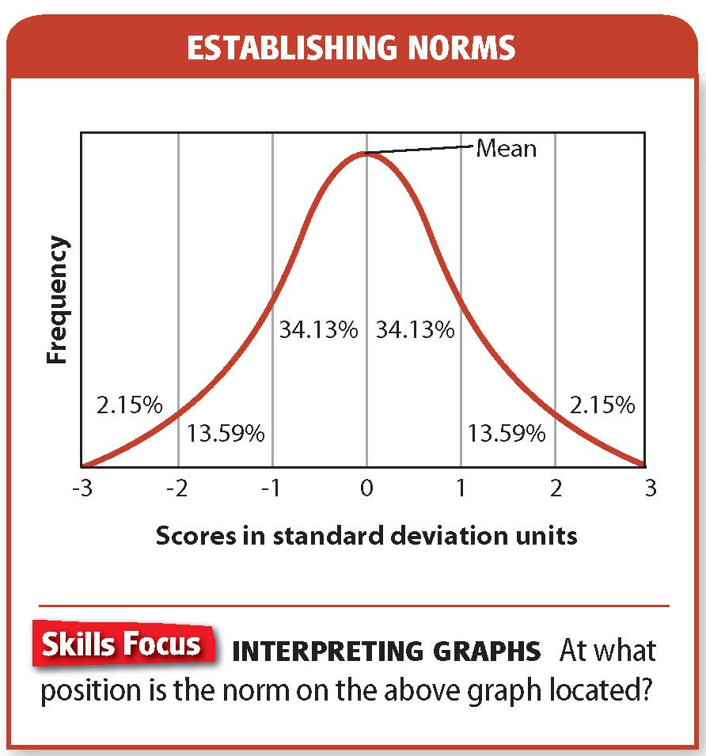

Slide 11
Reading Check
Summarize
What is a standardized test?
Answer: one administered and scored the same way every time

Slide 12
Computers and Testing
Computers can be used to administer tests and to help students prepare for tests such as the SAT and ACT.
Practice tests contain detailed tutorials, practice questions, and recommended strategies
Computerized Assessment System for Psychotherapy Evaluation and Research (CASPER) is one computer-based psychological test.
Asks a wide variety of questions about relationships, activities, life satisfaction, and behavior
People find CASPER user-friendly, and results appear to be more consistent when the test is administered on a computer.

Slide 13
Reading Check
Summarize
What is one advantage of computer testing?
Answer: standardization easier, more consistent

Slide 14
Section 2 at a Glance
Measuring Achievement, Abilities, and Interests
Three major kinds of tests measure achievement, aptitudes, and interests.
Achievement tests measure people’s skills and knowledge in specific academic areas.
Aptitude tests measure a specific set of skills.
Vocational aptitude tests help people figure out what their interests are.

Slide 15
Measuring Achievement, Abilities, and Interests
Main Idea
Achievement tests and aptitude tests are both commonly administered to students in high school.
Reading Focus
What do achievement tests measure?
What do aptitude tests measure?
How do people distinguish between achievement and aptitude?
What are two vocational interest inventories?

Slide 16
What do you want to be when you grow up?

Slide 17
Achievement Tests
Achievement tests measure people’s skills and the knowledge they have in specific academic areas.
History or math tests are examples.
Intelligence and motivation play roles, but so does learning.
Students who wish to go to graduate school may be required to take a test in their major field of study.
Tests are designed to show whether students have enough knowledge in the specific area to succeed.

Slide 18
Reading Check
Summarize
What are some examples of achievement tests?
Answer: school test in history, math, science

Slide 19
Aptitude Tests
Aptitude tests measure whether a person is likely to do well in a given field of work or study.
Scholastic Assessment Test is a general aptitude test.
The SAT predicts how well students are likely to do in college.
The Law School Admission Test and the Medical College Admission Test use percentile grade equivalent scores.
Aptitude is not the only factor that influences achievement in school.
Positive attitude
Placing a high value on education
Perseverance
Optimism

Slide 20
Reading Check
Identify Supporting Details
What is an example of an aptitude test?
Answer: SAT, LSAT, MCAT

Slide 21
Distinguishing Between Achievement and Aptitude
Aptitude tests are intended to measure potential for learning in a specific area.
They are usually given before a person has had any training in the specific area, and used to predict how well the person will do in that area.
However, current abilities and future success are often based on past achievements.
The SAT consists of verbal and quantitative parts that test the amount one has learned or achieved.
It may be that there is no such thing as a “pure” aptitude test.

Slide 22
Reading Check
Summarize
What two areas of knowledge does the SAT rely heavily upon?
Answer: verbal and quantitative (mathematical)

Slide 24
Vocational Interest Inventories
People usually perform better in jobs that interest them, and people who share interests with those who are successful at a job are more likely to be successful.
Vocational interest inventories help find interests
Kuder® Career Search
Forced-choice format: the test taker is forced to choose one of the answers, even if none seems to fit exactly
Results show interests such as science, music, art, literature, etc.
CampbellTM Interest and Skill Survey (CISS®)
Not as direct as the Kuder test
Compares test taker’s interests with interests of people successful in various jobs
Evaluation of Interest Inventories
They are useful to students who do not have specific career goals.
Tests provide only one source of guidance.

Slide 25
Reading Check
Summarize
What is a forced-choice format?
Answer: test in which a person is required to choose one answer; “none of the above” is not an option

Slide 26
Current Research in Psychology
Implicit Attitude Tests
These tests measure what people’s actions reveal them to implicitly, or unconsciously, believe.
Many implicit attitude tests reveal that many people have unstated and unacknowledged prejudices base on race and gender.
One test reveals that both white and black test takers are more likely to perceive black men as a threat.
Project Implicit studies beliefs about disabilities, religion, body weight, and age.
Most people have biases against women in positions of power and authority.
Many people reveal prejudice against obese people.
Some recent research says that answers might change if the test taker knows the results will be made public.
Notes:
–

Slide 28
Thinking Critically
What do implicit attitude tests measure?
What are some ways implicit biases might be overcome?

Slide 29
Section 3 at a Glance
Personality Tests
Objective tests present test takers with a standardized group of test items in the form of a questionnaire.
Projective tests have no clearly specified answers and use an open-ended format.

Slide 30
Personality Tests
Main Idea
Objective tests and projective tests can help to describe and measure various aspects of personality.
Reading Focus
What are objective tests?
How would you describe projective tests?

Slide 31
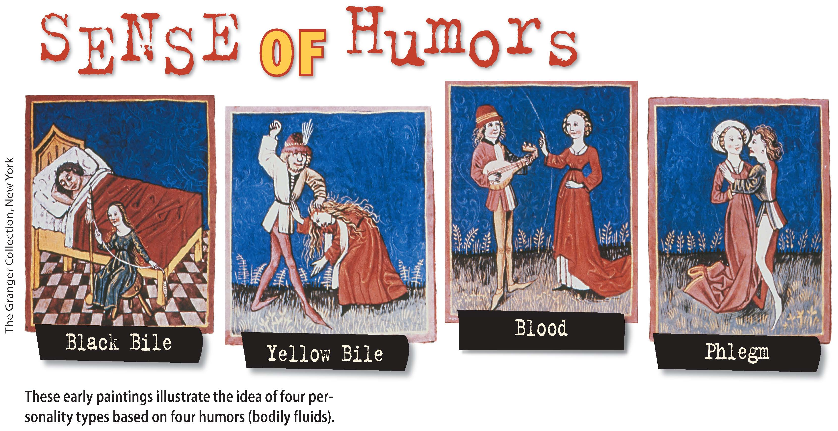
Why are people the way they are?

Slide 32
Objective Tests
A person’s personality consists of his or her characteristics, habits, preferences, and moods. Psychologists sometimes use tests to determine psychological problems. Objective tests present test takers with a standardized group of test items in the form of a questionnaire.
Minnesota Multiphasic Personality Inventory (MMPI)
California Psychological Inventory (CPI)
Most widely used test
Consists of true/false questions
Can determine psychological problems, as well as tendencies
Scores are placed on a scale that helps determine problems
Designed to test “normal” personality traits
CPI more reliable than MMPI
Seems to be a better indicator of success, leadership, and reactions to stress
Notes:
–

Slide 33
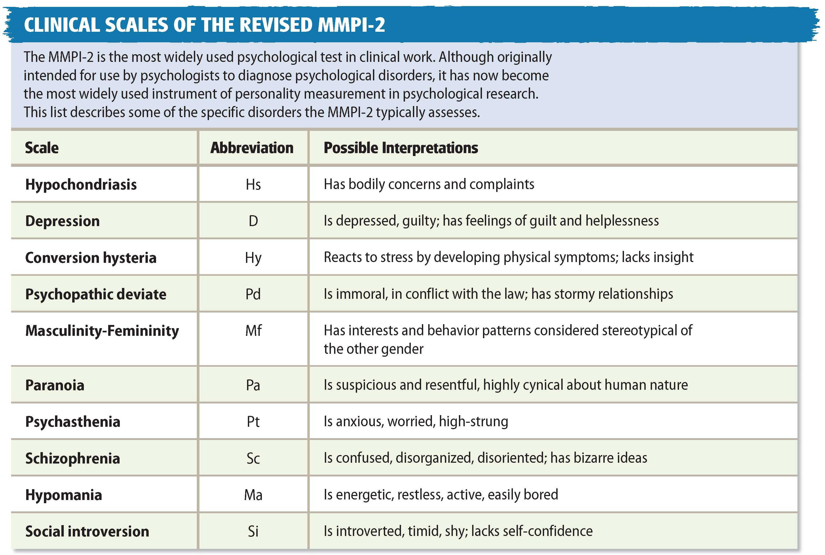

Slide 34
Reading Check
Find the Main Idea
What are two examples of objective tests?
Answer: the MMPI-2 and the CPI

Slide 35
Projective Tests
Projective tests: test takers are asked to report what the stimuli represent to them
Open-ended format: no specified answers
Rorschach Inkblot Test
Thematic Apperception Test
Test takers look at an inkblot and tell the psychologist what it looks like to them.
Attempts to standardize the Rorschach conclude that four factors influence answers: location, determinants, content, and form.
Test takers are given a card with an illustration, and are directed to tell a story about what is occurring in the picture.
The test taker’s answer can reveal his or her needs or values.
Notes:
–

Slide 37
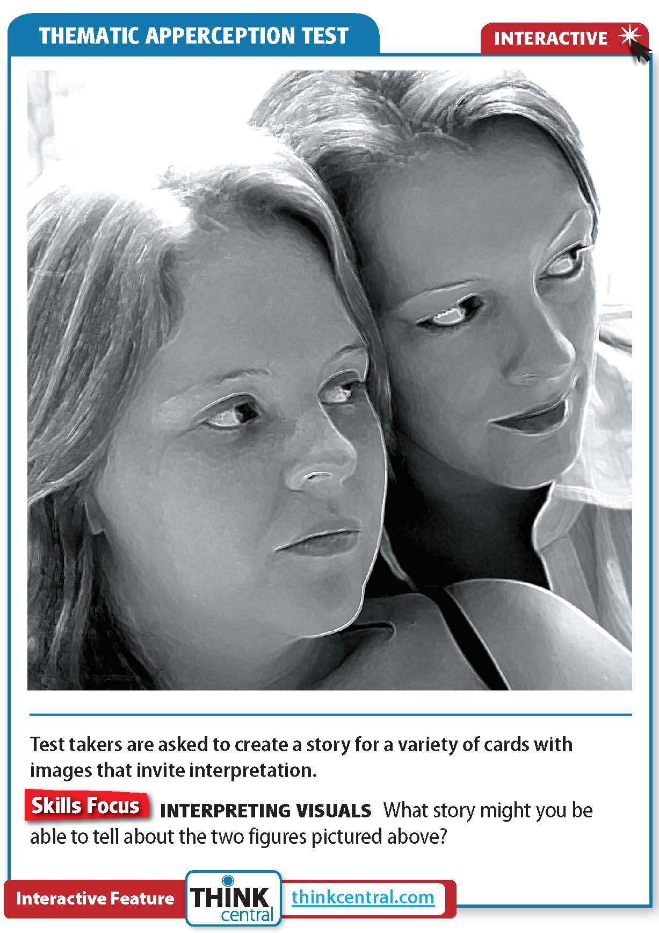
Click on the image to play the Interactive.

Slide 38
Reading Check
Summarize
What are two examples of projective tests?
Answer: the Rorschach inkblot test and the Thematic Apperception Test

Slide 39
Section 4 at a Glance
Taking Tests
Students can follow some general tips to improve their performance on tests.
Multiple-choice questions are common on standardized tests such as the SATs.
There are ways for students to reduce test anxiety.

Slide 40
Taking Tests
Main Idea
Taking tests can be a nerve-racking experience, but there are ways to improve your performance.
Reading Focus
What are some tips for taking tests?
Multiple-choice questions are found on what sorts of tests?
What are some warning flags in true-false questions?
What strategies can you use for short-answer and essay questions?
How can you reduce test anxiety?

Slide 41
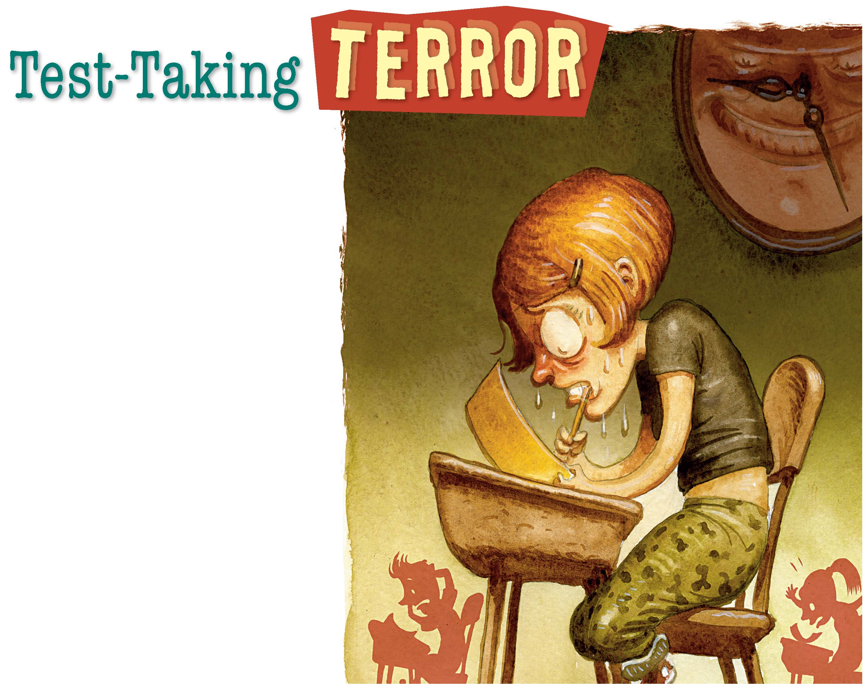
Why are my palms sweating?

Slide 42
Tips for Taking Tests
Some students know the material being tested, yet still perform poorly on tests.
You might think you have little control over the tests you take, but there are many things students can do to take charge of tests.
Gather Information
Learn where and when the next test will be given.
Find out what kinds of questions will be asked.
Ask previous students where questions come from.
Practice
Plan regular study periods.
Create a study group.
Define key terms and outline essay questions.
Answer all questions, even those not assigned.
Be Test-Wise
Read and follow the directions.
Bring the right materials to class.
Have working pens and paper.
Ask teachers if you can use a dictionary or calculator.

Slide 43
Reading Check
Recall
What is an example of being test-wise?
Answer: read directions, follow them closely; bring right materials to class; ask about using helpful tools

Slide 44
Multiple-Choice Questions
Multiple-choice questions encourage students to focus on the right answer (and reject the wrong ones), and they can be graded quickly and objectively.
Hints:
Try to answer before you look at the choices.
Consider every possible choice.
Look for answers that are opposite: one of them is likely to be the answer.
Look for the best choice listed.
Mark difficult questions so that you can come back to them later.
Guess only when the odds of gaining points outweigh the odds of losing points.
Change your answer if you think you’ve made a mistake.

Slide 45
Reading Check
Analyze
Why should you look for answers that are opposites?
Answer: One of the two is likely to be correct.

Slide 46
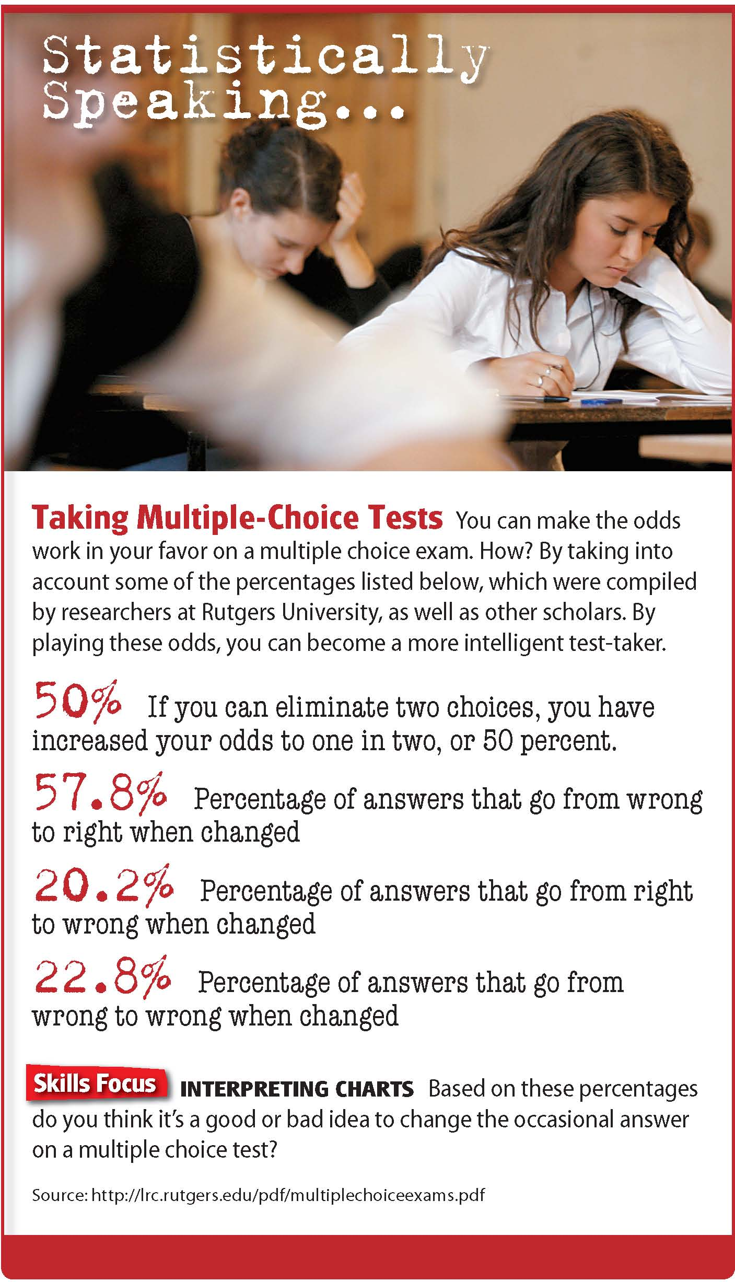

Slide 47
True-False Questions
True-false questions can be tricky.
Hints:
For the item to be true, every part of it must be true.
Be wary of items that use absolutes such as all, always, or never.
Items that provide more information and are longer than others tend to be true.

Slide 48
Reading Check
Analyze
What are the odds of answering a true-false question correctly?
Answer: 50 percent

Slide 49
Short-Answer and Essay Questions
Short-answer items ask the test taker to give a brief response to a question.
Hints:
Answer in brief but complete sentences.
Include significant terms in your answer.
Avoid simply restating the question in different terms or making circular arguments.
Use detail if time and space allow.
Essay question hints:
Make certain you understand the question.
Make a quick outline before beginning to write.
Express your strongest ideas first.

Slide 50
Reading Check
Summarize
What is the first step in answering an essay question?
Answer: making certain you understand the question

Slide 51
Test Anxiety
Some students experience feelings of dread and foreboding before and during exams.
Some test-anxious students allow negative thoughts and self-doubts to distract them from the test.
Be Prepared
Review the material beforehand.
Avoid cramming, or preparing hastily for an exam.
Plan regular study sessions.
Overlearn
Review materials even after you think you have mastered them.
Think Helpful Thoughts
Cognitive restructuring: writing down negative thoughts and replacing them with positive thoughts.

Slide 52
Reading Check
Summarize
What is cognitive restructuring?
Answer: consciously changing the thoughts one has in a given situation

Slide 53
Lab: Applying What You’ve Learned
Writing a Personality Quiz
What do your answers to questions on a personality quiz say about you? Can your answers reveal your gender?
1. Introduction
2. Writing the Quiz
In this lab, you will simulate a personality quiz by writing test items for such a test.
The class will work in groups divided by gender to write questions.
Review the questions to determine if they are appropriate and valid.
Choose the top five questions.
List why each one is valid.
Notes:
–

Slide 54
Lab (cont'd.)
3. Class Presentation
4. Written Presentation
After participating in the group presentation, each individual should write a couple of paragraphs describing what he or she has learned.
First, answer the top five questions. Then discuss how the questions were created.
Each group should present their questions to the class.
Explain how they came up with the questions.
Explain how the questions reveal personality, especially gender traits.
Notes:
–

Slide 55
Lab (cont'd.)
5. Discussion
As a class, discuss the following:
How successful was the class at writing quiz items?
Were some items particularly easy to write? Why?
Were some items particularly difficult? Why?
What kinds of questions are most effective? Why?
Notes:
–

Slide 56
