Slide 1
Vietnam images
PROVIDE A CAPTION TO EACH PHOTO AND ARRANGE THEM IN THE ORDER YOU FEEL IS MOST APPROPRIATE TO TELL THE STORY OF THE VIETNAM WAR.

Slide 2
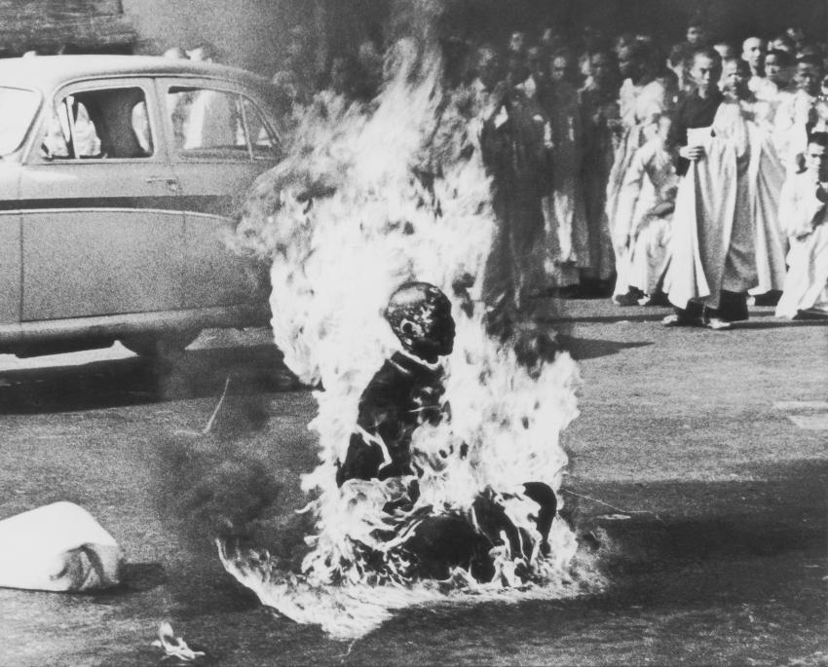
1

Slide 3
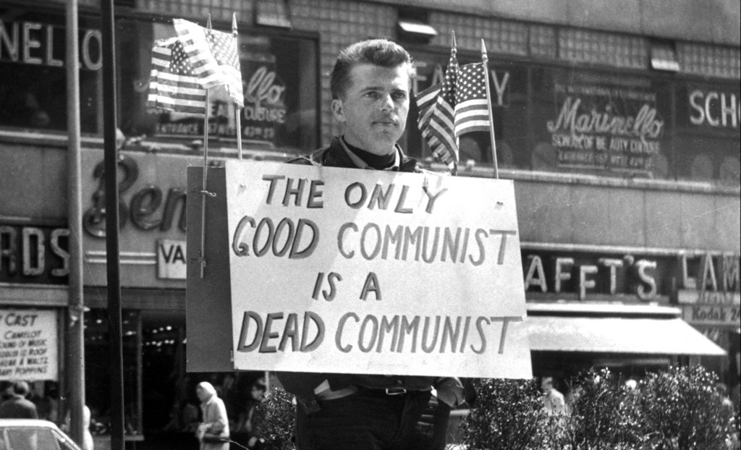
2

Slide 4
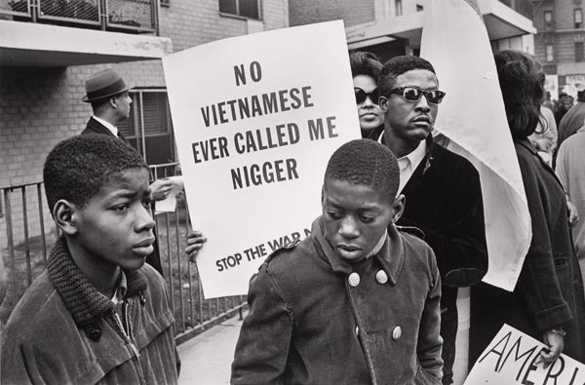
3

Slide 5
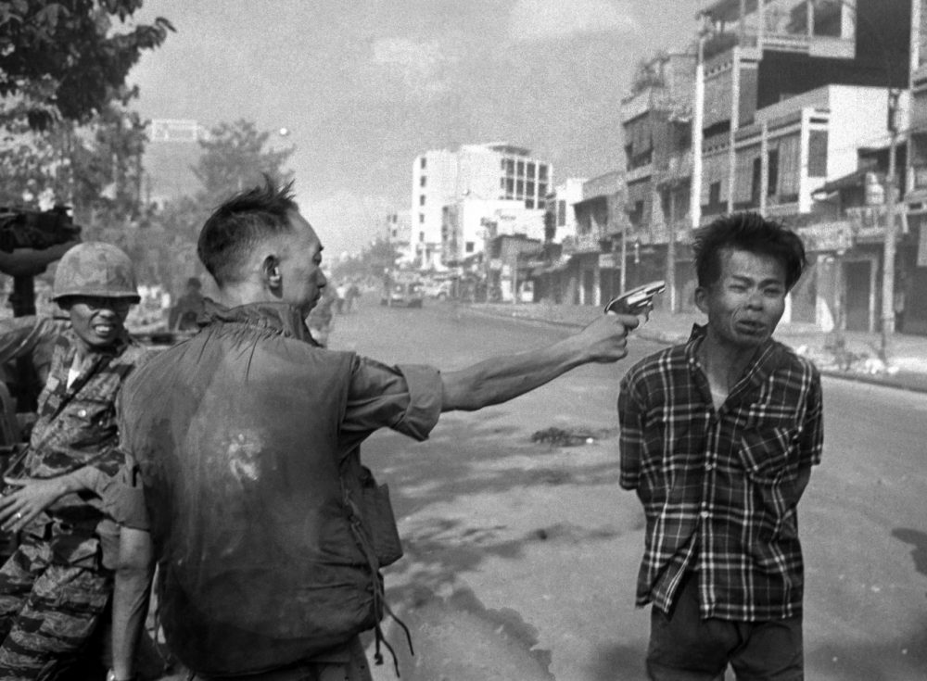
4

Slide 6
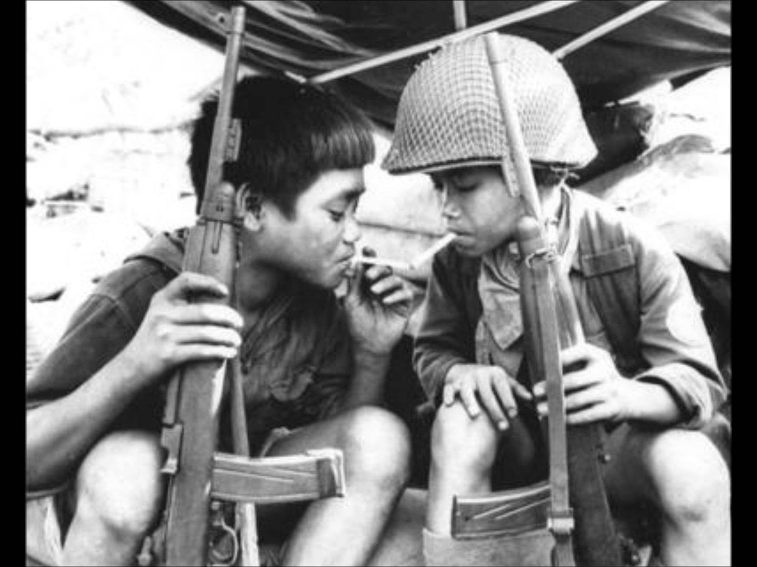
5

Slide 7
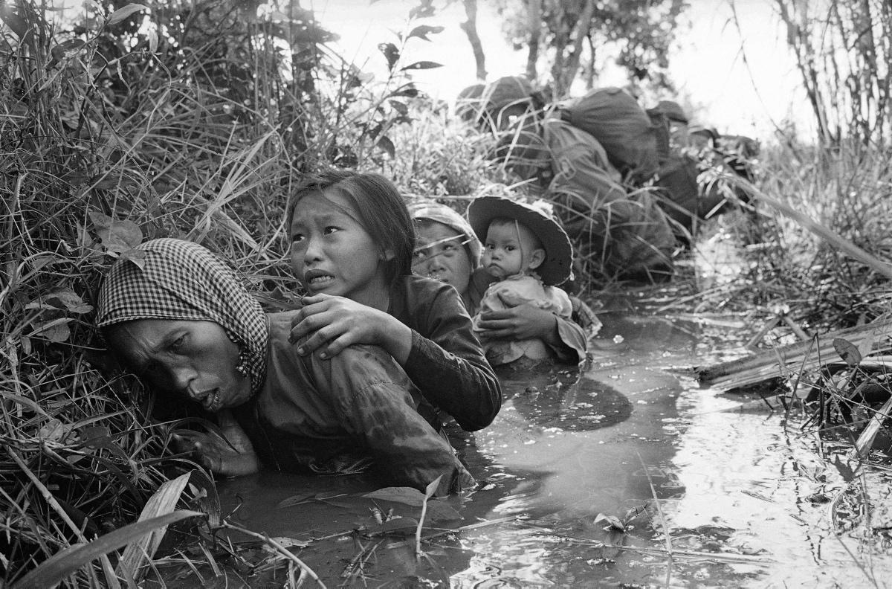
6

Slide 8
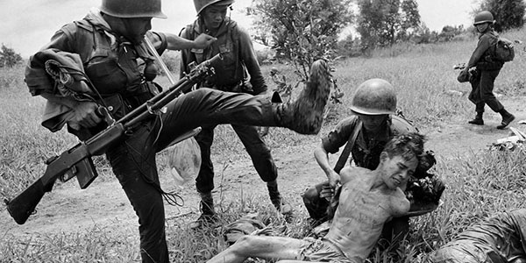
7

Slide 9
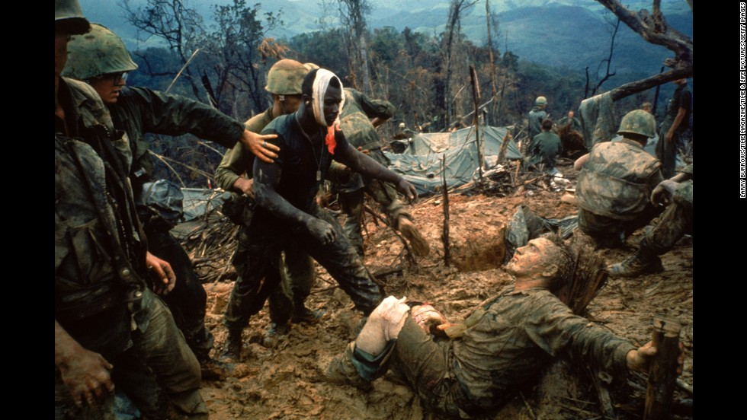
8

Slide 10
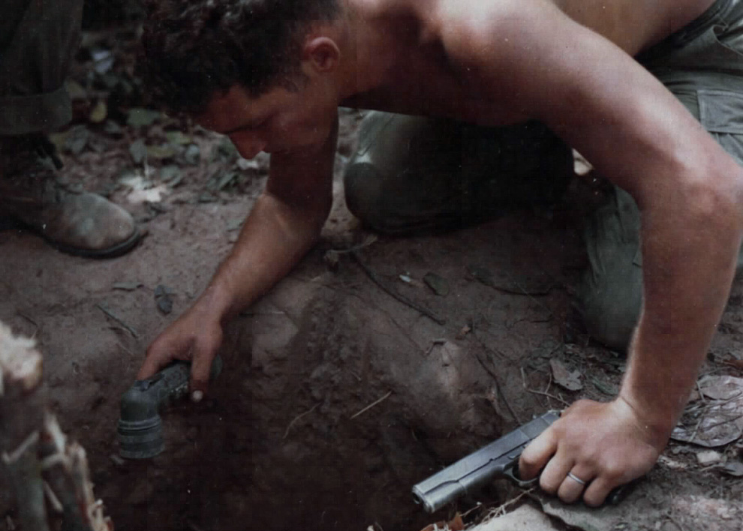
9

Slide 11
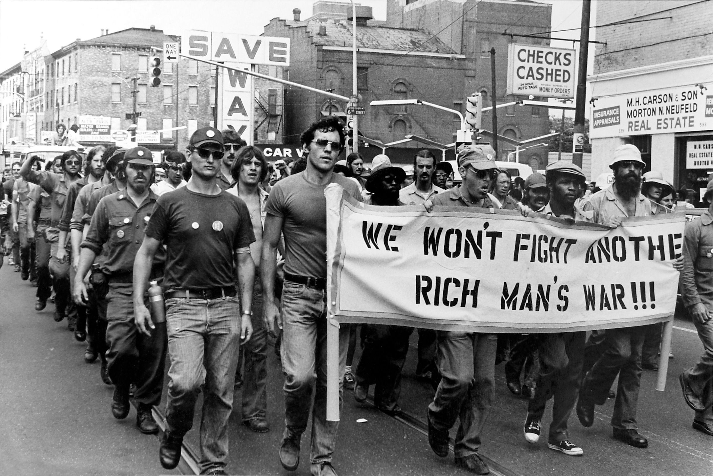
10

Slide 12
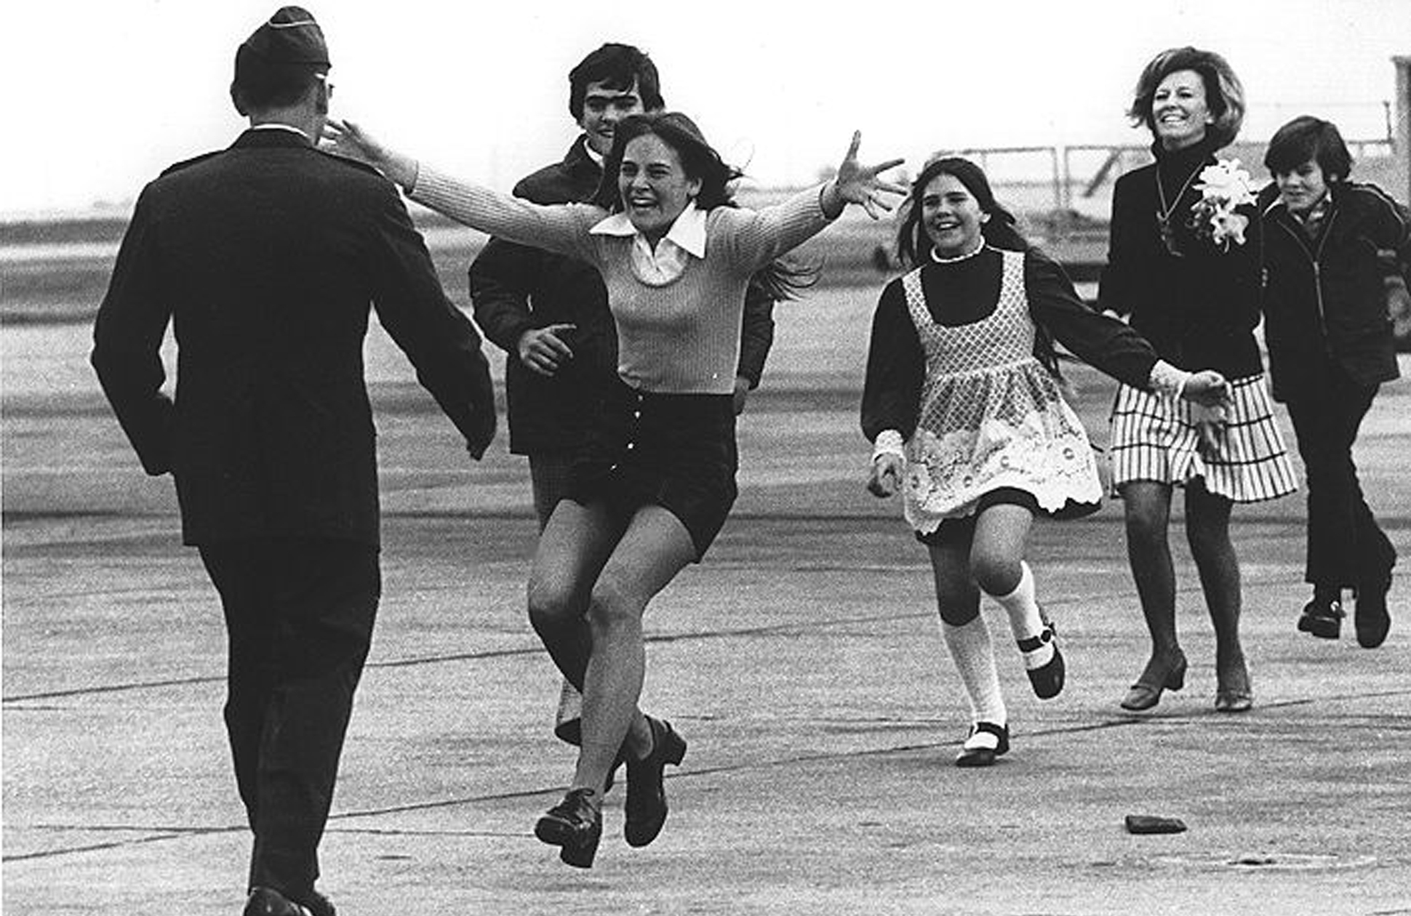
11

Slide 13
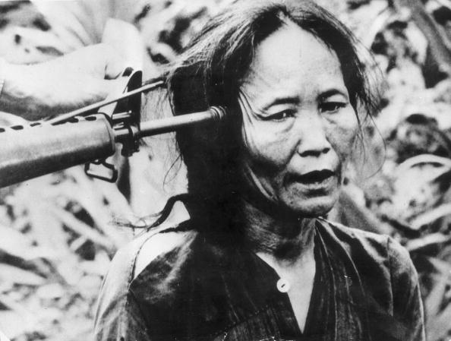
12

Slide 14
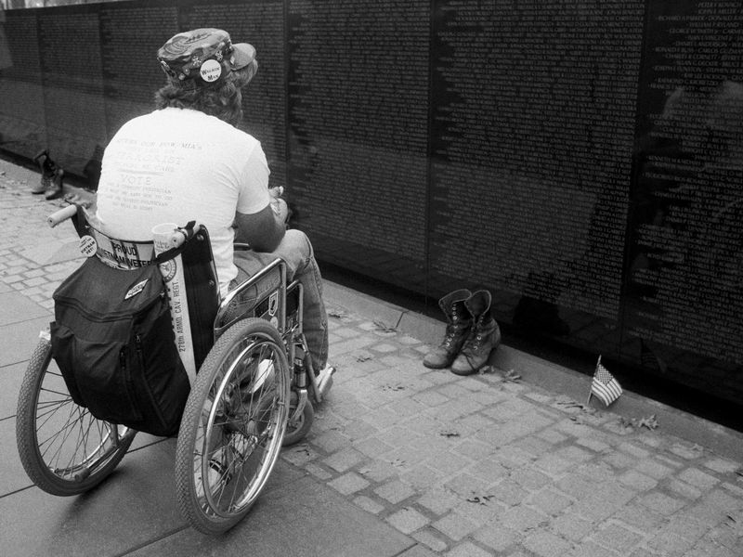
13

Slide 15
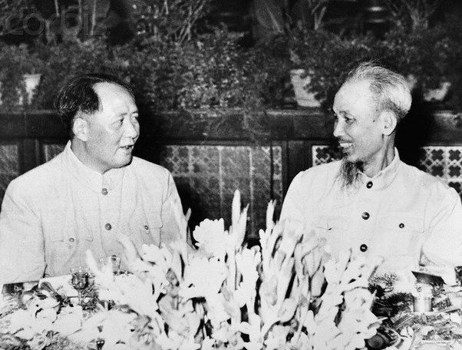
14

Slide 16
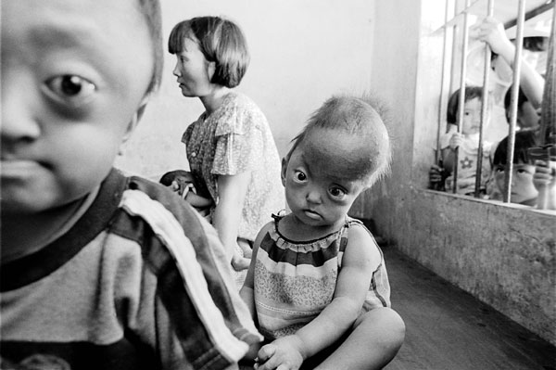
15

Slide 17
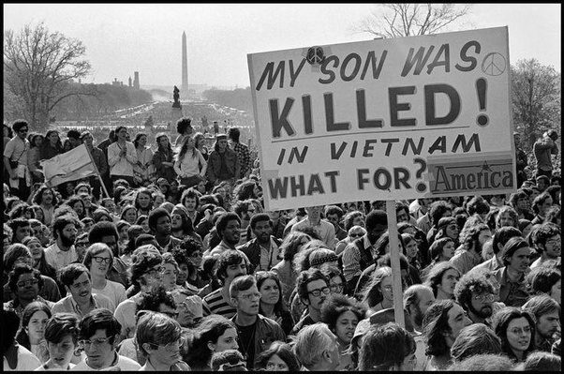
16

Slide 18
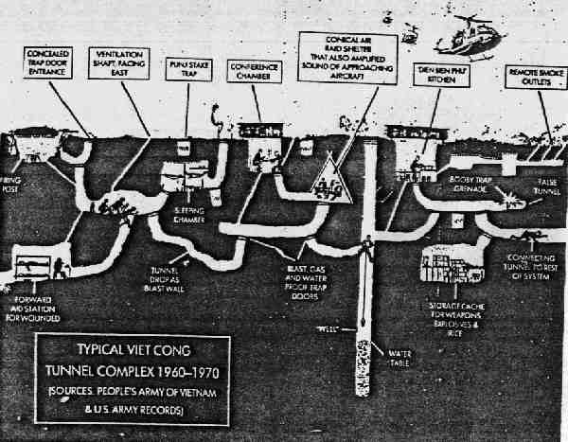
17

Slide 19
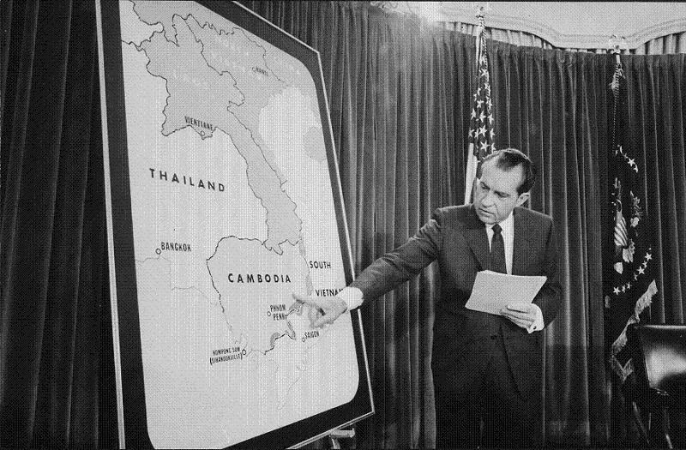
18

Slide 20
What themes emerged from these images?
*
*
*
*
*
*

Slide 21
Now choose one
IF YOU HAD TO PICK ONE OF THESE IMAGES TO BEST REPRESENT THE VIETNAM WAR, WHICH ONE WOULD YOU CHOOSE AND WHY?

