Slide 1
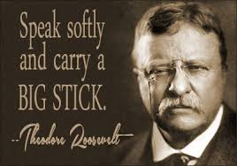
Theodore “Teddy” Roosevelt
President of the United States 1901 - 1909
Served in the Spanish-American War. Famous for victory at San Juan Hill.
Strong supporter of the Navy. Created the “Great White Fleet” when president.
Made a deal to build the Panama Canal
“Square Deal”
New York City Police Commissioner 1895
Governor of New York 1899-1900
Vice President 1900-1901
Survived an assassination attempt
Nearly blind in one eye due to an old boxing injury
Won the Nobel Peace Prize 1906
Saved the game of football
Mr. Marsico’s favorite president

