Slide 1
Class Notes: Atomic Models

Slide 2
Democritus= 400 B.C. – said the world was made of two things: empty space and tiny particles called “atoms”
--said atoms were the smallest particles of matter, and said there were different types of atoms for each material in the world

Slide 3
Atom = the smallest part of an element that still has the properties of that element
Dalton – developed Dalton’s Atomic Theory – 4 parts:
1. Elements are composed of indestructible particles called atoms

Slide 4
2. All atoms of an element are identical to each other and different from the atoms of another element
3. “Law of Multiple Proportions”: Atoms combine in whole number ratios to form compounds
(can’t have half an atom)

Slide 5
4. In chemical reactions, atoms are joined, separated, or rearranged, but never changed into different kinds of atoms

Slide 6
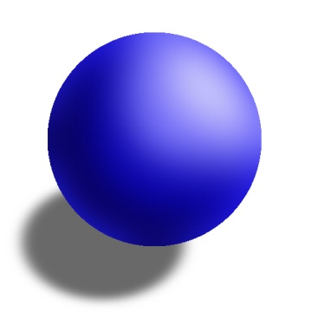

Slide 7
2. Thompson – “plum pudding” – electrons dispersed throughout a lump of protons (no neutrons)

Slide 8
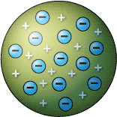

Slide 9
3. Rutherford – electrons surround a dense nucleus of protons and neutrons

Slide 10
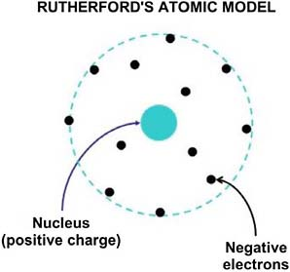

Slide 11
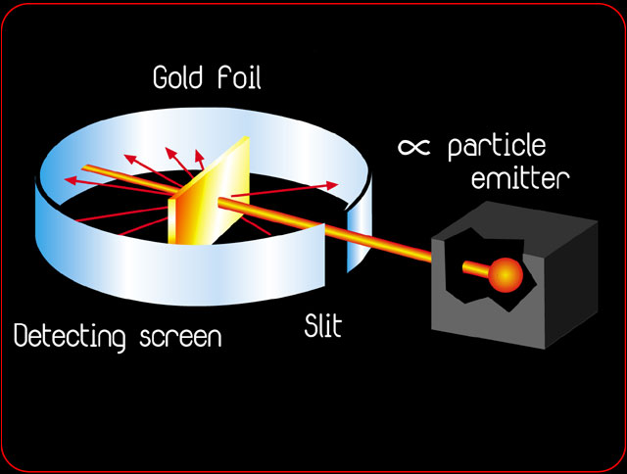
Rutherford’s Gold-Foil Experiment: gave evidence of the atomic nucleus

Slide 12
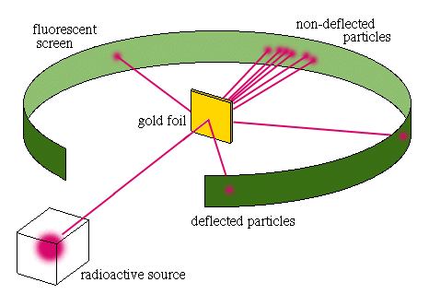

Slide 13
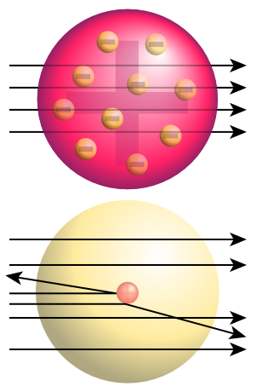

Slide 14
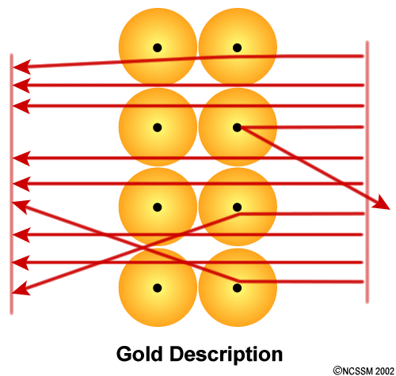

Slide 15
4. Bohr – planetary model = electrons follow fixed orbits around the nucleus with a fixed amount of energy
The energy level – a set amount of energy must be lost or gained to change levels (= ladder model)

Slide 16
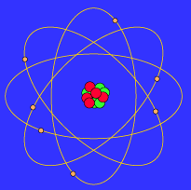

Slide 17
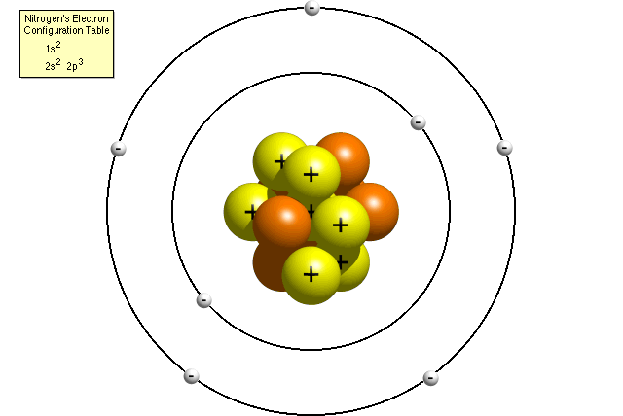

Slide 18
5. Schrodinger – the quantum mechanical model = mathematical; there is a set number of electrons, but they follow no fixed path
There is a cloud of negative charge surrounding the nucleus where the electron is probably found 90% of the time

Slide 19
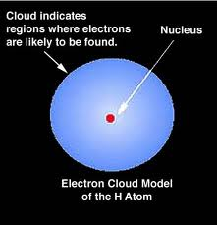

Slide 20
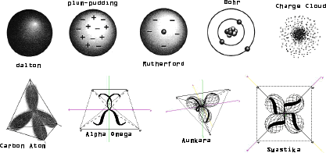

Slide 21
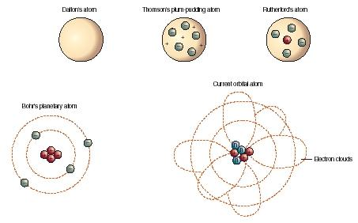

Slide 22
Class Notes: Subatomic Particles

Slide 23
3 Subatomic Particles: Protons, Neutrons, Electrons
-subatomic means they are smaller than the atom

Slide 24
Proton (p⁺)
Location – nucleus
Charge – positive 1+
Mass – 1 amu
(atomic mass unit = 1.66 x 10⁻²⁴g)

Slide 25
2. Neutron (n⁰)
Location – nucleus
Charge – zero, neutral
Mass – 1 amu

Slide 26
3. Electron (e⁻)
Location – in the electron cloud around the nucleus (in energy levels or shells)
Charge – negative 1⁻
Mass – 1/1840 amu

Slide 27
**all the mass (99.9%) is in a very small nucleus
** all the volume is in the electron cloud
**most of the atom is empty space!

Slide 28
Atomic Number = the number of protons in the nucleus
= the large number on the periodic table
= the number of electrons in a neutral atom
-every element has a different atomic number
-the number of protons determines what the element is

Slide 29
Mass Number = protons + neutrons
=atomic number + neutrons
# neutrons = mass number – atomic number
# protons = mass number – neutrons

Slide 30
Class Notes: Isotopes and Atomic Mass

Slide 31
Dalton said: “all atoms of an element are identical…”
Not true!
Even though atoms of an element have the same number of protons, the numbers of neutrons can be different

Slide 32
Isotope = atoms with the same numbers of protons, but different numbers of neutrons
-this means - different mass numbers
-also - different atomic masses (number of amu’s)
-chemically alike because the numbers of p+ and e- are the same

Slide 33
mass #
atomic #
Symbols for isotopes:
Calculate
The number of protons and neutrons and electrons for:
Carbon-12 Carbon-13 Carbon-14
11 10
5 5
B B
p⁺ 6 p⁺ 6 p⁺ 6
n⁰ 6 n⁰ 7 n⁰ 8
e⁻ 6 e⁻ 6 e⁻ 6

Slide 34
Atomic mass = weighted average of the masses of an atom’s isotopes
-weighted means relative numbers or % of each
*this is why the atomic mass of an element is not a whole number

Slide 35
To calculate average atomic mass:
(Mass of isotope₁ x %) /100 = amu₁
(Mass of isotope₂ x %) / 100 = amu₂
amu₁ + amu₂ = average atomic mass
*found under atomic symbol in the periodic table

