Slide 2
The Great War: World War I The War to End All Wars
“The lamps have gone out all over Europe and we shall not see them lit again in our lifetime.”
- British Prime Minister Lord Grey

Slide 3
Long Term Causes of World War I
Nationalism
Militarism
Imperialism
Peace time alliances
Long-standing ethnic grudges

Slide 4
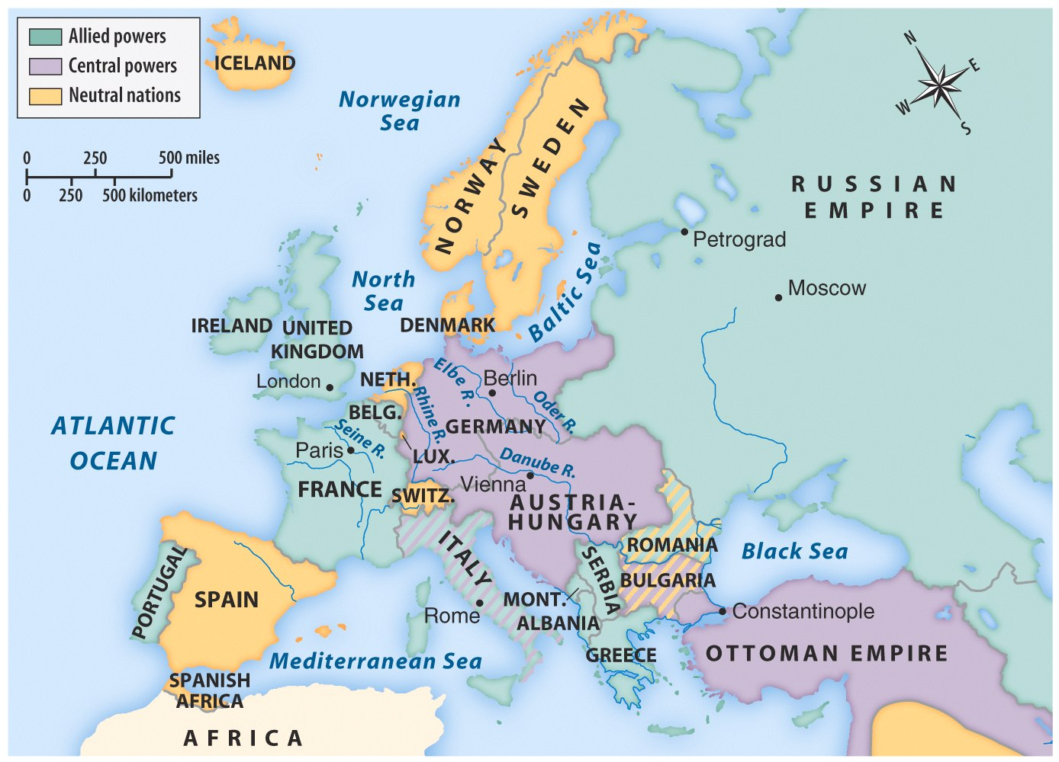
Map 22.1 European Alliances in 1914 (p. 638)
Notes:
Map 22.1 European Alliances in 1914 (p. 638) ©Bedford St. Martin’s

Slide 5
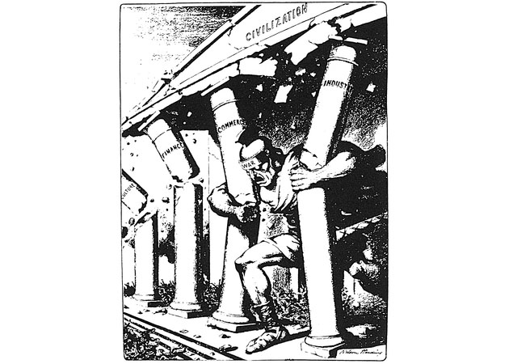
25_8.jpg
Notes:
In this cartoon, the Samson-like War pulls down the temple of Civilization

Slide 6
Short term timeline leading to World War I
June 28 - Assassination of Austro-Hungarian Archduke and heir, Francis Ferdinand (and Sophie, his wife)
July 23 - Austria issues ultimatum to Serbia and invades on July 27
July 28-30 - Russians mobilize as Serbia’s ally
August 1 - Germany, Austria-Hungary’s ally, declares war on Russia (and Serbia)
August 3 - Germany declares war on France (allied with Russia) and invades Belgium en route to Paris, France
August 4 - Great Britain, France’s ally, declares war on Germany

Slide 7
The sides formed
Triple Entente (Allies)
France
Great Britain
Italy
Russia (1917 exit)
United States (1917 entry)
Central Powers
Germany
Austria-Hungary (empire)
Ottoman Empire
Bulgaria

Slide 8
United States remains neutral
Woodrow Wilson: “Remain neutral in thought as well as deed”
To protect international trading rights
“He kept us out of war.” 1916 presidential campaign slogan

Slide 9
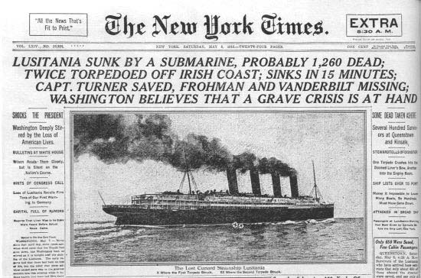
U.S. Neutrality under fire
British blockade of North Sea
Germans engage in submarine (u-boat) warfare
Lusitania crisis (May 1915) British liner sunk by German U-boats
Arabic and Sussex sinkings (Germans issue Sussex pledge)
Economic ties with Britain and France - war time trade and US financing of allied war effort

Slide 10
Shifting US public opinion
Reports of German cruelty (Huns) reinforced by Lusitania
Ethnic loyalties
Native born Americans (not Indians) favored Britain and French victory
British War Propaganda
Pro-War politicians (TR)

Slide 11
More Propaganda

Slide 12
Preparedness
Greater $ for military spending necessary
National Security League
National Defense Act: June 1916
Midwest and Western Americans opposed to preparedness (Populists, Progressives, Socialists)

Slide 13
Election of 1916
“He Kept us out of War”
Peace efforts had failed
Wilson narrowly won
January 1917, “Peace without Victory” Speech
April 1917, Wilson asked for declaration of war.

Slide 14
From Neutrality to War
Zimmermann Telegram (1917)
Russian Revolution (1917)
Unrestricted Submarine Warfare
“The World Must be made safe for Democracy” (Progressive crusade)

Slide 15
Mobilization in the USA
War Industries Board (Bernard Baruch) coordinated production and price controls
Food Administration (Herbert Hoover) voluntary efforts to conserve food for soldiers
Financing - Liberty Bonds

Slide 16
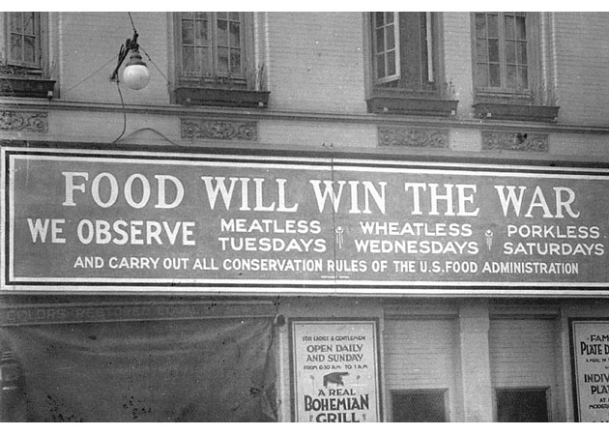
25_10.jpg
Notes:
Food Will Win the War

Slide 17
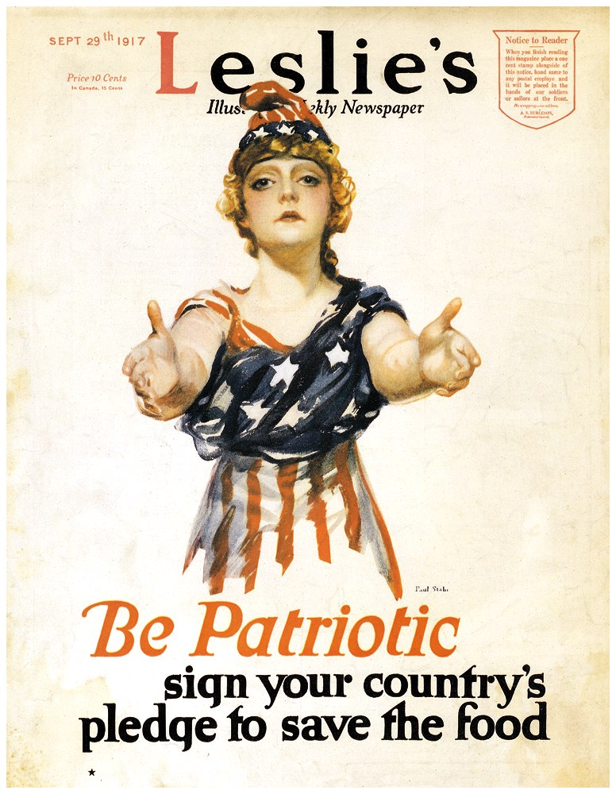
America and the War Effort (p. 636)
Notes:
America and the War Effort (p. 636) ©Bedford St. Martin’s

Slide 18
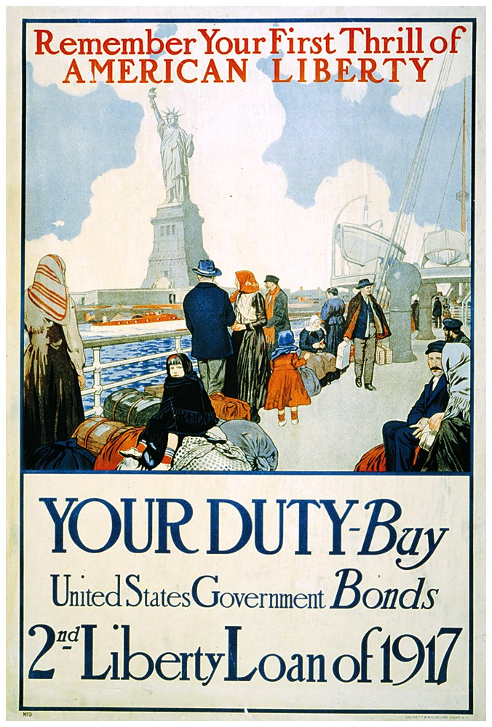
“Remember Your First Thrill of American Liberty” (p. 649)
Notes:
“Remember Your First Thrill of American Liberty” (p. 649) ©Bedford St. Martin’s

Slide 19
Wartime Public Opinion
Committee on Public Information - propaganda agency in America (George Creel) “do your bit” for the war
Hate the Hun, Liberty Cabbage, Salisbury Steak, Can the Kaiser

Slide 20
Wartime Civil Liberties
Espionage and Sedition Acts (1917-18) jail sentences for those critical of disloyal or abusive remarks toward US war effort
Schenck v. United States (1919) “clear and present danger” - free speech could be limited

Slide 21
The Armed Forces
Selective Service Act (1917) draft: 2.8 million draftees, 2.9 million volunteers
Eventually 2 million were sent to Europe
Blacks - 400,000 served, few officers
Blacks hoped for service abroad = equal rights at home (not so)

Slide 22
American Society
Women took mens jobs while men were “Over There” led to Nineteenth Amendment
Mexicans - left Mexico (upheaval and revolution) and took jobs in American West
Blacks - Great Migration to northern cities for job opportunities and to escape poverty

Slide 23
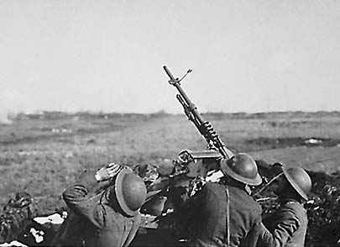
Fighting the War
New style of warfare: mechanized
Machine guns
tanks
long-range, heavy artillery
poison gas (various types)
Trench warfare (not entirely new)
“No-Man’s Land”
Hand grenades

Slide 24
Other factors after US entry
Russian revolution and withdrawal (Treaty of Brest-Litovsk) allowed Germany to focus on Western front entirely
Naval shipping losses = huge. Led to “Convoy System” and record ship construction

Slide 25
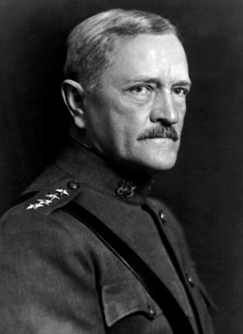
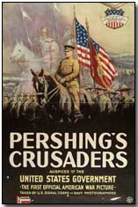
Pershing’s Crusaders: The Doughboys
American Expeditionary Force (AEF)
General John J. Pershing
First major action in spring 1918

Slide 26
American Battles:1918
German Counter-offensive
Chateau-Thierry (2nd Battle of the Marne)
Belleau Wood (June 1918)
Meuse (river) - Argonnes (forest) Offensive (Fall 1918)
St. Mihiel
November 11, 1918 - Armistice (cease-fire)

Slide 27
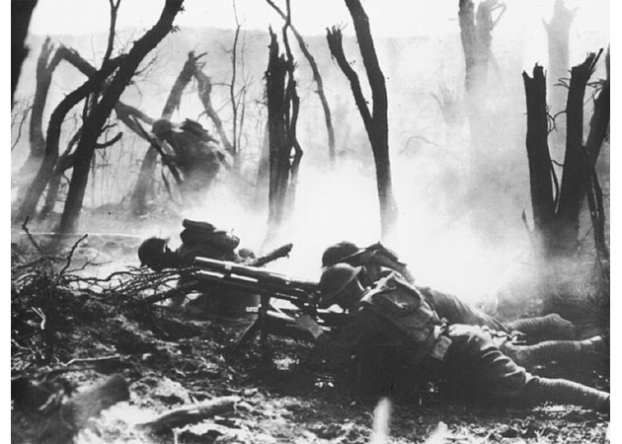
25_13.jpg
Notes:
A gun crew firing on entrenched German positions

Slide 28
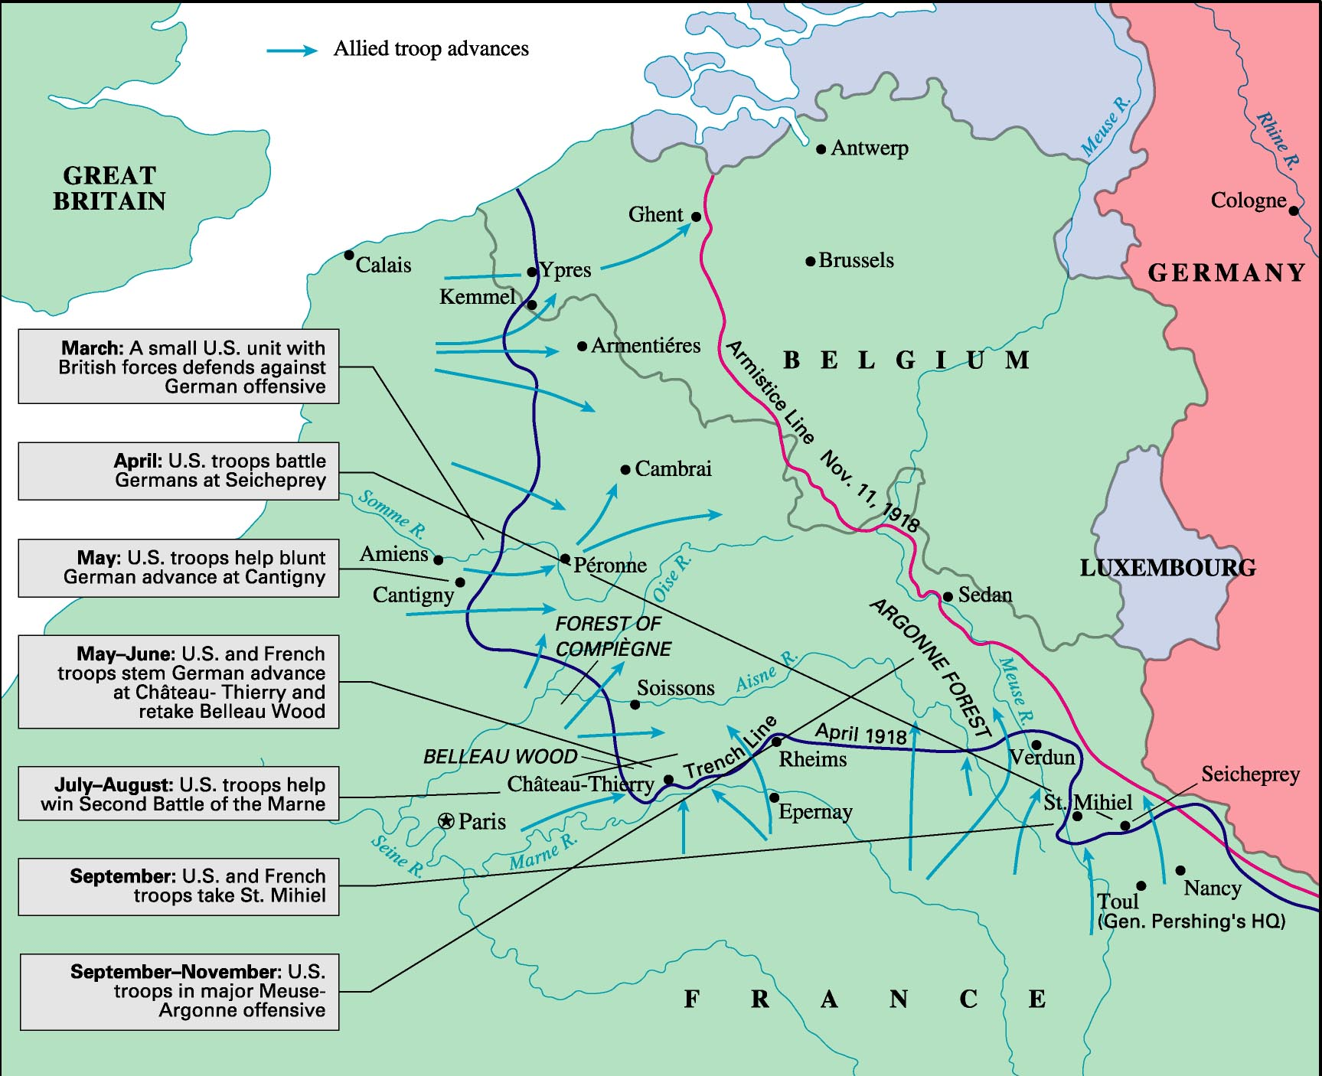
American Troops at the Western Front, 1918
Notes:
Figure 15: American Troops at the Western Front, 1918 ©Houghton Mifflin

Slide 29
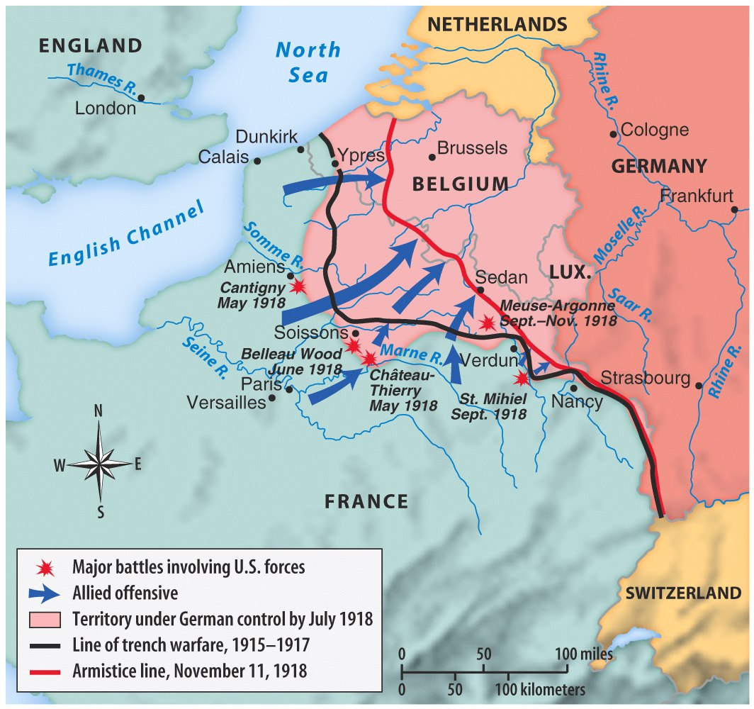
Map 22.2 U.S Participation on the Western Front, 1918 (p. 644)
Notes:
Map 22.2 U.S Participation on the Western Front, 1918 (p. 644)© Bedford St. Martin’s

Slide 30
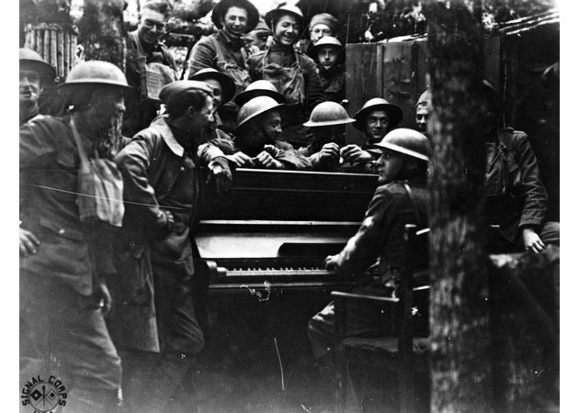
25_19.jpg
Notes:
Yanks play abandoned German piano

Slide 31
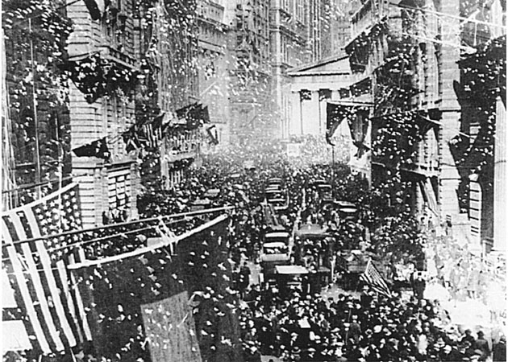
25_16.jpg
Notes:
Celebration of the Armistice, New York City

Slide 32
Casualties
50,000 Americans died in 1918 combat
1918 Influenza epidemic (worldwide) killed thousands of soldiers and millions of people around the globe
112,000 American fatalities

Slide 33
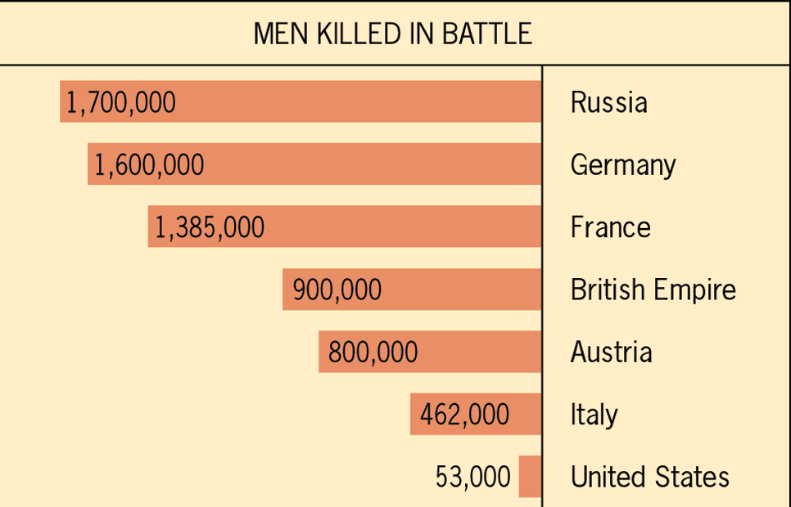
Approximate Comparative Losses in World War I
Notes:
Figure 31.1: Approximate Comparative Losses in World War I ©Houghton Mifflin

Slide 34
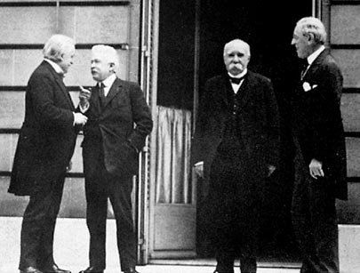
Winning the Peace: The Versailles Peace Conference
Paris and Palace of Versailles
Big Four:
Woodrow Wilson (USA)
David Lloyd George (GBR)
Georges Clemenceau (FR)
Orlando Vittorio (IT)
Russia excluded
Defeated powers humiliated
Wilson’s 14 points the major proposal

Slide 35
Wilson’s 14 Points
To “make the world safe for democracy”
#1-5 - international law recommendations
#6-13 - European boundary restructure
#14 - League of Nations

Slide 36
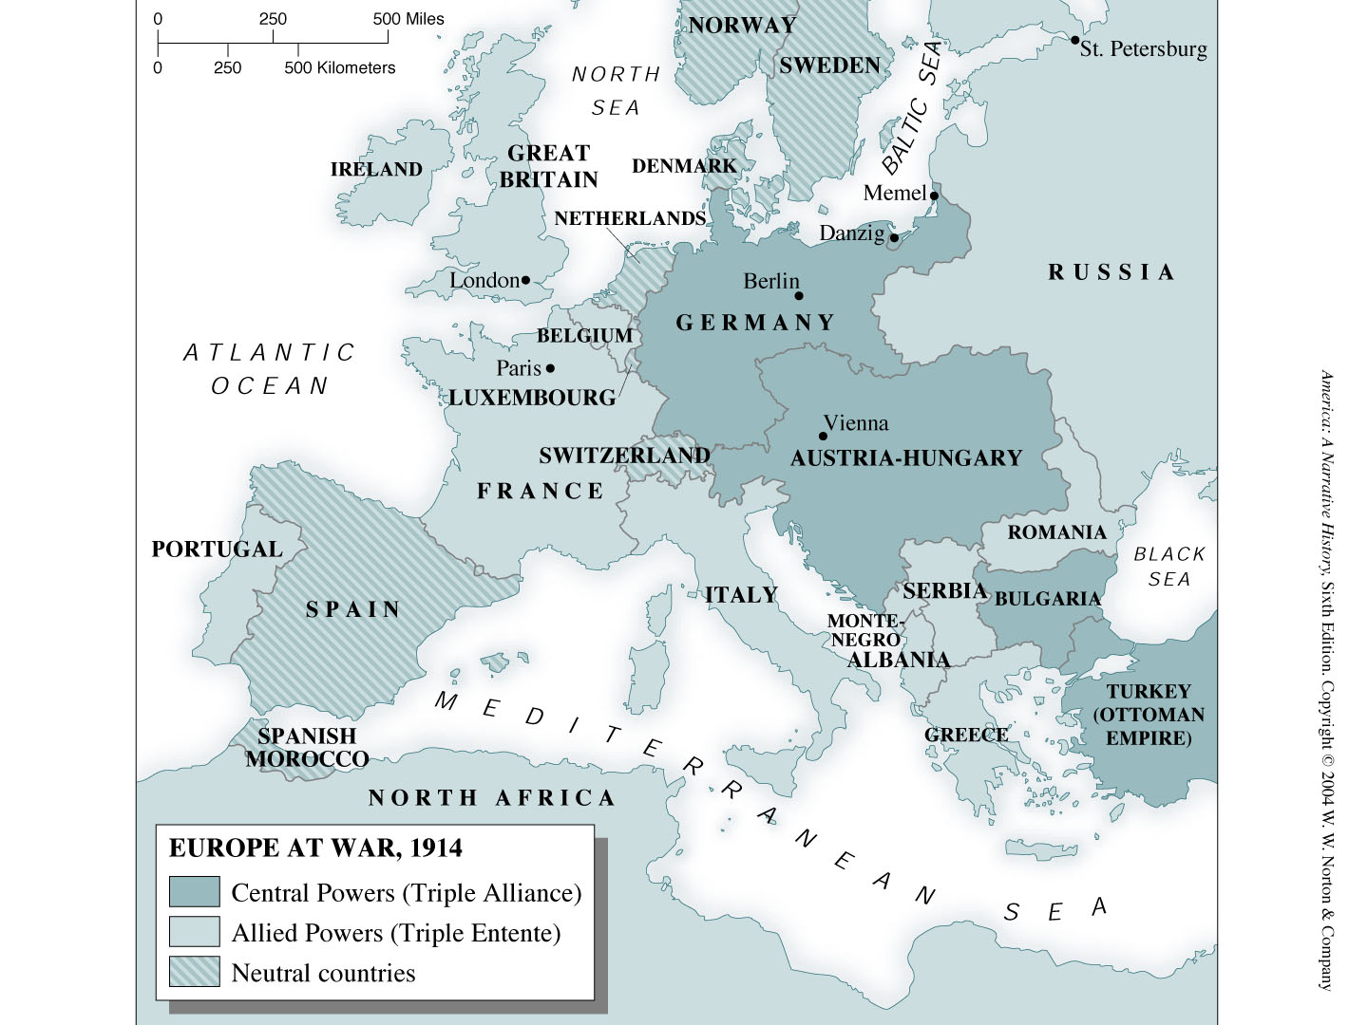
page1012.jpg
Notes:
Map: Europe at War, 1914

Slide 37
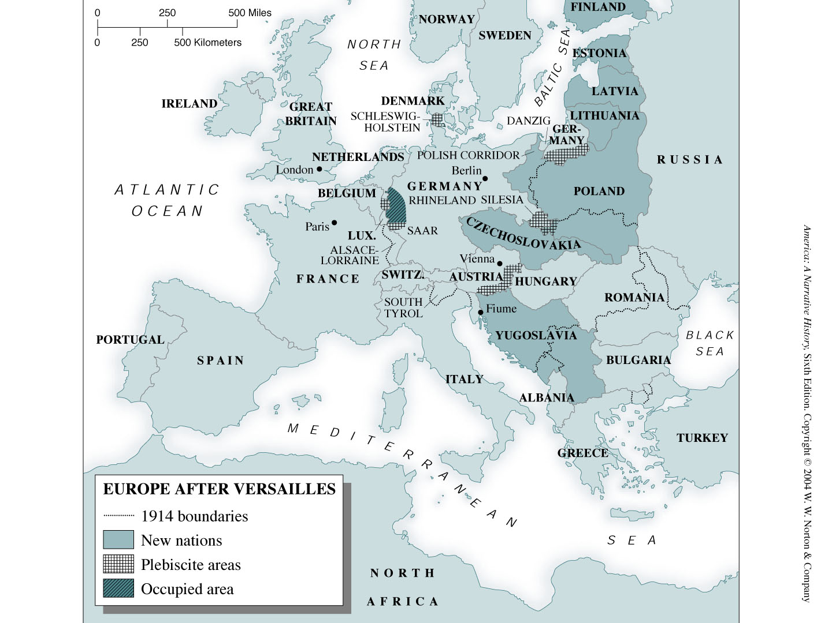
page1039.jpg
Notes:
Map: Europe after Versailles

Slide 38
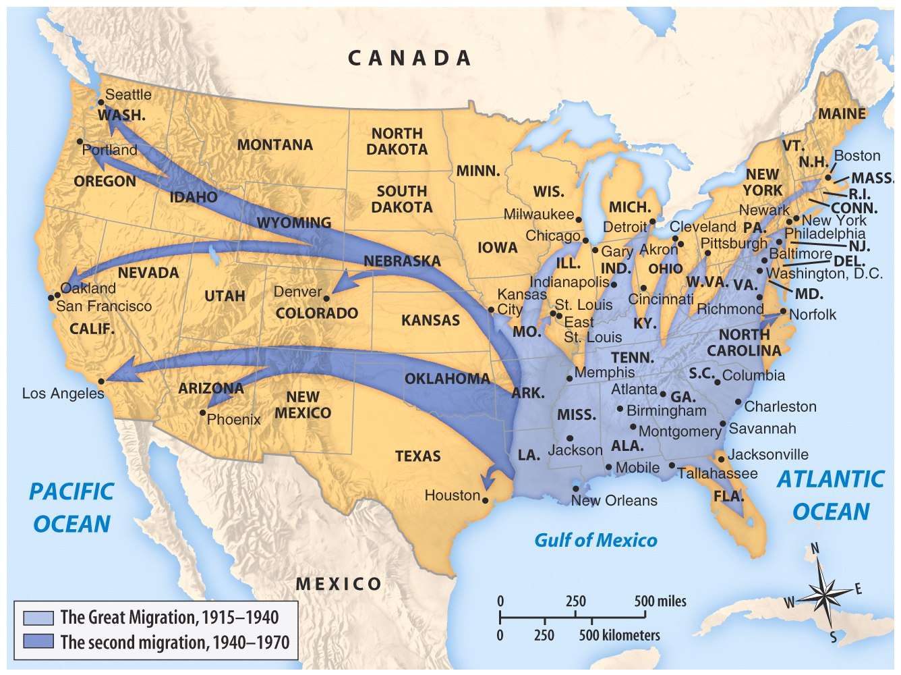
Map 22.3 The Great Migration and Beyond (p. 650)

