Slide 1

MC 3: Unit 3, Era 5 Introductory PowerPoint
The Emergence of the First Global Age
1400 – 1800 C.E.

Slide 2


The Great Global Convergence
The Great Global Convergence
Welcome to
Unit 3!
Big Era 5 lasted from 1400 to 1800 CE.
Today
Era 3
Era 4
Era 5
Era 6
7
8
9

Slide 3
What was global convergence?
Converge means to come together.
Change accelerated when people, resources, and ideas from the whole world came together.
That made the world more like we know it today—more modern!
Accelerate means to speed up.

Slide 4
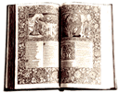

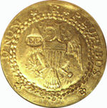

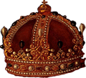
Exchanges that began in Afroeurasia continued to bring about change.
Scholars translated books, taught others, and worked to gain knowledge.
Trade introduced people to new products, increasing the demand for luxuries.
Money moved across countryside and continents in exchange for goods.
Religious ideas were hotly debated, and missionaries spread religions to new lands.
Ruling groups debated laws, and military struggles continued.

Slide 5
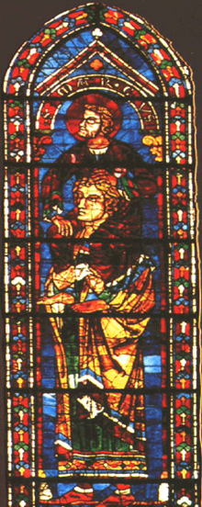
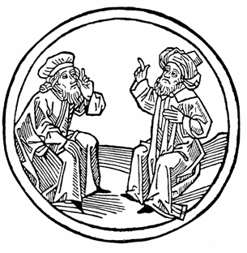
Sciences, philosophy, and the arts flowered in Europe after 1400.
“Knowledge of the Ancients” entered Europe during the 12th century. Its origins were Greek, Arabic, Chinese, and Indian. It contained all natural sciences, math, applied sciences, and philosophy.
Europeans had some catching up to do.
Scholars flocked to Spain in the 1100s to translate books from Arabic to Latin.
Scholars represented the heritage of ancient and eastern knowledge as a “giant.”

Slide 6
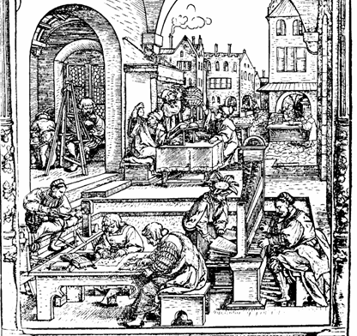
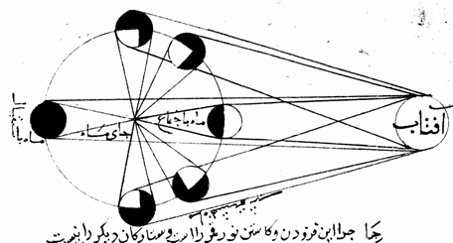
Rise of European Universities
Demand for education stimulated the growth of European universities in major towns.
These universities introduced new knowledge into the curriculum.
Notes:
Woodcut 1513: Image copyright-free from Dover publications

Slide 7
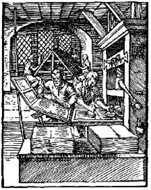
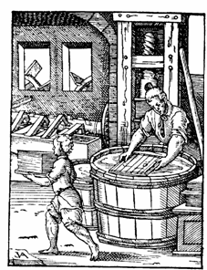
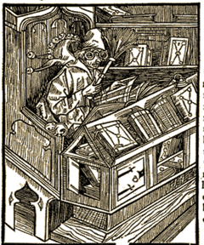
Printing technology spread from China to Europe. European and Korean artisans invented printing with moveable metal type at about the same time.
Gutenberg’s printing press with moveable type could reproduce pages quickly, adding woodcut illustrations.
By the time he invented his printing press, papermaking had spread to Europe.
In the first century of printing, thousands of books were sold and added to Europe’s growing libraries.

Slide 8
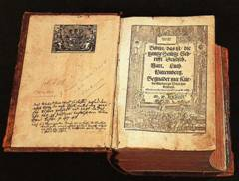
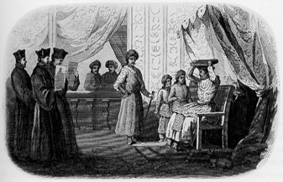
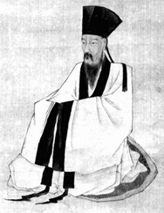

Religious institutions and ideas changed with the times
Martin Luther challenged the Catholic Church’s authority and brought on the Protestant Reformation after 1517. He translated the Bible into German.
Political leaders took sides, spawning European religious and national conflicts that lasted more than a century—to the mid-1600s.
Neo-Confucian doctrines were challenged by Wang Yangming (1472-1529) and his followers, emphasizing rational thought and reflection.
International religious institutions developed, such as Sufi orders in Islam, Catholic and Protestant missionary orders in Christianity, and Muslim reformist groups in Africa and Arabia.
Notes:
German Bible: http://en.wikipedia.org/wiki/Image:Lutherbibel.jpg
Wang Yangming: http://www.wisdomportal.com/Enlightenment/WangYangMing.html
Sufi calligraphic engraving of Jesuits at Akbar’s court: http://eapi.admu.edu.ph/jesuitica/india/photos/photo9.html

Slide 9
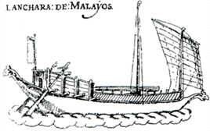
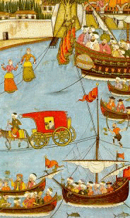
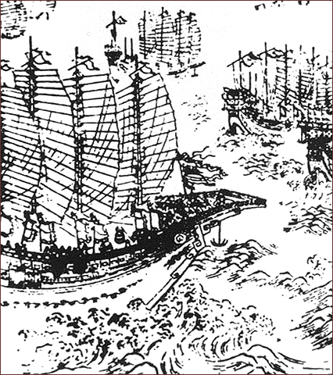
Asian commercial and political voyages on the seas continued.
Indian Ocean trade routes attracted merchants as they had for centuries.
Zheng He, Admiral of the Ming fleet, made seven voyages around the Indian Ocean.
Ottoman naval vessels patrolled the Mediterranean, the Black Sea, and the Indian Ocean.
Notes:
Malay ship: http://www.puncacipta.com/Pavilioncipta/iksas/lanchara%20-%20perahu%20besar.htm
Golden horn display:http://www.osmanli700.gen.tr/english/album/miniatures53.html, Or:http://www.osmanli700.gen.tr/english/album/miniaturesindex.html
Ming ship: http://en.wikipedia.org/wiki/Zheng_He

Slide 10
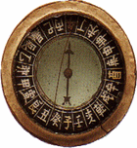
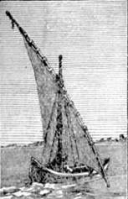
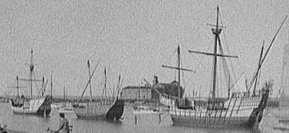
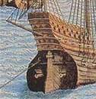

Technologies from Afroeurasia led to new European ship designs in the 15th century.
Arab lateen sail
Chinese compass
Chinese sternpost rudder
Muslim portolan charts and maps
Notes:
Ship image: Library of Congress
Lateen sail: http://www.probertencyclopaedia.com/cgi-bin/xphrase.pl?keyword=lateen
Charta Rogriana world map, Islamic, anonymous,1154:
http://gallery.sjsu.edu/cartography/maps/maps-Thumb.00002.html
http://www.probertencyclopaedia.com/cgi-bin/xphrase.pl?keyword=lateen
Exploration 40 © Kathleen Cohen 1998 xploration 40 © Kathleen Cohen 1998

Slide 11
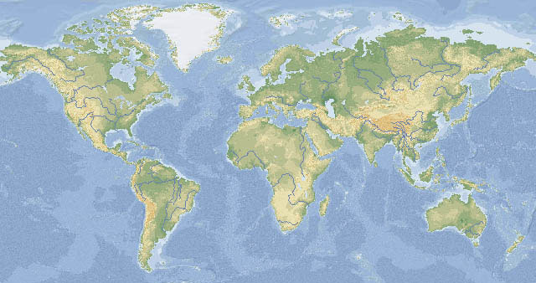
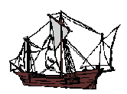
Slide 11
Vasco da Gama
1498
Columbus 1492
Magellan
1519
After 1415, European mariners made voyages across the seas toward east and west. By 1519, Spanish ships had circumnavigated the globe. Others set out in search of wealth and adventure.

Slide 12
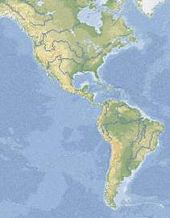

Spanish conquistadors ended Aztec and Inca rule and claimed their lands in Mesoamerica and Andean South America.
In 1492, two major empires in the Americas, the Aztecs and the Inca, ruled many people.
Aztec Empire
Mayan
States
Inca Empire

Slide 13
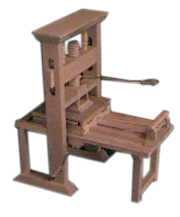
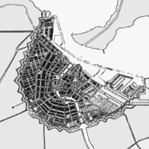

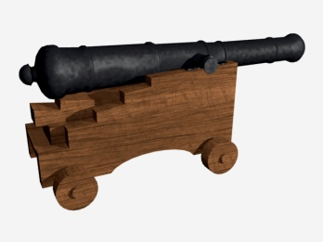

Slide 13
Global convergence sped up the dynamic of world change.
From 1400 to 1800 the rate of change accelerated more rapidly in many areas of human activity.
Population & Environment
Ideas & Inventions
Trade & Manufacturing
States & Empires

Slide 14
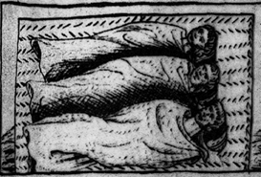
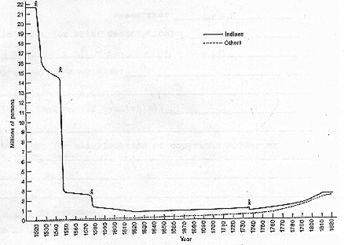

The Great
Dying
Population & Environment
The Great Dying was caused by smallpox and other disease germs carried by the conquerors. Native Americans had no immunity to these diseases.
By some accounts, the population of the Americas fell from 22 million in 1500 to less than 1 million in 1640.
Notes:
Migration CD with this image as “evidence: http://www.whc.neu.edu/prototype/01/amie1_3i.html

Slide 15
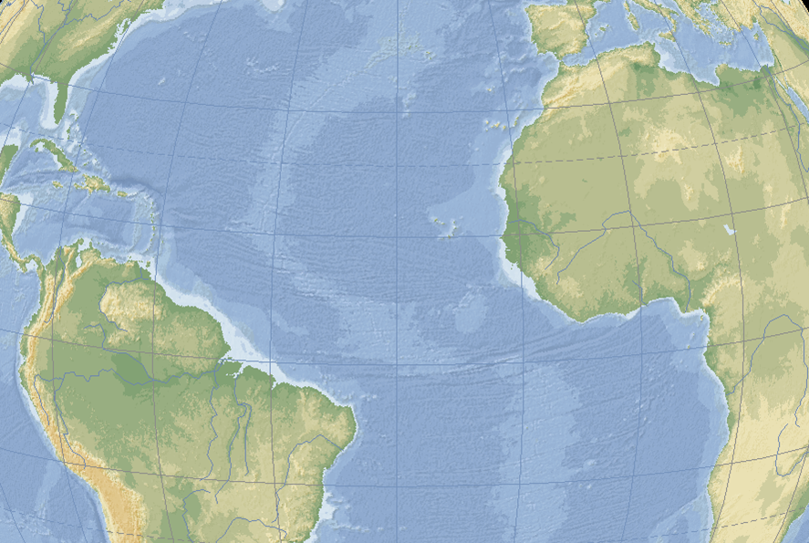
Slide 15
Europeans brought African slaves across the South Atlantic to labor in the colonies. The Atlantic slave trade grew from about 1,000 per year in the early 1500s to nearly 80,000 per year at the end of the 1700s.
Population & Environment

Slide 16
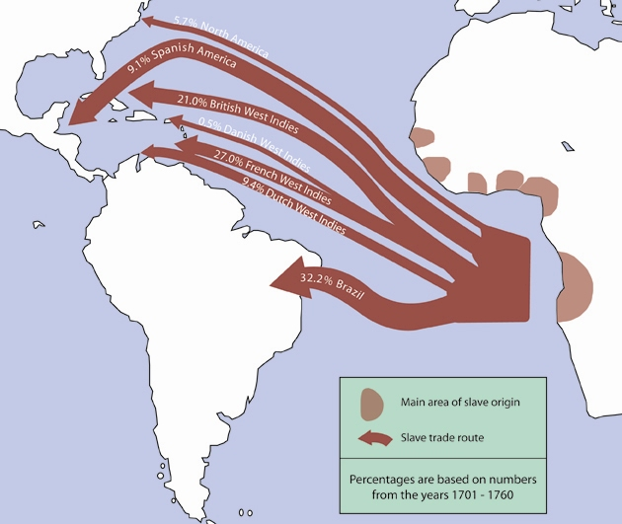
Slide 16
Notes:
Map by Robert Prom
Adapted from maps in Philip D. Curtin, The Atlantic Slave Trade: A Census (Madison, WI: University of Wisconsin Press, 1969)

Slide 17
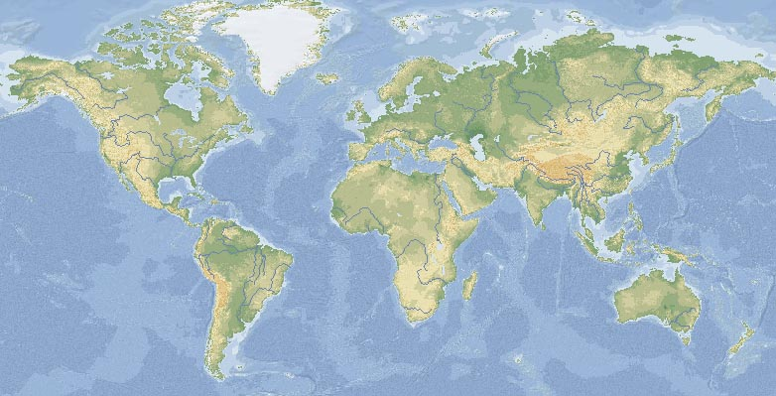
























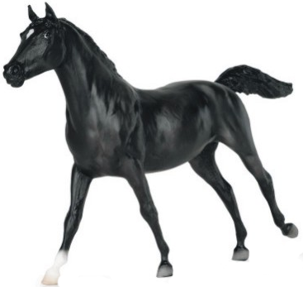

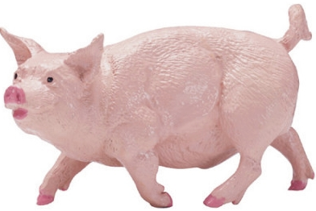
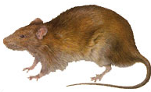
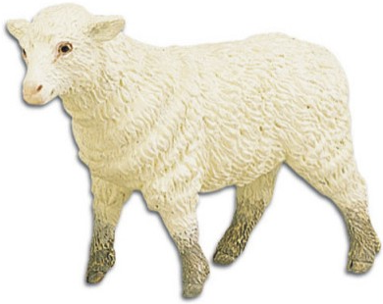
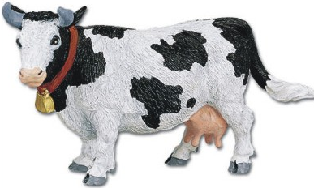
Slide 17
The Columbian Exchange
Population & Environment
Plants, animals, and micro-organisms of Afroeurasia were exchanged with those of the Americas across the oceans.
Notes:
Americas: turkey, pumpkin, corn or maize, chocolate, tomato, tobacco, potato, chili pepper, peanut, pineapple, beans
Afroeurasia: citrus, cotton (varieties) coffee, sugar, tea, wheat, yam, banana, rice, millet, sorghum.

Slide 18

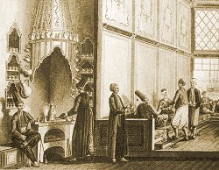
The Columbian Exchange
Population & Environment
New crops like potatoes and beans spread and improved nutrition worldwide.
Luxury products like coffee, chocolate, tea, tobacco, and spices meant new cultural habits for those with money to spend.
Notes:
www.coffeecoast2coast.com/history.html has a history of coffee with chronology timeline
http://www.superluminal.com/cookbook/essay_coffee.html

Slide 19
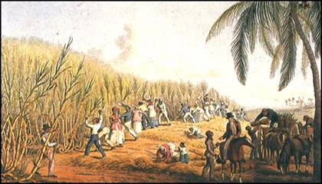
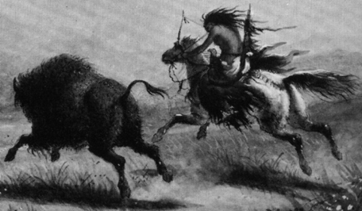
Environmental changes resulted from introducing new species
Population & Environment
Global cash crops were grown on large plantations with slave labor.
Caribbean sugar plantation
1600s
Livestock introduced to the Americas changed indigenous groups’ ways of life.
Plains woman hunting buffalo 1800s
Notes:
George Catlin:
http://www.geocities.com/westhollywood/castro/8260/wowar.gif

Slide 20

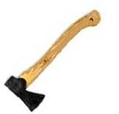


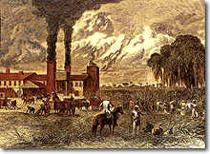

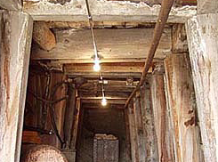
____
Slide 20
Deforestation intensified with growth in mining, shipbuilding, and plantation agriculture.
Population & Environment
mining
boiling sugar

Slide 21

Slide 21
World population grew a lot from 1400-1800
Population & Environment
The number of people in the world increased about 2 ½ times between 1400 and 1800 CE
Growth differed among world regions.

Slide 22
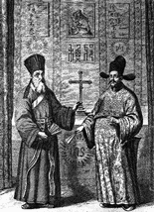
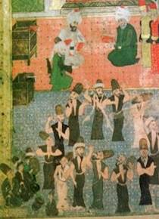
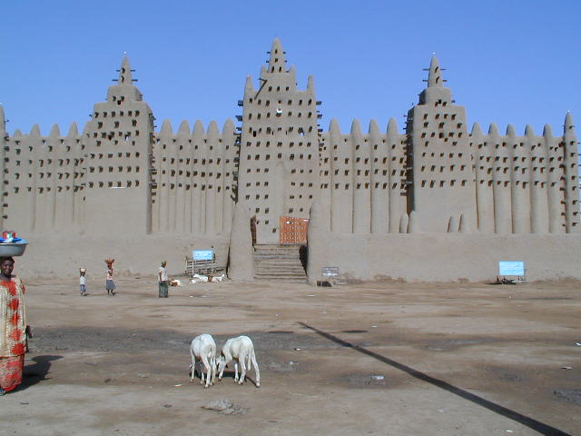
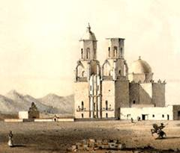
____
Slide 22
Islam and Christianity spread with empires, trade, and migration.
Population & Environment
Traders and Sufi orders spread Islam in Africa and Asia.
The Ottoman Empire expanded into eastern Europe, and Islam spread into the Balkans.
Catholic missionaries and religious orders followed the spread of empires in Asia, Africa, and the Americas.
Protestants colonized North America.
Notes:
Djenne mosque: http://en.wikipedia.org/wiki/Image:Great_Mosque_of_Djenn%C3%A9_3.jpg

Slide 23
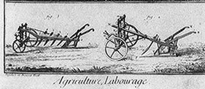
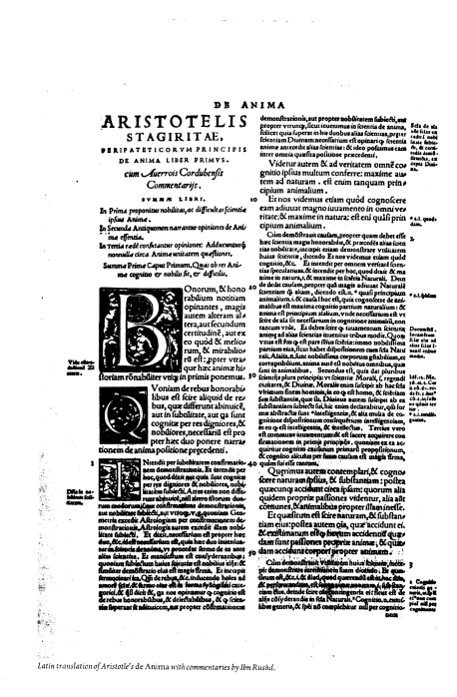
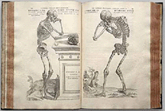
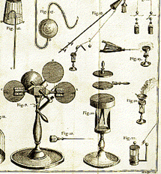

Printed books carried more and more information.
Ideas & Inventions
Page numbers, indexing, and other citation systems became common.
Sharp, accurate engraved illustrations helped spread innovative inventions rapidly.
Scientists shared detailed diagrams to replicate experiments and instruments.
Rich illustrations stimulated interest in literacy and learning.

Slide 24


Copernicus, Galileo, and Kepler proved that the earth was not the center of the universe… but the Church opposed the idea.
You mean I’m not the center of everything?!
Galileo facing the Roman Inquisition, a
painting by Cristiano Banti, 1857
Notes:
http://www.law.umkc.edu/faculty/projects/ftrials/galileo/galileotrial.jpg

Slide 25



Slide 25
Maps reflected discovery and colonization.
Ideas & Inventions
…and helped exchanges of knowledge among people in the world.
Notes:
Cantino map 1502: http://www.henry-davis.com/MAPS/Ren/Ren1/306.html
Jesuits Teaching (and probably also learning) Astronomy at the Chinese Court. Detail. Guy Louis Vernansal.18th c. Baroque, France.
Exploration 10 © Kathleen Cohen 1998: http://gallery.sjsu.edu/cartography/gallery/gallery-Full.00035.html

Slide 26


Maritime technologies continued to improve after 1500.
Ideas & Inventions
Mapping world wind patterns and oceanic currents.
Ships were fully rigged with sails for speed and handling.
Ships grew larger & stronger (500 tons in 1450 to 2000 tons by 1590).
The sextant greatly improved navigation at sea.
Cannons and ammunition improved.

Slide 27








Trade encircled the globe.
Trade & Manufacturing
Notes:
All images were snipped out of larger images or produced on Adobe photoshop. A few are from commercial catalogs and the codfish is snipped from a historical image at a public library, e.g.

Slide 28






Global artistic influences led to new European industries.
Trade & Manufacturing
Chinese silks and Indian cottons led to building of English and French textile factories.
Ottoman and Persian ceramics led to Holland’s Delft stoneware industry.
Chinese influence led English manufacturers to try to make “china” after they found the right clay.
Notes:
Jaipur calico: http://www.musee-impression.com/gb/collection/jaipurZoom.html
Delft tile: www.ceramicstoday.com/articles/080497.htm

Slide 29


Banking and law served new demands.
Trade & Manufacturing
Accountants learned double-entry bookkeeping with “Arabic” numerals.
Commercial law protected private property and investments.
More efficient bureaucracies and taxation increased the power of the government’s purse.
European monarchs issued charters to colonize overseas.
Jurists experimented with civil and constitutional law.
Notes:
Copyright-free woodcuts from Dover publications

Slide 30


Slide 30
Big Era 5 was the first age of global empires.
Large bureaucratic states in Afroeurasia used gunpowder and artillery to expand trade and win territory in several parts of Afroeurasia.
States & Empires
Notes:
Big cannon: http://www.jendaveallen.com/1999-March-Scotland/edinburgh.htm

Slide 31



Slide 31
Gunpowder empires in Asia, Africa, and Europe honed skills in production of artillery and handguns.
States & Empires
Land and maritime empires battled over control of trade, resources, and territory.
Persian, Indian, Turkish, Chinese, Japanese, and European artisans experimented with steel production for weapons.
Notes:
Cannon trajectory: http://www.princeton.edu/~sbutt/his291/artisans.html
See Ottoman also
Mughal knife: http://www.thecityreview.com/mughal.html
Chinese gunners: http://www.antiqueprints.com/Prints/china_costume_prints.html

Slide 32

Slide 32
States and Empires in 1519 CE
States & Empires
Notes:
Map by Robert Prom

Slide 33

Slide 33
States and Empires in 1600 CE
States & Empires
Notes:
Map by Robert Prom

Slide 34

Slide 34
States and Empires in 1714 CE
States & Empires
Notes:
Map by Robert Prom

Slide 35

Slide 35
States and Empires in 1804 CE
States & Empires
Notes:
Map by Robert Prom

Slide 36








Slide 36
Monarchs claimed
absolute power.
States & Empires
Philip II
Spain
1556-1598
Elizabeth I
England 1558-1603
Louis XIV
France 1643-1715
Catherine the Great Russia
1762-1796
Süleyman Ottoman Empire 1520-1566
Xizong Ming China 1620-1627
Shah Abbas
Persia
1587-1629
Jahangir
India
1605-1627
Notes:
Miniature of Sultan Süleyman: http://en.wikipedia.org/wiki/Suleiman_the_Magnificent

Slide 37






Slide 37
Challenges to absolutism came from new elites with ideas about human rights.
States & Empires
Louis XVI
1775-1793
Charles I
1625-1649
Charles I, beheaded in 1649
King George III
1760-1820
Rebellion in American Colonies 1776
French Revolution
1789

Slide 38
Summary: global convergence led to accelerating world change.
Environmental change accelerated with the Columbian Exchange, intensified resource exploitation, and continuing deforestation.
World population increased owing to improved nutrition and migration. But Africa gained only slowly due to slavery, and native Americans suffered massive population losses because of Old World disease pathogens.
Science, technology and cultural development expanded with the invention of printing and new knowledge institutions—libraries, universities, and museums.

Slide 39
Summary: global convergence led to accelerating world change.
World trade volume increased dramatically and began to shift its center from Asia to the Atlantic region.
States increased their power with gunpowder conquests and new sources of mercantile wealth.
In Europe rising economic elites enjoyed growing wealth, which led them to challenge old landed aristocracies and monarchs.

Slide 40


Is Big Era 5 the Modern World?
Are we there yet?
Modernity

Slide 41
Historians argue whether the world became “modern” in Big Era Five.
“Modernity” means advanced, continuous human development in science, technology, standards of living, and social organization.
Wait until you see Big Era Six!
Do you think human society was “there yet” in Big Era Five?

Slide 42
End of MC 3 Unit 3: Big Era 5

