Slide 1
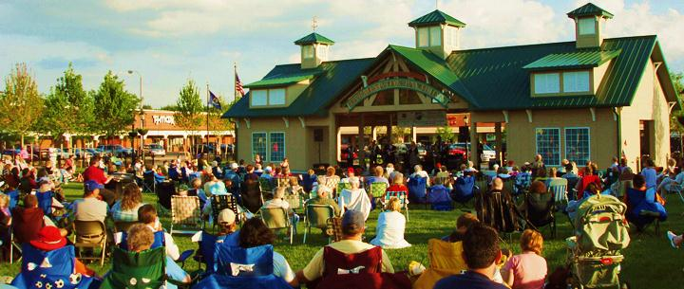
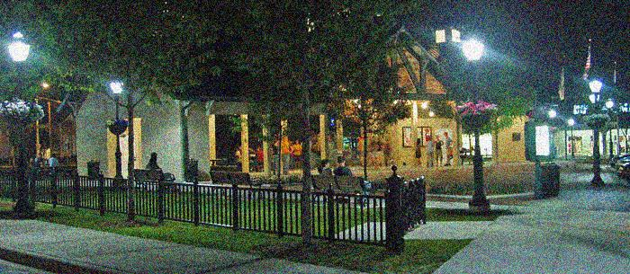
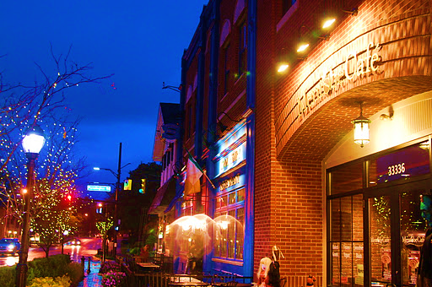
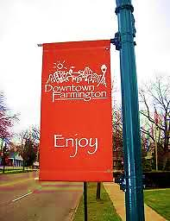
Farmington
Monica Mungarwadi and Haley DeVos-Roy

Slide 2
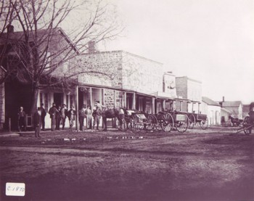
History
Farmington was founded in 1824 by Arthur Power a Quaker from Farmington, New York
Power Middle School is named after him
The first school was founded in 1828
During slavery, Farmington served as a station for the Underground Railroad
Officially incorporated as a village in 1867
Until the 1950s, Farmington was a small village that served as the area’s farming committee
During the post-war boom, people began to move from Detroit to Farmington making it as a suburb
During the 1960’s the city annexed 500 acres extending the boundary to Halsted Road
Today, Farmington is known for its’ pleasant neighborhoods and historical districts

Slide 3
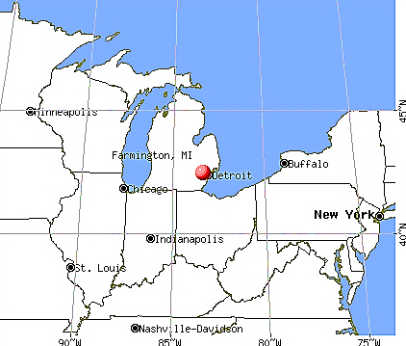
Geography
Total area of 2.7 square miles
City consists of all land (no water)
Bordered by Farmington Hills and Livonia

Slide 4
Demographics
Population
10,372 people, 4,624 households, and 2,735 families residing in the city
Racial Makeup
71.5% White,
Household
45.9% were married couples living together, 10.4% had a female householder with no husband present, and 40.9% were non-families. 35.9% of all households were made up of individuals and 13.7% had someone living alone who was 65 years of age or older. The average household size was 2.22 and the average family size was 2.92.
11.4% African American,
0.4% Native American, 13.9% Asian,
0.1% Pacific Islander, 0.4% from other races, and 2.1% from two or more races.
Age
Average income: $56,442
Income
median income for a family was $67,407.
4.4% are below the poverty line
22.0% under the age of 18, 6.1% from 18 to 24, 29.4% from 25 to 44, 26.9% from 45 to 64, and 15.6% who were 65 years of age or older.

Slide 5
Major Industries In the Area…
The city employs 400 people who work in municpal services. One big-employment area is activity services. Farmington is known for the Costick and John Grant Center.
Botsford Hospital
Farmington Schools
City Services
BENEFITS: Some benefits for employees include medical coverage, dental care, life insurance, paid time off, and employee discounts
Farmington Schools employ 1700 people. Employees get health and dental care, paid time off
Botsford hospital employs 2,000 people. Botsford is likely to employ more people because as people get older, they need more health care.
**Average wages could not be found

Slide 6
Basic Structure of Government
City Council Members
Mayor J.T. (Tom) Buck
Was elected in November 2009
Serves on the Board of Zoning Appeals and on the Commission of Children, Youth, and Family
Mayor Pro Tom William E. Galvin
Was appointed in September 2011
Serves on the Commission of Aging
Councilmember JoAnne M. McShane
Elected in November 1989
Served as Mayor 4 times
Serves on the Mainstreet Design Committee

Slide 7
Continued..
Councilmember Kristen Kuiken
Elected in November 2011
Served on the Planning Commission
Councilmember Greg P. Cowley
Elected in November 2011
Member of the Mainstreet Organization Committee
How Policies are implemented…
Boards and Commissions
There are several Boards and Commissions
All serve without pay
They are required by state law
They address certain matters that are important to citizens

Slide 8
Continued
K2
Voter ID
Debate on Merging
Lawmakers are encouraging prompt legislative action for the Michigan senate to ban K2.
IMPACT: Waiting for the state of Michigan to ban K2 will take a while.
Recent Ordinances…
Voters for the 2012 Presidential election will receive new voter ID cards by mid-June.
IMPACT: More people will be reminded to vote.
Many argue that Farmington and Farmington Hills should be merged into one city. This would save a large amount of money. For example, there are two fire stations two minutes apart from one another. Only using one would allow us to use that money for something else.

