Slide 1
Vocabulary
term definition
predation Noun. An interaction through which one species kills and consumes another species.
competition Noun. An interaction in which two species require the same limited resource, such as food, water, shelter, or sunlight.
mutualism Noun. A symbiotic relationship in which both species benefit from the interaction.
commensalism Noun. A symbiotic relationship in which one species benefits from the interaction and the other species is neither harmed nor helped.
parasitism Noun. A symbiotic relationship in which one species benefits from the interaction and the other species is harmed.
interdependence Noun. The relationship that results when organisms in an environment rely on each other for resources.
coevolution Noun. A change in one species that results from a change in a different species with which it interacts.
introduced species Noun. An organism that is brought into a new ecosystem where it is not native.
invasive species Noun. A species that is introduced to a new ecosystem, becomes established in that ecosystem, and threatens local biodiversity.
Symbiosis Noun. A long-term relationship between two different species.
Prerequisite Vocabulary:
Species, ecosystem, biodiversity

Slide 2
Please insert an image of organisms from a savannah ecosystem interacting with one another.
Notes:
Timing~0.5 minutes
Greeting!
Discuss image: Organisms in an ecosystem interact with one another in different ways. Some competed with each other, while others work together.[address the image specifically please]
Discuss title: In this lesson you will learn about the different relationships among organisms.
Transition to warm up: Before you begin, you will need to recall important terms you should already know, which are used throughout the lesson.

Slide 3
Recalling Key Terms
DD1
species
ecosystem
*biodiversity
DD2
*species
ecosystem
biodiversity
DD3
species
*ecosystem
biodiversity
Use the drop down menus to match the following definitions to the corresponding terms.
DD1 the total variety of organisms that live in the biosphere
species ecosystem biodiversity
DD2 a group of organisms that breed and produce offspring that can breed
species ecosystem biodiversity
DD3 all of the biotic and abiotic factors in an area
species ecosystem biodiversity
Notes:
Timing~ 1.0 minute
Entry audio: Recall key terms that will be used throughout the lesson.
Exit audio: In this lesson you will use these key terms to help you understand relationships among organisms.

Slide 4
Lesson Objectives
By the end of this lesson, you should be able to:
Describe the five major types of interactions between organisms.
Examine how symbiotic relationships can create dependency among species.
Explain how invasive species affect the environment they occupy.
Science Practice: Describe various ways evidence can be interpreted or explained.
Notes:
Timing~ 0.5 minutes
In the warm up, you recalled the definitions of species, ecosystem, and biodiversity. These vocabulary words will be important as you learn about the relationships among organisms. In this lesson, you will:
[animate] Describe the five major types of interactions between organisms.
[animate] You will then examine how symbiotic relationships can create dependency among species.
[animate] You will also explain how invasive species affect the environment they occupy.
[animate] Lastly, you will describe various ways evidence can be interpreted or explained.

Slide 5
How do organisms interact with each other and the environment?
Please adjust the boxes as needed. The top two boxes need to be one color, while the remaining three boxes, on the bottom, need to be a different color (but all three the same)
A species is a group of organisms that breed and produce offspring that can breed.
Next: Interactions among organisms
Predation
Competition
Mutualism
Commensalism
Parasitism
Notes:
Timing~ 0.5 minutes
Recap: In the warm up you identified key terms that will help you in this lesson. You recalled that a species is a group of organisms that breed and produce offspring that can breed. When species live in the same area, they often interact with one another.
Connect: Throughout this lesson you will be answering the lesson question [read lesson question]
Preview: [animate Next and first two boxes]You will begin with the short term interactions among organisms including predation and competition. [animate bottom three boxes] You will then learn about interactions that are long term such as mutualism, commensalism, and parasitism.[note the differences in color of boxes and that these are all vocab terms that will be defined within the lesson]

Slide 6
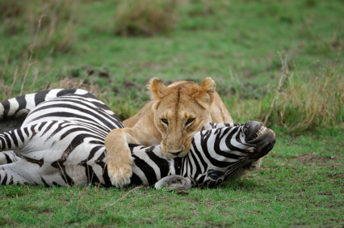
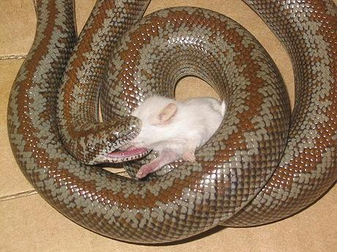
Predation
Predation – an interaction where one species kills and consumes another species
Photo licensed by iStockphoto
Photo by Cole Shatto
Notes:
Timing ≈ 0.5 minutes
Predation is an interaction where one species kills and consumes another species.
[Please discuss the following examples (each on click):]
[animate]A lion kills and eats a zebra for food. [circle the lion, noting the lion is the predator]
[animate]A snake kills and eats a mouse for food. The snake kills and eats the mouse. [circle the snake’s face, noting the snake is the predator]
SOURCES:
Lion and zebra image licensed by iStock 2/11/11
Snake and mouse Cole Shatto CC/GNU 12/11/06 http://commons.wikimedia.org/wiki/File:Rosy_boa_eating.JPG 2/9/11

Slide 7
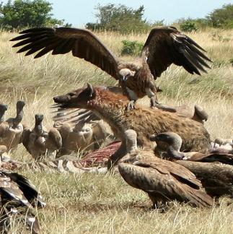
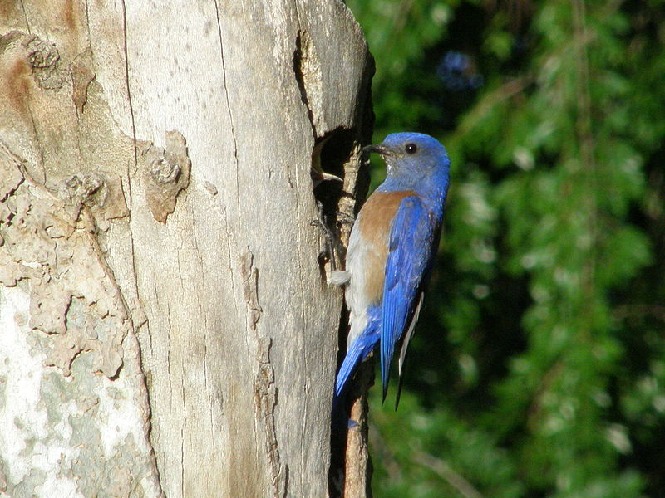
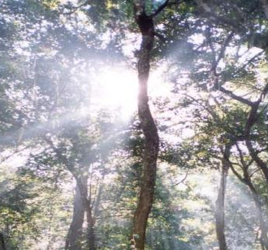
Competition
Please adjust the images so the entire definition of competition can be seen.
Competition – an interaction where two species require the same limited resource such as food, water, shelter, or sunlight
Photo by Matthew Westercamp
Photo by VivaVictoria
Notes:
Timing ≈ 0.5 minutes
Competition is an interaction where two species require the same limited resource such as food, water, shelter, or sunlight. A resource is an element needed for survival (food, water, shelter, or sunlight)
[Please explain the examples (each on click).]
[animate] Hyenas and other African carnivores (like these vultures) have the same food source (zebras, gazelles) and live in the same environment. They compete fiercely and even battle for food.
[animate] Different species of birds like the bluebird and sparrow compete for places to build their nests.
[animate] The trees in a rainforest compete for sunlight. Trees need to grow tall in order to gain the sunlight they need. They crowd out smaller trees as they compete for light and space.
SOURCES:
Hyena vs. vultures Matthew Westercamp CC share alike 6/1/08 http://www.flickr.com/photos/silentcow/2842633020/in/photostream/ 2/11/11
Forest in Bangladesh USAID PD 9/18/04 http://en.wikipedia.org/wiki/File:BN-forest.jpg 2/11/11
Bluebird nest VivaVictoria CC/GNU 5/6/07 http://commons.wikimedia.org/wiki/File:Sialia-Mexicana-Sunnyvale-Male-Feeding.jpg 2/11/11

Slide 8
Recalling Interactions Among Organisms
DD1
Competition
*Predation
DD2
*Competition
Predation
DD3
*Competition
Predation
DD4
Competition
*Predation
Identify the interaction described below.
DD1 One organism benefits, while the other one is killed
Competition Predation
DD2 Two species need the same resource, which is limited
Competition Predation
DD3 Two male deer fight for the opportunity to mate with a female deer.
Competition Predation
DD4 An owl catches a mouse and eats it for dinner.
Competition Predation
Notes:
Timing~ 1 minute
Entry audio: Recall the first two interactions among organisms and use that knowledge to help you answer the questions provided.
Exit audio: An interaction where one species benefits and the other species is killed, is known as predation. An interaction where two species compete for the same resource is known as competition.

Slide 9
Symbiotic Interactions
Please adjust the boxes as needed. The three boxes need to stay the same color.
Symbiosis is a long-term relationship between two different species .
Mutualism
Commensalism
Parasitism
Notes:
Timing ≈ 0.5 minutes
You will now take a look at the three long term relationships among organisms, which collectively are known as symbiotic relationships.
Symbiosis is a long term relationship between two different species.
[Explain that the animals live together and interact over a long period of time. This is different than predation because the interaction happens one time: one species eats the other. In competition, the interaction is also short term: one species dominates and the other either moves on or dies out.]
There are 3 types of symbiotic interactions
[animate the three interactions – mutualism, commensalism, and parasitism. Have students write these terms down and we will define them next]
You will now learn about each of these interactions
SOURCES:

Slide 10
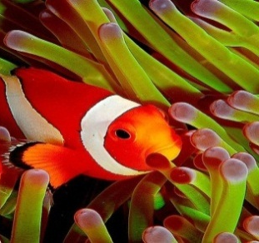
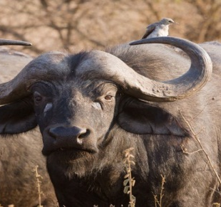
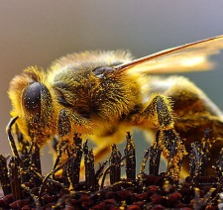
Mutualism
In addition to scaring off predators, some scientists speculate that clownfish waste may serve as a nutrient for the anemones…
Mutualism – a symbiotic relationship where both species benefit from the interaction.
Photo by Jenny
Photo by Ikiwaner
Photo by Jon Sullivan
Notes:
Timing~ 0.5 minutes
Mutualism is a symbiotic relationship where both species benefit from the interaction.
[Discuss the symbiotic relationships shown. (Each picture on click)]
[animate] Anemone provides the clown fish with protection from predators. The territorial clownfish protects it’s home from anemone-eating fish, thus protecting the anemone. Scientists also speculate that clownfish waste may serve as a source of nutrition for the anemones. Both benefit.
[animate] Wattled Starling eat the ticks on the back of African Buffalos. The bird gets food, and the buffalo benefits by having the bothersome ticks removed.
[animate] The bee gains food from the flower, the flower benefits by having its pollen carried to other flowers (reproduction)
SOURCES:
Clownfish Jenny CC generic 5/24/06 http://commons.wikimedia.org/wiki/File:Ocellaris_clownfish,_Flickr.jpg 2/9/11
Buffalo and Starling Ikiwaner GNU 7/30/10 http://commons.wikimedia.org/wiki/File:Serengeti_Bueffel1.jpg 2/9/11
Pollinating bee 2 Jon Sullivan PD 8/14/04 http://commons.wikimedia.org/wiki/File:Bees_Collecting_Pollen_2004-08-14.jpg 2/9/11

Slide 11
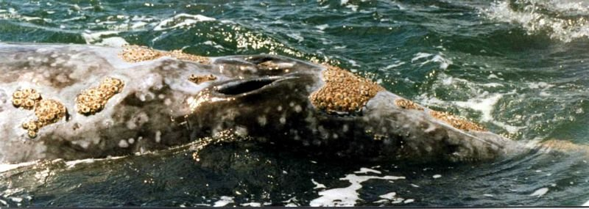
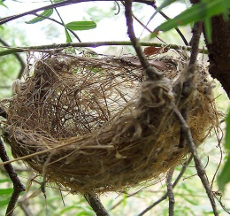
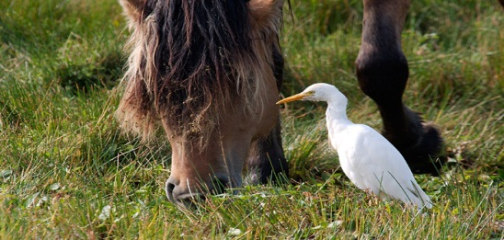
Commensalism
Please adjust the images so the entire definition of commensalism is seen.
Commensalism – a symbiotic relationship where one species benefits from the interaction and the other species is neither harmed nor helped
Photo by Fir0002
Photo by Xav801972
Notes:
Timing ≈ 0.5 minutes
Commensalism is a symbiotic relationship where one species benefits from the interaction and the other species is neither harmed nor helped.
[Discuss the symbiotic relationships shown (each on click):]
[animate] Barnacles cannot move on their own, they attach to whales in order to catch a free ride to food. The barnacles benefit, but the whales are not affected in any way. Whales are neither harmed nor helped by the barnacles.
[animate] When a bird builds a nest in a tree, the bird gains shelter and the tree is not affected.
[animate] The cattle egret spends time near animals that are grazing. As the animals move through the grass, they stir up the insects that the egrets eat. The grazers are not affected by the egret’s presence.
SOURCES:
Barnacles on whale Phil Konstantin PD 3/28/97 http://commons.wikimedia.org/wiki/File:GrayWhaleByPhilKonstantin.jpg 2/9/11
Bird nest Fir0002 CC/GNU 4/26/05 http://commons.wikimedia.org/wiki/File:Basket_style_nest.jpg 2/9/11
Cattle egret Xav801972 CC/GNU May 2007 http://commons.wikimedia.org/wiki/File:H%C3%A9ron.jpeg 2/9/11

Slide 12
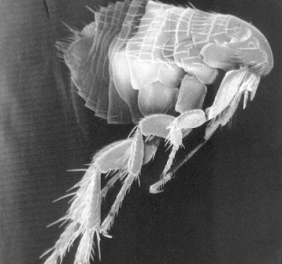
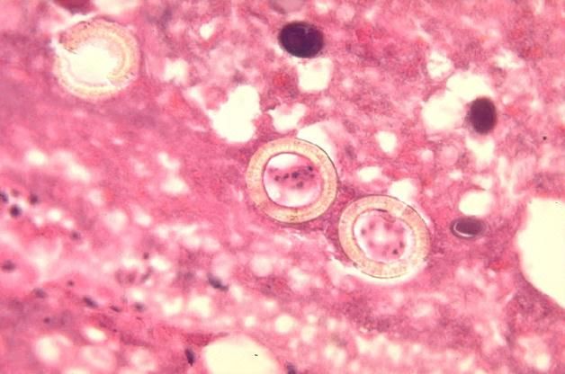
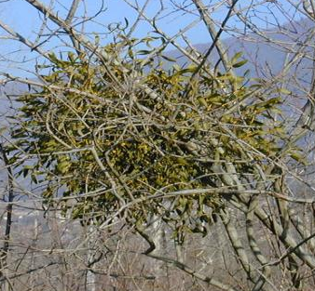
Parasitism
Please adjust the images as needed.
Parasitism – a symbiotic relationship where one species benefits from the relationship and the other species is harmed
Photo by Semnoz
Notes:
Timing~ 0.5 minutes
Parasitism is a symbiotic relationship where one species benefits from the relationship and the other species is harmed.
[Please discuss the following examples (each on click):]
[animate] Fleas live on dogs and other animals to gain shelter and food (in the form of blood). The fleas cause the animals to itch and may cause hair loss.
[animate] Tapeworms can live in the intestines of humans and other animals. The tapeworms “steal” nutrients from their hosts. Eventually, the host animals become sick due to lack of nutrition.
[animate] Mistletoe is a plant that grows on tree trunks and branches. The mistletoe gets water and nutrients from the tree’s sap. Eventually, the tree suffers from lack of water and nutrients, making it vulnerable to disease.
SOURCES:
Scanning Electron Micrograph of a Flea http://commons.wikimedia.org/wiki/File:Scanning_Electron_Micrograph_of_a_Flea.jpg CDC/ Janice Carr PD 3/14/12
Tapeworms CDC PD 1971 http://commons.wikimedia.org/wiki/File:Histopathology_of_Taenia_saginata_in_appendix_05G0045_lores.jpg 2/9/11
Mistletoe Semnoz CC/GNU January 2005 http://commons.wikimedia.org/wiki/File:200501_Gui_I.JPG 2/9/11

Slide 13
Recall Interactions Among Organisms
DD1
Parasitism
*Commensalism
Mutualism
DD2
Parasitism
Commensalism
*Mutualism
DD3
*Parasitism
Commensalism
Mutualism
DD4
Parasitism
Commensalism
*Mutualism
DD5
*Parasitism
Commensalism
Mutualism
DD6
Parasitism
*Commensalism
Mutualism
Identify the interaction described.
DD1 an interaction where one species benefits and the other species is neither harmed nor helped
Parasitism Commensalism Mutualism
DD2 an interaction where both species benefit
Parasitism Commensalism Mutualism
DD3 an interaction where one species benefits and the other species is harmed.
Parasitism Commensalism Mutualism
DD4 Humans release carbon dioxide, which is needed by plants; in return plant provide oxygen, which is needed by humans.
Parasitism Commensalism Mutualism
DD5 Tapeworms enter the intestines of a human through contaminated water; the tapeworm steals nutrients from the human.
Parasitism Commensalism Mutualism
DD6 Remora sharks attach themselves to whales by way of an adhesive disk on their dorsal surface; the remora sharks then feed off of the scraps from the whale’s meals.
Parasitism Commensalism Mutualism
Notes:
Timing~ 1 minute
Entry audio: Use your understanding of the interactions among organisms, specifically symbiosis, to answer the questions provided.
Hint audio 1: The interactions described are a form of symbiosis. Symbiosis is a long term relationship between two different species.
Hint audio 2: Use the definitions you just reviewed to help you identify the relationship described.
Exit audio: Parasitism is an interaction where one species benefits and the other species is harmed; an example is a tapeworm in the intestines of a human. Commensalism is an interaction where one species benefits and the other species is neither harmed, nor helped; an example is the remora shark attached to a whale. Mutualism is an interaction where both species benefit from the interaction; an example is the exchange of oxygen and carbon dioxide between humans and plants.

Slide 14
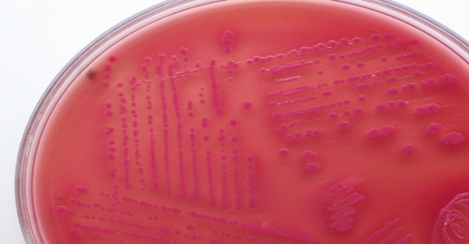
E. coli bacteria live in your intestines . . .
Can you survive without the bacteria?
Can the bacteria survive without you?
Photo by Microrao
Notes:
Timing ≈ 0.5 minutes
[Transition to this real-world connection]
E. coli are a type of bacteria that live in your intestines.
[animate 2x and read questions on screen]
SOURCES:
E. Coli Microrao PD 8/23/09 http://commons.wikimedia.org/wiki/File:Macconkey_e_coli.jpg 2/11/11

Slide 15
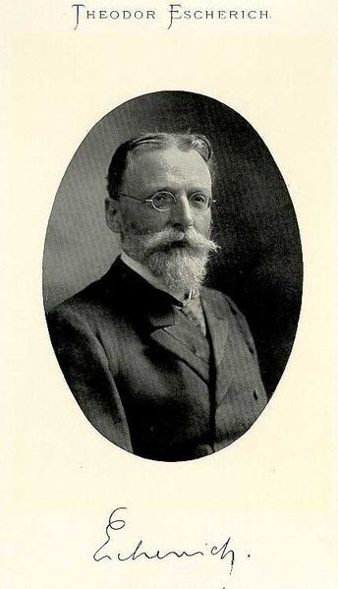
Theodor Escherich
Theodor Escherich discovered the bacteria known as Escherichia coli (E. coli) in 1885.
He was examining infant feces.
Discovered that E. coli is found in the intestines of healthy children, but it can also make people sick.
Notes:
Timing ≈ 0.5 minutes
[Discuss the history of E.coli. By reading information on the screen] [animate 3x]
SOURCES:
Theodor Escherich Lipotymia PD 3/23/06 http://en.wikipedia.org/wiki/File:Theodor_Escherich.jpg 2/11/11

Slide 16
E. Coli Bacteria
Format as needed.
You have a symbiotic relationship with the E. coli bacteria that live in your intestines.
The bacteria gain nutrition and a place to live.
You gain essential nutrients.
Which type of symbiotic relationship does this describe?
[space for teacher to write]
Notes:
Timing ≈ 0.5 minutes
The studies by Escherich help us understand the role of E. coli in our bodies today.
[animate]E. coli bacteria live in your intestines.
[animate]These bacteria gain shelter and food from your intestines.
[animate]In return, they provide you with the Vitamin K (an essential nutrient) you need.
[animate]Which type of symbiotic relationship does this describe?
This describes mutualism [write ‘mutualism’ on slide]
The E. coli bacteria remain in your intestines and do not make you sick, however if they died off, you would become very ill because you would lack essential nutrients.
When humans die, the E. coli in their intestines die too. The E. coli no longer have a source of nutrition.
Humans depend on E. coli for survival, and the E. coli depend on humans for nutrition.
[Note that as long as the E. coli bacteria remain in your intestines, they do not make you sick. E. coli infections occur when poor hygiene results in the spread of E. coli to areas outside the intestines. ]

Slide 17
How do organisms interact with each other and the environment?
Please adjust the boxes as needed
Interactions among organisms:
Next: Interdependence of organisms
Predation
Competition
Mutualism
Commensalism
Parasitism
Notes:
Timing~0.5 minutes
Recap: You just learned the five interactions among organisms including [animate 5x] predation, competition, mutualism, commensalism, and parasitism [note short-term vs. long-term]
Connect: You are continuing to answer the lesson question [read lesson question]
Preview: [animate Next] In this section you will learn about the interdependence of organisms.

Slide 18
Relationships
Please insert image of the bees and flower from the previous slides. {this is addressed in notes, so needs to be bees and flowers}
The interactions between organisms lead to interdependence, the relationship that results when organisms in an environment rely on each other for resources
  Population size
  Coevolution is a change in one species that results from a change in another species that it interacts with.
Notes:
Timing ≈ 0.5 minutes
Let’s talk about what interdependence is.
[animate] Interdependence occurs when organisms in an environment rely on each other for resources. [please note that this is over a long period of time] [please address the bees and the flower and how they depend on one another]
[animate] It can affect the overall population size for each species involved. For example, increases in one population may lead to decreases in the other population.
[animate] It can also affect the evolution of the species involved. Changes in one species over time can lead to changes in the species that it interacts with. This is called coevolution: a change in one species that results from a change in another species that it interacts with.
SOURCES:

Slide 19
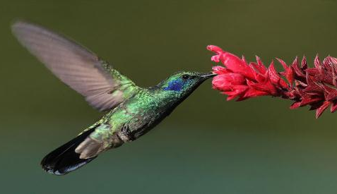
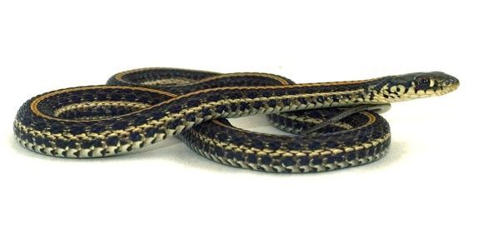
Coevolution
Results in a close match between the characteristics of two species
Photo by Mdf
Photo by Thamnophis
Notes:
Timing ≈ 0.5 minutes
Let’s look closer at coevolution.
[animate hummingbird image] The beak of hummingbird is a perfect match to the shape of the flower. These two species have changed together over time until they became a perfect match.
[animate snake image] Another example of coevolution involves garter snakes and a certain type of salamander. Over time, the salamander evolved toxic skin to protect itself from its predator (the snake). The snake, in turn, developed immunity to the toxin. Changes in one species depend on changes in the species that it interacts with.
SOURCES:
Hummingbird Mdf CC/GNU 1/30/08 http://en.wikipedia.org/wiki/File:Colibri-thalassinus-001-edit.jpg 2/11/11
Garter snake Thamnophis CC share alike 3/30/09 http://commons.wikimedia.org/wiki/File:Plains_gartersnake.jpg 2/11/11

Slide 20
Identify Interdependence of Organisms
DD1
Coevolution
*Interdependence
DD2
*Coevolution
Interdependence
Identify the key term described.
DD1 the relationship that results when organisms in an environment rely on each other for resources
Coevolution Interdependence
DD2 a change in one species that results from a change in another species that it interacts with
Coevolution Interdependence
Notes:
Timing~ 1 minutes
Entry audio: Recall the key terms used to describe interdependence of organisms.
Exit audio: Interdependence is the relationship that results when organisms in an environment rely on each other for resources. It can lead to a change in population size or coevolution, a change in one species that results from a change in another species that it interacts with.

Slide 21
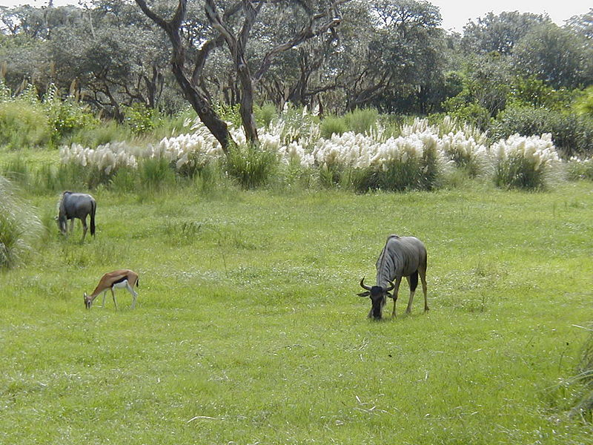
Relationships and Interdependence
Designer: Insert picture of another ecosystem
All five types of interactions result in interdependence
  Mutualism
  Commensalism
  Parasitism
  Predation
  Competition
Photo by LtPowers
Notes:
Timing ≈ 0.5 minutes
Explain that each symbiotic relationship results in interdependence between the species involved. Tell students that we will now examine the interdependence resulting form each type of relationship.
SOURCES:
Savanna LtPowers CC share alike 8/29/04 http://wikitravel.org/shared/Image:Walt_Disney_World_-_Animal_Kingdom_-_Savanna.jpg 2/11/11

Slide 22
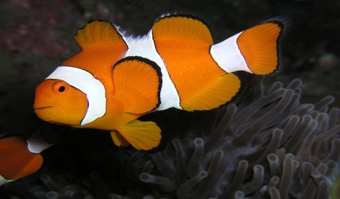
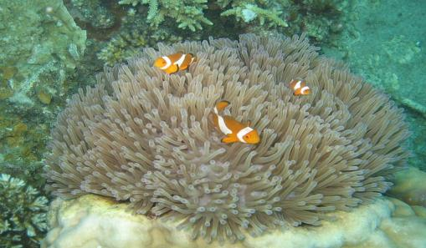
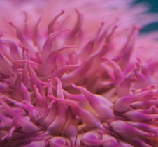
Mutualism and Interdependence
Please see notes and adjust the screen as needed for visual appeal. Right now it is harsh.
The middle image can stay on the screen when the outside images are animated in.
Clownfish depend on anemones for shelter
Anemones depend on clownfish for scraps of food
Photo by Nick Hobgood
Photo by Bart de Goeij
Photo by Ryan E. Poplin
Notes:
Timing ≈ 0.5 minutes
(Picture of individual organisms will appear on click after bullets and picture of them together)
[Explain that if the population of clownfish suddenly declined, you would also expect to see a decline in the anemone population because they would lose a food source. The reverse is true as well. If the anemones decline, the clown fish would decline due to lack of shelter. The size of one population depends on the size of the other population.
[Draw arrows as you talk to show the change in population size.]
SOURCES:
Clownfish Nick Hobgood CC/GNU 1/18/09 http://commons.wikimedia.org/wiki/File:Amphiprion_ocellaris_(Clown_anemonefish)_Nemo.jpg 2/14/11
Sea anemone Ryan E. Poplin CC share alike 6/8/07 http://www.flickr.com/photos/27446776@N00/578058904 2/14/11
Clownfish and anemone Bart de Goeij CC share alike 9/12/07 http://commons.wikimedia.org/wiki/File:Common_Clownfish.jpg 2/14/11

Slide 23
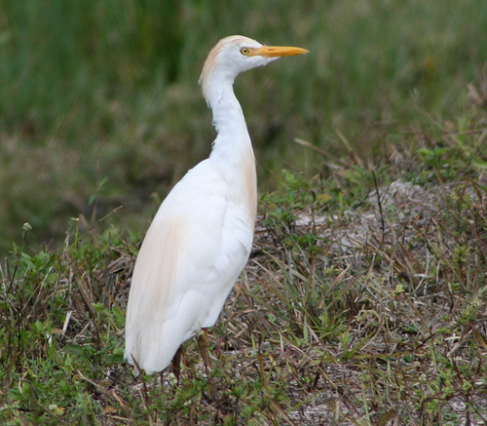
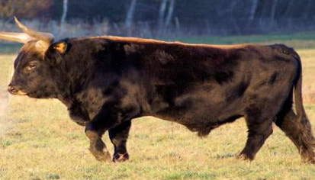
Commensalism and Interdependence
Cattle egrets depend on cattle to stir up insects for food
The cattle are not affected
Photo by Maureen Leong-Kee
Photo by Walter Frish
Notes:
Timing ≈ 0.5 minutes
[Explain that if the cattle population declined in an area, you would likely see a decline in the egret population. The size of the egret population depends on the size of the cattle population. However, the size of the egret population would not affect the size of the cattle population because the cattle are not affected. ] [Draw arrows as you talk to show the change in population size.]
SOURCES:
Cattle egret and cattle Charles Lam CC share alike 12/23/09 http://www.flickr.com/photos/kclama/4220576194/ 2/14/11
Cattle egret Maureen Leong-Kee CC share alike 3/20/09 http://www.flickr.com/photos/mleongkee/3382637854/ 2/14/11
Heck cattle male Walter Frisch CC share alike 12/15/06 http://commons.wikimedia.org/wiki/File:Heck_cattle_male.jpg 2/14/11

Slide 24

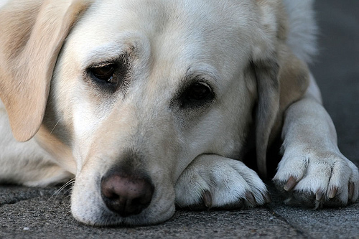
Parasitism and Interdependence
Please adjust the images as needed
Tapeworms depend on their host species for food
The host species is harmed by the tapeworm
Image courtesy of the CDC
Photo by protographer23
Notes:
Timing ≈ 0.5 minutes
If the host species’ population declines, you would expect to see a decline in the tapeworm population. However, if the tapeworm population declined, you would expect to see an increase in the host population.
[Draw arrows as you talk to show the change in population size.]
SOURCES:
Tapeworms CDC PD 1971 http://commons.wikimedia.org/wiki/File:Histopathology_of_Taenia_saginata_in_appendix_05G0045_lores.jpg 2/9/2011
Sad dog protographer23 CC share alike 8/9/08 http://www.flickr.com/photos/protographer23/2750299656/ 2/14/11

Slide 25
Identify Interdependence of Organisms
DD1
Parasitism
Commensalism
*Mutualism
DD2
Parasitism
*Commensalism
Mutualism
DD3
Increase
*Decrease
Not affected
DD4
*Increase
Decrease
Not affected
Identify the interaction used to describe each type of interdependence among organisms.
DD1 The red-billed oxpecker (a bird) eats ticks off the fur of an impala (a type of antelope). The oxpecker receives food and removes the ticks from the impala.
Parasitism Commensalism Mutualism
DD2 Titan triggerfish move large rocks in the ocean to find food. In return smaller fish are able to eat because the rocks are moved to expose food for the smaller fish; the titan triggerfish are not affected.
Parasitism Commensalism Mutualism
Notes:
Timing~ 1.5 minutes
Entry audio: Use your understanding of interdependence and interactions among organisms to answer the following questions.
Exit audio: The red-billed oxpecker and impala have a mutualistic relationship. If the population of impala decreases, the population of oxpecker would also decrease. Titan triggerfish and smaller fish have a commensalistic relationship. If the population of triggerfish increases, the population of smaller fish would also increase.

Slide 26
Identify Interdependence of Organisms
DD1
Parasitism
Commensalism
*Mutualism
DD2
Parasitism
*Commensalism
Mutualism
DD3
Increase
*Decrease
Not affected
DD4
*Increase
Decrease
Not affected
Determine what would happen to the populations organisms below, given the type of relationship identified above.
DD3 If the population of impala decreases, what would happen to the population of oxpecker?
Increase Decrease Not affected
DD4 If the population of triggerfish increases, what would happen to the population of smaller fish?
Increase Decrease Not affected
Notes:
Timing~ 1.5 minutes
Entry audio: Use your understanding of interdependence and interactions among organisms to answer the following questions.
Exit audio: The red-billed oxpecker and impala have a mutualistic relationship. If the population of impala decreases, the population of oxpecker would also decrease. Titan triggerfish and smaller fish have a commensalistic relationship. If the population of triggerfish increases, the population of smaller fish would also increase.

Slide 27
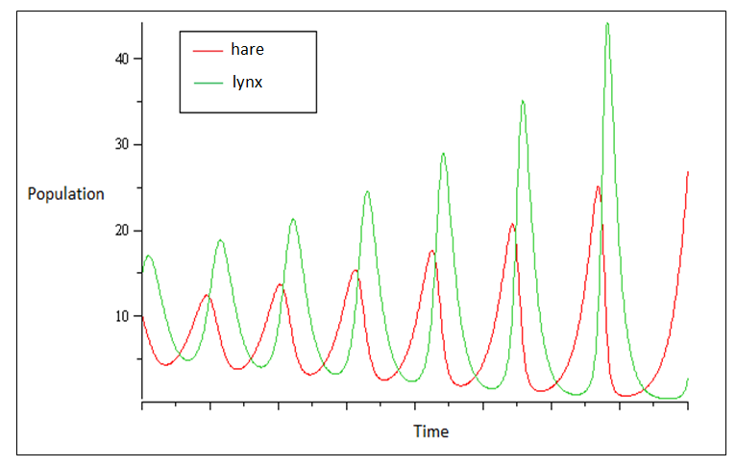
Predation and Interdependence
Is there a way to enlarge the text or bold the lines so they appear more clear?
The lynx population depends on the hare for food
The hare depends on the lynx population to keep it from overpopulating
Adapted from image by Bloor
Notes:
Timing ≈ 2 minutes
[please point out on screen which color represents each organism. Also, since the text is small, write on the screen as needed to explain]
Explain that a hare is a rabbit and a lynx is a large cat. Show the cyclical relationship between the two populations. As the lynx population increases, the hare population decreases, once the hare population decreases, the lynx population starts to decrease because they have less food available. With less predators, the hare increase again and so on.
[Explain that the lynx (predator) and hare (prey) populations keep each other in balance. Without the lynx, the hare would overpopulate, and without the hare, the lynx could go extinct.]
http://sfscience.wordpress.com/2010/01/01/prey-vs-predator/
SOURCES:
Lotka-Volterra diagram Bloor CC/GNU 9/12/07 http://commons.wikimedia.org/wiki/File:Lotka_Volterra_Dynamique.gif 2/14/11

Slide 28
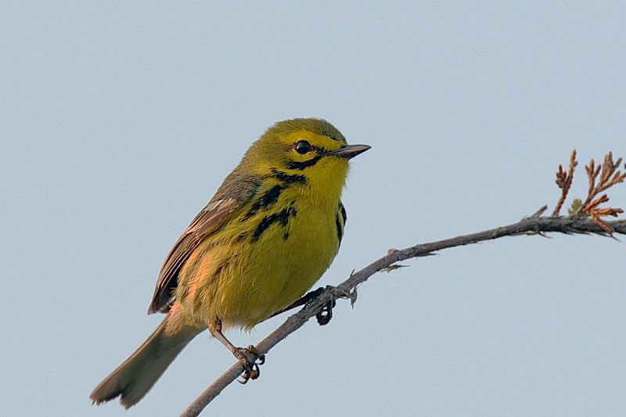
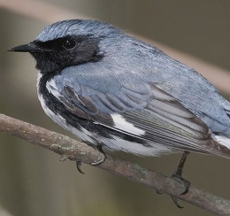
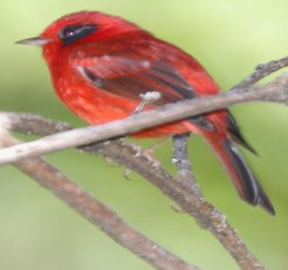
Competition and Interdependence
Species can evolve to use the environment in slightly different ways
One species can cause the other to go extinct
Photo by Wolfgang Wander
Photo by Mdf
Photo by Dominic Sherony
Notes:
Timing ≈ 0.5 minutes
Different warbler species compete for the same food. Over time, they have evolved to live in different areas of the tree in order to reduce competition. Some species prefer the top of the tree, other species prefer the middle, and other warbler species prefer to live at the bottom of the tree. If the warbler species did not adapt or evolve to reduce competition, the stronger species’ population would increase and the weaker species’ population would decline (possibly to extinction).
SOURCES:
Yellow warbler Wolfgang Wander CC/GNU 6/11/05 http://commons.wikimedia.org/wiki/File:Prairie-Warbler.jpg 2/14/11
Red warbler Dominic Sherony CC share alike 2/13/09 http://www.flickr.com/photos/9765210@N03/3323645553 2/14/11
Blue warbler Mdf CC share alike 5/18/09 http://commons.wikimedia.org/wiki/File:Dendroica-caerulescens-001.jpg 2/14/11

Slide 29
Identify Interdependence of Organisms
DD1
Predation
*Competition
DD2
*Predation
Competition
DD3
*Increase
Decrease
Not affected
Identify the interaction used to describe each type of interdependence among organisms.
DD1 Having too many fish in a pond can limit the amount of food and space available for the fish.
Predation Competition
DD2 The cheetah population depends on the gazelle population for food.
Predation Competition
Determine what would happen to the populations organisms below, given the type of relationship identified above.
DD3 If the population of cheetah decreases, what would happen to the population of gazelle?
Increase Decrease Not affected
Notes:
Timing~ 1.5 minutes
Entry audio: Use your understanding of interdependence and interactions among organisms to answer the following questions.
Exit audio: Having too many fish in a pond can cause competition and limit the amount of food and space available for the fish. Predation occurs between the cheetah and the gazelle because the cheetah depends on the gazelle for food. If the population of cheetah decreases, the population of gazelle would increase.

Slide 30
How do organisms interact with each other and the environment?
The interdependence of organisms is the relationship that results when organisms in an environment rely on each other for resources.
Interdependence can lead to coevolution or changes in population size.
Next: Invasive species
Notes:
Timing~0.5 minutes
Recap: The interdependence of organisms is the relationship that results when organisms in an environment rely on each other for resources. It can lead to coevolution or changes in population size.
Connect: Sometimes the natural interactions are disturbed when a new species comes into the environment and begin interacting. These interactions between organisms can affect interdependence and disrupt the environment.
Preview: [animate Next] In this section you will learn how invasive species can affect the environment they live in.

Slide 31
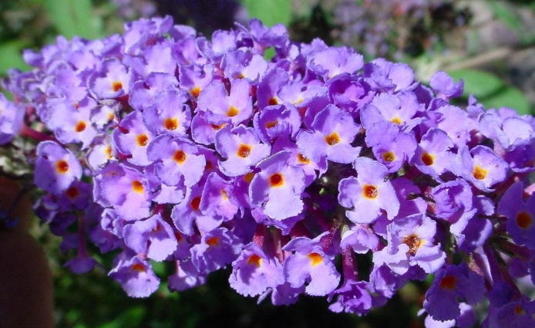
Foreign Species
please insert an image of a butterfly bush, native to southwestern China
If a different image is used, the notes need to be changed please.
Introduced species – an organism that is brought into a new ecosystem where it is not native
Invasive species – a species that is introduced to a new ecosystem, becomes established in that ecosystem, and threatens local biodiversity
Notes:
Timing~0.5 minutes
Interactions among organisms can be interrupted when a new species is introduced into the environment.
Over past 200 years, several thousand foreign plant & animal species have become established in the US! They are known as introduced species because they originated from somewhere else.
[animate]An introduced species, also known as a non native species, is an organism that is brought into a new ecosystem where it is not native. Humans are usually responsible for this introduction. This can happen either accidentally or intentionally. After a species is introduced it can become invasive. [the image on the screen is a butterfly bush which was introduced to America in the 1900s from China] These organisms begin to interact in the environment and they being to disrupt the environment.
[animate]An invasive species is a species that is introduced to a new ecosystem, becomes established in that ecosystem, and threatens local biodiversity. 1 in 7 of the species that entered the US has become invasive. This means that the new species begins to take over their new ecosystem and threatens the local plants and animals.

Slide 32
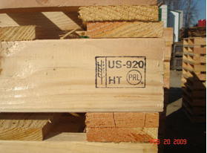
Introducing Foreign Species
Please insert an image or a few that fit the points on screen.
Carried in cargo crates
Traveled in or on ships
Hidden inside produce or meat
Carried on clothing or in luggage
Intentionally introduced by humans
Notes:
Timing~ 1 minute
Humans are the main source of species introductions. Most introduced species are carried to their new ecosystem accidentally.
[ Please discuss the examples on the slide.]
[animate]They may be accidentally carried along with cargo in planes, trains, or boats. They climb into the crates before shipment. Many insects and rodents are introduced this way.
[animate]Marine and freshwater organisms are often introduced to new environments by ships. Some actually cling onto the ship (barnacles) others are accidentally carried in the ships ballast tanks. When a ship empties its cargo at its destination, it becomes much lighter. In order to compensate for this, ships have ballast tanks. They fill these tanks up with lake or ocean water in order to balance the ship. When they return home, they empty these tanks into their lake or ocean. The problem is, they don’t just suck water into these tanks, many small marine and freshwater organisms are sucked in too and are accidentally carried to a new ecosystem.
[animate]Many pest species are carried in produce or meat. The organism is living on the produce in their native environment. Once the produce is harvested, they are carried to the new environment where it is sold. Mediterranean fruit flies were introduced to the US this way.
[animate]People can accidentally carry small organisms on their clothing or in their luggage when they travel. They end up bringing home more than just souvenirs when they travel.
[animate]Some species are intentionally introduced by humans. When people first came to America, they brought with them birds from Europe to make it seem more like home. People have introduced many beautiful plants into new environments for landscaping and many other organisms for food or pets. For example, Lovebirds are native to Africa, but are sold in the US as pets. People released their lovebirds in Arizona because they no longer wanted them. Lovebirds have become established in Arizona and are outcompeting native birds for nest space.

Slide 33
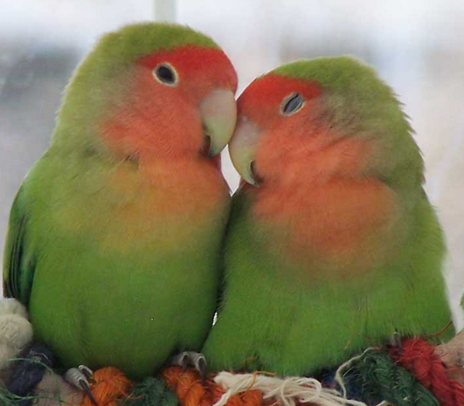
Introduced Species Become Established
Please insert an image of a lovebird (native to africa)
Introduced to a habitat similar to their own
Outcompete native species
Generally have no native predator
Often have high reproductive rates
Can tolerate a range of conditions
Notes:
Timing~ 0.5 minutes
Let’s think about those lovebirds, how were they able to become established in a different ecosystem. First, they were introduced to a habitat similar to their own. Southern Arizona is similar to the African desert. And, they were able to outcompete native bird species for food and nest sites.
There are five characteristics that make an introduced species likely to become invasive[animate through the five examples]:
[animate] Introduced to a habitat similar to their own
[animate] Out compete native species(for food or shelter)
[animate] Generally have no native predator(which would have kept their population in check)
[animate] Often have high reproductive rates
[animate] Can tolerate a range of conditions(can adapt to different climates, food sources, etc)

Slide 34
Impact of Invasive Species
Please insert an image of a farm in the background
Cause environmental harm – threaten biodiversity and disrupt food chains
Cause economic harm – costs farmers, homeowners, and communities
Harmful to human health – attack humans and cause health issues
Notes:
Timing ~ 0.5 minutes
[animate]Invasive species threaten their new environment. They out compete native species and threaten biodiversity in the ecosystem. They disrupt food chains and throw off the ecological balance in these ecosystems.
[animate]Invasive species cause economic harm. Fruit flies for example damage the crops of many farmers. A species of termite introduced to New Orleans causes millions of dollars in damage to homes and buildings. Invasive species are difficult to get rid of. Millions of dollars are spent trying to remove these species.
[animate]Invasive species are harmful to human health. Africanized killer bees were introduced to the US threatening humans. A small worm introduced to the San Francisco bay causes a rash called swimmers itch when it imbeds itself in the skin of people swimming in the area.

Slide 35
Recall Invasive Species
How are species introduced to new ecosystems? Check all that apply.
[ ] carried in on cargo crates
[ ] traveled in or on ships
[ ] result from mutations in other organisms
[ ] hidden inside produce or meat
[ ] carried on clothing or in luggage
[ ] intentionally introduced by humans
[ ] coevolution of two species
How do introduced species become established in a new ecosystem? Check all that apply.
[ ] introduced to a habitat similar to their own
[ ] introduced to a habitat different than their own
[ ] outcompete native species
[ ] generally have no native predators
[ ] generally have native predators
[ ] often have high reproductive rates
[ ] often have low reproductive rates
[ ] can tolerate a range of conditions
Notes:
Timing~1 minute
Entry audio: Use your understanding of introduced and invasive species to answer the questions provided.
Exit audio: A species that is introduced into a new ecosystem is known as an introduced species. Once it becomes established in the ecosystem and threatens biodiversity, it is known as an invasive species.

Slide 36
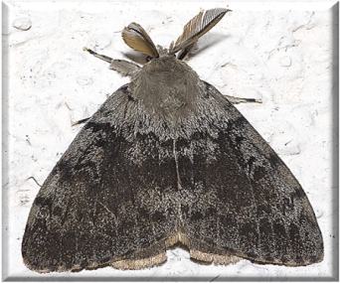
Gypsy Moth
Please adjust as needed. Image was taken from original lesson (human impact on environment section 2)
Please have each row animate one at a time
Where did it originate? | Europe
Where did it invade? | Originally Massachusetts and now the entire Eastern US
How did it invade? | A monk brought some moths to the US for experiments
How did it affect the environment? | The moths ate trees and devastated local forest ecosystems and tree farms
Notes:
Timing~ 1 minute
[this is also the science practice: different way evidence can be interpreted or explained]
[please address that people thought it was harmless to bring new species to America, and other parts of the world. Over time, however, these species became established and began causing problems for the environment and native species]
Let’s take a look at two examples of invasive species.
[animated by row; there are 4 total rows]
[animate] The Gypsy Moth is native to Europe.
[animate] There were two invasions of Gypsy moth: The first invasion was Massachusetts and then spread throughout the Northeast. The second invasion was in North Carolina and spread throughout the Southeast.
[animate] In 1869, a French Monk brought some Gypsy Moths to the U.S. from Europe in order to experiment with them. Some escaped. In 1993, a ship docked in North Carolina, opened its cargo hold, and out flew dozens of Gypsy Moths.
[animate] Gypsy Moths eat the leaves of trees. The female moth can fly making it easy to spread. The moth has no predator in the US. With a high birthrate, no predator, and the ability to fly….you can see how this quickly became a problem. The moths devour leaves and damage forest ecosystems all over the east coast.
SOURCES:
Gypsy moth Olaf Leillinger CC/GNU 8/10/08 http://commons.wikimedia.org/wiki/File:Lymantria.dispar.7679.jpg 5/18/11

Slide 37
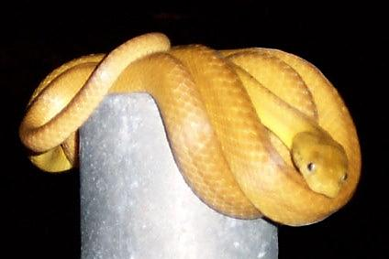
Brown Tree Snake
Please format as needed. Image was taken from section two of lesson “Humans Impact on Environment section 2” from the old course
Please animate each row one at a time
Where did it originate? | Australia
Where did it invade? | The island of Guam
How did it invade? | Carried in WWII military plane
How has it it affect the environment? | It has decimated the populations of birds, small mammals, and amphibians
Notes:
Timing~ 1 minute
[please animate by row; there are 4 total rows]
[animate] The Brown Tree Snake is native to Australia.
[animate] It was introduced to the island of Guam. Invasive species are especially dangerous in island ecosystems. There as many as 12,000 snakes per mile on Guam!!
[animate] It was brought over concealed in a WW II military transport plane. The snake has a high reproductive rate, eats a variety of animals, and has no predator on Guam. It quickly became invasive.
[animate] It is too late to save Guam’s wildlife from the snake. It has decimated the native population of birds, mammals, and amphibians.
The snakes climb along electric wires causing power outages every 6 days!
They have climbed aboard ships and made it to Hawaii at least 6 times. Luckily, they have been caught before they made it to the islands.
SOURCES:
Brown tree snake Mark Kempen CC/GNU 2003 http://en.wikipedia.org/wiki/File:Snake_browntree.jpg 5/18/11

Slide 38
How do organisms interact with each other and the environment?
Notes:
Timing ≈ 0.5 minutes.
In this lesson you were answering the lesson question “How do organisms interact with each other and the environment?”, which identifies the unique interactions among organisms in the environment.
Let’s review what you have learned today.

Slide 39
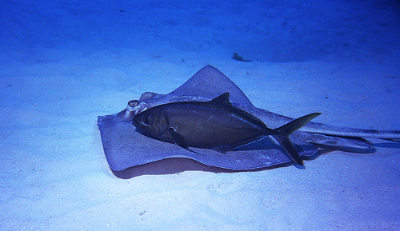
Interactions Among Organisms
Five main types of interactions: mutualism, commensalism, parasitism, predation, and competition
Symbiosis – a long-term relationship between two different species
Mutualism, commensalism, and parasitism are symbiotic interactions
Notes:
Timing ≈ 0.5 minutes
[please review the main points; animate 3x]
SOURCES:
Ray and fish icelight CC generic 12/16/07 http://www.flickr.com/photos/icelight/2116064994/ 2/11/11

Slide 40
Interdependence
Please adjust image
All five types of interactions result in interdependence
  Interdependence can lead to influences on the size of populations
  Interdependence can lead to coevolution
Photo by Bart de Goeij
Notes:
Timing ≈ 0.5 minutes
[please review the main points; animate 3X]
SOURCES:

Slide 41
Invasive Species
Please insert image of gypsy moth
Introduced species - brought into a new ecosystem
Invasive species – become established into new ecosystem
Cause environmental harm, economic harm, or harm to human health
Notes:
Timing~ 0.5 minutes
[please review; animate 3x]

Slide 42
How do organisms interact with each other and the environment?
As a result of this lesson, you now should be able to:
Describe the five major types of interactions between organisms.
Examine how symbiotic relationships can create dependency among species.
Explain how invasive species affect the environment they occupy.
Science Practice: Describe various ways evidence can be interpreted or explained.
Notes:
Timing ≈ 0.5 minutes
Review the lesson’s objectives, which are listed on the slide. As a result of this lesson, you now should be able to do all of these things.

Slide 43
Explore interactions among organisms.
In this assignment, you will explore common interactions among organisms. You will use the information you learn to answer questions related to the five interactions among organisms as well as information on invasive species.
Photo by LtPowers
Notes:
Timing~ 0.5 minutes
Entry audio: In this assignment, you will explore common interactions among organisms. You will use the information you learn to answer questions related to the five interactions among organisms as well as information on invasive species.

Slide 44
Explore Predators
http://idahoptv.org/dialogue4kids/season4/prey/facts.cfm
KEYWORDS:
Claws, jaws, teeth
Read the information on predators using this link, then answer the questions provided.
Which organisms are considered predators? Check all that apply.
[ ] organisms that eat meat
[] organisms that eat plants
[ ] organisms that eat carcasses of animals
[] organisms that eat plants and animals
What are the three main weapons of predators?
[text area 3 lines]
Check the items you included.
[-] claws
[-] jaws
[-] teeth
Notes:
Timing~ 5 minutes
Entry audio: Read the information on predators using the link provided, then answer the questions.
Hint audio 1: Predators are organisms that hunt or prey on other animals for food.
Hint audio 2: The weapons used by predators are also known as adaptations. Adaptations are traits that help an organism survive.
Exit audio: Predators prey on other animals for food. Teeth, claws, and jaws are the three main weapons used by predators to catch their prey.

Slide 45
Explore Symbiosis
http://www.marietta.edu/~biol/biomes/symbiosis.htm
DD1
Commensalism
*Mutualism
Parasitism
DD2
Commensalism
Mutualism
*Parasitism
Read about symbiosis using this link, then answer the questions provided.
Identify the type of symbiosis described.
DD1 The Saguaro Cactus provides food for the white-winged dove through the large fruit on the cactus. The bird consumes the fruit, ingesting the seeds, and then deposits the seeds in a new location. The cactus gets the seeds transported to a new location and the bird gets food.
Parasitism Commensalism Mutualism
Identify the type of symbiosis described.
DD2 The brown-headed cowbirds lay eggs in other birds’ nests. They trick the birds into raising their young. The cowbirds hatch first and push the eggs out of the next. The cowbirds are then fed by the nest-builder.
Parasitism Commensalism Mutualism
Notes:
Timing~ 5 minutes
Entry audio: Read the information on symbiosis using the link, then answer the questions provided.
Exit audio: Symbiosis is a long term interaction between two different species. Mutualism, commensalism, and parasitism are the three types of symbiosis.

Slide 46
Explore Invasive Species
http://dnr.wi.gov/org/caer/ce/eek/veg/plants/wildparsnip.htm
KEYWORDS: Europe, Asia, burn, burns, skin, reproduce, rapidly, removed, root, brush cutter
Read about invasive species in Wisconsin using this link, then answer the questions provided.
Describe the invasion of wild parsnip including the harm it is causing.
[text area 5 lines]
Check the items you included.
[-] Homeland Europe and Asia
[-] invaded the entire state of Wisconsin
[-] can burn your skin
[-] reproduces rapidly
[-] can be removed at root or with a power brush cutter for large populations
Notes:
Timing~ 5 minutes
Entry audio: Read about invasive species in Wisconsin using the link provided, then answer the questions.
Exit audio: Wild parsnip are an invasive species in Wisconsin. It is unknown how it invaded Wisconsin, but it is seen throughout the state and grows rapidly. If your skin comes into contact with wild parsnip and it interacts with ultraviolet light, you will have a burn on your skin from the wild parsnip. The burn can blister and last for up to two days. To remove the parsnip it needs to be cut at the root and for large populations you can use a power brush cutter.

Slide 47
Explore Invasive Species
http://dnr.wi.gov/org/caer/ce/eek/earth/isam09.htm
KEYWORDS: clean, brush, pick, seeds, clothes, shoes, pets, remove, plant, parts, trails, hiking, firewood, avoid, transferring
Read about defending invasive species using this link, then answer the questions provided.
Describe how you can avoid spreading invasive plant species.
[text area 6 lines]
Check the items you included.
[-] brush or pick seeds off your clothes
[-] put seeds you find at home in the trash
[-] clean your pets (coat and feet) to remove seeds and plant parts you find
[-] stay on trails when hiking
[-] check boats, trailers, shoes, bikes, and people for plant seeds or plant parts
[-] use firewood in the same place you find it to avoid transferring seeds
Notes:
Timing~5 minutes
Entry audio: Read about how you can avoid spreading invasive species using this link, then answer the questions provided.
Exit audio: There are things you can do to avoid the spread of invasive plant species from one area to another. A few things you can do include cleaning yourself, pets, equipment, shoes to remove any plant seeds or plant parts. You can also stay on trails when hiking, throw seeds you find at home in the trash, and use firewood in the same place you find it. All of these things can help reduce the spread of invasive plant species.

