Slide 1

Introduction to Sociology

Slide 2
What is Sociology?
Perrin Definition: Sociology is the scientific study of human societies and of human behavior in social settings.
Stark Definition: The scientific study of the patterns and processes of human social relations

Slide 3
Sociology’s Relationship to…
Science (Hint: What does it mean to say something is empirical?)
Social Problems and other “Causes”
The other social sciences
    Anthropology
    Economics
    Political Science
    Psychology

Slide 4
What do sociologists study?
Socialization
Crime (and Juvenile Delinquency)
Deviant Behavior
Social Stratification (economic inequality)
Race and Ethnicity
Gender
The Family
Religion
Politics, Population, Urbanization…

Slide 5
Why Study Sociology?
  To understand – sociology is the “study of society”
  Encourages critical thinking – Famous Peter Berger quote: “It can be said that the first wisdom of sociology is this – things are not what they seem”
  Knowledge of social forces gives us power over those forces
  Ultimately, make the world a better place?

Slide 6
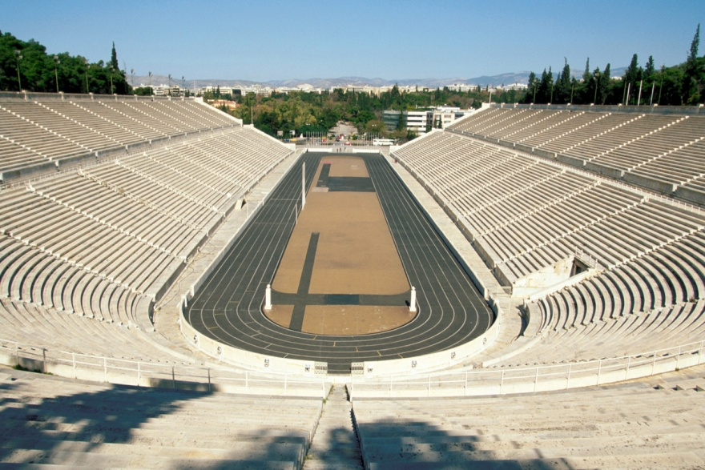
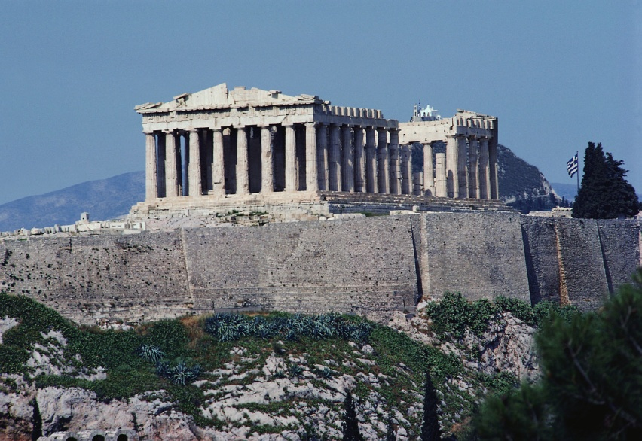
Pre-Sociological Influences:
The fundamental foundations of sociology have been gleaned (as all things seem to be) from the ancient Greeks.

Slide 7
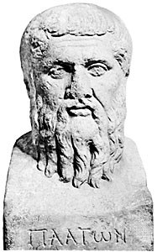
Pre-Sociological Influences:
Even though Plato is not considered the “father” of sociology--he is probably the first person to systematically study society in a “sociological” way. In other words, he thought like a sociologist.

Slide 8
Pre-Sociological Influences:
The basic notion of natural law is found in Plato’s Republic. There is an order to society--a universalism, urged the Greek philosopher. The essence of this universal, unfortunately, was not totally clear. On the one hand, society was characterized as an organism, an enclosed, total, holistic unit. This was the Platonic “is” of society.

Slide 9
Pre-Sociological Influences:
The entire state of nature, however, was not yet known. Consequently, man was in a position to use logic--”the act and method of correct thinking”--to posit an “ought” of what society could be. This inherent contradiction between the Platonic “is” and the “ought” is fundamental to the processes of random fact gathering in Western thought.

Slide 10

Pre-Sociological Influences:
  Plato’s Six Basic Assumptions of Society
  Man is an organism.
  Organisms tend toward survival.
  Man survives in groups.
  Man is a social animal.
  Man lives in an ordered society.
  The order of society is knowable.

Slide 11
Origins of Sociology
Sociology grew out of social upheaval of early 1800s
Industrial Revolution - Europe changing from agricultural to factory, rural to urban
Cities depressing places…
The upheaval of the times got people questioning and demanding answers

Slide 12
The Discovery Of Social Facts
In 1825, the French Ministry of Justice began to collect criminal justice statistics.
Soon, they began collecting data on activities such as suicide, illegitimate births and military desertion.
Became known as moral statistics because of the moral implications of the activities.

Slide 13
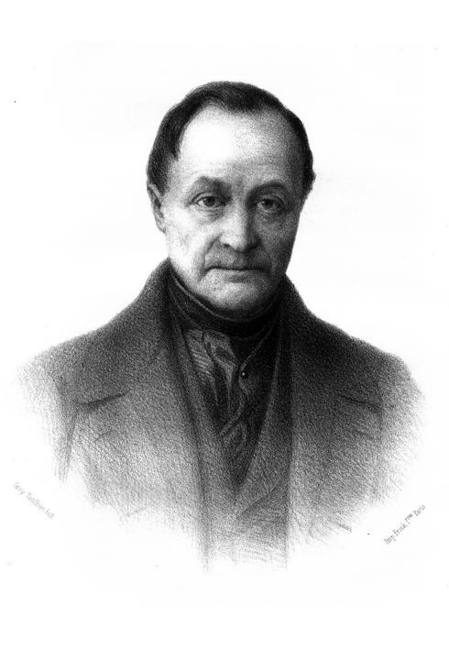
The Father of Sociology:
Auguste Comte
1798-1857
The new social science that Comte sought to establish was first called social physics but he later found the term stolen by another intellectual so he coined the word sociology, a hybrid term compounded of Latin and Greek parts
Comte first used the term sociology in print in 1838

Slide 14
The Father of Sociology:
The “father of sociology;” French philosopher who asserted . . . that the fate of mankind depends in many respects upon the development of a science of human social relationships, that established scientific disciplines have progressed only to the degree that they have been grounded in facts and experience, and that therefore the needed new science of human social relationships (a science which Comte suggested naming sociology) should adopt the study and experimental techniques of the physical sciences.

Slide 15
Human Beings Are Social and Socialized:
  We are born dependent on others. We survive because of them; we learn how to survive from them; we are socialized by them. Socialization is no small matter. Through socialization, we take on the ways of society and become members of society. We learn to control ourselves through the rules and perspective of society, thus making society possible.
  Through socialization, we develop symbols, self, and mind, qualities that make us both human and to some extent, free. Finally, either because of socialization or because of our nature, humans come to live their whole lives around others, subject to the rules that dominate all social life.

Slide 16
Humans Are Social Actors: We Interact and We Create Social Patterns
  Because we act around others, they become important influences on what we do. We consider them as we act; we are social actors in almost every situation. Interaction—mutual social action—socializes us, influences our actions and ideas, and, over time, influences the development of social patterns.
  Social patterns, once created, take on a life of their own, influencing actors in interaction. It is such patterns that form the basis of social organization.

Slide 17

Humans Live Their Lives Embedded in Social Organization
  We are in the center of many organizations, most of which we had no part in creating. Dyads, groups, formal organizations, communities, and society are, to some extent, the walls of our prison. Each represent rules we are expected to follow.

Slide 18

Social Structure Is an Important Social Pattern in All Social Organization
  It positions each actor, tells each actor what is expected (role), gives the actor an identity and perspective, distributes power, privilege, and prestige. What we do, what we are, and what we believe are linked to our positions in many social structures.

Slide 19
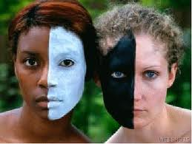

Society Is a System of Inequality
  This system of inequality includes class, gender, and racial/ethnic group positions. These social structures are far-reaching, are very hard to change, and place us in positions that are very important for our entire lives.

Slide 20

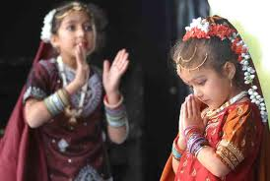
All Social Organization Has Culture
  Culture, too, is a social pattern. It is what people share as they interact: their ideas, values, goals, and norms.
  Our actions are influenced by what our social organizations teach us. What may seem to us like free choice often proves to be products of the culture we have learned.

Slide 21
Agree…………………..Disagree
The death penalty deters (stops) homicide
Spanking does more harm than good
Homosexuality is biologically determined
The rich should give more to the poor

Slide 22
Agree…………………..Disagree
I will be the first person in my family to attend college
Couples who live together before marriage are more likely to stay together in marriage
I fear terrorism
Peace is more powerful than war

Slide 23
Agree…………………..Disagree
Poverty rates have increased the past 3 years
Illegal drugs are more of a problem now than they were 25 years ago
The United States has the greatest economic inequality in the world
The United States is in moral decay

Slide 24
http://www.bolender.com/Sociological%20Theory/Sociological%20Theorists.htm
http://faculty.pepperdine.edu/rperrin/courses/soc200/200powerpointindex.htm

