Slide 1
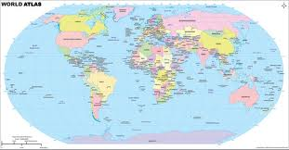
Seven Countries of the world
By: Stephan Clark
Done in March 2012

Slide 2
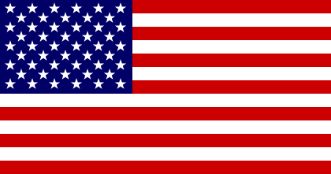

United States
Government: Federal Republic
President: Barack H. Obama
Vice President: Joseph Biden
Land area: 3,539,225 sq mi (9,166,601 sq km)
Population: 310,232,863 (growth rate: 0.9%)
Birth Rate: 13.8/1000
Infant Mortality Rate: 6.1/1000
Life Expectancy: 78.2
Density per sq mi: 85
Capital: Washington, DC
Monetary unit: dollar
Languages: English 82%, Spanish 11%
Religions: Protestant 52%, Roman Catholic 24%, Mormon 2%, Jewish 1%, Muslim 1%, none 10%
Literacy rate: 99%

Slide 3
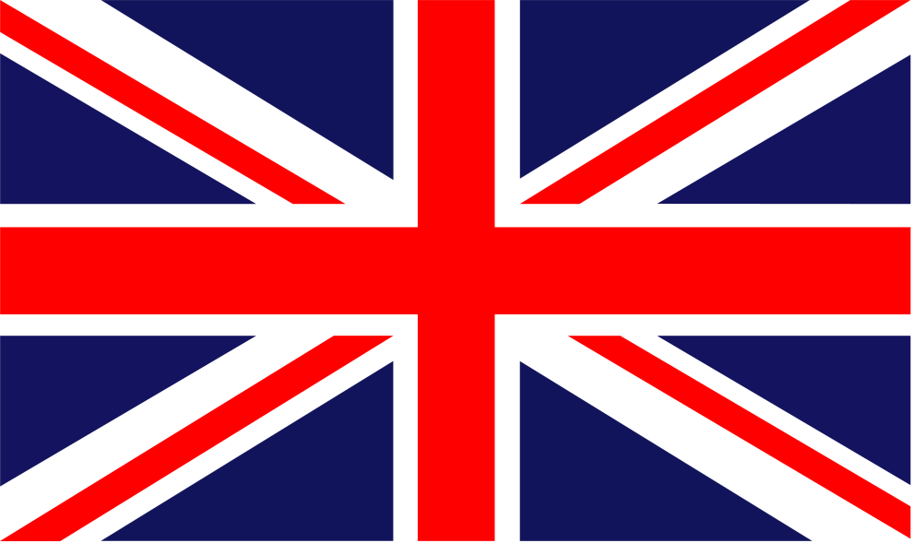
Great Britain
Government: Constitutional Monarchy and Parliamentary Democracy
Sovereign: Queen Elizabeth II
Prime Minister: David Cameron
Land area: 93,278 sq mi (241,590 sq km)
Population: 61,284,806 (growth rate: 0.2%)
Birth Rate: 10.6/1000
Infant Mortality Rate: 4.7/1000
Life Expectancy: 79.1
Density per sq km: 246
Capital: London
Monetary unit: Pound sterling
Languages: English, Welsh, Scots Gaelic
Religions: Christian (Anglican, Roman Catholic, Presbyterian, Methodist) 71.6%, Muslim 2.7%, Hindu 1%, other 1.6%, unspecified or none 23.1%
Literacy rate: 99%

Slide 4
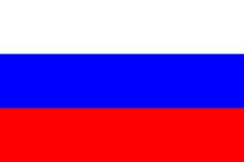
Russia
Government: Constitutional Federation
President: Dmitry Medvedev
President-elect: Vladimir Putin
Prime Minister: Vladimir Putin
Land area: 6,592,812 sq mi (17,075,400 sq km)
Population: 139,390,205 (growth rate: –0.5%)
Birth Rate: 11.1/1000
Infant Mortality Rate: 10.3/1000
Life Expectancy: 66.1
Density per sq mi: 21
Capital: Moscow
Monetary unit: Russian ruble
Languages: Russian, many minority languages
Religions: Russian Orthodox 15%–20%, other Christian 2%, Islam 10%–15%
Literacy rate: 100%

Slide 5
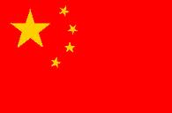
china
Government: Communist State
President: Hu Jintao
Prime Minister: Wen Jiabao
Land area: 3,600,927 sq mi (9,326,411 sq km)
Population: 1,336,718,015 (growth rate: 0.493%)
Birth Rate: 12.29/100
Infant Mortality Rate: 16.06/1000
Life Expectancy: 74.68
Capital: Beijing
Monetary unit: Yuan/Renminbi
Languages: Standard Chinese (Mandarin/Putonghua), Yue (Cantonese), Wu (Shanghaiese), Minbei (Fuzhou), Minnan (Hokkien-Taiwanese), Xiang, Gan, Hakka dialects, minority languages note:Mongolian is official in Nei Mongol, Uighur is official in Xinjiang Uygur, and Tibetan is official in Xizang (Tibet)
Religions: Officially atheist; Daoist (Taoist), Buddhist, Christian 3%–4%, Muslim 1%–2%
Literacy rate: 92.2%

Slide 6
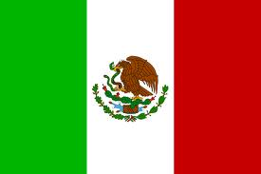
Mexico
Government: Federal Republic
President: Felipe Calderón
Land area: 742,485 sq mi (1,923,039 sq km)
Population: 112,468,855 (growth rate: 1.1%)
Birth Rate: 19.4/1000
Infant Mortality Rate: 17.8/1000
Life expectancy: 76.2
Density per sq km: 57
Capital: Mexico City
Monetary unit: Mexican Peso
Languages: Spanish, various Mayan, Nahuatl, and other regional indigenous languages
Religions: nominally Roman Catholic 89%, Protestant 6%, other 5%
Literacy rate: 91%

Slide 7
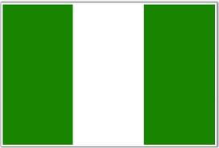
Nigeria
Government: Multiparty government transitioning from military to civilian rule
President: Goodluck Jonathan
Land area: 351,649 sq mi (910,771 sq km)
Population: 152,217,341 (growth rate: 1.9%)
Birth Rate: 36.0/1000
Infant Mortality Rate: 92.9/1000
Life Expectancy: 47.2
Density per sq km: 151
Capital: Abuja
Monetary unit: Naira
Languages: English (official), Hausa, Yoruba, Ibo, Fulani, and more than 200 others
Religions: Islam 50%, Christian 40%, indigenous beliefs 10%
Literacy rate: 68%

Slide 8
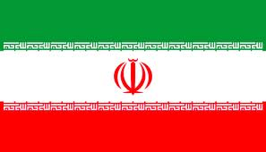
Iran
Government: Islamic Theocracy
Chief of State: Ayatollah Ali Khamenei
President: Mahmoud Ahmadinejad
Land area: 631,659 sq mi (1,635,999 sq km)
Population: 67,037,517 (growth rate: 0.9%)
Birth Rate: 17.3/1000
Infant Mortality Rate: 34.6/1000
Life Expectancy: 71.4
Density per sq km: 40
Capital: Tehran
Monetary unit: Rial
Languages: Persian and Persian dialects 58%, Turkic and Turkic dialects 26%, Kurdish 9%, Luri 2%, Balochi 1%, Arabic 1%, Turkish 1%, other 2%
Religions: Islam 98% (Shi'a 89%, Sunni 9%); Zoroastrian, Jewish, Christian, and Baha'i 2%
Literacy rate: 77%

Slide 9
Sound Links
If the sound links did not play you may listen to them at http://www.nationalanthems.info/

