Slide 1
Chapter 14
AP U.S. Government
The Congress, the President, and the Budget: The Politics of Taxing and Spending

Slide 2
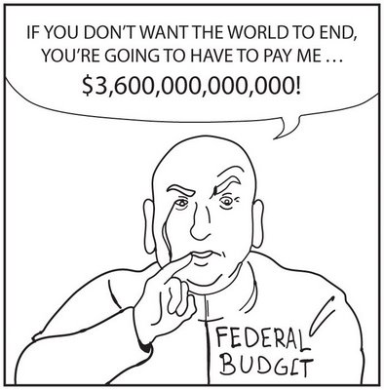
Basic Knowledge
Budget:
A policy document allocating burdens (taxes) and benefits (expenditures)
Deficit:
An excess of federal expenditures over federal revenues
Expenditures:
What the government spends money on
Revenues:
Sources of money for the government
Federal Debt:
all money borrowed over the years and still outstanding

Slide 3
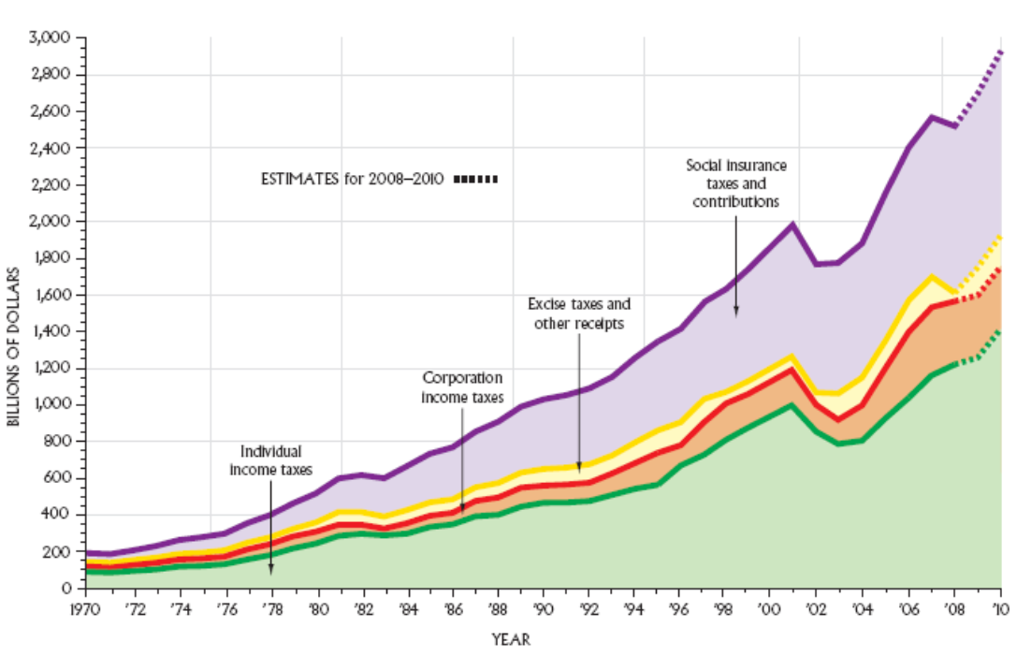
Things to Know
Income Tax
Shares of individual wages and corporate revenues
Individual taxes are the largest single revenue source for the government.
Income tax is progressive: Those with more income pay higher rates of tax on their income.
Social Insurance Taxes
Taxes for specific funds: Social Security and Medicare

Slide 4
How we get money we don’t make
Borrowing
The Treasury Department sells bonds—this is how the government borrows money.
The federal debt is the sum of all the borrowed money that is still outstanding.
The government competes with other lenders.
The government does not have a capital budget.

Slide 5
Taxes and Public Policy
Tax Loopholes: tax breaks or benefits for a few people
Tax Expenditures: revenue losses that result from special exemptions, exclusions, or deductions on federal tax law
Tax Reduction: the general call to lower taxes
Tax Reform: rewriting the taxes to change the rates and who pays them
Tax Reform Act of 1986—extensive tax reform

Slide 6
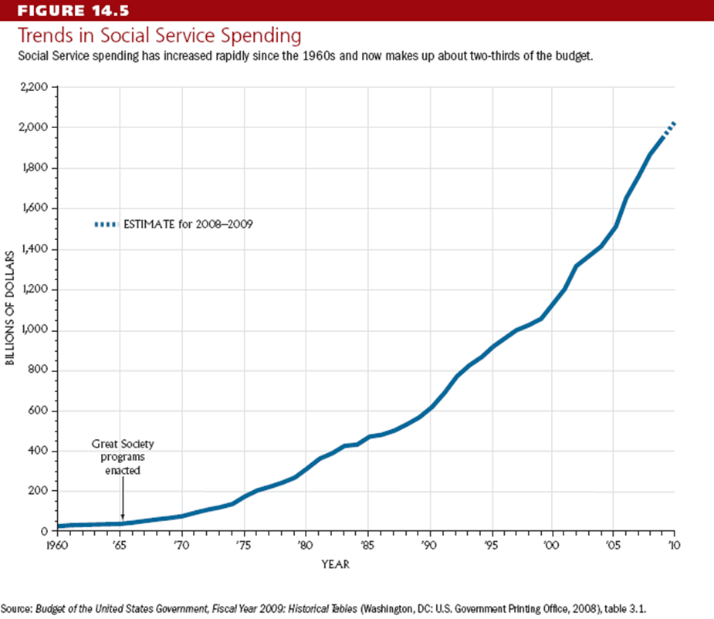
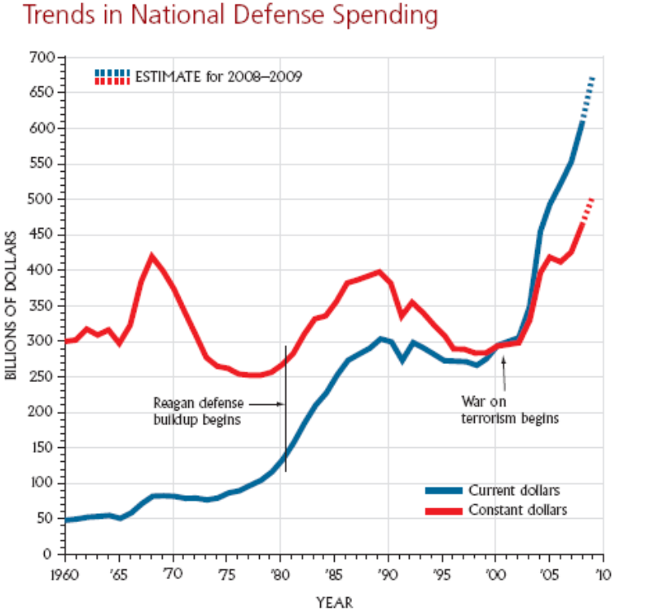
BIG GOVERNMENT = BIG SPENDING
As the size of government increases, so does its budget
Defense is about one-sixth of all federal expenditures.
The biggest part of federal spending is now for income security programs.
Social Security, Medicare, Medicad

Slide 7
Federal Expenses
Incrementalism
The idea that last year’s budget is the best predictor of this year’s budget, plus some
Budgets tend to go up a little each year
Uncontrollable Expenditures
mandated under current law or by a previous obligation.
About two-thirds of the federal budget is uncontrollable-based on expenditures.
Many expenditures are uncontrollable because Congress has in effect obligated itself to pay X level of benefits to Y number of recipients. Such policies are called
entitlements.

Slide 8
all federal appropriations must be authorized by Congress-a control sometimes called the "power of the purse."
Key players
House Ways Means Committee
the Senate Finance Committee

Slide 9
The Congressional Budget and Impoundment Control Act of 1974
An act designed to reform the congressional budgetary process
Fixed budget calendar
A budget committee in each House
The CBO (Congressional Budget Office), which advises Congress on the probable costs of its decisions, forecasts revenues, and is counterweight to OMB (Office of Management and Budget, which advises the pres. On budget matters)

Slide 10
WHAT YOU SHOULD KNOW
Federal budget consumes one-fifth of GDP
Government growth has meant higher taxes to pay for additional services, often through deficit spending.
The budgetary process is complex.
The budget is used, some argue, to buy votes, leading to an ever larger government.

Slide 11
The Federal Bureaucracy
Chapter 15

Slide 12
THE BUREAUCRATS
Once Congress, the president, or the Supreme Court makes a policy decision, it is most likely that bureaucrats must step in to implement those decisions

Slide 13
Some Bureaucratic Myths and Realities
Myths
Realities
Americans dislike bureaucrats.
Bureaucracies are growing bigger each year
Most federal bureaucrats work in Washington, D.C
Bureaucracies are ineffective, inefficient, and always mired in red tape
Americans are generally satisfied with bureaucrats
Not in the federal bureaucracy.
Only about 12 percent do.
No more so than private businesses.

Slide 14
How to become a Bureaucrat
100 years ago, a person got a job with the government through the patronage system (a hiring and promotion system based on knowing the right people).
Under this "spoils system,“ presidents staffed the government with their friends and allies.
Today, most federal agencies are covered by some sort of civil service system.
The rationale rests on the merit principle and the desire to create a nonpartisan government service

Slide 15
The Other Route to Federal Jobs
Recruiting from the Plum Book
Lists the very top jobs available for Presidential appointment
Presidents work to find capable people to fill the positions.
Some plum jobs (ambassadorships) are patronage.

Slide 16
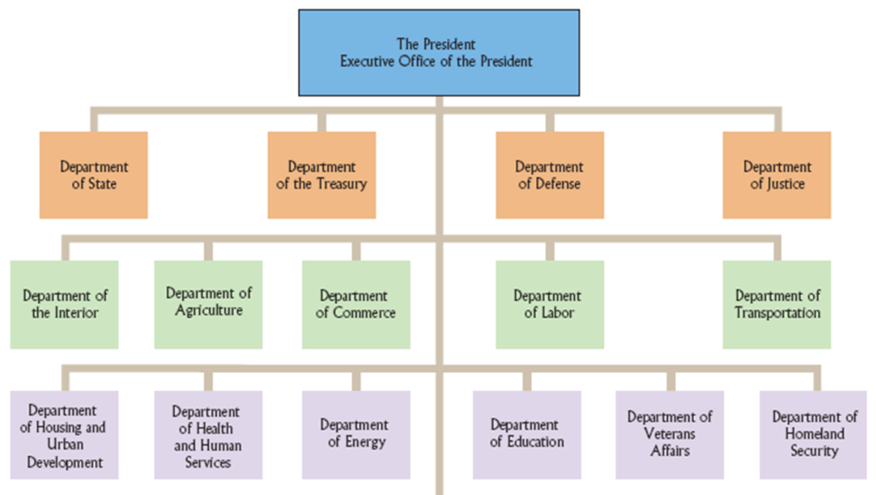
The Cabinet Departments
Thirteen Cabinet departments headed by a secretary
Department of Justice headed by Attorney General
Each has its own budget, staff, and policy areas

Slide 17
The Independent Regulatory Agencies
has responsibility for some sector of the economy
Regulatory agencies make and enforce rules designed to protect the public interest; they also judge disputes over those rules
Federal Communications Commission (FCC)
Federal Trade Commission (FTC)
Securities and Exchange Commission (SEC)

Slide 18
The Government Corporations
provide a service that could be handled by the private sector.
They typically charge for their services, though often at cheaper rates than the consumer would pay a private sector producer.
Postal Service
Independent Executive Agencies
are not part of the cabinet departments and generally do not have regulatory functions.
They usually perform specialized functions
NASA

Slide 19
bureaucrats play three key roles
they are policy implementors; they administer public policy; and they are regulators.
Policy implementation
occurs when the bureaucracy carries out decisions of Congress, the president, and the courts.
bureaucrats translate legislative policy goals into programs
If implementations fails bureaucrats take blame

Slide 20
Why implementation fails sometimes
Program Design
Lack of Clarity
Congressional laws are ambiguous and imprecise.
Sometimes the laws conflict with each other.
Lack of Resources
Agencies may be big, but may not have staff to carry out policy goals.
Many different types of resources are needed: personnel, training, supplies, and equipment
May also lack the authority to act
Administrative Routine
Standard Operating Procedures (SOPs) bring uniformity to complex organizations.
It is often difficult to change the routines.

Slide 21
Administrative discretion
is the authority of administrative actors to select among various responses to a given problem
regulation
is the use of governmental authority to control or change some practice in the private sector

Slide 22
Bureaucracy and Democracy
Congress Tries to Control the Bureaucracy
Influence appointment of agency heads
Senate confirms presidential nominees
Alter an agency’s budget
Hold oversight hearings
Rewrite legislation or make it more detailed

Slide 23
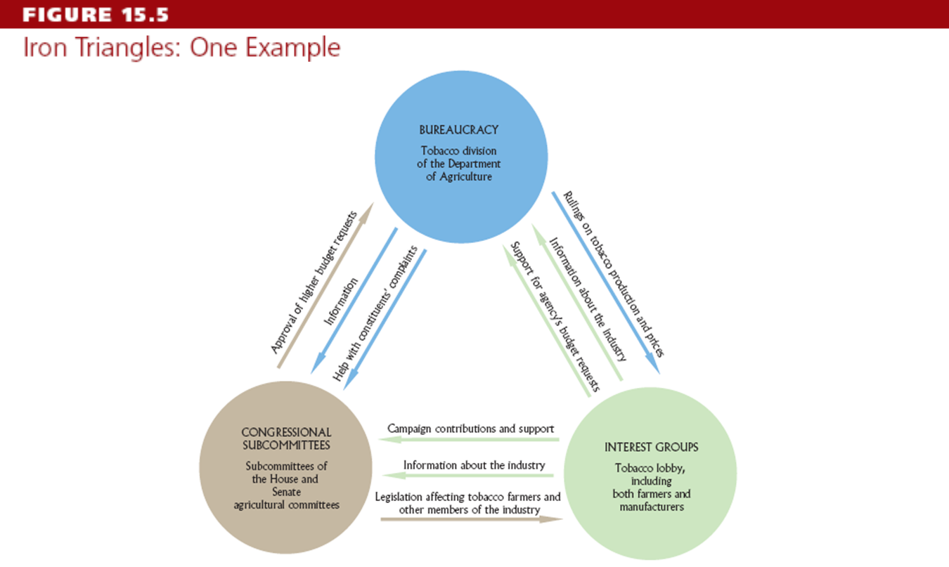
Iron Triangles and Issue Networks
Iron Triangles: a mutually dependent relationship between bureaucratic agencies, interest groups, and congressional committees or subcommittees
These subgovernments can add a strong decentralizing and fragmenting element to the policymaking process.

Slide 24
What You Should Know
Bureaucrats shape policy as administrators, implementers, and regulators.
Bureaucracy’s primary responsibility is the implementation of public policy.
Federal bureaucracy has not grown but has in fact shrunk of late.

Slide 25
The Courts
Chapter 16

Slide 26
Participants in the Judicial System
Litigants
Plaintiff—the party bringing the charge
Defendant—the party being charged
Jury—the people (normally 12) who often decide the outcome of a case
Standing to sue: plaintiffs have a serious interest in the case; have sustained or likely to sustain a direct injury from the government
Justiciable disputes: a case must be capable of being settled as a matter of law.

Slide 27
Count.
Groups
Use the courts to try to change policies
Amicus Curiae briefs used to influence the courts
“friend of the court” briefs used to raise additional points of view and information not contained in briefs of formal parties
Attorneys
800,000 lawyers in United States today
Legal Services Corporation: lawyers to assist the poor
Access to quality lawyers is not equal.

Slide 28
Federal District Courts
Original Jurisdiction: courts that hear the case first and determine the facts - the trial court
Deals with the following types of cases:
Federal crimes
Civil suits under federal law and across state lines
Supervise bankruptcy and naturalization
Review some federal agencies
Admiralty and maritime law cases
Supervision of naturalization of aliens

Slide 29
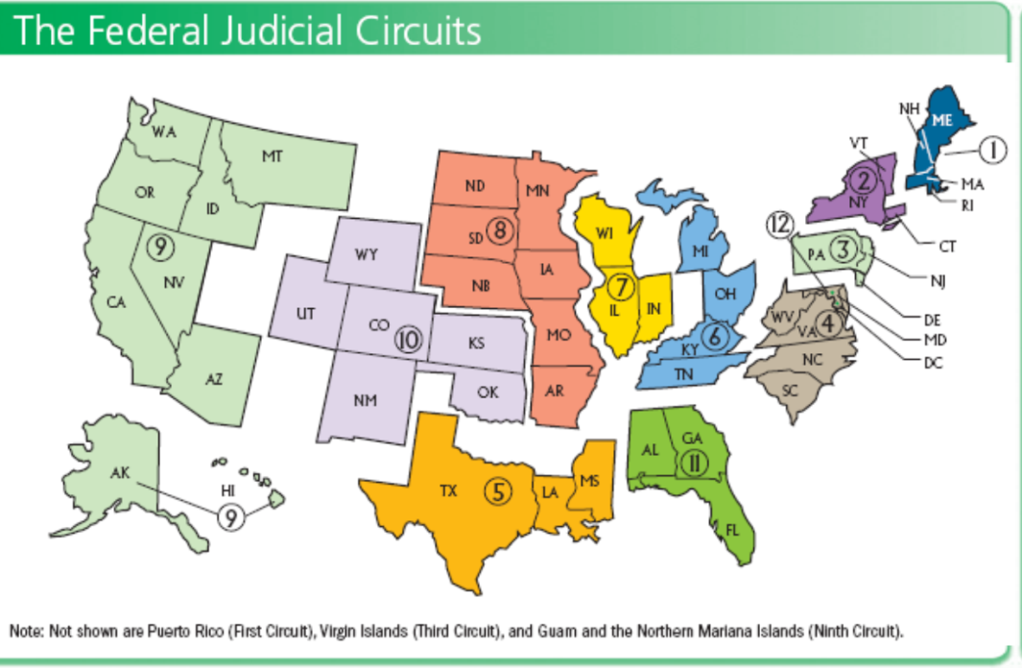
Courts of Appeal
Appellate Jurisdiction: reviews the legal issues in cases brought from lower courts
Hold no trials and hear no testimony
12 circuit courts
U.S. Court of Appeals for the Federal Circuit – specialized cases
Focus on errors of procedure and law

Slide 30
The Supreme Court
Ensures uniformity in interpreting national laws, resolves conflicts among states and maintains national supremacy in law
9 justices – 1 Chief Justice, 8 Associate Justices
Supreme Court decides which cases it will hear—controls its own agenda
Some original jurisdiction, but mostly appellate jurisdiction
Most cases come from the federal courts
Most are civil cases

Slide 31
Judicial Selection
Presidents appoint members of the federal courts with “advice and consent” of the Senate.
The Lower Courts
Appointments handled through Senatorial Courtesy:
Unwritten tradition where a judge is not confirmed if a senator of the president’s party from the state where the nominee will serve opposes the nomination
Has the effect of the president approving the Senate’s choice
President has more influence on appellate level

Slide 32
Judicial Selection
The Supreme Court
Fewer constraints on president to nominate persons to Supreme Court
President relies on attorney general and DOJ to screen candidates
Chief Justice can be chosen from a sitting justice, or as a new member to the Court

Slide 33
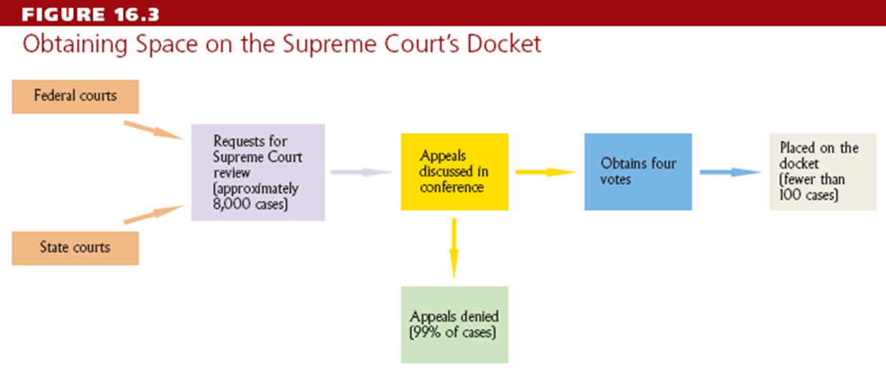
Accepting Cases
Use the “rule of four” to choose cases- when four justices agree to see a case
Issues a writ of certiorari to call up the case
From a lower federal or state court-a formal document that orders the lower court to send up a record of the case for review
Supreme Court accepts few cases each year

Slide 34
Making Decisions
the Court hears oral arguments in two-week cycles.
Unlike a trial court, justices are familiar with the case before they ever enter the courtroom.
The Court will have received written briefs from each party. They may also have received briefs from parties who are interested in the outcome of the case
known as amicus curiae-or "friend of the court"-briefs

Slide 35
opinion
Majority opinion -statement of legal reasoning behind a judicial decision
Dissenting opinions- are written by justices who oppose the majority.
Concurring opinions- are written in support of the majority but stress a different legal basis.
Stare decisis: let previous decision stand unchanged
Precedent: how similar past cases were decided
May be overruled
Original Intent: the idea that the Constitution should be viewed according to the original intent of the framers

Slide 36
Marbury v. Madison (1803) established judicial review
courts determine constitutionality of acts of Congress

Slide 37
What You Should Know
Judicial policymaking and implementation occur in lower federal and state courts.
Many important questions are heard by the courts.
Much decision making is limited by precedent.
Even the unelected courts promote democratic values.

Slide 38
Seeking new lands, seeing with new eyes
Chapter 1

Slide 39
What is Comparative Politics?
The study to understand the differences and similarities among national governments and other political unites around the world.
You can’t spell comparative without COMPARE…well you can but comparing two countries is a main method used amongst political scientist.
Events taking place around the world affect us all.
Relationship between allies
Oil consumption
Foreign trade
Winning of Elections
The Stakes of political life vary from place to place and time to time.

Slide 40
Key Terms
The Government: Term to describe the formal part of the state or the administration of the day. Or, it may be used to refer to the people in power at the moment.
The State: All individuals and institutions that make public policy, whether they are in the government or not. The State deals with the institutions and individuals that have power.
Power: the ability to for people or groups to do what they otherwise would not do.
The Regime: The institutions and practices that endure from government to government, such as the constitutional order in a democracy.
The Nation: primarily a psychological term to describe attachment or identity rather than a geopolitical unit such as the state

Slide 41
Types of States
Industrialized Democracies: The richest countries with advanced economies and liberal states EX: Great Britain, France, United States
Current and Former Communist Regimes: Communism: Theory developed by Marx and Engels that was adapted and used in such countries as China and the former Soviet Union EX: China, Russia
LDCs (Less Developed Countries) EX: Mexico, India, Nigeria, Iran
Newly Industrializing Countries: South Korea, Signapore, Indonesia and Malaysia

Slide 42
Core Concepts
The Interplay between Democracy and Capitalism
Strong State: One with the capacity and the political will to make and implement effective public policy
Weak State: One without the capacity and the political will to make and implement effective public policy.
Political Culture: Basic values and assumptions that people have toward authority, the political system, and other overarching themes in political life. Political Participation: The opportunities that countries give their people to interact with their state.
EX: In a Democracy people are given the right to vote while in an authoritarian system opportunities rarely exist.
Public Policy: The decisions made by a state that define what it will do.
Imperialism: The policy of colonizing other countries.

Slide 43
Core Concepts Cont.
Totalitarianism: Regime in which the state has all but total power.
Globalization: Popular term used to describe how international economic, social, cultural, and technological forces are affecting events inside individual countries
These concepts play an important role in Comparative Politics. It all depends on the countries political culture, their regime, political system, etc…

Slide 44
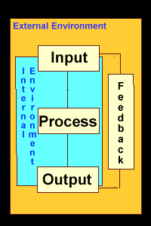
The Political System: The Systems Theory
5 Concepts:
Inputs: Support or demand from people to the state.
Individuals
Interest Groups
Political Parties
Political Culture
Decision Making: The way governments (or other bodies) make policies.
Outputs: Public policy in systems theory.
Feedback: How events today are communicated to people later on and shape what people do later on.
Environment: In systems theory, everything lying outside the political system

Slide 45
Historical and Contemporary Factors
Imperialism: Colonization both positivly and negatively affected different parts of the world.
EX. The US vs LDC (India, Nigeria)
Globalization
International Political Economy (IPE) The network of economic activity that transcends national boundaries.

Slide 46
The Industrialized Democracies
Chapter 2

Slide 47
Industrialized Democracies
Ex: United States, Great Britain, France and Germany
The Basics: Rights: Basic individual freedoms
Competitive Elections:
Electoral systems: ways of counting votes and allocations seats.
Single-member districts
Rule of Law: In a democracy, the principle that legal rules rather than arbitrary and personal decisions determine what happens
Civil Society and Civic Culture
Capitalism and Affluence

Slide 48
The Evolution of Democratic Thought
Thomas Hobbes (1586-1679) “war of all against all” if people were left to their own. Government is used to stop anarchy. People need to give up some freedom to maintain order.
Laissez-faire capitalism: Economic policy that stresses a limited government role. John Locke(1632-1704) State’s role was to protect “life, liberty, and property.”
No country can be considered democratic with the right to vote. Suffrage (the right to vote) was an important part to the evolution of democracy. Voting is a key concept in the system of democracy.

Slide 49
Building Democracies
Transformations into democracy
The Creation of the nation and state
The role of religion in society and government
The development of pressures for democracy
The industrial revolution
Problems that occurred
Cleavages: Deep and long-lasting political divisions Some New democracies turned to Fascism(Right-wing regimes, often drawing on racist philosophies in countries such as Germany and Japan between the two world wars.)
Successful Democracies have legitimacy(key concept stressing the degree to which people accept and endorse their regime.)

Slide 50
Political Parties and Elections
Political Parties: Organization that contests elections or otherwise contends for power.
Social Democratic Parties: Support the nationalization of industry, extensive social welfare programs, and greater equality.
Center Parties: Liberals and Radicals
Christian Democratic Parties
Right Side: Dominated by conservatives.
Catch-All Parties: Term devised in the 1960s to describe a new type of political party that plays down ideology in favor of slogans, telegenic candidates, and the like.

Slide 51
New Divisions
This was a time period that revealed new issues, such as the differences between men and women, the Gender Gap, or the safety and protection of our environment.
Postindustrial society: Society in which the dominant industries are in the service and high-tech sectors.
Post materialism: Theory that young middle-class voters are likely to support environmentalism, feminism, and other new issues.
Greens: In Germany, the first major environmentally oriented party; a junior partner in government until 2006. Realignment: shift in the basic electoral balance of power in which substantial groups in a society change their long-term party identification.
Interest Groups: An organization formed to work for the views of a relatively narrow group of people, such as a trade union or business association. Interest Groups represent the point of view of a certain interest; it is another way of political participation.
Political Protest: form of political participation.

Slide 52
Presidential and Parliamentary Systems
Both are based on competitive elections.
Presidential: The only on is in the US. The president deals with constant compromise, rapid decision making is difficult. Presidents bills go through the House and Senate, Committees, debates and ect..
Parliamentary: Prime Minister calls the shots and does not have to compromise. This causes the government to work quickly. Majority seats in the house basically gets what they want passes. The Prime Minister has so much leverage that he can get what he wants though parliament without worry about committee and debates. Important feature: Cabinet Responsibility(Principle that requires a prime minister and government to retain the support of a parliamentary majority. )

Slide 53
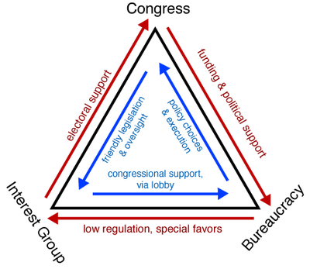
The Rest of the State
Beaucracy: The part of the government composed of technical experts and others who remain from administration to administration.
Iron triangles: A variety of close relationships between business leaders, politicians, and civil servants.
Integrated Elite: In Japan, France, and Germany, refers to cooperation among government, business, and other interest groups.

Slide 54
The Interventionist State
Governments in industrialized democracies that pursue an active economic policy.
Social Services:
Basic Health Care and Education
Subsidized and/or free education at all levels
Unemployment compensation
Pensions and other Programs for seniors
Capitalist economies, most businesses are privately owned.
Privatization: The selling off of state-owned companies.

Slide 55
Great Britain
Chapter 4

Slide 56
Gradualism
Gradualism: the concept of gradualism is used to describe the belief that change ought to be brought about in small, discrete increments rather than in abrupt strokes such as revolutions or uprising.
The Brits are known for the gradual change over time, unlike Russia and China.

Slide 57
Basics
6 predominantly Protestant Countries of Ireland.
UK has just over 60 million people.
Britain has become more diverse, it is no longer an all white country.
Economic Decline
Welfare state is still strong.
Social Class: In Britain it is easy to tell one’s social class by the clothing they were, their accents, or the sport the play.
EX: Soccer is an upper-class sport while Rugby Union is a middle-class sport.

Slide 58
Evolution of the British State
Evolution:
Defined Religion
Building the Nation State
Establishing Liberal Democracy
Dealing with Industrial Revolution
The Brits were able to deal with these events separately and did not need to create a written constitution thanks to gradualism.

Slide 59
The Broad Sweep of British History
(1215) King George forced to sign the Magna Carta, getting rid of an absolute monarchy.
King and Parliament start to shared power/ religion Removed from the Political World
Decline of Royal Power
Great Reform Act of 1832:Law passed in 1832 that expanded the suffrage; widely seen as a key step toward democracy in Britain.
Class Conflict: Workers demand more rights, supports for the Labour Party vs. The Conservative Party
Trades Union Congress(Britain's leading trade union confederation) called for a general strike in 1962.

Slide 60
The Collectivist Consensus
Cross-party British support for the welfare state that lasted until the late 1970s.
Golden Period (1945-mid 1970’s)
Leaders from both parties were on agreement on a variety of issues.
Beveridge Report: Published in the 1940s; set the stage for the British welfare state.
WWII jumped started the collectivist census.
The Collectivist Census failed because
It needed steady economic growth, which wasn’t happening.
There were to many diverse issues coming about that the parties could not agree upon.

Slide 61
Political Participation
1950’s: Low political participation.
1970’s: More people became politically involved, more protest.
1980’s: Unemployment rises, caused strikes, protests and violence.
Growing dissatisfaction with the right wing.
Manifesto: In Britain and other parliamentary systems, another term for a party's platform in an election campaign.

Slide 62
The Conservatives
Britain's most important right-of-center party, in power more often than not for two centuries.
Pragmatic Politicians: flexible with policies if the time permitted.
Noble Roots: High Class, connection to the Royal beginning.
Elitist and effect organization.
Thatcher: Conservative and first woman prime minister of Great Britain. Privatization was what she was known for.
Thatcher was popular in the beginning but after her the conservative party had a hard time getting back on top.

Slide 63
The Labour Party
A center-left democratic socialist political party in the United Kingdom allied with the wider social democratic movement in Europe.
Alliance of trade unions, independent socialist movements and cooperative associations.
For a while, the Labour Party was doing so poorly that some feared that the Alliance(Lineral and Social Democrats) would replace the Labour Party.
Blair/Brown(Labour Leaders) were after Thatcher’s time.

Slide 64
Other Parties
Liberal Democrats
One of the two major political parties of the United Kingdom during the 19th and early 20th centuries. It was the third largest political party throughout the latter half of the 20th century.
Victim to the first-past-the-past (winner take all) electoral system.
Minor Parties: Scottish National Party and other parties created due to Scottish, Welsh and Irish nationalism.
Devolution: The process of decentralizing power from national governments that stops short of federalism.

Slide 65
Parliamentary Sovereignty
House of Commons: The all-important lower house of the British Parliament.
Parliamentary Party: The members of parliament from a single party.
Shadow Cabinet: In systems like Britain's, the official leadership of the opposition party that shadows the cabinet
Backbenches :Members of a parliament who are not in the government or shadow cabinet.
Collective Responsibility: The doctrine that all cabinet members must agree with all decisions.
Three-line Whip: In a parliamentary system, statements to MPs that they must vote according to the party's wishes.
Monarch is there but now only acts a s symbol, no power.
Power lies in the leadership of the majority.

Slide 66
Public Policy
Should Britain join the EU?
Centralized, professional media.
Domestic Politics
Thanks to Thatcher, the UK went from nationalization to privatization.

Slide 67
Current and Former Communist Regimes
Chapter 8

Slide 68
Communism
Controlled all media
Command Economies
Government owned and controlled nearly all industrial and retail activity
State planning committees determined output and consumption goals
Benefits of command economies began diminishing in late ‘80s

Slide 69
Socialism
Public ownership of means of production
Substantial material equality
Economic and political democracy

Slide 70
The Leninist State
Marxism
Communist Party controlled all political life
Democratic centralism was regime model
Until 1950s, USSR controlled “Communist World”
China and USSR split in late ‘50s offered an alternative model
Evolution of society
Dialectics
The belief that change occurs in dramatic bursts from one type of society to another
Historical materialism
Revolution

Slide 71
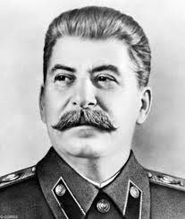
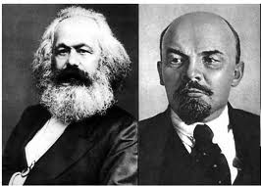
Marxism-Leninism
democratic centralism
Stalinism
totalitarianism

Slide 72
The Marxist-Leninist State
The Party State
Secretariat
term used to denote the bureaucratic leaders of a communist party
Politburo
Generic term used to describe the leadership of communist parties
Nomenklatura-
The Soviet system of lists that facilitated the CPSU''s appointment of trusted people to key positions, adopted by other communist regimes

Slide 73
Reform
Reform came too little too late
No longer a unified Communist movement
Need to change grew at a time leaders were trying to prevent change
Weaknesses of Communist regimes appeared by 1980s
States relaxed repressive policies
Factional disputes divided Chinese rulers
Mikhail Gorbachev became leader of USSR

Slide 74
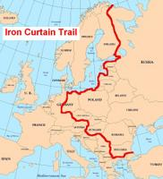
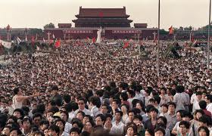
1989: The Year That Changed the World
Solidarity in Poland
Opening the Iron Curtain in Hungary
Emigration and protest in East Germany
Czechoslovakia’s “Velvet Revolution”
Violent revolution in Romania
Massive protest in Tiananmen Square

Slide 75
Transition out of communism
Former Communist states declared themselves democracies
Transitions very difficult
Success stories in Poland, Hungary, and others
China, Vietnam, North Korea, and Cuba remained Communist regimes
Former Soviet Union
No real shift of power to new leaders
Great problems with corruption

Slide 76
Russia
Chapter 9

Slide 77
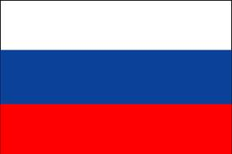
Russia
Was ruled by tsars until 1917
After the October revolution.
Weak state of government
neither domestic nor foreign policy worked

Slide 78
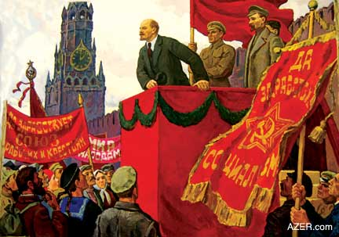
Lenin and the “wrong” revolution:
Lenin’s new take on Marxism led to democratic centralism and a revolution to create socialism
Its considered the wrong revolution because Marxist said to work best this communist party should come from a strong capitalist society first

Slide 79
Stalin, Terror, and the Modernization
Industrialization:
based on squeezing all possible surpluses out of agriculture to make industrial development possible
Foreign Policy:
moving from world revolution to “socialism in one country, to united fronts against fascism to the Cold War
The Purges:
the elimination of anyone who threatened or was thought to be a future threat to Stalin’s leadership

Slide 80
Khrushchev, Brezhnev, and the politics of decline
New leaders in the early ‘50s pursued group leadership and peaceful coexistence
Economic and technological decline result from a conservative consolidation of power

Slide 81
Gorbachev’s ascendancy in ’85 led to innovation
Reform
Glasnost: greater transparency in Party and government operation
Democratization: strengthening of government powers and the election of a legislature
Peristroika: economic restructuring and introduction of market mechanisms
Small-scale private ownership
Agricultural reform
Facilitation of joint ventures with foreign investors
Foreign policy: end the Cold War

Slide 82
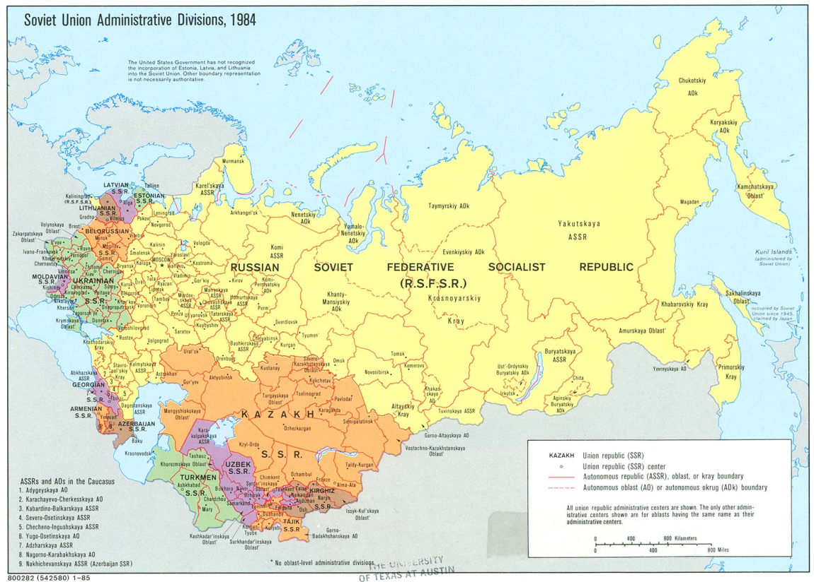
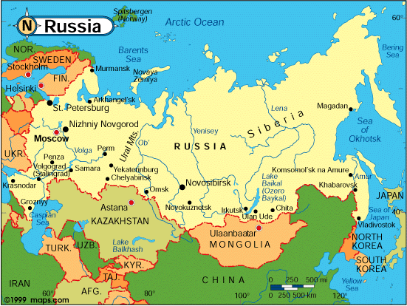
Collapse
Disintegration of Communist Eastern Europe and the USSR- 1991
Security services led coup to replace Gorbachev with Yeltsin

Slide 83
Between Dictatorship and Democracy
The Russian people had a big transition from one president to another
The Russian political culture was based on at the time the certain person in charge that it made the transitions hard
Transition was hard because the political culture was based on the person in charge (like a cult of personality)
Trying out Western ideas in the Russian way

Slide 84
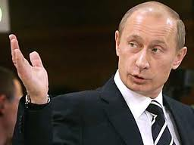
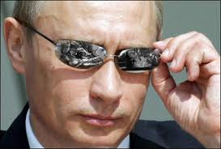
Putin
Named Prime Minster and acting president
Was well received initially
Known for his Stability
Elected president and consolidated power
Since 2000, Putin has centralized power more and more on presidency

Slide 85
Political Culture
Lacking legitimacy, regimes in Russia have relied on force
This leads to continuing suspicion of power elites even if they’re elected
People don’t expect much besides authoritarianism from regimes
Political Parties
Floating party system (means that people don’t identify with a party)
Putin’s manipulation of parties reduces their legitimacy and increases alienation
Elections
Low participation rates
Changing rules and parties reduces legitimacy of votes

Slide 86
China
Chapter 10

Slide 87
The Basics of the People’s Republic of China
Size Matters: China is the world’s most populous country.
Homogenous Population: Rare diversity
Many languages
China is currently in a time of transition.
They are a poor country but working on their social and economic problems
They have a large military(People’s Liberation Army)
Life expectancy has reached age 72

Slide 88
The Evolution of the Chinese State
Confucianism: Chinese philosophical and religious tradition stressing, among other things, order and hierarchy. Confucianism was a thought process that taught social conduct, and shaped the political culture and China itself.
Dynasties played a major role in China’s history.
Chinese began to be colonized in the early nineteenth century. The British took control of their affairs and introduced to a drug called Opium. Extraterritoriality: Portions of China, Japan, and Korea where European law operated during the late nineteenth and early twentieth centuries
During the Hundred Days Reform of 1898 education, the economy, military and the beaucracy were all modernized but it was too late for the already weakened China.

Slide 89
A Failed Revolution
China Steps Up
Sun Yat-sen : President of China after the 1911 revolution. Head of the Nationalist Party (The Kuomintang, the ruling party in China before the CCP victory) or the Kuomintang(KMT) This was a time period were China was trying to reject imperialism. General Yuan Shikai, a warloard, briefly brought the country together.
May Fourth Movement: Chinese protest movement triggered by opposition to the Treaty of Versailles; a major step on the path leading to the creation and victory of the CCP.
Chinese Communist Party (CCP): The only legal party in China, which has run the country since 1949.
Tensions began rising between KMT and the CCP. Communism was separating and growing in power.
Mao Zedong(1893-1976) A man of peasant background who became leader of the of the CCP, and would end up trying to change the culture and moral roots of China. Long March: Retreat by the CCP in the mid-1930s, which turned into one of its strengths in recruiting support.

Slide 90
Factionalism
The Chinese system started to resemble that of the Soviet state that Gorbochev gained. The CCP has power and dominance over all areas. Also based on democratic centralism.
Democratic Centralism: The Leninist organizational structure that concentrates power in the hands of the party elite.
Factions(A group organized on ideological or other lines operating inside a political party) still existed in the CCP, though they were small and “loosely” organized.
Sino-Soviet split: Tensions between the USSR and China that rocked the communist world. Hundred Flowers Campaign: Reformist Chinese campaign in the mid-1950s. Great Leap Forward: This was a failed attempt made by the Chinese in the 1950’s to speed up development. Mao used this to fight opposition.
This failure hurt a whole generation of education
Stifled innovation
Hurt the Economy
Affect China for many years to come
Times change and the idea of the four modernizations came about;
Agriculture
Industry
Science
Military

Slide 91
After Mao’s Death
Organized Dissent
Tiananmen Square: Symbolic heart of Chinese politics; site in Beijing of protests and a massacre in 1989.
The Political culture was being reinvented, the CCP wanted to instill these values:
Collectivism
Struggle and Activism
Egalitarianism and Populism
Self-reliance
Less top-down political activity since Mao’s time.
The people in control become more willing to hear the ideas of the locals.
This was a time period for the Chinese people that represented change and a sort of uprising.
Democracy Wall: Literally, a wall on which Chinese dissidents wrote big-character posters in the late 1970s.
Wei Jingsheng: Major Chinese dissident, now in exile in the United States for critizing the CCP more than anyone dared too.
Democracy Movement (1978) Protests by Chinese students and others that culminated in the Tiananmen Square disaster of 1989 in Beijing.
Falun Gong: Chinese spiritual movement suppressed by the government since the late 1990s.

Slide 92
The Party State
The Party State
Central Committee: The most important body in a communist party; its influence declined as it grew in size and the party needed daily leadership
Politburo: Generic term used to describe the leadership of communist parties.
Standing Committee: The subcommittee that runs the Politburo in China.
Central Advisory Commission (CAC) set up 1982. Informal group of senior Chinese Communist leaders to advise the politburo.

Slide 93
The Party State
Economic Reform
When Mao died the economy was in bad shape, but thanks to Deng and his colleagues, China strayed away from the socialist principles of economics.
Private property
Market force should allocate goods and services and to determine prices
Material incentives(wages, profit, ect..)
Agriculture
Collective farms were divided and split amongst families in plots.
Improved life of peasants for a time being but they were still very poor.
Private Enterprise
Special Economic Zones: Cities and regions in China in which foreigners are allowed to invest.
State-owned enterprises were losing the race and bring China down.
Joint ventures were established.
This was a step for China into the right direction but China was still suffering economically.
Foreign Policy
China Enters WTO
Rocky Relationship with the US

Slide 94
Less Developed Countries
Chapter 11

Slide 95
Less Developed Countries: Third World Countries
Poverty
Violence
Lack of Education
Failed States
Human Development Index (HDI): Combines date on GNP with that on literacy and lifestyle.
Debt Crisis(1980’s): This time period brought the expansion of world trade and the debt of many LDC’s.
Newly Industrializing Countries, have been doing well for themselves but it still aren’t caught up with the rest of the world.

Slide 96
Problems
Environment: The environment of LDC’s is very important. The population is rapidly growing, without the resources to deal with the growth. Since poverty is such a prevalent theme, it also affects the environment. For example, peasants would be willing to cut down trees to sell for food. Clean water is in short supply, which is a terrible factor.
Ethnicity: Racial, linguistic, ethnic and religious conflict is a theme in most LDC’s.
Globalization
Dependency: A radical critique of mainstream economic theory that stresses the continued power the north has over the third world.
Structural Adjustment: Development strategy that stresses integration into global markets, privatization, and so on. Supported by the World Bank, IMF, and other major northern financial institutions.

Slide 97
Imperialism
Imperialism had a permit effect on the countries that it took hold of. They forced their cultures on whatever people they were colonizing.
Three distinct phases:
16th & 17th Century
19th Century
After WWI
Most of the new colonized states has subsistence economies, but the imperial rulers exploited the countries natural resources by using commercial agriculture.
Subsistence Economies: One in which peasants predominate and grow food and other crops primarily for domestic consumption.
They treated the native people as slaves, destroyed their culture and lifestyle, and exploited the people.
Independence came for some:
18th and 19th centuries in Americas
20th Century in Middle East
Post-WWII for Asia and Africa

Slide 98
Postcolonial Problems
The governments degenerated to military, single-party or authoritarian rule.
Trends of civil wars, regional conflicts cleavages, and corruption within the government spread through-out after colonization.
Identity:
Lack of national Identity
Colonial Languages
Patron-Client relations: Relations in which patronsgain the support of clients through the mutual exchange of benefits and obligations.
Fundamentalism: Religious beliefs of a literal nature that often lead to right-wing political views. (Which caused deeper cleavages within the countries.)
Lack of Legitimacy

Slide 99
Weak Sates
Democracies: Few LCD’s have establish this type of government.
Single Party Regimes
Military Regimes
Personal Dictatorships
Failed States
States struggle to maintain law and order.
Lack of Money is a problem.
Trouble Developing Regimes.
Plagued by corruption

Slide 100
Import Substation: Development strategy that uses tariffs and other barriers to imports, and therefore stimulates domestic industries.
Ineffective
debt
Parastatals: Companies owned or controlled by the state in the third world.
Hard Currencies: Currencies that can be traded openly on international markets.
Structural adjustment: Development strategy that stresses integration into global markets, privatization, and so on. Supported by the World Bank, IMF, and other major northern financial institutions.
Free enterprise
International Financial institutions
IMF International Monetary Fund
World Trade Organization (WTO)
World Bank
Conditionality: The imposition of stipulations before the granting of loans by the IMF, World Bank, and other international financial institutions.
Foreign Aid
Money or goods provided by richer countries to help poorer ones develop
Debt trap: The inability of third world countries to pay back their loans to northern creditors.
Microcredit: Lending and development strategy that stresses small loans for new businesses, developed by the Grameen Bank in Bangladesh.

Slide 101
Hope for Democracy?
There is a chance for LCD’s to adapt a democratic political system that recognizes human rights and has more political participation assimilated into the political culture.
There is lack of western influence in their feedback, which stifles the spread of the influence.
It is all about timing, global factors and the people’s support
Though the regimes might develop, it may not be exactly what we imagine as democracy.

