Slide 1
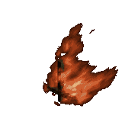
Objective: To examine the significance of the Triangle Shirtwaist Factory Fire.
The Triangle
Shirtwaist
Factory Fire,
March 25, 1911

Slide 2
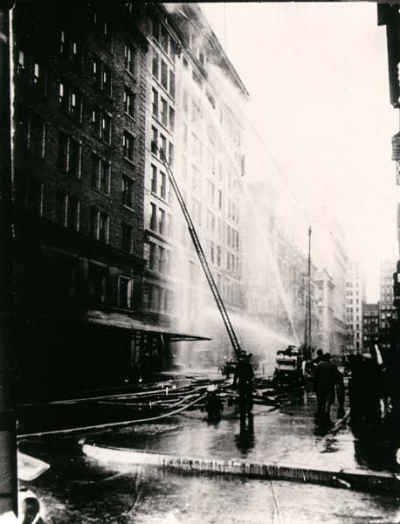
Triangle Fire – (1911) One hundred and fifty people, mostly young women, died in a fire at the Triangle Shirtwaist Factory in New York City.
Fire fighters arrived soon after the alarm was sounded but ladders only reached the 6th floor and pumps could not raise water to the highest floors of the 10-story building. Still the fire was quickly controlled and was essentially extinguished in half an hour. In this fire-proof building, 146 men, women, and children lost their lives and many others were seriously injured.

Slide 3
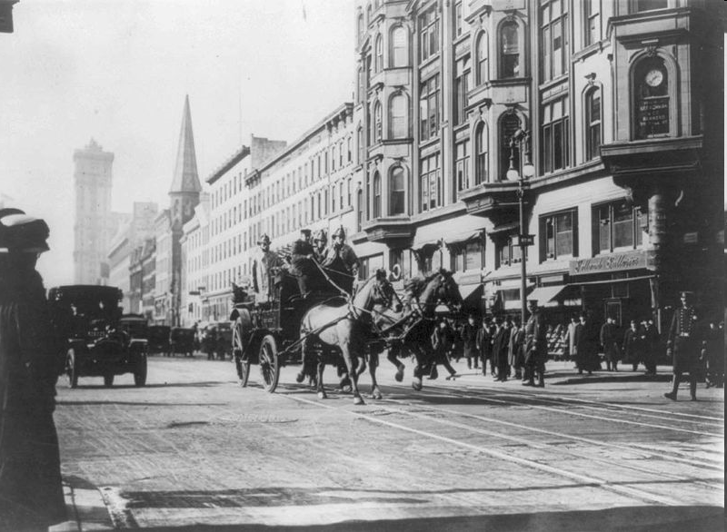
Horse-drawn fire engines in street, on their way to the Triangle Shirtwaist Company fire, New York City (March 25, 1911)

Slide 4
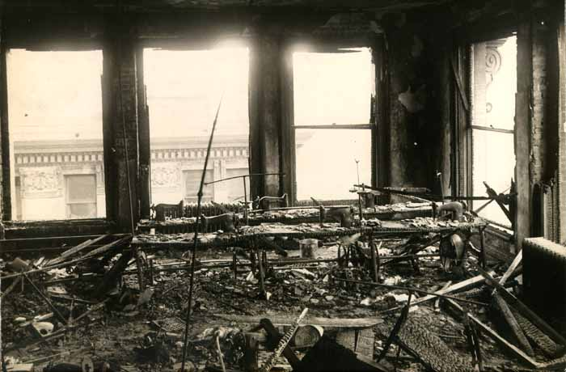
The 240 employees sewing shirtwaists on the ninth floor had their escape blocked by back-to-back chairs and workbaskets in the aisles. The 75-foot long paired sewing machine tables obstructed essential access to the windows, stairs, and elevators.

Slide 5
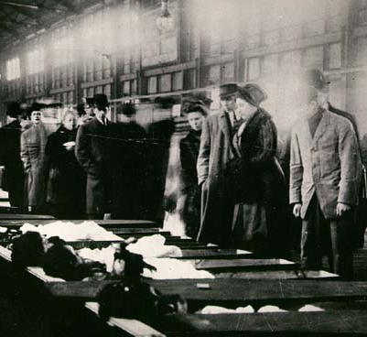
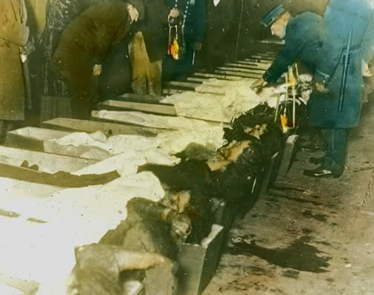
For endless hours, police officers held lanterns to light the bodies while crowds filed past victims laid out in numbered rough brown coffins. As the dead were identified the coffin was closed and moved aside. Forty-three were identified by sunrise on Sunday. Six days later 7 were still unrecognized.

Slide 6
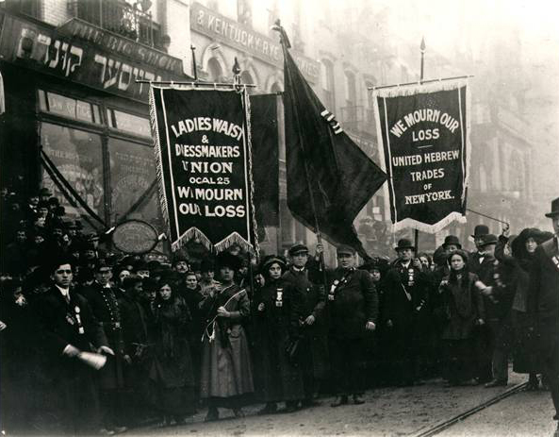
Labor unions, religious communities, political groups and social reform organizations assembled to mourn the lost lives and demand real progress in worker protection. At times their differences in methods and priorities threatened to take back gains made in public awareness and the commitment to act.

Slide 7
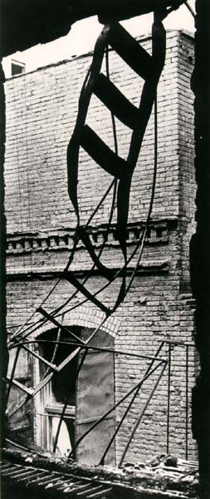
Few of the terrified workers on the 9th floor knew that a fire escape was hidden behind iron window shutters. The ladder descended next to the building forcing those fleeing to climb down through flames as they struggled past other shutters stuck open across their path. The design had been deemed inadequate and the material from which it was made was insubstantial. After a few made their way down, the heat of the fire and weight of the people caused the ladder to twist and collapse dropping many who had chosen it as their lifeline.

Slide 8
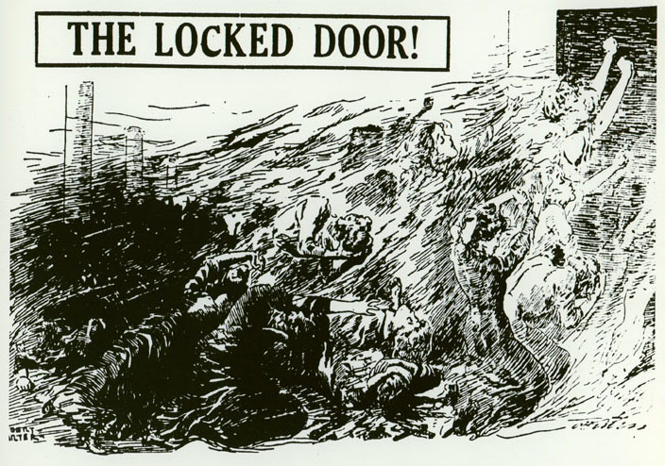

Slide 9
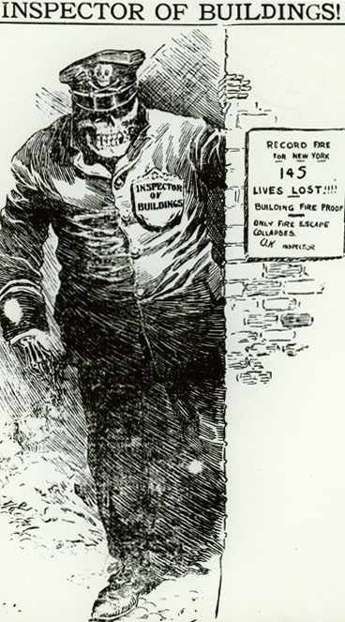
- After the fire, new laws were passed to protect factory workers.
Webpage for the HBO documentary “Triangle: Remembering the Fire”

Slide 10
Out of the Ashes
International Ladies’ Garment Workers’ Union membership surged.
NYC created a Bureau of Fire
Prevention.
New strict building codes were
passed.
Tougher fire inspection of
sweatshops.
Growing momentum of support for
women’s suffrage.
Further exposed the abuses of women and children in factory work.

