Slide 1
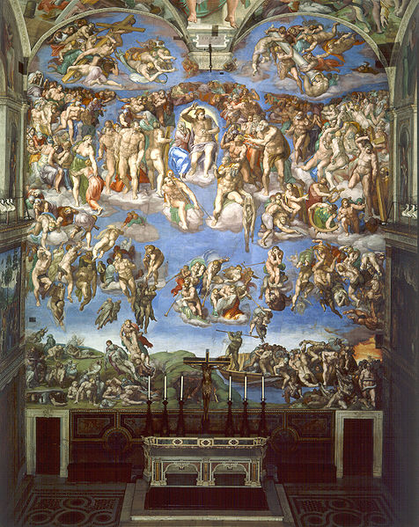
The last supper
BY

Slide 2

Michelangelo

Slide 3
The last judgment history
The work was started in 1537 and completed in 1541.
The work was painted on the wall behind the altar in the Sistine chapel.
The painting was considered immoral and was denounced by the church.
Later censored by Daniele da Volterra who was nicknamed the trouser artist

Slide 4
Artistic significance
This painting sparked the fig leaf campaign
The fig leaf campaign was a movement form the catholic church to remove indecency from art.

Slide 5
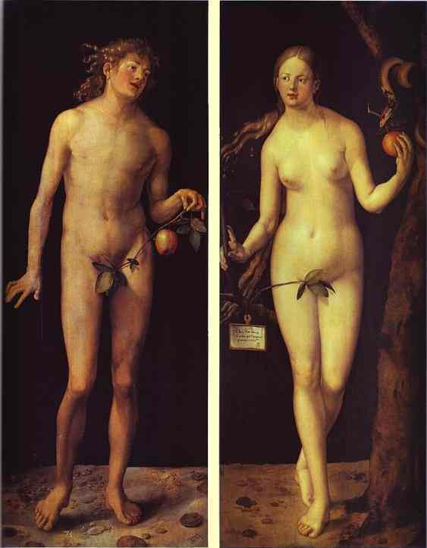
Note the fig leafs
The much later blue box campaign

Slide 6
Symbolism
There are two major symbolic gestures in this painting
The first is a depiction of Biagio da Cesena who was the Popes master of ceremonies and a major critic of this work as minos judge of the under word with donkey ears.
When Cesena complained to the poped the pope stated that he had no jurisdiction in hell it would remain as is

Slide 7
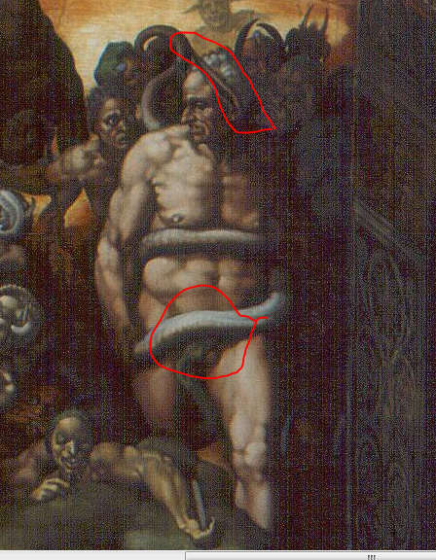
Note the donkey ears
censorship

Slide 8
Symbolism Cont
The second was a depiction of Pietro Arentino as St.Bartholomew holding flayed skin which resembled Michelangelo
Arentino (a satirist and eroctic writer was trying to extort a valuable drawing from Michealangelo
The flayed skin represented his resentment at having to do the painting and his pain at being extorted

Slide 9
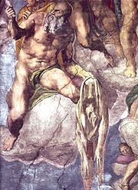

Slide 10
Importance to Asher
This painting was not assigned to Asher by Jacob Kahn
Asher chose to do this picture to scare a classmate so he would stop picking on him.
This painting is significant because it was the first time asher really put an emotion other than happiness or sadness into one of his painting
I Believe the artist chose this painting because Michealangleo similar to Asher put the faces of people who were causing him pain into the picture

Slide 11
Bibliography
John Dixon-The Terror of Salvation-@ http://www.crucifixion.com/visual/theology/johndixon/terror.htm
The last judgement-images of a masterpiece @ http://www.italian-renaissance-art.com/Last-Judgement.html
The last judgment-@ http://mv.vatican.va/3_EN/pages/x-Schede/CSNs/CSNs_G_Giud.html

