Slide 1
Chapter 9: Intelligence
Case Study: What Makes a Creative Genius?
Section 1: What Is Intelligence?
Section 2: Measurement of Intelligence
Section 3: Differences in Intelligence
Section 4: What Influences Intelligence?
Lab: Applying What You’ve Learned

Slide 2
Case Study: What Makes a Creative Genius?
Harvard psychologist Howard Gardner studied some of the most creative people of the 1900s and developed a set of characteristics that describe an Exceptional Creator.
People in Gardner’s Study
The Exceptional Creator
Sigmund Freud
Albert Einstein
Pablo Picasso
Igor Stravinsky
T. S. Eliot
Martha Graham
Mohandas Gandhi
Using what he learned, Gardner developed an imaginary person who combines common characteristics of creative people.
He called the imaginary person an Exceptional Creator.
Notes:
–

Slide 3
What do you think?
What seven types of intelligence did Gardner’s Exceptional Creator demonstrate?
What living person do you consider an Exceptional Creator? How does he or she exhibit the common characteristics of creators?

Slide 6
Section 1 at a Glance
What Is Intelligence?
Intelligence is different from achievement.
Psychologists have developed several different theories of intelligence.

Slide 7
What Is Intelligence?
Main Idea
Psychologists have many different theories of intelligence.
Reading Focus
How is human intelligence a puzzle?
What are some of the leading theories of intelligence?

Slide 8
Can a computer be a Grand Master?

Slide 9
The Intelligence Puzzle
Understanding Achievement
Psychologists say that intelligence is not the same as achievement.
Achievement refers to knowledge and skills gained from experience.
Intelligence makes achievement possible by giving people the ability to learn.
Understanding Intelligence
Intelligence is the abilities to learn from experience, to think rationally, and to deal effectively with others.

Slide 10
Reading Check
Analyze
What is the difference between achievement and intelligence?
Answer: Achievement refers to knowledge and skills gained from experience, whereas intelligence gives people the ability to learn from experience.

Slide 11
Theories of Intelligence
Spearman’s Two-factor Theory
The g factor, or general intelligence, represents the abilities to reason and to solve problems.
Specific, or s, factors account for people’s specific abilities.
Thurstone’s Theory of Primary Mental Abilities
There are seven “primary mental abilities.”
They are: word fluency, verbal comprehension, spatial visualization, facility with numbers, memory, reasoning, and perceptual speed.

Slide 12
Gardner’s Theory of Multiple Intelligences
There are nine types of intelligences that are independent of one another.
They are: verbal or linguistic; logical-mathematical; visual-spatial, bodily-kinesthetic, musical-rhythmic, intrapersonal, interpersonal, naturalist, and existential.
Sternberg’s Triarchic Theory
Intelligence has three factors: analytical intelligence, creative intelligence, and practical intelligence.
People use more than one factor at the same time.

Slide 13
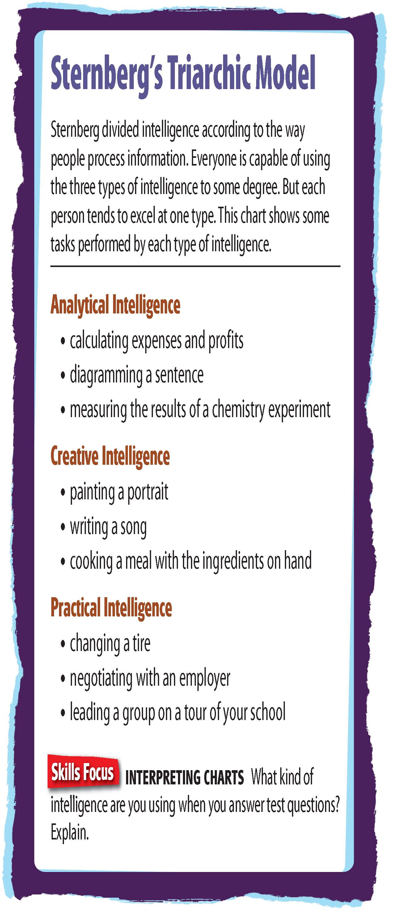

Slide 14
Emotional Intelligence
The emotional intelligence theory consists of five factors that are involved with success in school or on the job.
The five factors are: self-awareness, mood management, self-motivation, impulse control, and people skills.

Slide 15
Reading Check
Summarize
Name and describe the theory of intelligence that suggested that there was a single, basic intelligence.
Answer: Spearman’s two-factor theory; general intelligence, or g, represents abilities to reason, solve problems, underlies intellectual abilities.

Slide 16
Section 2 at a Glance
Measurement of Intelligence
Psychologists use tests to measure a person’s intelligence.
Intelligence tests must be both reliable and valid.
Problems with the use and design of intelligence tests have led to some controversies.

Slide 17
Measurement of Intelligence
Main Idea
Psychologists have developed different kinds of intelligence tests. To be useful, the tests must be reliable and valid.
Reading Focus
What are the two most widely used intelligence tests?
How are test reliability and validity measured?
What are some controversies and problems associated with intelligence tests?

Slide 18
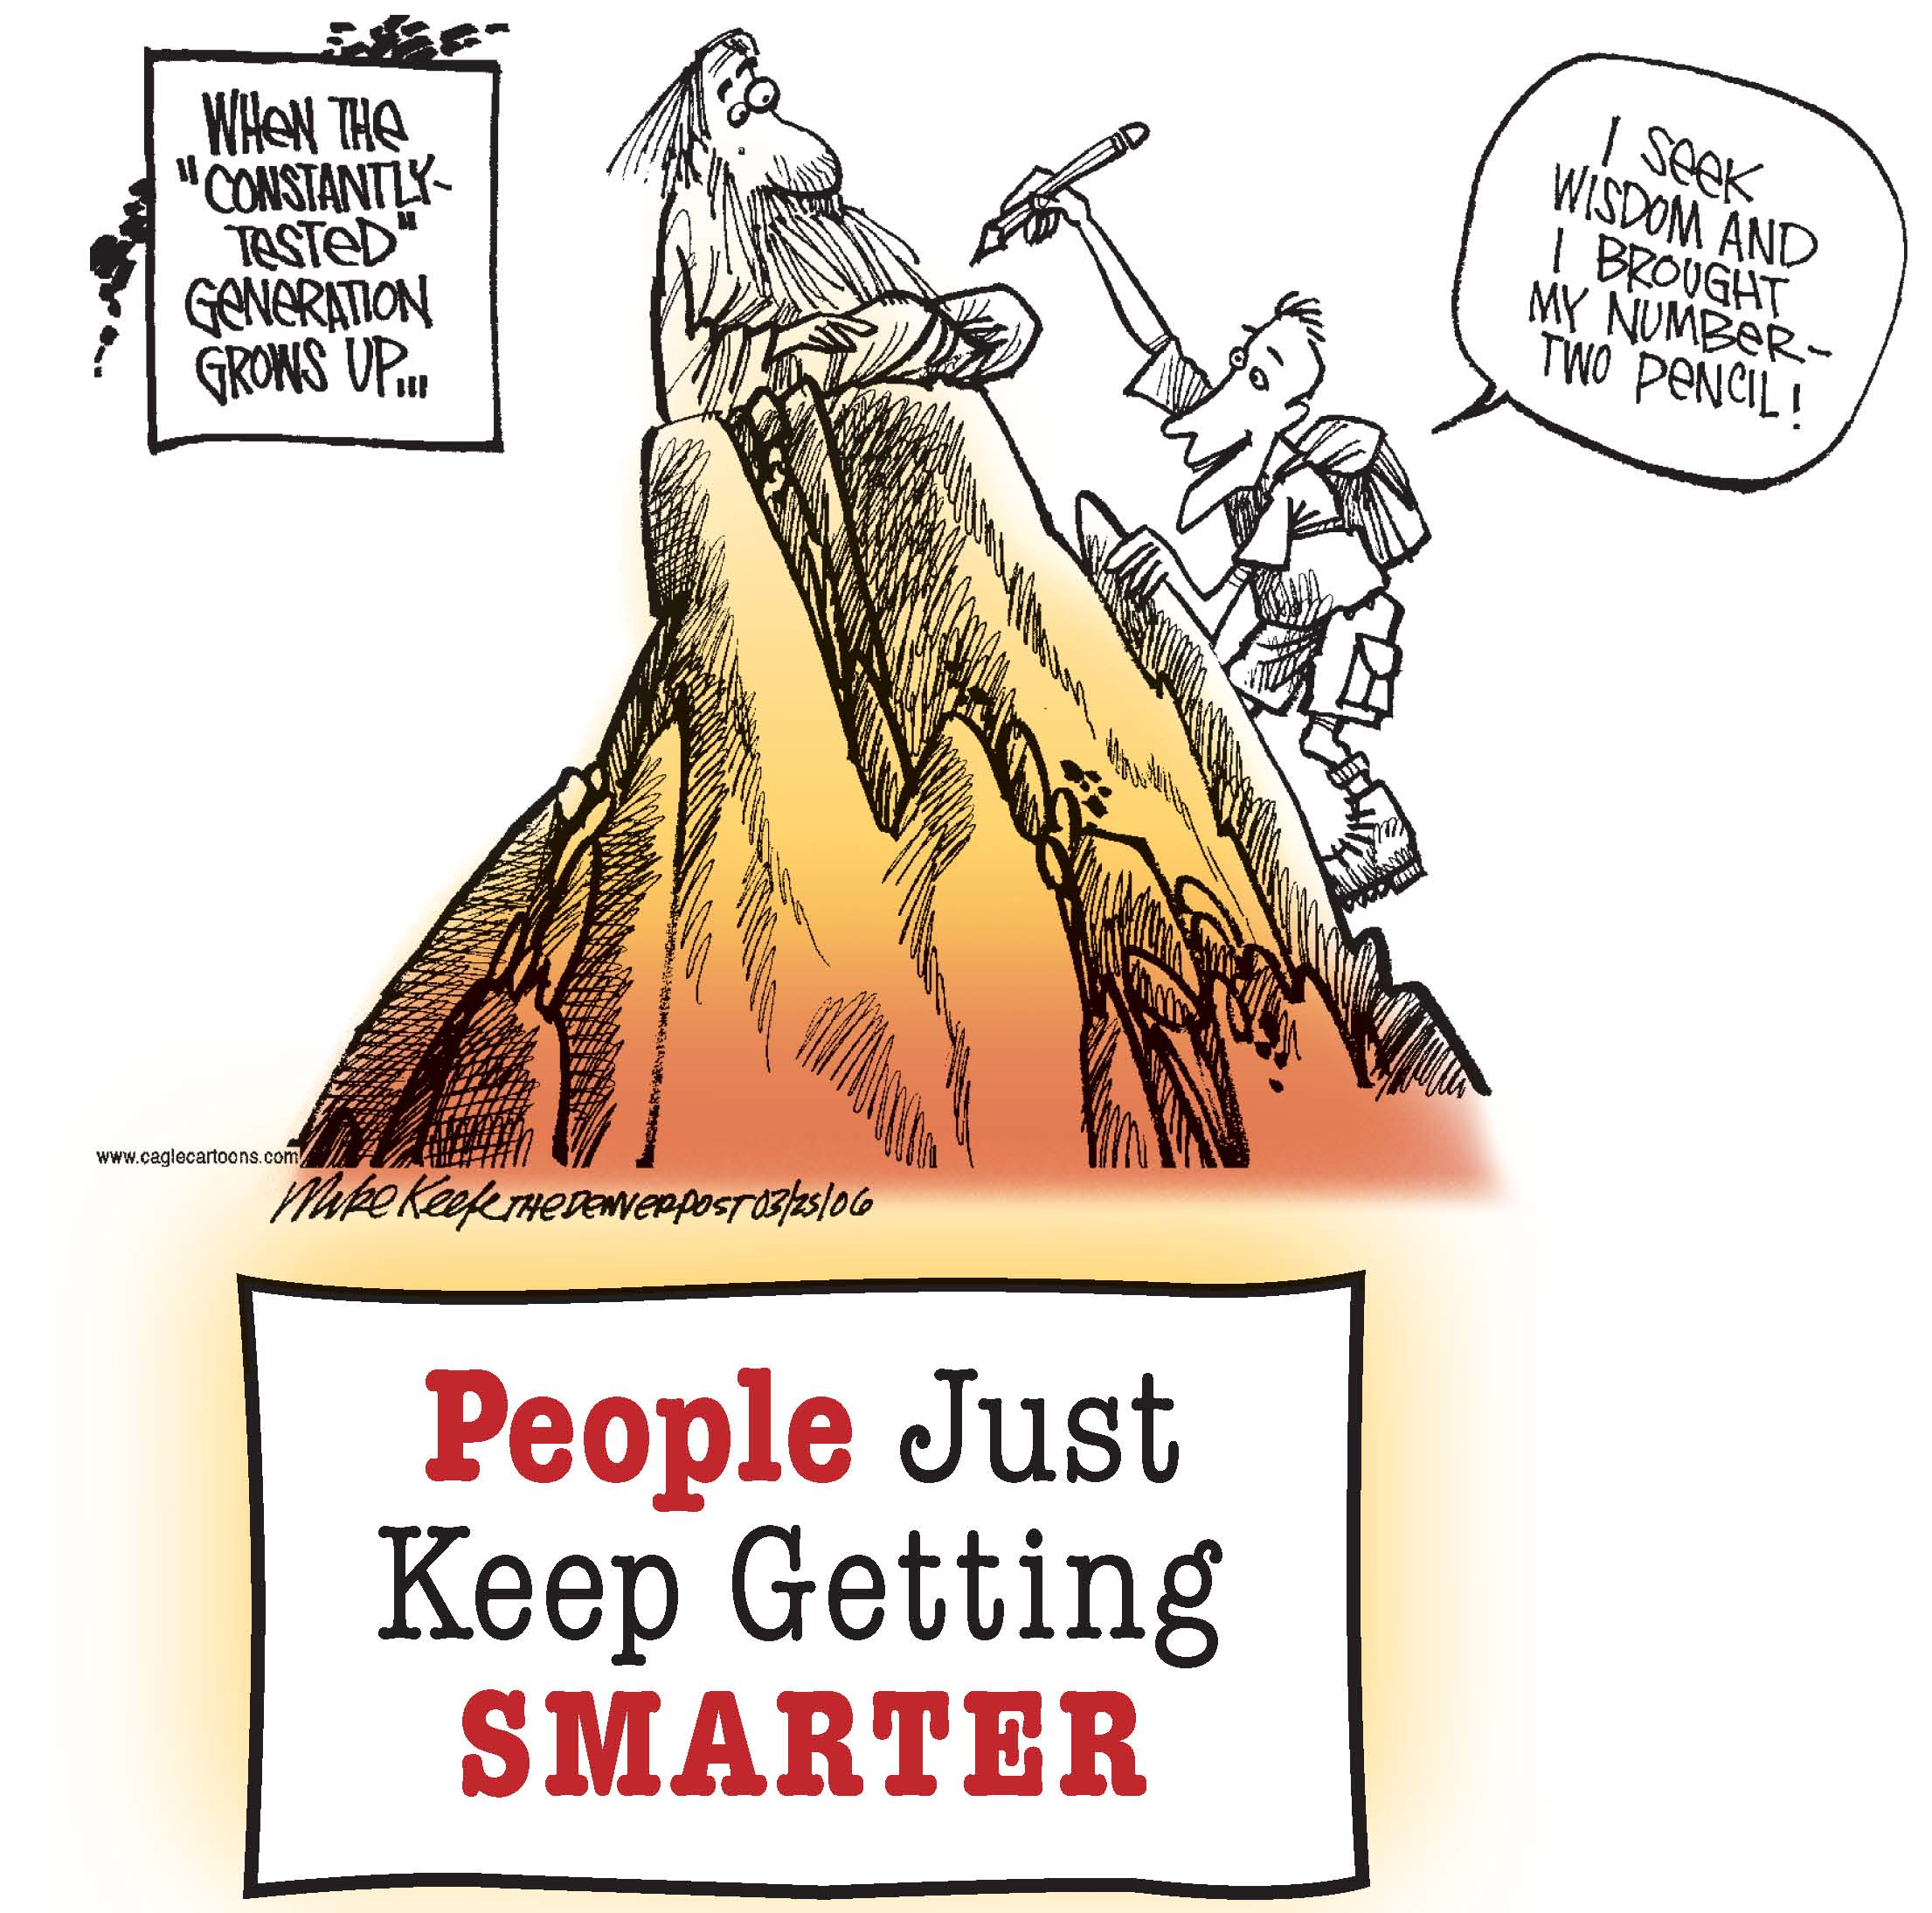
Why do scores keep rising on intelligence tests?

Slide 19
Two Intelligence Tests
The Stanford-Binet Scale
Original test first used in 1905
Gave a score called a mental age (MA), which shows the intellectual level at which a child is functioning
After 1916, known as the Stanford-Binet Intelligence Scale
Version used today gives an intelligence quotient (IQ), or a number that reflects the relationship between mental age and chronological age
IQ is an example of a transformed score
The Wechsler Scales
Revised Wechsler Adult Intelligence Scale (WAIS-R) has subtests, each measuring a different intellectual skill
Scales do not use mental age
Scales measure both verbal and nonverbal abilities
WAIS-R scores based on comparisons of a person’s answers with the answers of others in the same age group

Slide 20
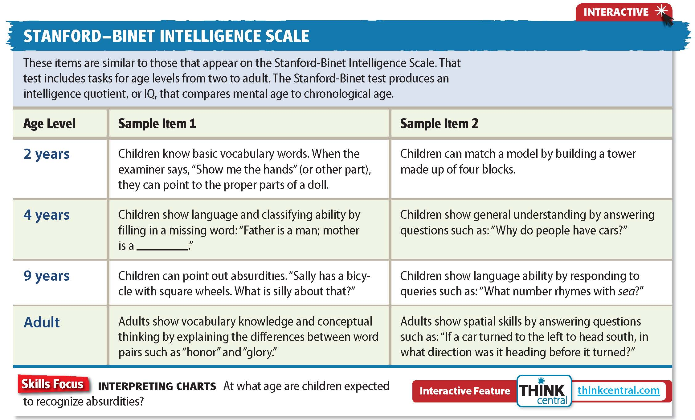
Click on the image to play the Interactive.

Slide 21
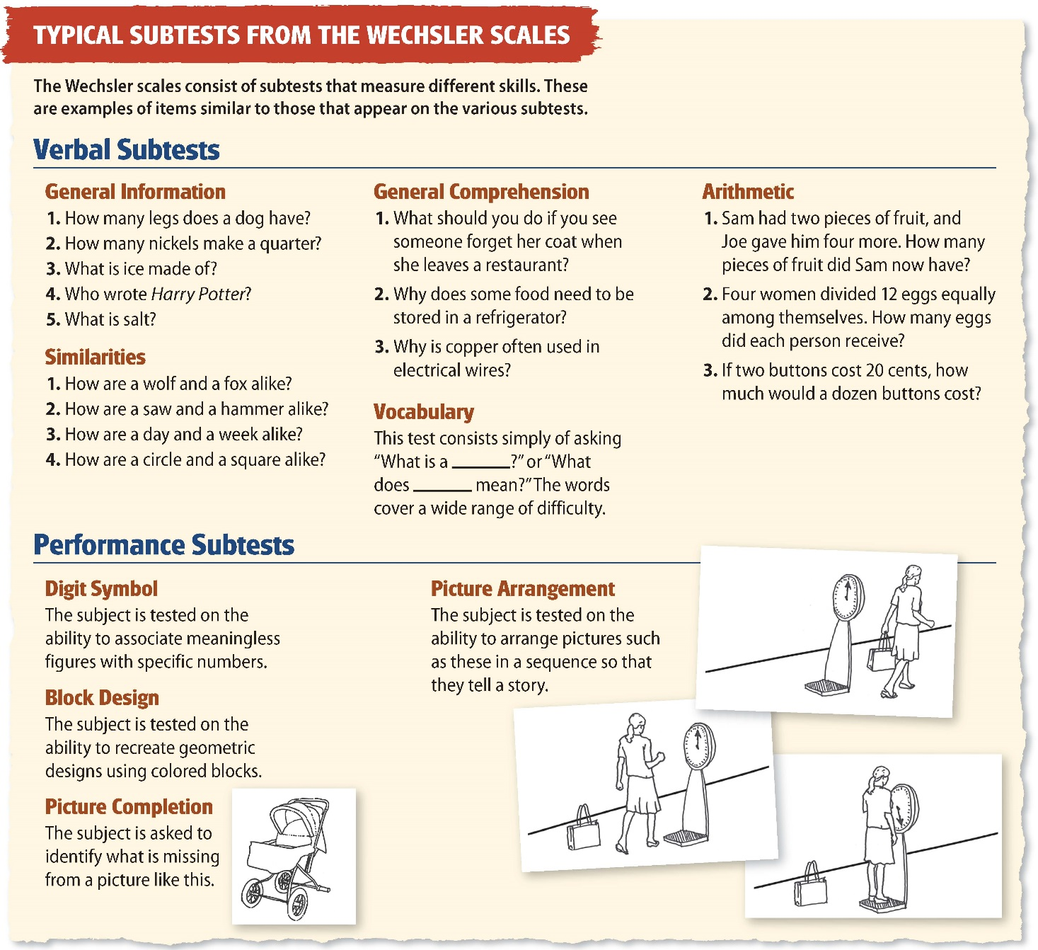

Slide 22
Reading Check
Identify
What is now the most widely used intelligence test?
Answer: the revised Wechsler Adult Intelligence Scale

Slide 23
Reliability and Validity
Intelligence tests must be reliable and valid.
Test Reliability
Test Validity
The reliability of a test refers to its consistency.
One common way to show reliability is called test-retest reliability, which is determined by comparing scores earned by the same person on the same test taken at different times.
A test has validity if it measures what it is supposed to measure.
Test scores are compared with outside standards or norms to determine test validity.
Some psychologists believe that it is difficult to make definitive statements about the validity of IQ tests.
Notes:
–

Slide 24
Reading Check
Infer
What scores would you expect if a person took an unreliable test several different times?
Answer: Most likely, the scores would vary widely.

Slide 25
Controversies and Problems
Controversies
In the early 1900s, intelligence tests were used to limit the number of immigrants entering the United States and many states sterilized “mentally defective” people.
Another controversy focused on cultural bias that charges that some tests give an advantage to a particular group of people.
Problems
Education, economic background, and motivation can affect the results of intelligence tests.
Stereotype threat is another problem associated with intelligence tests.

Slide 26
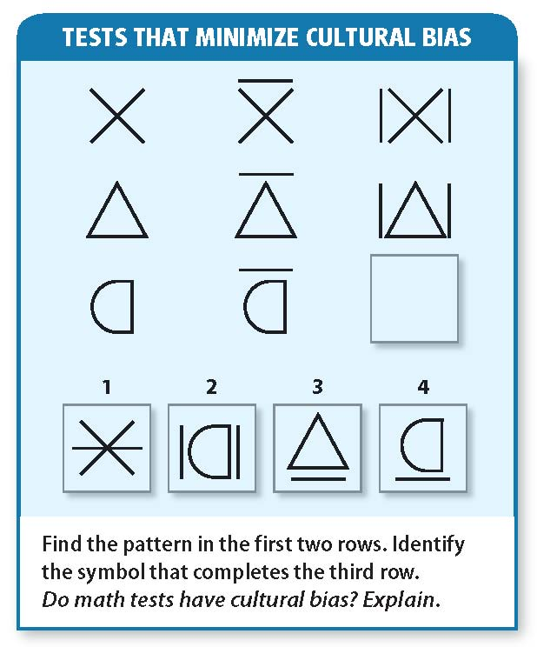

Slide 27
Reading Check
Identify Supporting Details
What are two ways in which an intelligence test might show cultural bias?
Answer: designed by and for one specific culture; based on factors common to a particular culture

Slide 28
Section 3 at a Glance
Differences in Intelligence
Most people have average intelligence.
There are several levels of mental retardation.
The gifted have high intelligence and special talent.
Creativity is independent of intelligence.

Slide 29
Differences in Intelligence
Main Idea
Most people have average intelligence. A few have either very high or very low intelligence.
Reading Focus
What is average intelligence?
How is mental retardation defined?
Does giftedness just mean being very smart?
What is creativity?

Slide 30
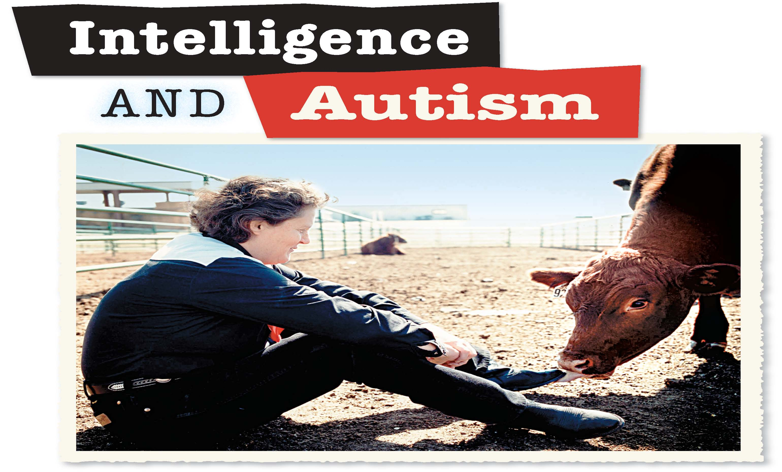
Does autism help Temple Grandin understand animals?

Slide 31
Average Intelligence
Intelligence tests help identify people who are out of the ordinary.
The education system best suits people with average intelligence.
By design, the average IQ score is 100.
About half of the people in the United States have IQ scores in the broad average range of 90 to 110.
Nearly 95 percent get scores between 70 and 130.
People with scores of 70 or below are defined as having mental retardation.
People with scores of 130 or above are regarded as gifted.
In both cases, special help is needed.

Slide 32
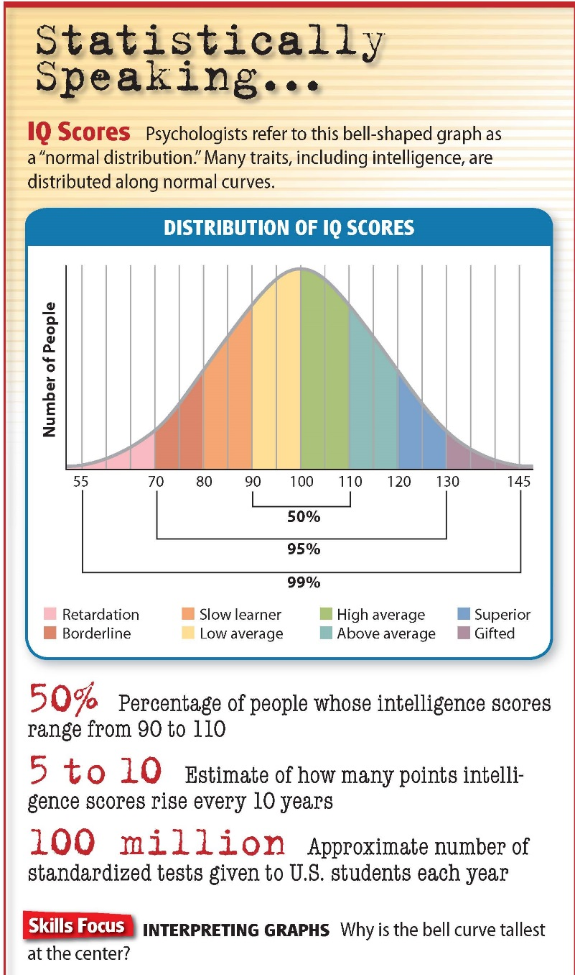

Slide 33
Reading Check
Find the Main Idea
What is the average score on an intelligence test?
Answer: 100

Slide 34
Mental Retardation
The technical definition of mental retardation is an IQ score at or below 70.
There are several levels of mental retardation.
Mild Retardation
Moderate Retardation
About 80 percent of people classified as mentally retarded have IQs ranging from 50 to 70.
As children, they have some difficulty learning to walk, talk, and feed themselves.
As adults, they are often able to take care of themselves and hold jobs.
People with IQ scores from 35 to 49 have moderate retardation.
They can learn to speak, dress themselves, and work under supportive conditions.
Children with Down syndrome are most likely to be classified at this level.
Notes:
–

Slide 35
Severe Retardation
People with an IQ of 20 to 34 are severely retarded.
They usually need constant supervision.
They can perform daily routines and repetitive activities, but need continuing direction in a protective environment.
Profound Retardation
People with an IQ below 20 are profoundly retarded.
They are dependent on other people for their care throughout their lives.

Slide 36
Causes of Retardation
Accidents that result in brain damage and difficulties during childbirth can cause mental retardation.
Genetic disorders or abnormalities are also causes.

Slide 37
Reading Check
Identify
What are the four levels of mental retardation?
Answer: mild, moderate, severe, profound retardation

Slide 38
Giftedness
The technical definition of gifted means to have an IQ score of 130 or above.
Generally, to be gifted is to possess outstanding talent or to show the potential for performing at remarkably high levels of accomplishment when compared with other people of the same age, experience, or environment.
The most gifted children are sometimes called child prodigies.
A prodigy develops special skill in a particular talent or discipline in childhood.

Slide 39
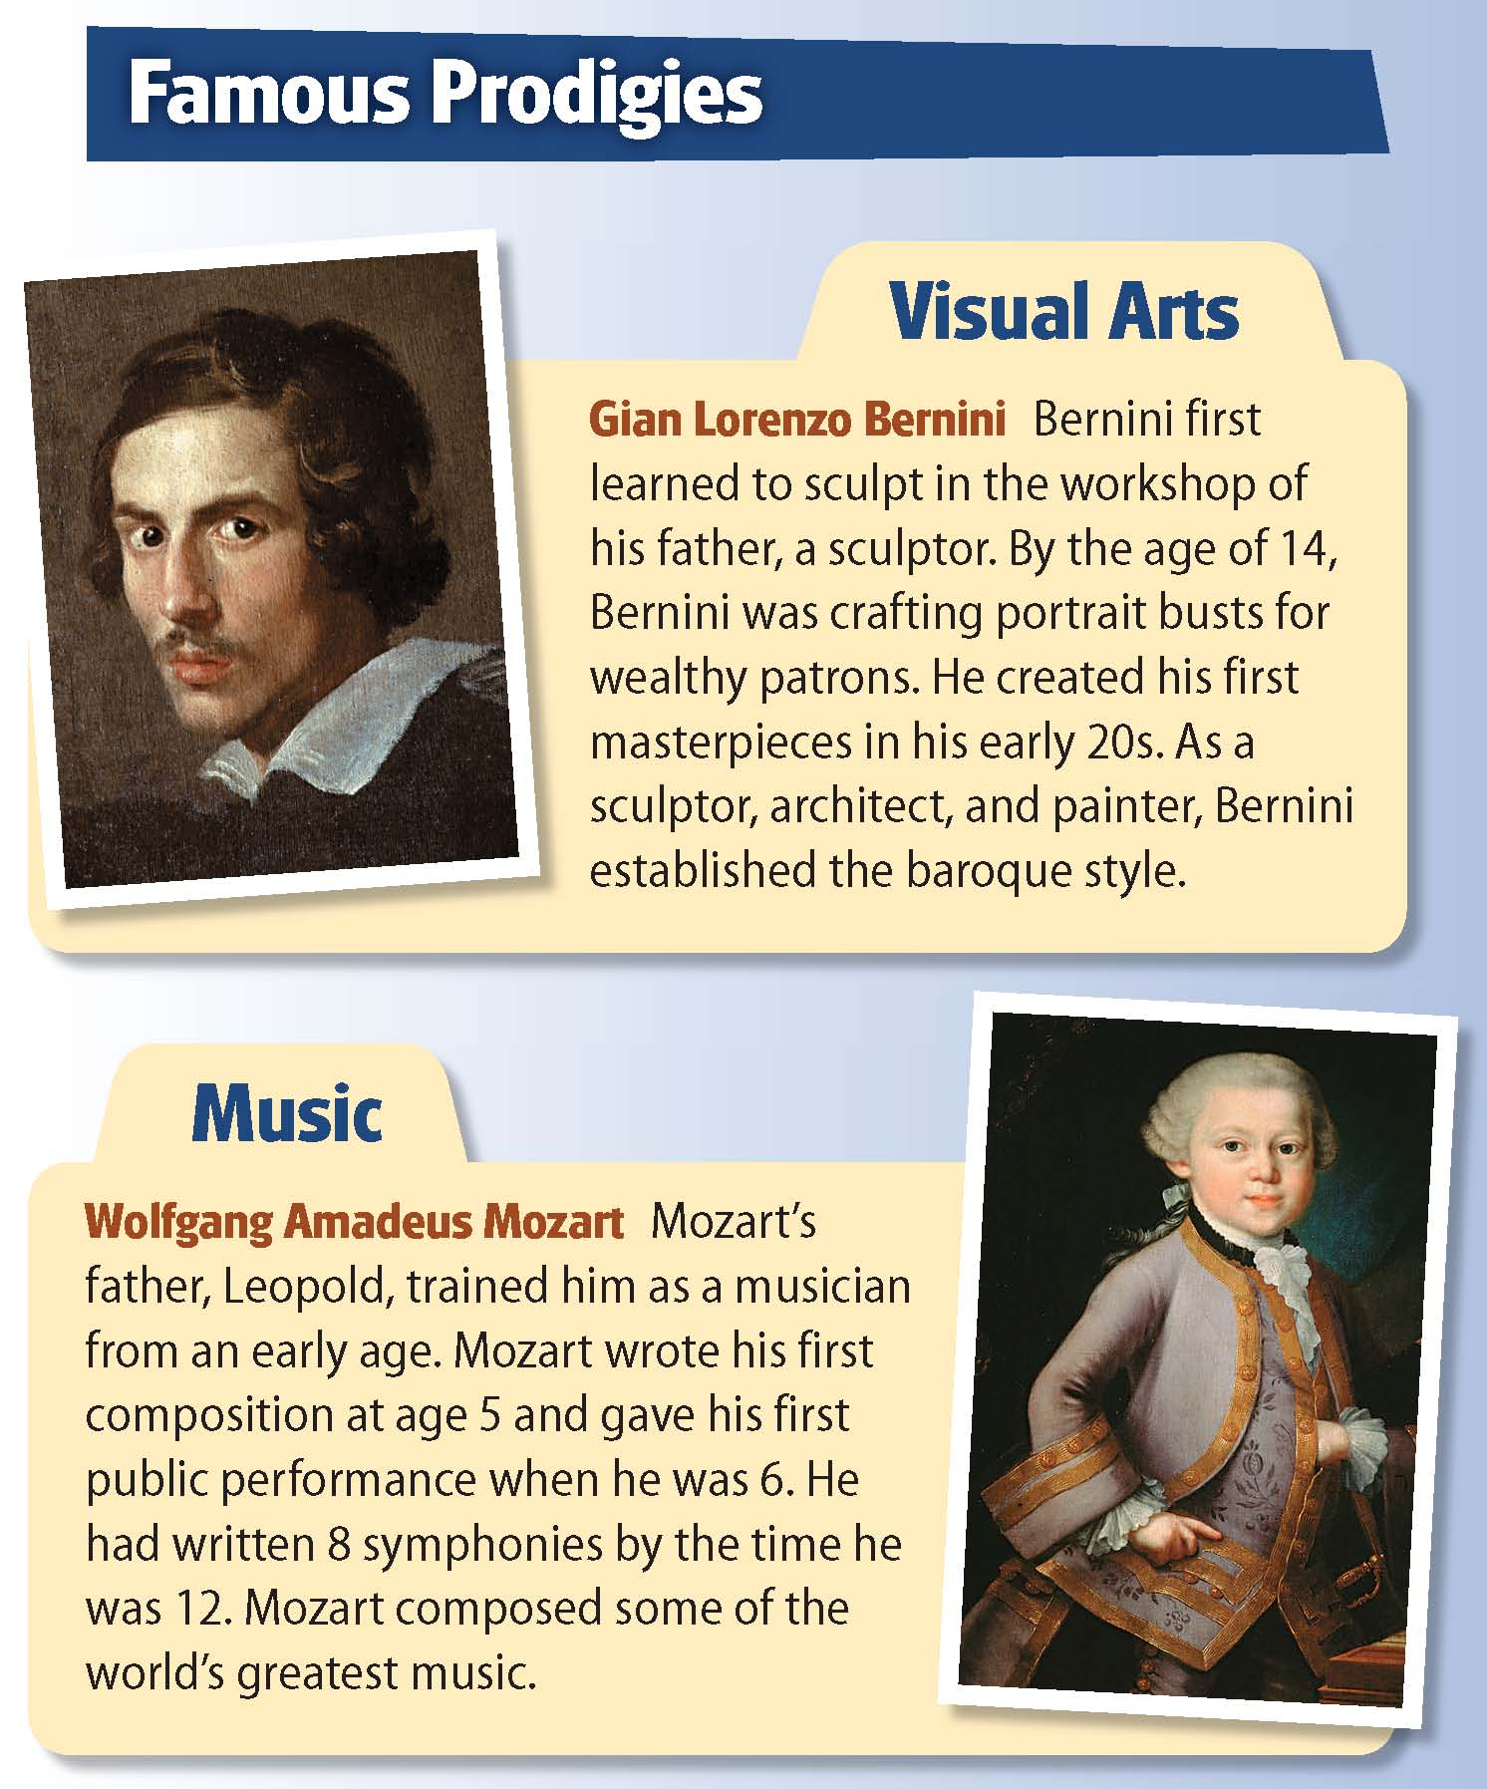
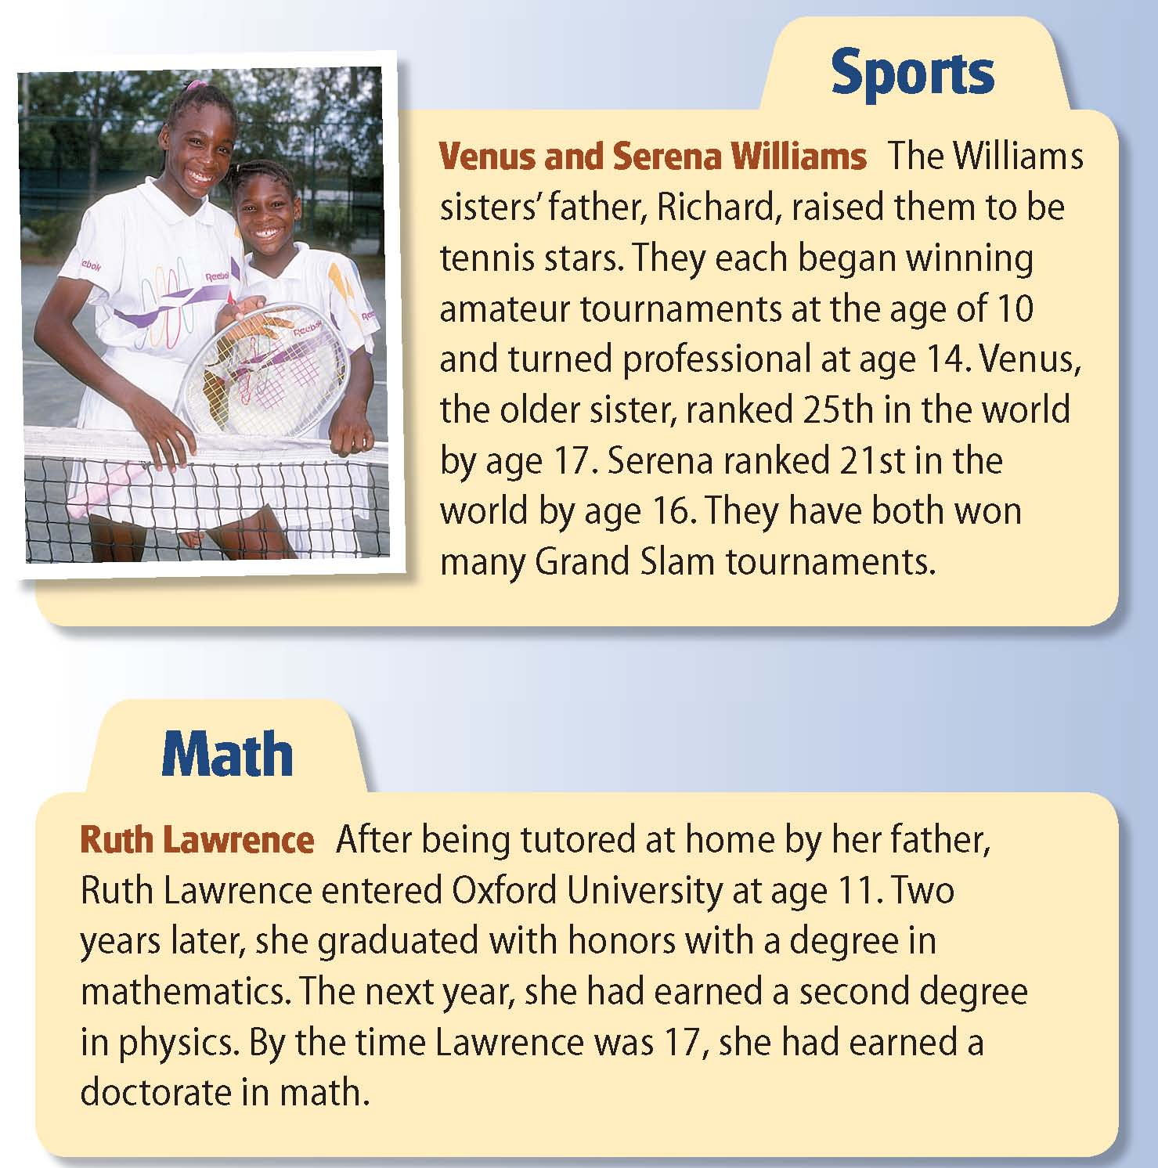

Slide 40
Reading Check
Summarize
What does it mean to be gifted?
Answer: to possess outstanding talent or to show the potential for performing at remarkably high levels of accomplishment

Slide 41
Creativity
Giftedness is often linked with creativity.
Creativity is the ability to invent new solutions to problems or to create original or ingenious materials.
A person can be highly creative without being gifted.
High intelligence does not guarantee high creativity.

Slide 42
Reading Check
Draw Conclusions
Are all creative people highly intelligent? Explain.
Answer: No, some highly creative people may be below average in intelligence.

Slide 43
Section 4 at a Glance
What Influences Intelligence?
Genetic factors have a strong influence on intelligence.
A nurturing environment promotes intellectual development in children.
Advanced age limits some aspects of intelligence.

Slide 44
What Influences Intelligence?
Main Idea
Both heredity and environment influence a person’s intelligence.
Reading Focus
How does your genetic makeup influence your intelligence?
How does your environment influence your intelligence?
What are some of the connections between aging and intelligence?

Slide 45
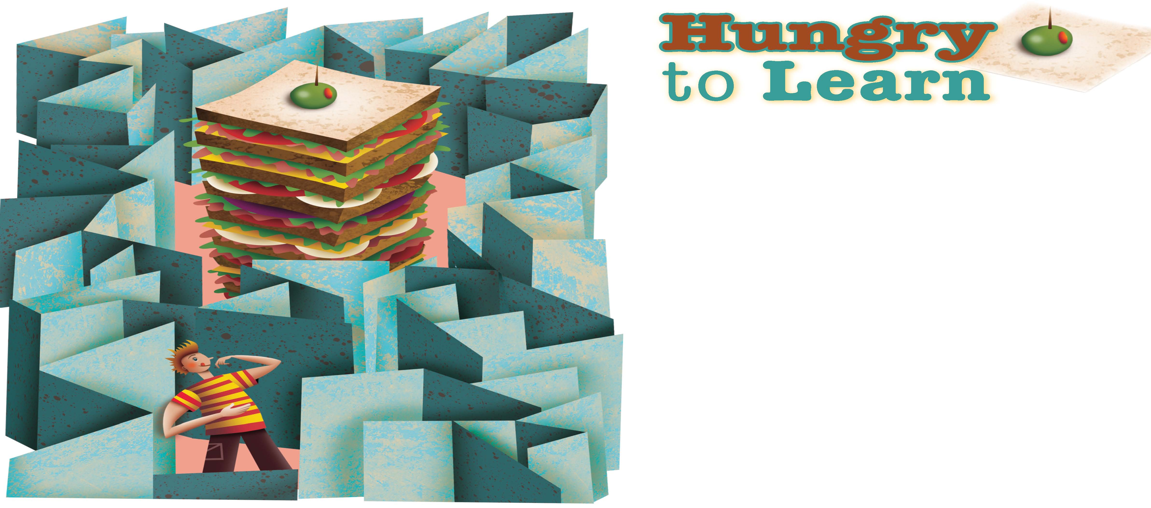
Can hunger make you smarter?

Slide 46
Genetic Influences on Intelligence
Kinship Studies
Kinship studies show that the intelligence test scores of identical twins are more similar than those of any other group of people.
Most studies suggest that the heritability of intelligence ranges from 40 to 60 percent.
Heritability is the extent to which variations in a trait from person to person can be explained by genetic factors.
Adoptee Studies
Most studies of adopted children have found that their intelligence test scores are more like those of the biological parents than those of the adoptive parents.
Some psychologists argue that overemphasis on heredity can undermine efforts to help children learn.

Slide 47
Reading Check
Draw Conclusions
Whose intelligence test score will probably be closest to yours: a parent, a cousin, or a neighbor? Explain.
Answer: a parent

Slide 48
Environmental Influences on Intelligence
Home and Parenting
Studies have shown that home environment and styles of parenting influence the development of intelligence.
A range of factors help improve intellectual functioning in children, including parents being responsive to their children’s needs, providing educational toys, being involved in activities, providing varied experiences during preschool years, and encouraging children to be independent.
Preschool Programs
Preschool programs such as Head Start have been shown to increase intelligence test scores, achievement test scores, and academic skills of participants.

Slide 49
Reading Check
Summarize
What did Bouchard find that demonstrates the importance of environment on intelligence?
Answer: Intelligence scores are more alike for pairs of people reared together than for pairs reared apart.

Slide 51
Aging and Intelligence
Most older people show some drop-off in intelligence as measured by scores on intelligence tests, most notably in timed test questions.
Slowed response times are part of a decline in fluid intelligence, or mental capacities that allow us to respond quickly to novel situations or problems.
On the other hand, the sum of our knowledge about the world, called crystallized intelligence, remains more stable and can continue to grow.

Slide 52
Reading Check
Contrast
What is the difference between fluid and crystallized intelligence?
Answer: fluid intelligence—mental capacities that allow us to respond quickly to novel situations and problems; crystallized intelligence—sum of our knowledge about the world

Slide 53
Current Research in Psychology
Emotional Intelligence Influences Success
If you are really smart, are you guaranteed to achieve success? Or does it take more than just book smarts to succeed? Despite the emphasis still placed on traditional measures of intelligence, researchers have found that other types of intelligence are just as important to success at school and work. In particular, emotional intelligence turns out to play a significant role in success.
The smartest people are not necessarily the most successful.
Studies have found that IQ can account for as little as 10 percent of a person’s success at work.
One study showed that executives with low emotional intelligence were the most likely to fail.
Another study showed that executives with high emotional intelligence were the most likely to succeed.
Another study showed that optimism and pessimism can affect success. Some studies show that IQ and emotional intelligence are related.
Notes:
–

Slide 54
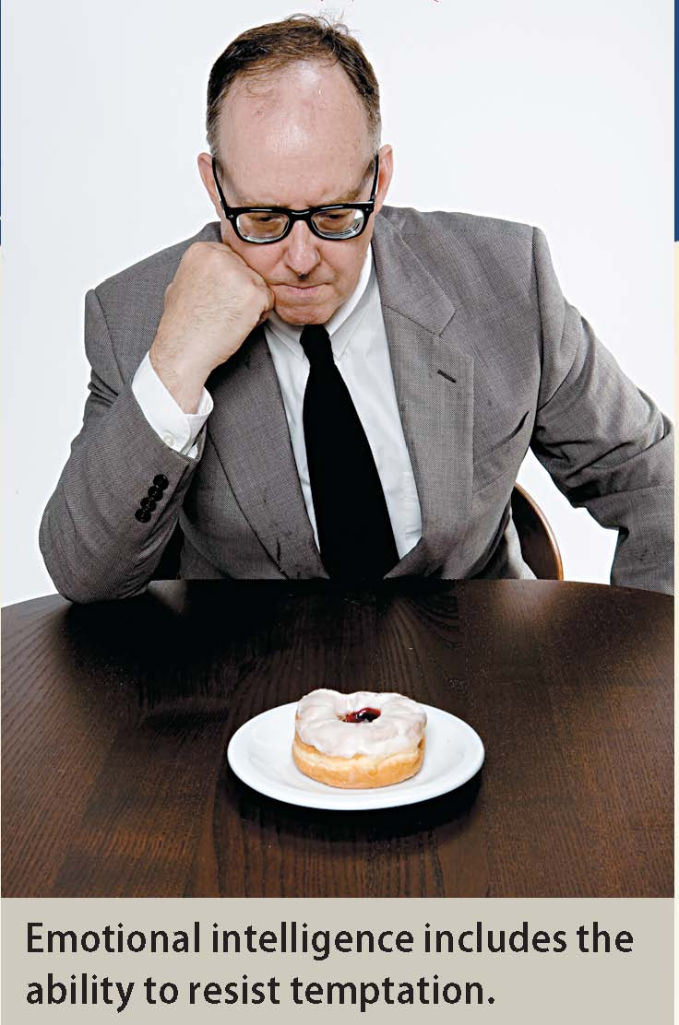

Slide 55
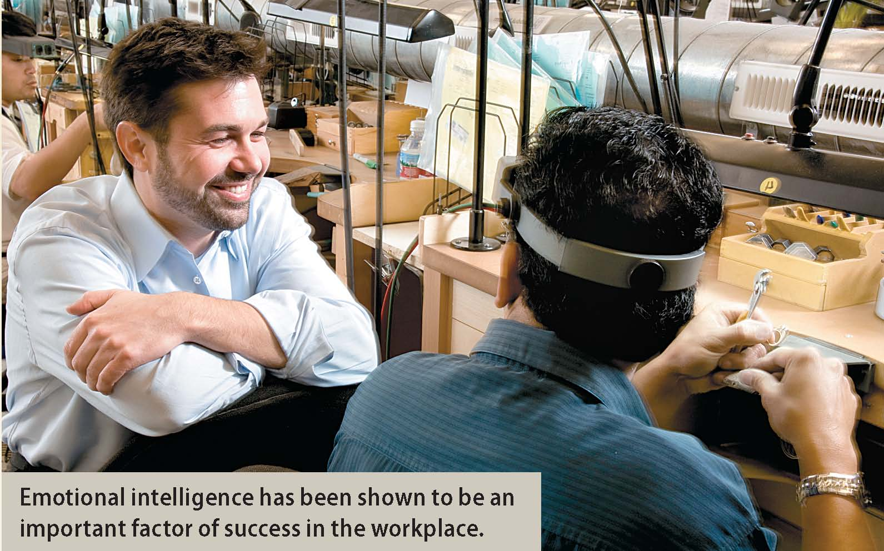

Slide 56
Thinking Critically
How is emotional intelligence related to IQ?
Name some careers for which emotional intelligence might be important. Explain your answer.

Slide 57
Lab: Applying What You’ve Learned
Profile of a Genius
What are the most important qualities for a genius to have? Who has met the profile of a genius?
1. Introduction
2. Writing a Profile
You will work in a small group to create a profile of a genius.
You will use the information in this chapter.
You will present your profile to the class.
Your profile will be similar to a job description.
First write the main headings of the profile.
Next write specific details for each of the headings.
Then defend your reasoning.
Notes:
–

Slide 58
Lab (con’t.)
3. Presenting the Profile
4. Put the Geniuses to the Test
Each group will present their work before the class.
Each group listening must ask at least one clarifying question, refute a group’s choice, or make a suggestion.
Find information on the genius of your choice on the Internet or in your library.
Have the class identify which group’s profile best fits the genius.
Identify how many categories of the profile match this individual.
Calculate a percentage of corresponding qualities.
Label the individual as GENIUS or AVERAGE.
Notes:
–

Slide 60
