Slide 1
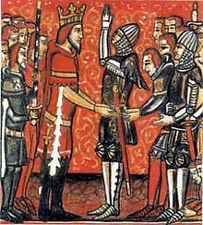
Medieval Europe
Feudalism

Slide 2
Feudalism
-Feudalism is a form of government that started in the middle ages.
-Feudalism only occurs when there is a weak central government because the king ends up giving away some of his land

Slide 3
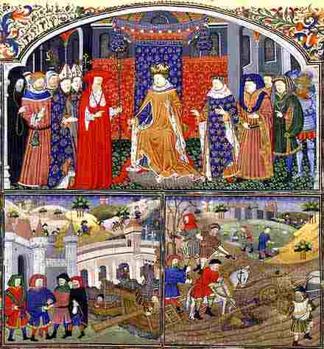
Medieval Society
Kings and Queens
Rulers
Nobility
Lords and Knights (vassals)
Controlled the land
Clergy
Church officials
Peasants
Majority of the population
Worked the land and served the nobles

Slide 4
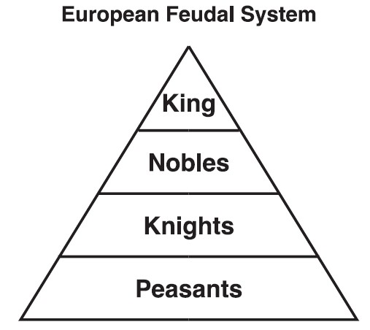
Feudalism
Political and social system based on the granting of land in exchange for loyalty, military assistance, and other services

Slide 5
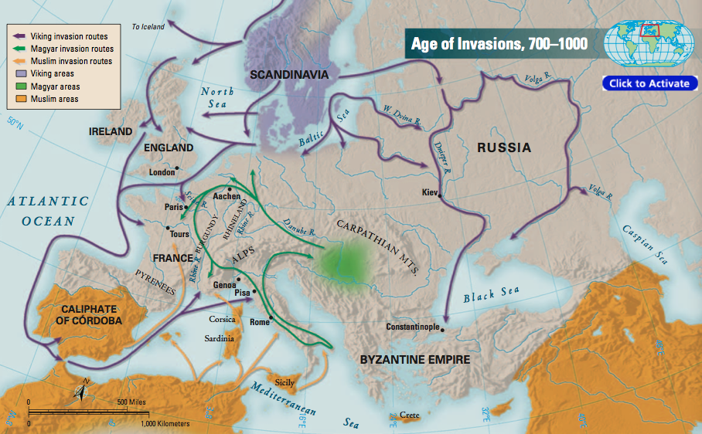
Feudalism
Developed as a result of frequent invasions in western Europe
Kings and nobles needed a way to protect their lands

Slide 6
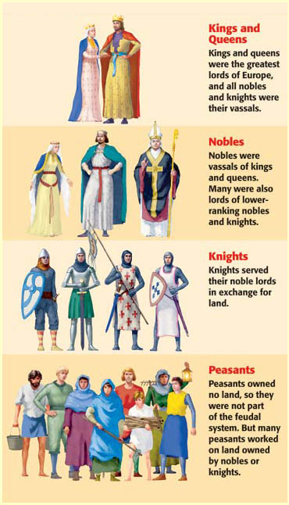
Feudalism
Lords divided their lands into estates called fiefs
Fiefs (land) given to vassals
A person granted land in return for loyalty or military service
All nobles were vassals to the king

Slide 7
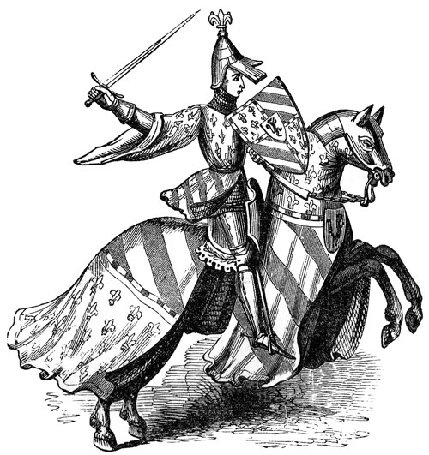
Feudalism
Knights
Mounted warriors who protected lord’s lands
Given land for their services
Chivalry
Code of ethics followed by knights
Honesty, fairness in battle, loyal, proper treatment of women

Slide 8
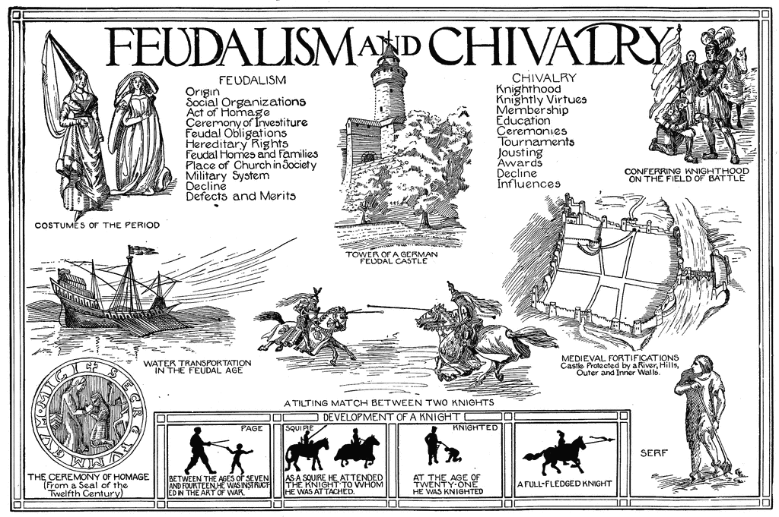

Slide 9
Feudal Obligations
Knights Obligation to Lord
Lord’s Obligation to Knights
Provide military service
Remain loyal and faithful
Give money on special occasions
Give Land
Protect from attack
Resolve disputes between knights

Slide 10
Constructing the Pyramid Feudal Power
SERFS AND FREEMEN
‹#›

Slide 11
Constructing the Pyramid of Feudal Power
LESSER NOBLES
(KNIGHTS)
LABOR
PROTECTION
SERFS AND FREEMEN
‹#›

Slide 12
Constructing the Pyramid of Feudal Power
POWERFUL
NOBLES
LOYALTY AND
MILITARY SERVICE
LAND AND
PROTECTION
LESSER NOBLES
(KNIGHTS)
LABOR
PROTECTION
SERFS AND FREEMEN
‹#›

Slide 13
Constructing the Pyramid of Feudal Power
KING
LOYALTY AND
SERVICE
LAND
POWERFUL
NOBLES
LOYALTY AND
MILITARY SERVICE
LAND AND
PROTECTION
LESSER NOBLES
(KNIGHTS)
LABOR
PROTECTION
SERFS AND FREEMEN
‹#›

