Slide 1
Lesson 48
Time

Slide 2
Time…It’s every day and everywhere

Slide 3
Time as a metaphysical issue
The history of metaphysics can be seen as the history of arguing over the issue of what is timeless. The major candidates are timeless truths, timeless laws of nature, and timeless realms such as the realms Platonic ideals, God, numbers and spatial geometry.

Slide 4
Time is complicated….like really complicated
The Internet Encyclopedia of Philosophy, one of the best philosophy resources in the world has an 18-section link on the subject. It goes into many disciplines and very challenging readings.

Slide 5
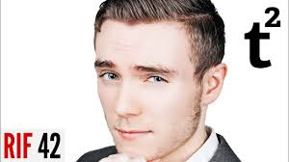
We will be relying on a video from Thoughty2 to give us a breakdown:
https://www.youtube.com/watch?v=Zqddpqbh6f0

Slide 6
:027: “How do we define time?”
Among the many short, snappy definitions of time that have been put forward are:
what clocks measure (attr. to physicists Albert Einstein, Donald Ivey, and others)
what prevents everything from happening at once (physicist John Wheeler and others)
a linear continuum of instants (philosopher Adolf Grünbaum)
a certain period during which something is done (Medical Dictionary)
a continuum that lacks spatial dimensions (Encyclopedia Britannica)

Slide 7
Defining Time
Some dictionary definitions
Wikipedia’s, which may be the best one.
the indefinite continued progress of existence and events in the past, present and future regarded as a whole (Oxford Dictionary)
the measured or measurable period during which an action, process or condition exists or continues (Webster’s Collegiate Dictionary)
the continuous passage of existence in which events pass from a state of potentiality in the future, through the present, to a state of finality in the past (World English Dictionary)
a continuous, measurable quantity in which events occur in a sequence proceeding from the past through the present to the future (Science Dictionary)
the measured or measurable period during which an action, process or condition exists or continues (Merriam-Webster Dictionary)
the dimension of the physical universe that orders the sequence of events at a given place (McGraw-Hill Encyclopedia of Science and Technology)
a non-spatial system in which events appear to happen in irreversible succession (WordSmyth Dictionary)
the inevitable progression into the future with the passing of present events into the past (Wiktionary)
the indefinite continued progress of existence and events in the past, present, and future regarded as a whole (Google)
A dimension in which events can be ordered from the past through the present into the future, and also the measure of durations of events and the intervals between them

Slide 8
Varying Aspects
Different Contexts
Past, present, and future
“Time stood still”
“Excuse me, do you have the time”
“It took a very long time”
“Adolescence is a difficult time”
“This is not the first time this has happened”
“It’s time for dinner”
“I don’t have time right now”
“Clap in time to the music”
“I had a good time last night”
“He completed the race in record time”
“Things were different in my time”
“He should be doing time for such a crime”
Source: Alvele, Ben. “Definition of Time.” Exactly What Is Time?, www.exactlywhatistime.com/definition-of-time/.

Slide 9
0:39-3:49: “History of Time”
Broad themes- “Sun high/Sun low”
Seasons
Sundials- localized
Local time ran on one clock
Then trains were invented….
Dec 1, 1847: Birth of Greenwich Mean Time (GMT)
Time zones in U.S.A.- Why we say, “hello”.
Nepal adopted GMT in 1986 and world is globalized.

Slide 10
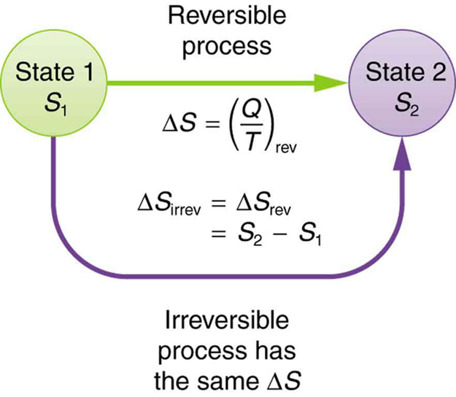
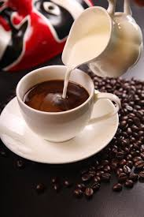
3:40-7:50: “Theory of Time”
Way to label and order events in the universe
Measure distance between two events
Time is a medium we move through that allows us to see that changes have happened (Arrow of time)
Entropy, or the Second Law of Thermodynamics. This measures the order, or disorder of a system.
Disorder is easier, and more likely than order.

Slide 11
7:50-10:18: “Time’s Speed”
Time is a subject of great importance to physics. Generally, this falls more in the realm of theoretical physics. It entails trains and ships moving at the speed of light, with balls being thrown and whatnot.
Please ask Mrs. Waeschle physics-related questions. Thank you.

Slide 12
10:18-13:00: “Personal Relativity”
Comparing 1 hour in your least favorite class with an hour of doing fun things.
“Flashbulb” memories
Circadian Rhythms

Slide 13
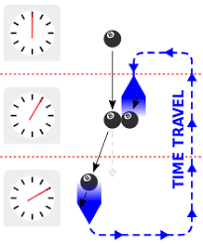
13:00-14:15: Time Travel
Special Relativity
Worm Holes
Bootstrap Paradox:
The Bootstrap Paradox is a theoretical paradox of time travel that occurs when an object or piece of information sent back in time becomes trapped within an infinite cause-effect loop in which the item no longer has a discernible point of origin, and is said to be “uncaused” or “self-created”.

Slide 14
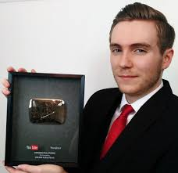
14:15- Wrapping things up
Time is a subject of importance in history, philosophy, and physics.
JOURNAL ENTRY: “What perspectives were given today regarding time? How do you feel about the subject now that you’ve learned about it?”

