Slide 1
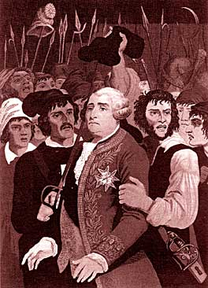
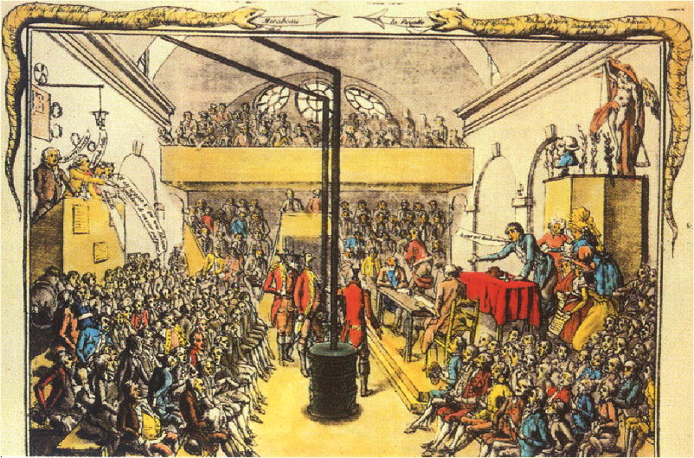
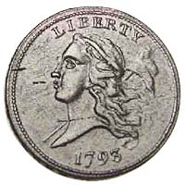
The Jacobins
Jacobin Meeting House
They held their meetings in the library of a former Jacobin monastery in Paris.
Started as a debating society.
Membership mostly middle class.
Created a vast network of clubs.

Slide 2
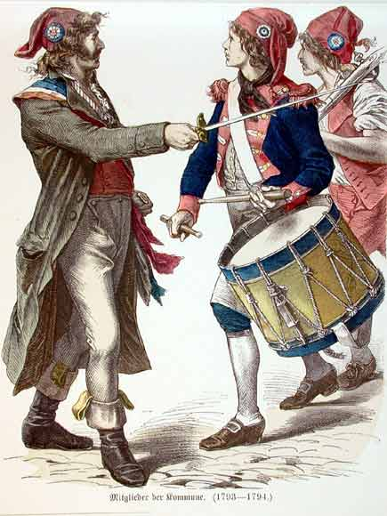
The Sans-Culottes: The Parisian Working Class
Small shopkeepers.
Tradesmen.
Artisans.
They shared many of the ideals of their middle class representatives in government!

Slide 3
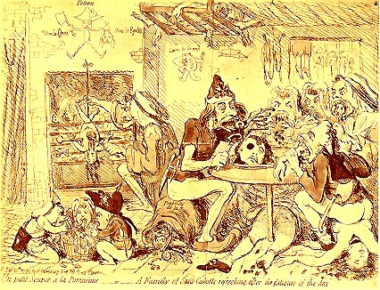
The Sans-Culottes
Depicted as Savages by a British Cartoonist.

Slide 4
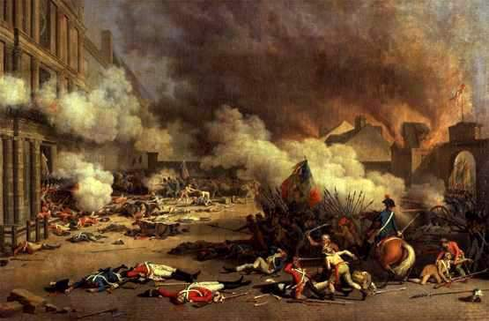
The Storming of the Tuilieres: August 9-10, 1792
This was triggered in part by the publication in Paris of the August 3 Brunswick Manifesto, which confirmed popular suspicions concerning the king’s treason.

Slide 5
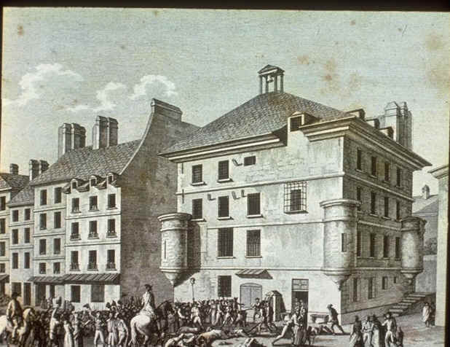
The September Massacres, 1792 (The dark side of the Revolution!)
Rumors that the anti-revolutionary political prisoners were plotting to break out & attack from the rear the armies defending France, while the Prussians attacked from the front.
Buveurs de sang [“drinkers of blood.”]→ over 1000 killed!
It discredited the Revolution among its remaining sympathizers abroad.

Slide 6
The National Convention (September, 1792)
Its first act was the formal abolition of the monarchy on September 22, 1792.
The Year I of the French Republic.
The Decree of Fraternity
it offered French assistance to any subject peoples who wished to overthrow their governments.
When France sneezes, all of Europe catches cold!

Slide 7
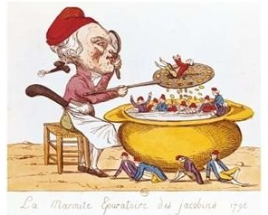
The “Purifying” Pot of the Jacobin

Slide 8
Louis XVI as a Pig
For the Montagnards, the king was a traitor.
The Girondins felt that the Revolution had gone far enough and didn’t want to execute the king [maybe exile him].

Slide 9
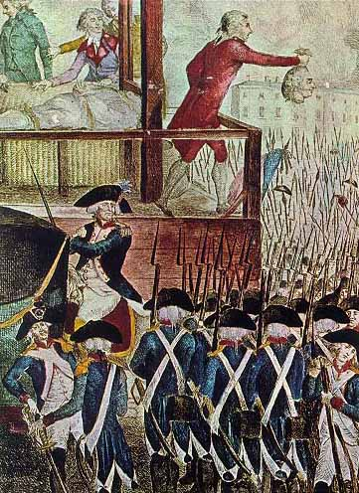
Louis XVI’s Head (January 21, 1793)
The trial of the king was hastened by the discovery in a secret cupboard in the Tuilieres of a cache of documents.
They proved conclusively Louis’ knowledge and encouragement of foreign intervention.
The National Convention voted 387 to 334 to execute the monarchs.

Slide 10
The Death of “Citizen” Louis Capet
Matter for reflection for the crowned jugglers.
So impure blood doesn’t soil our land!

Slide 11
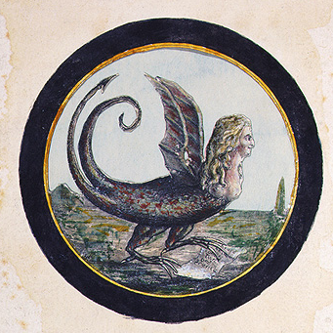
Marie Antoinette as a Serpent
The “Widow Capet”

Slide 12
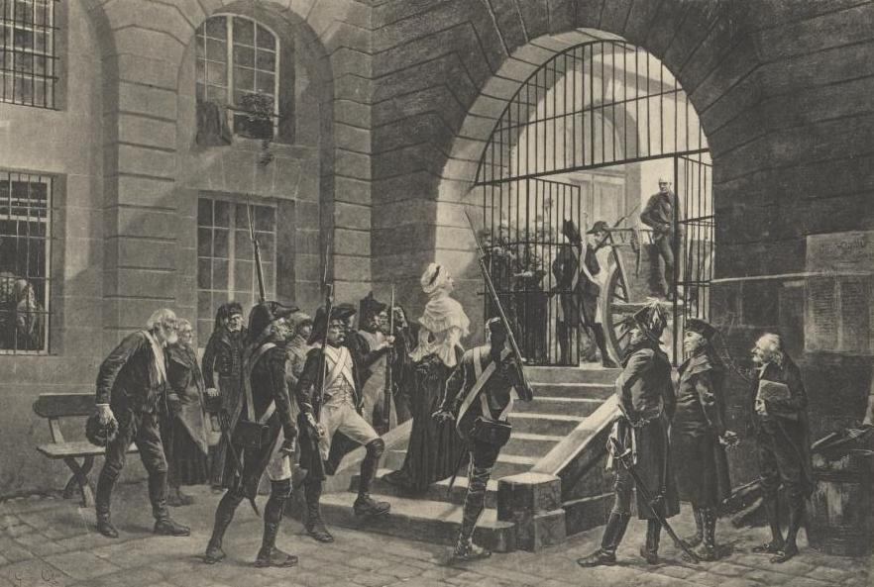
Marie Antoinette on the Way to the Guillotine

Slide 13
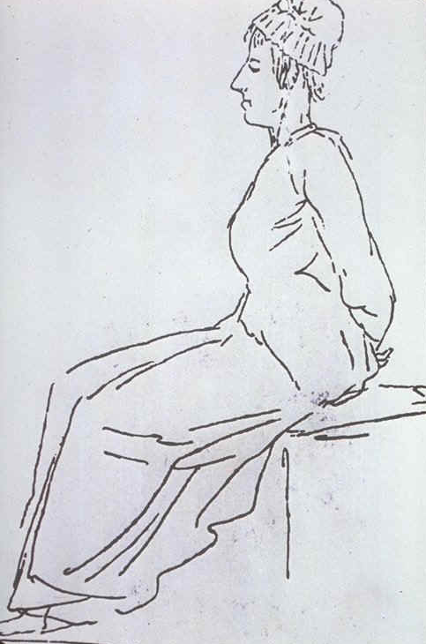
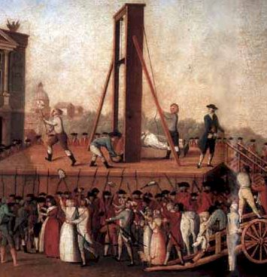
Marie Antoinette Died in October, 1793

Slide 14
Attempts to Control the Growing Crisis
Revolutionary Tribunal in Paris → try suspected counter-revolutionaries.
Representatives-on-Mission
sent to the provinces & to the army.
had wide powers to oversee conscription.
B. Watch Committees [comité de surveillance]
keep an eye on foreigners & suspects.
C. Sanctioned the trial & execution of rebels and émigrés, should they ever return to France.

Slide 15
Attempts to Control the Growing Crisis
The printing of more assignats to pay for the war.
Committee of Public Safety [CPS]
to oversee and speed up the work of the government during this crisis.
Committee of General Security [CGS]
responsible for the pursuit of counter-revolutionaries, the treatment of suspects, & other internal security matters.

Slide 16
Committee for Public Safety
Revolutionary Tribunals.
300,000 arrested.
16,000 – 50,000 executed.

Slide 17
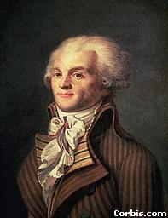
Maximillian Robespierre (1758 – 1794)

Slide 18
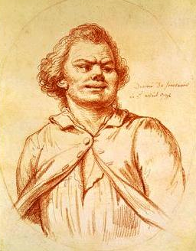
Georges Jacques Danton (1759 – 1794)

Slide 19
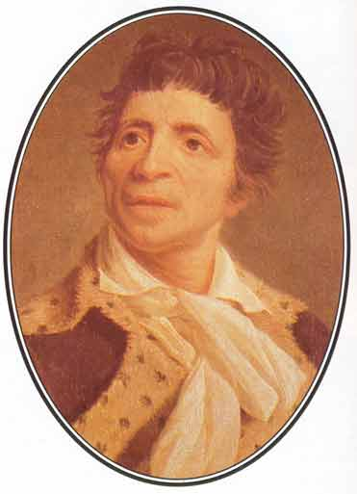
Jean-Paul Marat (1744 – 1793)

Slide 20
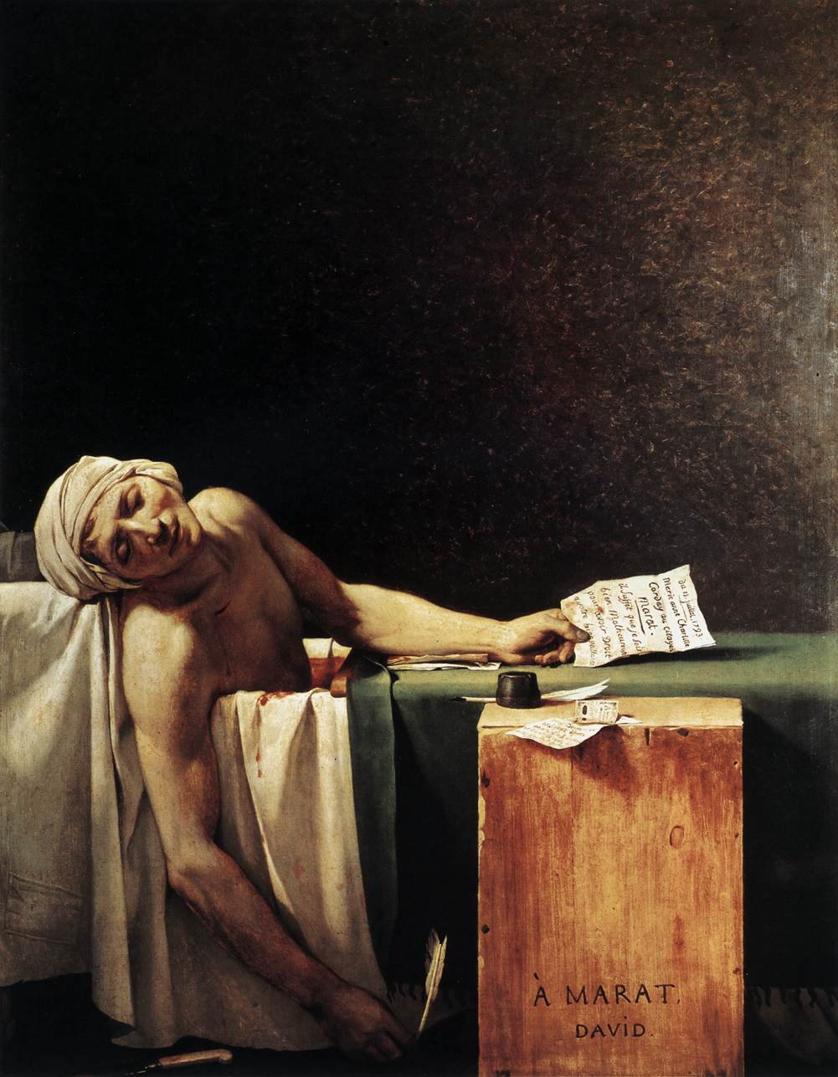
“The Death of Marat” by Jacques Louis David, 1793

Slide 21
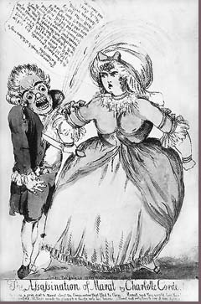
The Assassination of Marat by Charlotte Corday, 1793

Slide 22
The Levee en Masse: An Entire Nation at Arms! – 500,000 Soldiers
An army based on merit, not birth!

Slide 23
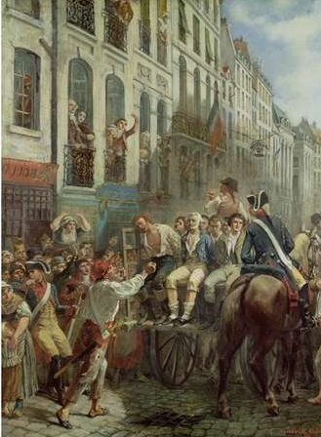
The Reign of Terror
Terror is nothing other than justice, prompt, severe, inflexible. -- Robespierre
Let terror be the order of the day!
The Revolutionary Tribunal of Paris alone executed 2,639 victims in 15 months.
The total number of victims nationwide was over 20,000!

Slide 24
The Guillotine: An “Enlightenment Tool”?
Oh, thou charming guillotine, You shorten kings and queens; By your influence divine, We have re-conquered our rights. Come to aid of the Country And let your superb instrument Become forever permanent To destroy the impious sect. Sharpen your razor for Pitt and his agents Fill your divine sack with heads of tyrants.

Slide 25
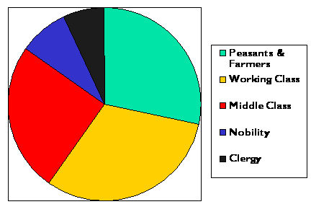
Different Social Classes Executed
7%
8%
28%
25%
31%

Slide 26
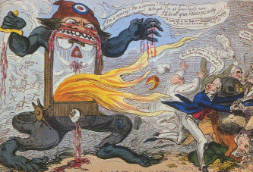
The “Monster” Guillotine
The last guillotine execution in France was in 1939!

Slide 27
Religious Terror: De-Christianization (1793-1794)
The Catholic Church was linked with real or potential counter-revolution.
Religion was associated with the Ancien Régime and superstitious practices.
Very popular among the sans-culottes.
Therefore, religion had no place in a rational, secular republic!

Slide 28
The De-Christianization Program
The adoption of a new Republican Calendar:
abolished Sundays & religious holidays.
months named after seasonal features.
7-day weeks replaced by 10-day decades.
the yearly calendar was dated from the creation of the Republic [Sept. 22, 1792]
The Convention symbolically divorced the state from the Church!!

Slide 29
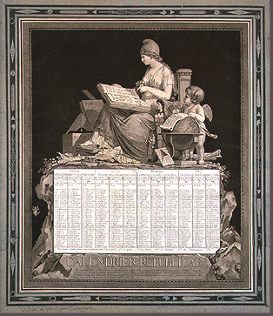
A Republican Calendar

Slide 30
Vendemaire | (Vintage) | 22 September-21 October
Brumaire | (Fog) | 22 October-20 November
Frimaire | (Frost) | 21 November-20 December
Nivose | (Snow) | 21 December-19 January
Pluviose | (Rain) | 20 January-18 February
Ventose | (Wind) | 19 February-20 March
Germinal | (Budding) | 21 March-19 April
Floreal | (Flowers) | 20 April-19 May
Prairial | (Meadows) | 20 May-18 June
Messidor | (Harvest) | 19 June-18 July
Thermidor | (Heat) | 19 July-17 August
Fructidor | (Fruit) | 18 August-21 September
The New Republican Calendar
New Name | Meaning | Time Period
Vendemaire | Vintage | September 22 – October 21
Brumaire | Fog | October 22 – November 20
Frimaire | Frost | November 21 – December 20
Nivose | Snow | December 21 – January 19
Pluviose | Rain | January 20 – February 18
Ventose | Wind | February 19 – March 20
Germinal | Budding | March 21 – April 19
Floreal | Flowers | April 20 – May 19
Prairial | Meadow | May 20 – June 18
Messidor | Harvest | June 19 – July 18
Thermidor | Heat | July 19 – August 17
Fructidor | Fruit | August 18 – September 21

Slide 31
Vendemaire | (Vintage) | 22 September-21 October
Brumaire | (Fog) | 22 October-20 November
Frimaire | (Frost) | 21 November-20 December
Nivose | (Snow) | 21 December-19 January
Pluviose | (Rain) | 20 January-18 February
Ventose | (Wind) | 19 February-20 March
Germinal | (Budding) | 21 March-19 April
Floreal | (Flowers) | 20 April-19 May
Prairial | (Meadows) | 20 May-18 June
Messidor | (Harvest) | 19 June-18 July
Thermidor | (Heat) | 19 July-17 August
Fructidor | (Fruit) | 18 August-21 September
A New Republican Calendar Year
I | 1792 – 1793
II | 1793 – 1794
III | 1794 – 1795
IV | 1795 – 1796
V | 1796 – 1797
VI | 1797 – 1798
VII | 1798 – 1799
VIII | 1799 – 1800
IX | 1800 – 1801
X | 1801 – 1802
XI | 1802 – 1803
XII | 1803 – 1804
XIII | 1804 – 1805
XIV | 1805
The Gregorian System returned in 1806.

Slide 32
The De-Christianization Program
The public exercise of religion was banned.
The Paris Commune supported the:
destruction of religious & royal statues.
ban on clerical dress.
encouragement of the clergy to give up their vocations.
The Cathedral of Notre Dame in Paris was turned into the “Temple of Reason.”
The deportation of priests denounced by six citizens.

Slide 33
The “Temple of Reason”
Come, holy Liberty, inhabit this temple, Become the goddess of the French people.

Slide 34
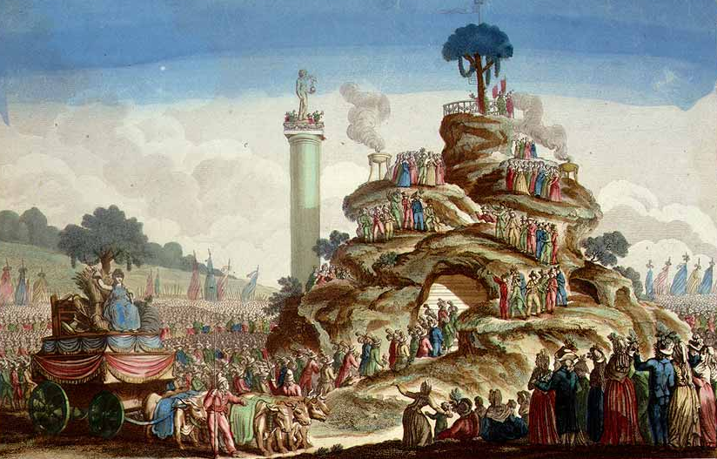
The Festival of Supreme Being
A new secular holiday

Slide 35
Backlash to the De-Christianization Program
It alienated most of the population (especially in the rural areas).
Robespierre never supported it.
he persuaded the Convention to reaffirm the principle of religious toleration.
Decree on the “Liberty of Cults” was passed
December 6, 1793.
BUT, it had little practical effect!

Slide 36
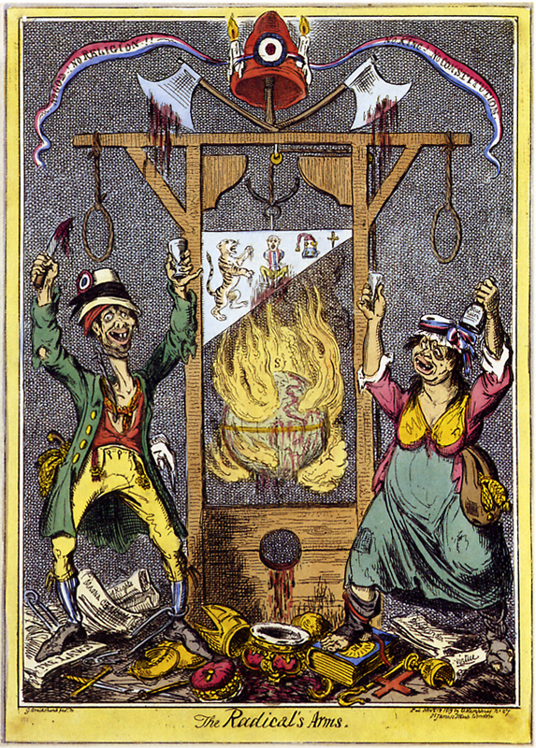
The Radical’s Arms:
No God! No Religion! No King! No Constitution!

Slide 37
The Terror Intensified: March to July, 1794
Jacques Hébert & the Hérbetists
Danton & the “Indulgents”
Executed in March, 1794
Executed in April, 1794
Law of 22 Prairial [June 10, 1794].
Trials were now limited to deciding only on liberty OR death, with defendants having no rights.
Were you an “enemy of the people?” (the law was so broadly written that almost anyone could fall within its definition!)
1,500 executed between June & July.

Slide 38
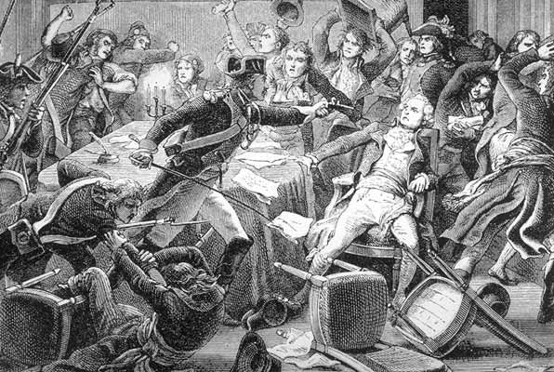
The Arrest of Robespierre

Slide 39
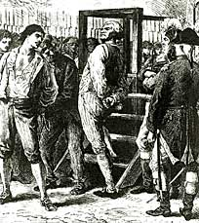
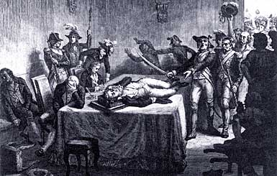
The Revolution Consumes Its Own Children!
Danton Awaits Execution, 1793
Robespierre Lies Wounded Before the Revolutionary Tribunal that will order him to be guillotined, 1794.

Slide 40
The “Cultural Revolution”Brought About by the Convention
It was premised upon Enlightenment principles of rationality.
The metric system of weights and measures
Was defined by the French Academy of Sciences in 1791 and enforced in 1793.
It replaced weights and measures that had their origins in the Middle Ages.
The abolition of slavery within France in 1791 and throughout the French colonies in 1794.
The Convention legalized divorce and enacted shared inheritance laws [even for illegitimate offspring] in an attempt to eradicate inequalities.

Slide 41
Sources
“Hist210—Europe in the Age of Revolutions.” http://www.ucl.ac.uk/history/courses/europe1/chron/rch5.htm
“Liberty, Fraternity, Equality: Exploring the French Revolution.” http://chnm.gmu.edu/revolution/
Matthews, Andrew. Revolution and Reaction: Europe, 1789-1849. Cambridge University Press, 2001.
“The Napoleonic Guide.” http://www.napoleonguide.com/index.htm

