Slide 1
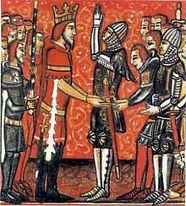
Day 54: Medieval Europe
FEUDALISM: The Government of the Middle Ages

Slide 2
Feudalism:
-Feudalism is a form of government that started in the middle ages.
-Feudalism only occurs when there is a weak central government because the king ends up giving away some of his land

Slide 3
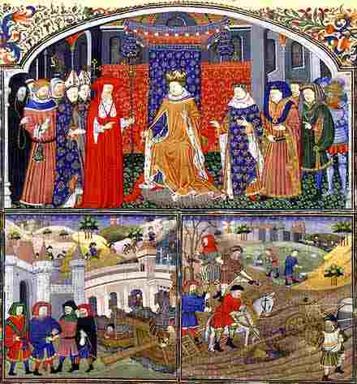
Medieval Society
Kings and Queens
Rulers
Nobility
Lords and Knights (vassals)
Controlled the land
Clergy
Church officials
Peasants
Majority of the population
Worked the land and served the nobles

Slide 4
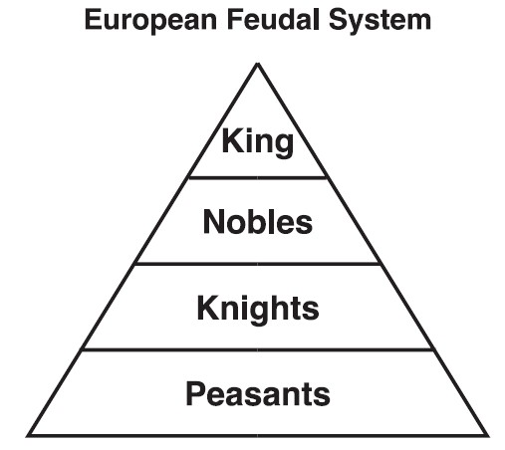
Feudalism Simplified….
Political and social system based on the granting of land in exchange for loyalty, military assistance, and other services

Slide 5
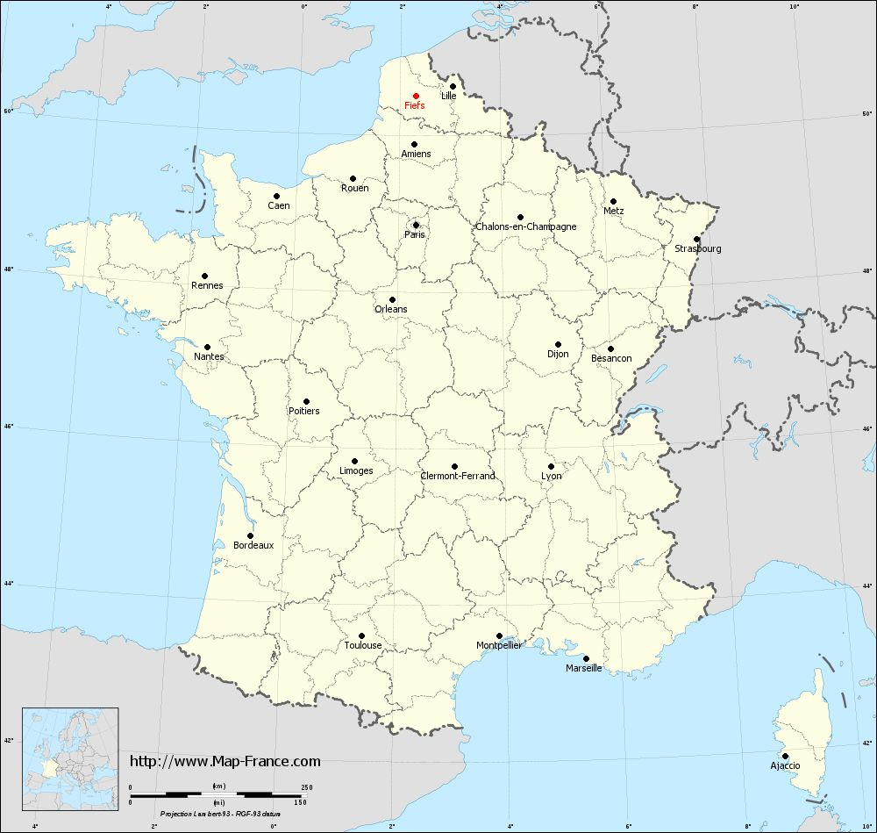
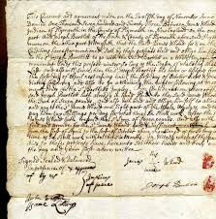
What kept it all together?
Fiefs and Feudal Contracts- Fiefs were parcels of land given out bound by contracts from the king.

Slide 6
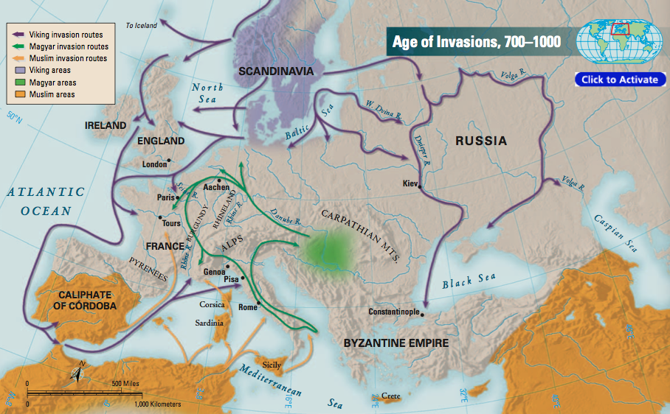
Feudalism: Why did it happen?
Developed as a result of frequent invasions in western Europe
Kings and nobles needed a way to protect their lands

Slide 7
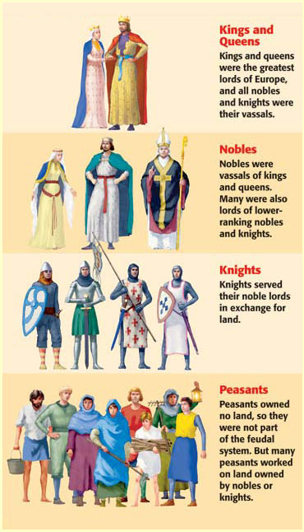
Feudalism: Four Divisions
Lords divided their lands into estates called fiefs
Fiefs (land) given to vassals
A person granted land in return for loyalty or military service
All nobles were vassals to the king

Slide 8
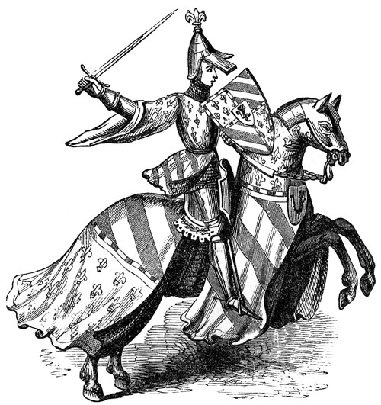
Code of Chivalry
Knights
Mounted warriors who protected lord’s lands
Given land for their services
Chivalry
Code of ethics followed by knights
Honesty, fairness in battle, loyal, proper treatment of women

Slide 9
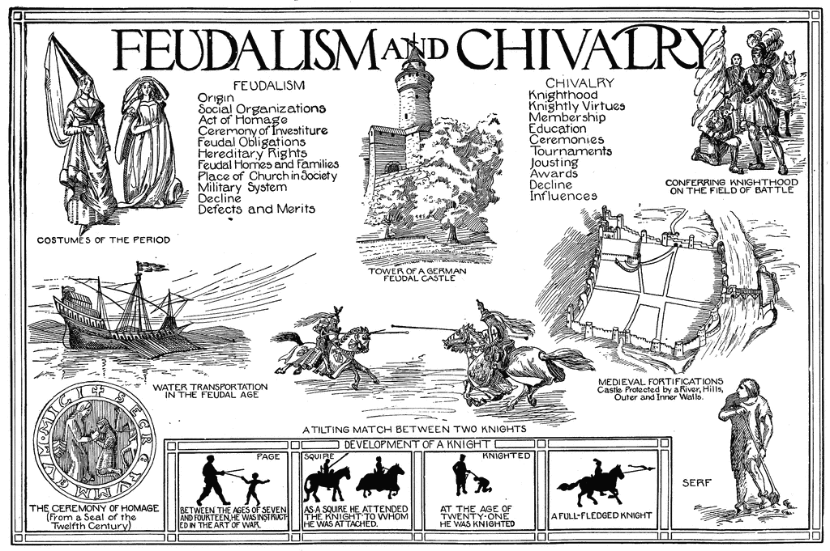

Slide 10
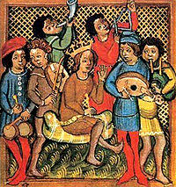
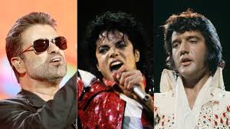
A modern feudal contribution
Troubadours- These were musical and comedic performers that spread music and entertainment throughout feudal times.

Slide 11
Feudal Obligations
Knights Obligation to Lord
Lord’s Obligation to Knights
Provide military service
Remain loyal and faithful
Give money on special occasions
Give Land
Protect from attack
Resolve disputes between knights

Slide 12
Constructing the Pyramid Feudal Power
.
SERFS/PEASANTS
12

Slide 13
Constructing the Pyramid of Feudal Power
.
LESSER NOBLES
(KNIGHTS)
LABOR
PROTECTION
SERFS/PEASANTS
13

Slide 14
Constructing the Pyramid of Feudal Power
.
POWERFUL
NOBLES
LOYALTY AND
MILITARY SERVICE
LAND AND
PROTECTION
LESSER NOBLES
(KNIGHTS)
LABOR
PROTECTION
SERFS/PEASANTS
14

Slide 15
Constructing the Pyramid of Feudal Power
KING
.
LOYALTY AND
SERVICE
LAND
POWERFUL
NOBLES
LOYALTY AND
MILITARY SERVICE
LAND AND
PROTECTION
LESSER NOBLES
(KNIGHTS)
LABOR
PROTECTION
SERFS/PEASANTS
15

