Slide 1
Ancient Civilizations Project
What I needed you to learn about these civilizations- Filling in the gaps from your classmate’s presentations.

Slide 2
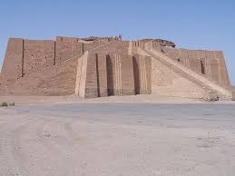
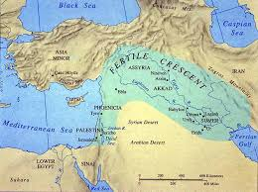
Mesopotamia (Sumer, Babylon, Assyria)

Slide 3
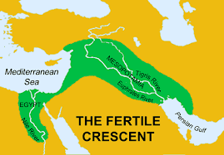
Geography
Tigris and Euphrates Rivers

Slide 4
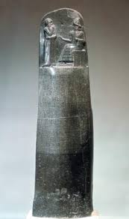
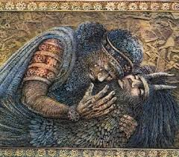
Writing Using Cuneiform
Epic of Gilgamesh
Hammurabi’s Code

Slide 5
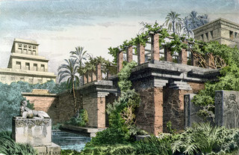
One of the Wonders of the Ancient World
Hanging Gardens of Babylon

Slide 6
* Brick * Astronomy * Wheel * Reed Sailboat * Plow * Time units of 60 * Maps * Mathematics * Checkers
Inventions of Mesopotamia

Slide 7
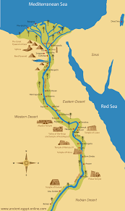
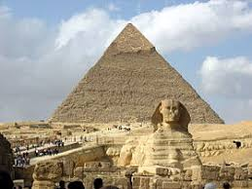
Ancient Egypt (Old, Middle, New Kingdoms)
Second Wonder of the Ancient World- Great Pyramid of Giza
Northeast Africa- Nile River

Slide 8
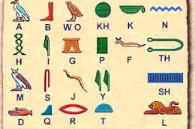
Egyptian Inventions and Innovations
Pyramids
Hieroglyphics
Black Ink
Ox-Drawn plow
Sickle
Irrigation Techniques
365-day calendar
Surgery
Make-up
First police force
Beer
Wigs

Slide 9
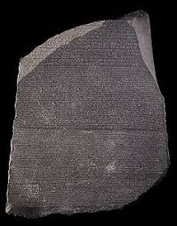
The Rosetta Stone

Slide 10
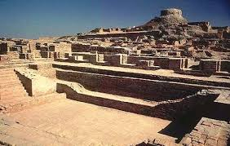
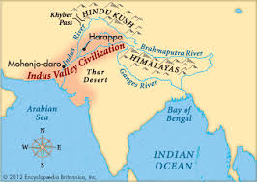
Indus Valley (Harappan)
Harappa
Indus River in modern Pakistan

Slide 11
* Masters of Water- Wells, drainage, bathrooms * Standard weights and measures * Roots of Hinduism * Much is lost due to not being able to understand their language. No Rosetta Stone to crack Indus Valley code…yet.
Indus Valley Contributions and Innovations

Slide 12
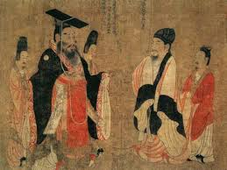
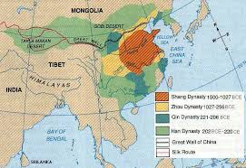
Ancient China (Xia, Shang, Zhou)
Xia is not substantiated by archaeological evidence, but Shang is.
Eastern China along the Yellow River (Huang He)

Slide 13
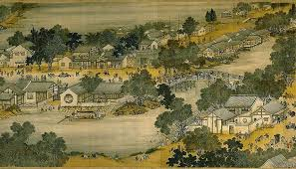
Ancient Chinese Contributions and Innovations
Legalism (Emphasizes the need for order above all other human concerns.)
Standardized writing and language
Standardized money
Standardized system of measurement
Irrigation projects
Building of the Great Wall
Terra cotta army
Expanded Network of Roads and Canals
Multiplication Table

Slide 14
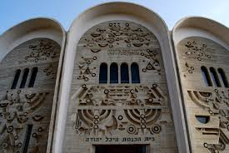
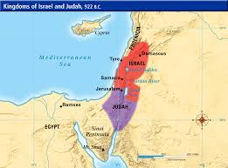
The Ancient Hebrews (Israelites)
Ten Commandments
In area of modern Israel

Slide 15
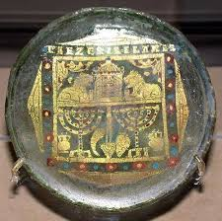
Glass Making
Ancient Hebrew glass making was the root of the way we make glass today.

Slide 16
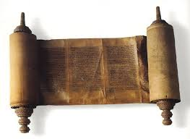
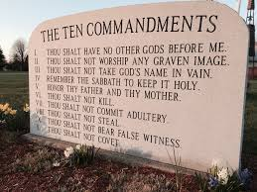
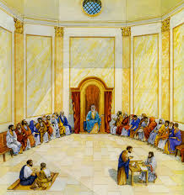
Three Big Influences
Torah
Rule of Law
The Sanhedrin

Slide 17
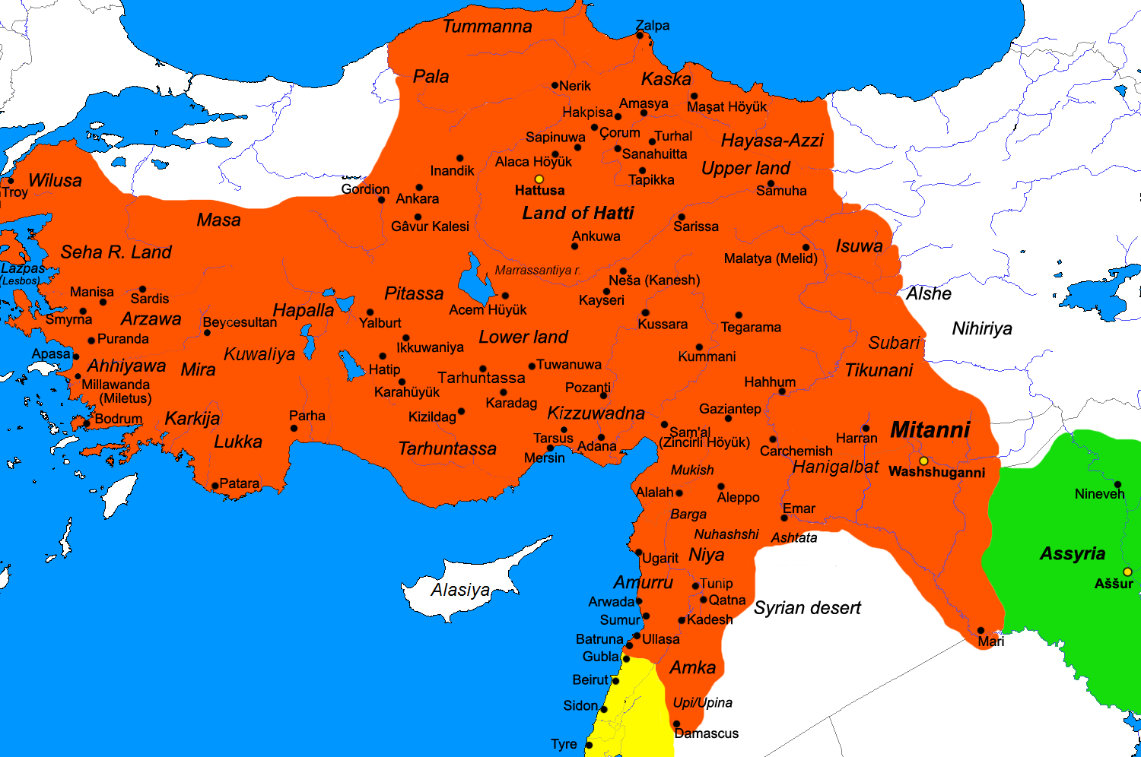
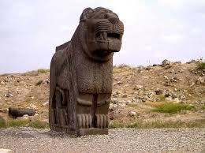
The Hittites (Anatolia)
Masters of Metal
Was located in modern Turkey

Slide 18
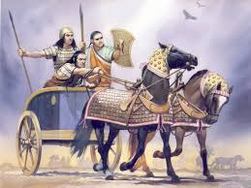
The Hittite Contributions and Innovations
IRON, shaping of metal- “More metal, more civilization”.
Chariots
Pioneers in Cultural Pluralism, meaning having many kinds of people under one leader. There were 9 languages spoken in the Hittite Civilization.

Slide 19
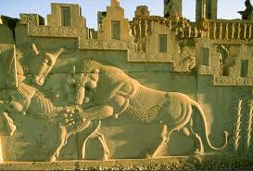
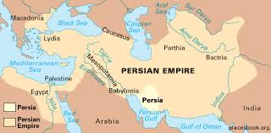
Ancient Persia
The largest Empire of the Ancient World
Conquered many lands and covered Southeastern Europe, the Middle East, Northeast Africa, and Asia Minor.

Slide 20
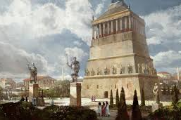
Third Wonder of the Ancient World
The Mausoleum at Halicarnassus

Slide 21
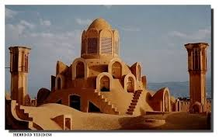
Persian Contributions and Innovations
Architecture
Algebra
Music
Art
FEDERALISM
Postal Service
Military Innovations, especially in archery

Slide 22
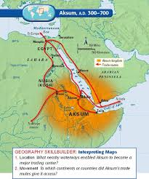
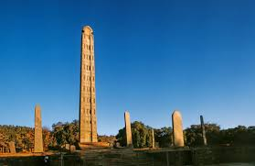
Aksum
Master traders
Eastern Africa in modern Ethiopia and Eritrea

Slide 23
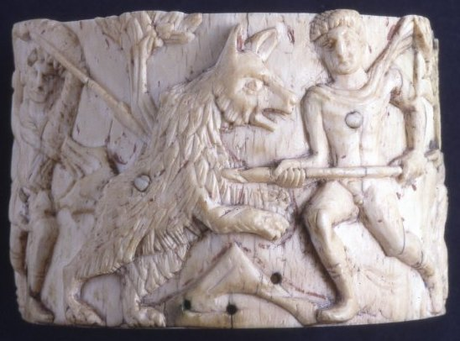
Least known of Ancient Civilization
Currency
Traded in commodities such as ivory, salt, and other goods
Described by Persian visitor as, “one four greatest powers in the world”.
First African people to convert to Christianity
Archaeology reveals them to be a kingdom with a variety of specialized jobs within their society.

Slide 24
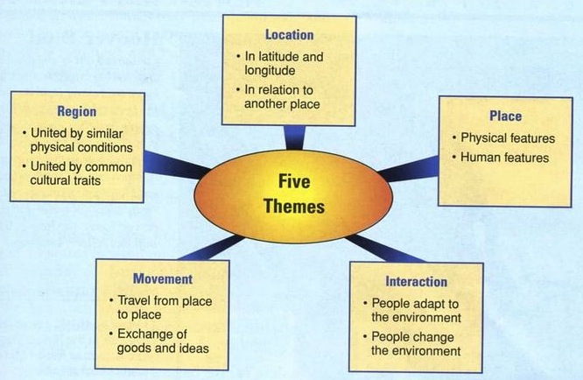
FIVE THEMES OF GEOGRAPHY

Slide 25
Final Word About Our Project
Research Skills-
Teamwork-
Oratory Skills-
“Ancient Civilizations are the foundation of the house the modern world rests upon”
They all possessed the seven criterion to be considered a civilization
Collective Learning

