Slide 1
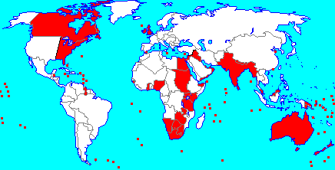
ENGLAND AT PEAK

Slide 2
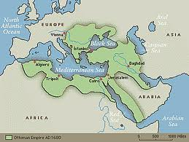
OTTOMAN EMPIRE

Slide 3
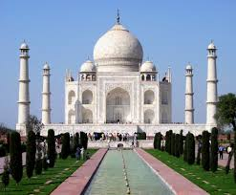
MUGHALS- TAJ MAHAL

Slide 4
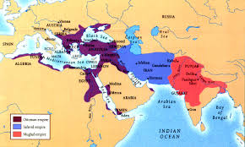
SAFAVID- IN BLUE

Slide 5
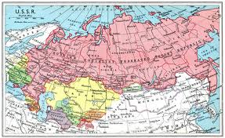
RUSSIA

Slide 6
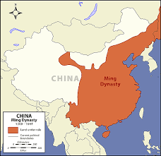
MING

Slide 7
Review Questions
1) Who were the Six Gunpowder Empires?
2) What did they share in common? What was different about them?
3) What weapons were used to achieve their respective hegemony?

