Slide 1
SECTION IX
By: Rodriog Ferrer – Gonzaga
Devin McKay Howell

Slide 2
Taxes for state expenses
Taxes pays for stuff

Slide 3
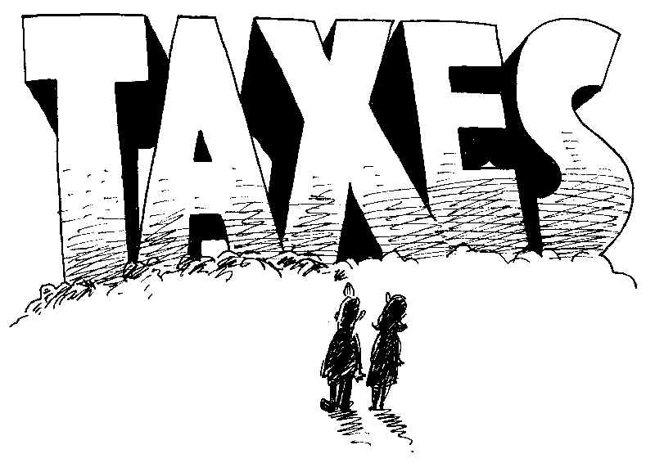
Power of taxation, relinquishment
Taxes will never go away.

Slide 4
Public bodies, borrowing power
Public places have the power to borrow money whenever they need it

Slide 5
Tax on tobacco products; dedication of proceeds
Every pack of cigarettes, 6% of the profit goes to health care.

Slide 6
Michigan veterans' trust fund
All money in Michigans Veterans trust fund from 1946 shall be transferred to the fund

Slide 7
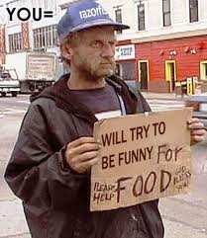
Income tax
If you’re rich you pay more
If you’re poor you pay less

Slide 8
Accounting for public moneys
The legislature shall provide by law for the annual accounting for all public moneys

Slide 9
Reduction of state spending paid to units of local government
The total amount of state spending cannot be reduced lower than it was in 1978-79

Slide 10
Sales tax; distribution to local governments
Everything you buy is taxed.

Slide 11
Financial records; statement of revenues and expenditures
Anything involved with money is open for the public to know.

