Slide 1
John D. Speth
Professor of Anthropology
Curator of Archaeology
Email: jdspeth@umich.edu
(734) 417-8994 (Cell)

Slide 2
<
100,000 -
200,000 yr

Slide 3
(99.8 % of Human Existence)
Homo spp.
Australopithecines
my = million years
BP = before present

Slide 4
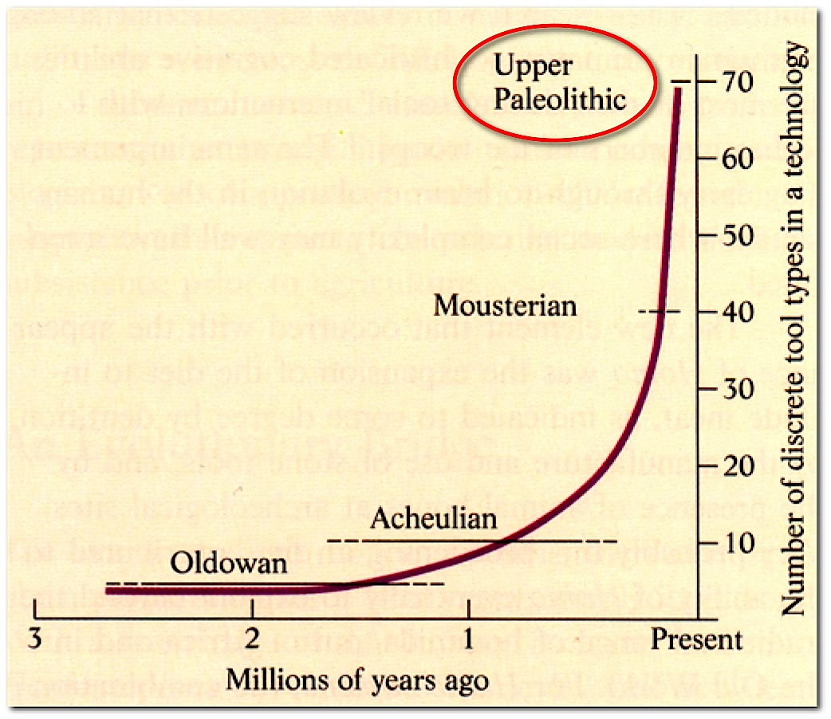
?
“Civilizations”
Population Growth
and
Technological Complexity
H. sapiens
H. neander.
H. erectus
Australopithecines

Slide 5
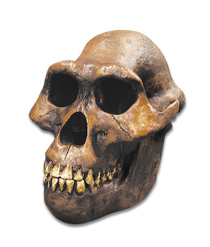
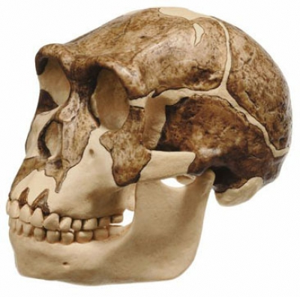
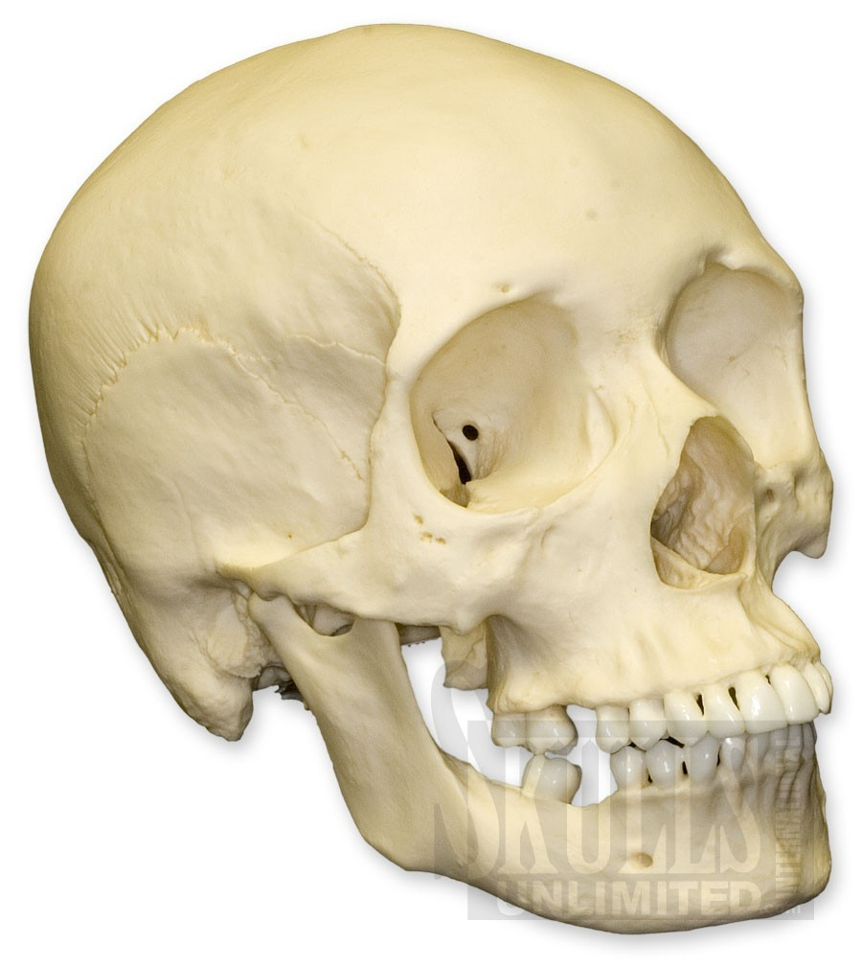
What Do You Notice?
H. Saipan
1300cc
H. Erectus
1000cc
Australopithecines
350cc

Slide 6
Brain Size Increase Shrinking Face
1300 cc
pithecines
1000 cc
350 cc

Slide 9
Darwin’s Predictions (1871)
Humans originated in Africa
Chimp (African ape) = closest living relative
“Feedback” model:
Africa
Climatic deterioration (ape decline)
Expanding savanna grasslands
Hunting
Tools
Bipedalism (obligate 2-legged)
Brain size

Slide 10
African
Apes
Asian
Primates
Monkeys
Human-Chimp Split
(5.0 – 6.0 my)

Slide 11
Very arthritic
Teeth lost
in life -
implies care

Slide 13
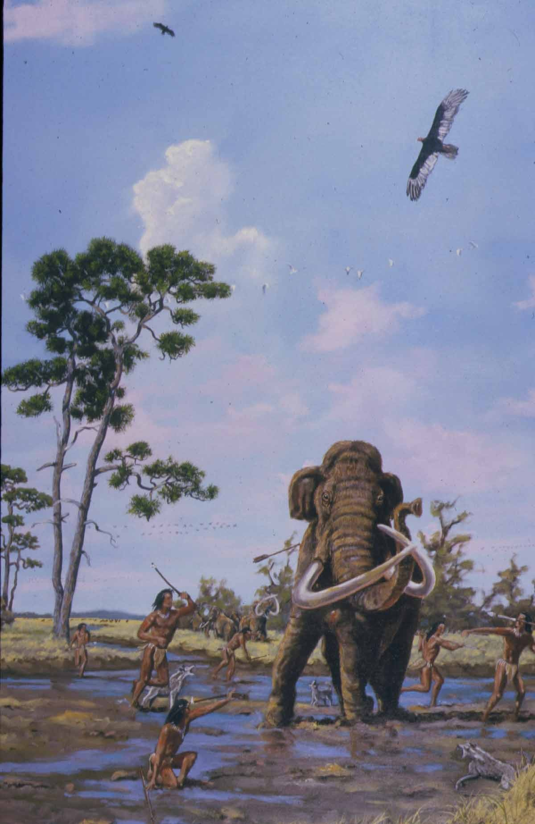
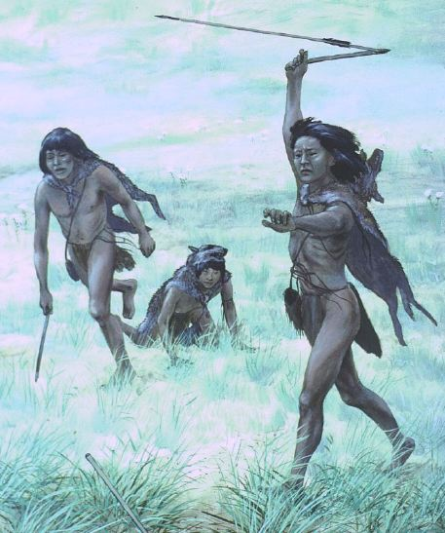
Clovis Mammoth/Mastodon Hunters
Atlatl (Spear-Thrower)

Slide 14
First Stone Tools

