Slide 1
Class Notes: Density, Temperature, and Percent Error

Slide 2
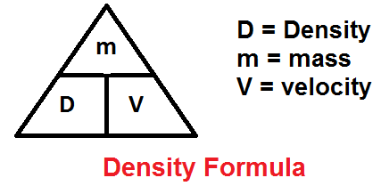
g
cm³
Density = = = =
Density: A physical property used to compare substances
Less dense substances float, more dense substances sink
Mass
Volume
m
v
g
mL

Slide 3
Temperature: the degree of hotness or coldness relative to water
-A measure of the KE of particles
Heat: a form of energy; can be transferred between objects
*differences in temperature indicate the direction of heat transfer

Slide 4
Measuring Temperature – 2 scales
Celsius (°C)
Kelvin (K, no degree °)
-Based on absolute zero (motion of particles ceases)
-water freezes at 273K and boils at 373K
K = °C + 273
K – 273 = °C

Slide 5
Percent Error
Accuracy: nearness to the true (accepted)
Value
Experimental value: the one you measured
Error = accepted value – experimental value
Accepted Value
x100

Slide 6
5 Steps to foolproof problem solving with formulas
Write the formula
List the variables
Rearrange the formula to solve for the unknown
Plug in numbers, calculate answer
Check (reasonable?, unit, box around answer)

