Slide 1
Day 84: Transatlantic Slave Trade
World History Unit 3

Slide 2
Ancient World Civilizations
Assyria
Babylonia
China
Egypt
India
Persia
Mesopotamia
Slavery was a universal institution in the ancient world but it was a dominant labor force only in a small number of societies.
First true slave society - Ancient Greece (6th to 4th Century)

Slide 3
Old World vs. New World Slavery
Classical world and medieval slavery was not based on racial distinctions.
Ancient world did not necessarily view slavery as a permanent condition.
Slaves did not necessarily hold the lowest status in early civilizations.
Slaves in the old world often were symbols of prestige, luxury and power (true even in the ne world prior to European Colonization).

Slide 4
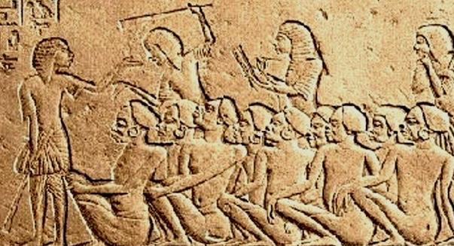
How was slavery justified?
Early civilizations - accident or bad luck.

Slide 5
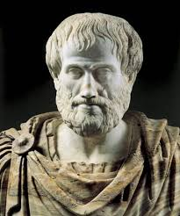
In Western Civilization….
Aristotle - notion of the “natural slave”
“For that some should rule and others be ruled is a thing not only necessary, but expedient; from the hour of their birth, some are marked out for subjection, others for rule”- Aristotle, Politics

Slide 6
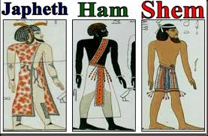
Justification in Christianity
Christian world - ‘Curse of Ham” ("A servant of servants shall he be unto his brethren." Genesis 9:25)

Slide 7
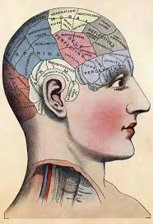
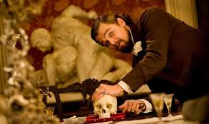
Phrenology
18th Century European - pseudo-scientific racism.

Slide 8
Why was Africa vulnerable to the Slave Trade?
Political Fragmentation
Sailing Routes
Availability of People (high birth rate)
Civilizations and Skills (metalworking, farming, herding)
No diplomatic repercussions.

Slide 9
Why not others?
Disease
Knowledge of terrain
Different Agricultural Skills
Supply deficit
Nation American women worked - not men!

Slide 10
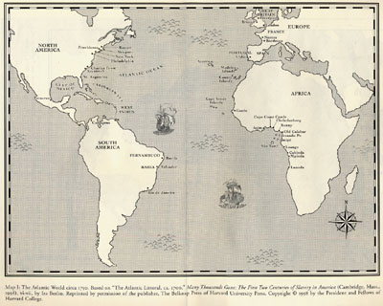
Countries Participating
Britain
Denmark
France
Holland
Portugal
Spain
Norway

Slide 11
Why did European powers eventually turn to African labor?
Labor supply was insufficient. Epidemics reduced the native population by 50% - 90%.
Evidence of deeply help racist sentiment. Racism was a consequence of racial slavery as well as a cause.
In English colonies the supply of servants decreased.

Slide 12
Middle Passage Origins of the Infamous Middle Passage
The middle leg of a three part voyage.
Began and ended in Europe.
Carried cargo of iron, cloth, brandy, firearms, gunpowder
Landed on Africa’s Slave Coast and exchanged cargo for Africans
Set sail for the Americas, where slaves were exchanged for sugar, tobacco, molasses.
Final brought the ship back to Europe.

Slide 13
Middle Passage 1600 - 1850’s The Capture
Approx. 60 forts build along the west coast of Africa.
Walked in slave caravans to the forts some 1000 miles away.
Selected by the Europeans and branded.
One half survived the death march.
Place in underground dungeons until they were boarded on ships.

Slide 14
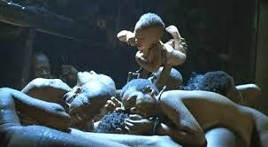
Middle Passage Conditions on Board the Ship
Slaves chained together and crammed into spaces sometimes less than five feet high.
Slavers packed three of four hundred Africans into the ship cargo holds.
Little ventilation, human waste, horrific odors. Unclean.

Slide 15
Middle Passage
Tight packing - belly to back, chained in twos, wrist to ankle (660+), naked.
Loose packing - shoulder to shoulder chained wrist to wrist or ankle to ankle.
Men and woman separated (men placed towards bow, women toward stern).
Fed once of twice a day and brought on deck for limited times.

Slide 16
British Slave Ship

Slide 17
Middle Passage
Journey lasted 6-8 weeks.
Due to high mortality rate, cargo was insured (reimbursed for drowning accidents but not for deaths from disease of sickness)
Common to dump your cargo for sickness or food shortages.
Slave mutinies on board ships were common (1 out of every 10 voyages across the Atlantic experience a revolt).
Covert resistance (attempted suicide, jumped overboard, refusal to eat).

Slide 18
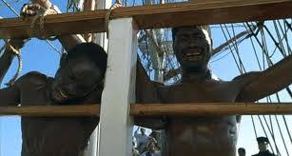
Deck for a limited time
Often slavers would use fear tactics to keep the slaves from rebelling. If disease was found in slaves they were thrown overboard.
Abuse was rampant. Neglect, whipping, malnutrition, sexual abuse, and dehumanization.

Slide 19
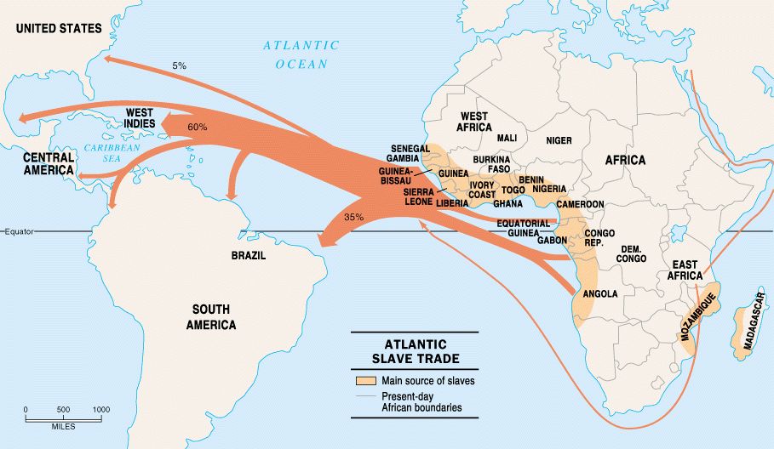
Destination of Captives
Caribbean 50%
Brazil 35%
Latin America 10%
British North America 5%

Slide 20
Growth of African American Population
1820 | 1.77 million | 13% free
1830 | 2.33 million | 14% free
1840 | 2.87 million | 13% free
1850 | 3.69 million | 12% free
1860 | 4.44 million | 11% free

Slide 21
Slave Resistance: Passive and Active Resistance
Breaking tools
Faking illness
Staging slowdowns
Committing acts of arson and sabotage
Running Away
Underground Railroad

Slide 22
Legacy of Slavery
Agriculture Rice Sweet Potatoes Herding Basketry Working Style (cooperative labor) Planting (heel to toe) | Food Spices (red pepper, sesame, cajun) Okra, black eyed peas Rice | Dishes Gumbo, jambalaya Ash and hot cakes Sweet potato pie
Music Banjo Drum Blues/Jazz Call and response Spirituals | Religion Call and response patterns Emotional services Multiple spirits and souls Voodoo | Tales and Words Trickster takes (Anansi the Spider, Brer Rabbit, Bugs Bunny) Words like bogus, bug, phony, yam, tote, gumbo, tater, jamboree, jazz. Creole Language

