Slide 1
DAY 71: great Zimbabwe
An example that changes the prior Eurocentric narrative.

Slide 2
To the gym we went to sketch.

Slide 3
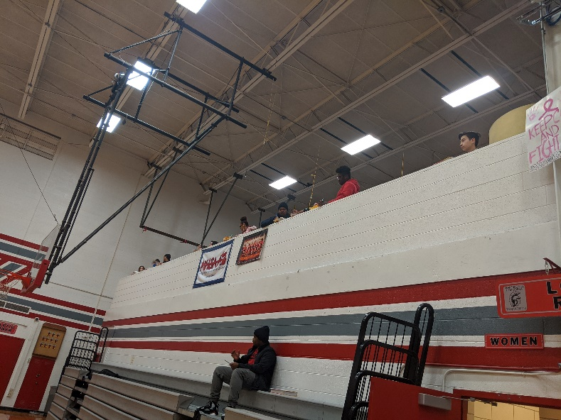
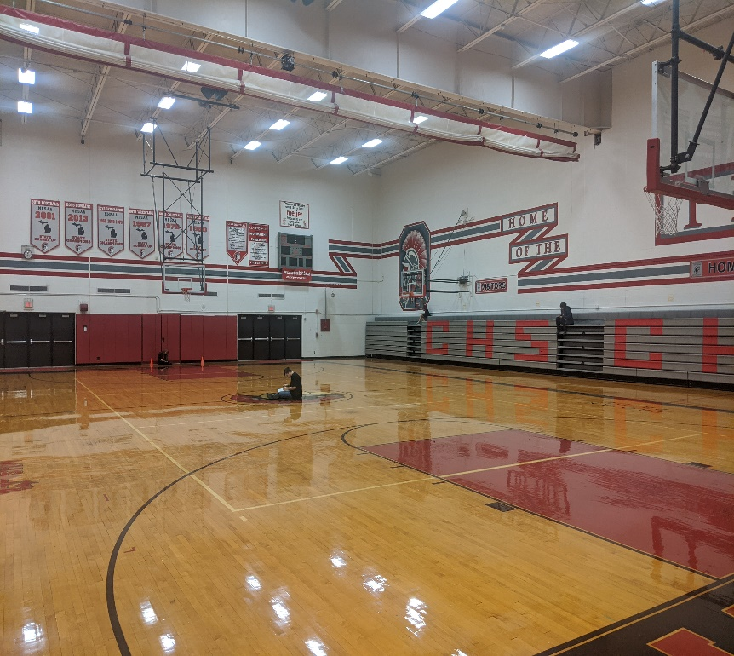
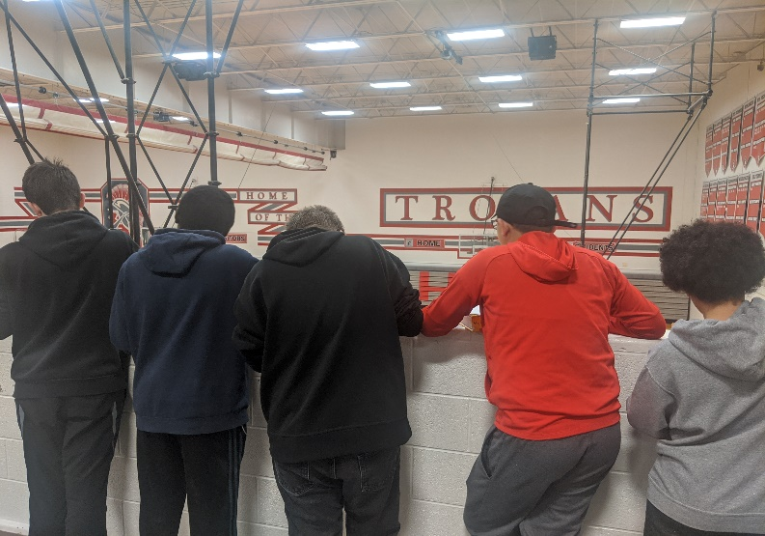
How to do so?

Slide 4
Not easy
SCALE
PERSPECTIVE
WHAT TO ADD? WHAT TO NOT ADD?
UNFAMILIAR ITEMS- HOW TO IDENTIFY THEM?
SIGNIFICANCE
IMAGINE ADDING CENTURIES OF TIME TO THIS PROCESS.
AND THE POINT TO THIS…..IT APPLIES TO LEARNING ABOUT GREAT ZIMBABWE

Slide 5
Let’s interpret this photo (source: tayo fatunla)

Slide 6
Yesterday v. today: both Africa…but as you know, Africa is a large continent.

Slide 7
Remember these two (I certainly hope so)

Slide 8
Indian ocean trade route
Another example of how hemispheric interactions increased during this time period in history.

Slide 9
Great Zimbabwe
Largest of 150 major stone ruins scattered throughout modern Zimbabwe and Mozambique

Slide 10
The shona (bantu) people
10,000-20,000 people were supported with animal husbandry, crop cultivation, and gold trading with the Indian coast.

Slide 11
Zimbabwe is a shona word for stone houses
This history is still alive in the memory of Southeast Africans.

Slide 12
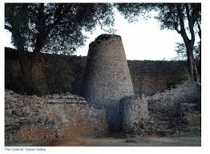
There were three main areas:
1) HILL COMPLEX (Spiritual and
Religious center)
2) THE GREAT ENCLOSURE (328 feet high)
3) THE VALLEY RUINS (Many daga
Dwellings)
Clear evidence of advanced civilization, despite its years of abandonment and disrepair.

Slide 13
IT WAS ATTRIBUTED TO NON-AFRICAN BUILDERS
An example of historical bias
An example of racist beliefs
Thought to be Phoenician, Greek, or Egyptian because of how advanced the people were.
This is an example of how history can be used as a tool to further a present narrative. Emphasizes the need for evidence, historiography, and squashing false narratives. These false narratives have caused great unpleasantness throughout history.

Slide 14
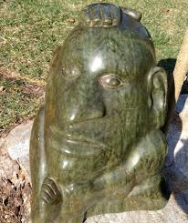
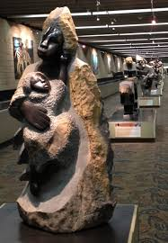
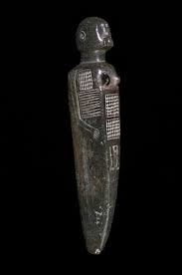
Zimbabwe soapstone art

Slide 15
Still a point of pride and a change of an old narrative.

Slide 16
Placing great Zimbabwe in the broader picture….

