Slide 1
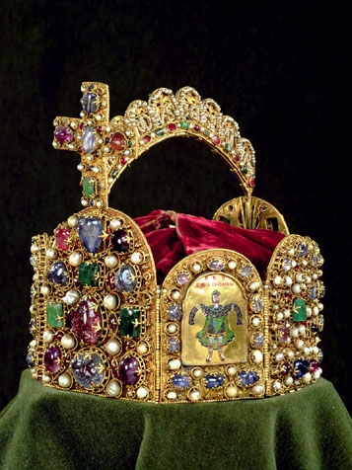
The Holy Roman Empire
11th c. imperial crown

Slide 2
Voltaire’s Famous Quote (1756)
“This agglomeration which was called and still calls itself the Holy Roman Empire was neither holy, nor Roman, nor an empire in any way.”

Slide 3
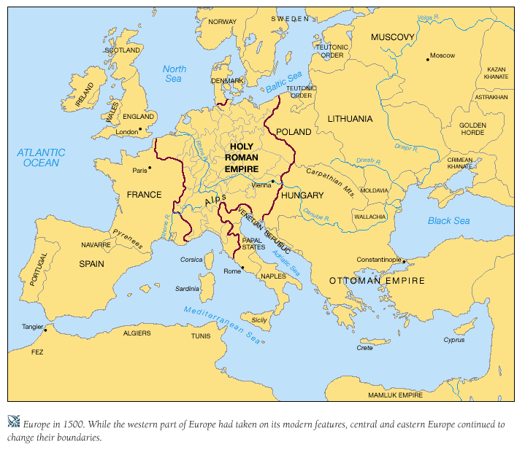
Europe in 1500

Slide 4
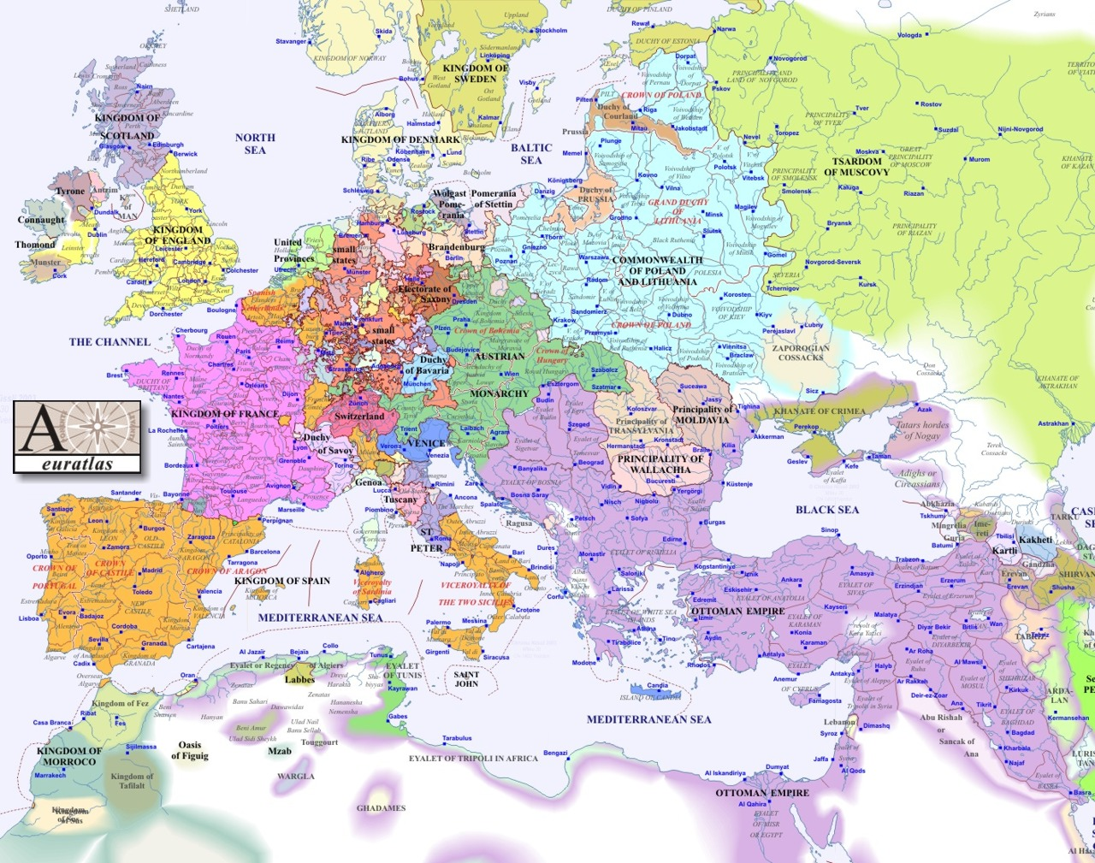
Europe in 1600

Slide 5
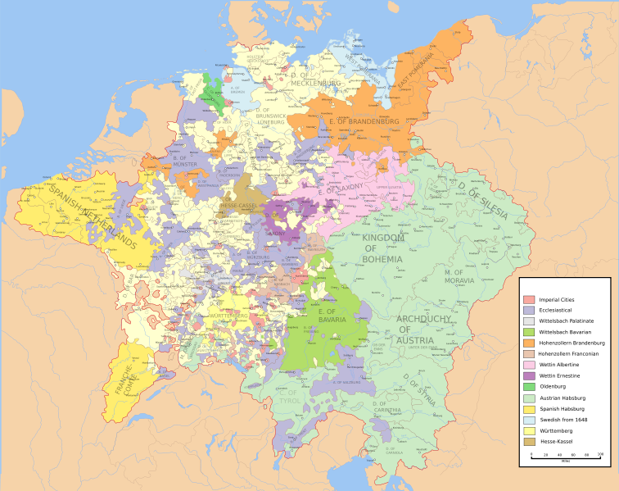
The “patchwork carpet” of Holy Roman Empire, 1648

Slide 6
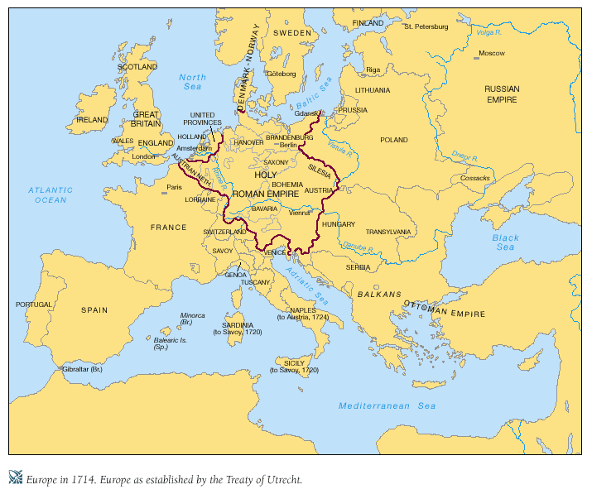
Europe in 1714

Slide 7
What is the Holy Roman Empire?
political entity that covered a large portion of Europe
centered on Germany
A.D. 800-1806

Slide 8
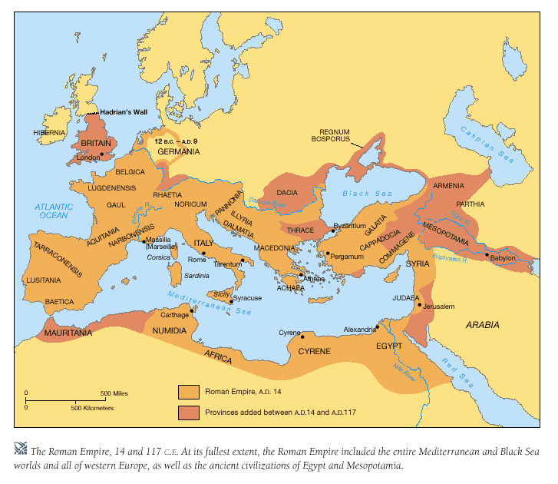
History of the Holy Roman Empire
476 – fall of the Roman Empire to Germanic tribes

Slide 9
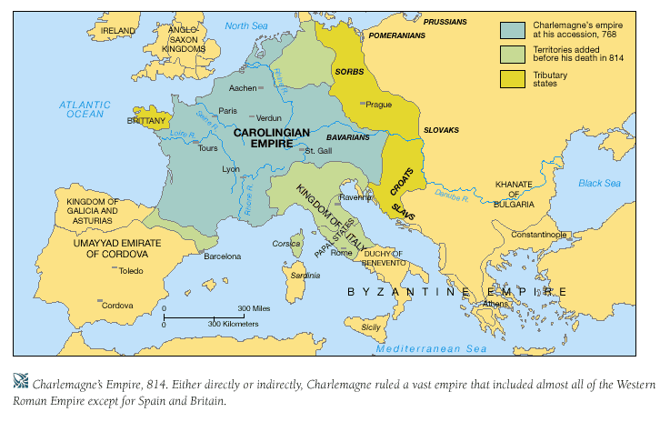

Slide 10
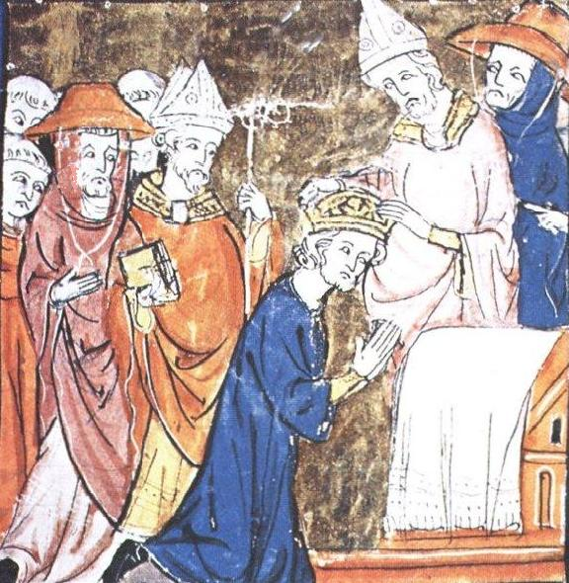
History of the Holy Roman Empire
800 – Charlemagne crowned “emperor” by Pope Leo III
Charlemagne = king of the Franks, a Germanic tribe
Carolingians believe the title of Roman emperor in the west had been suspended, not ended, with Rome’s fall in 476
est. church backing for HRE & Carolingians

Slide 11
What powers did the Holy Roman Emperor have?
Very little … from the later Middle Ages forward his power was mostly symbolic. Most real legal and administrative power was held in the territorial and municipal levels.
Peace of Westphalia (1648) gave almost complete sovereignty to the ≈300 states of the HRE. Henceforward the HRE primarily existed in name only. Habsburg emperors focused on consolidating their own states in Austria, etc.

