Slide 1
Michigan constitution: Article IV
Brenna O’Boyle, Kaley Burt, and Samantha Runyon

Slide 2
Section 1: LEGISLATIVE POWER
The legislative power in Michigan is held in the senate and house of representatives

Slide 3
SECTION 2: SENATORS
There cannot be less than 10 or more than 16 factors.
The population of districts cannot be less than 75% or more than 125% of a number determined by dividing the population of the county by the number of senators in the district.
The senate should have 38 members in their districts at the same election time as the governor.
After each county has selected one senator, the remaining senators are distributed to counties by the method of equal proportions—meaning each county is equal.

Slide 4
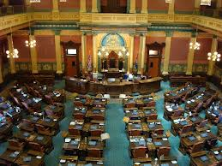
SECTION 3: Representatives
The house of representatives should consist of 110 members
Elected for 2-year terms from single member districts.
Decided on a basis of population.
The districts should consist of compact and convenient territory contiguous by land.

Slide 5
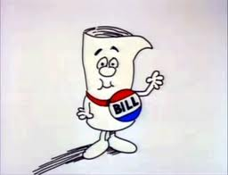
Section 22: bills
All legislation will come from either senators or representatives.

Slide 6
Section 24: laws; object, title, amendments changing purpose
No law can be on more than one object, which has to be expressed in its title.
No bill can be altered or amended on its passage through either house so as to change its original purpose as determined by its total content and not alone by its title.

Slide 7
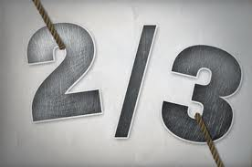
Section 27: laws, effective date
No act shall take effect until the expiration of 90 days from the end of the session at which it was passed.
The legislature can give effect to acts by a two-thirds vote.

Slide 8
Section 32: laws imposing taxes
Every law which imposes, continues or revives a tax shall distinctly state the tax.

Slide 9
Section 40: alcoholic beverages; age requirement; liquor control commission; excise tax; local option
People under 21 cannot purchase alcohol.
Also people under the age of 21 can’t have possession of any alcoholic beverages for the purpose of consumption.

Slide 10
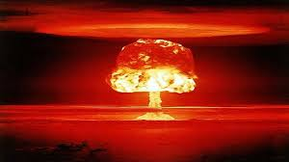
Section 50: Atomic and new forms of energy
The legislator may provide safety measures and regulate the use of atomic energy in forms of energy developed in the future.

Slide 11
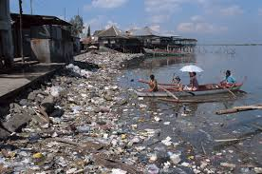
Section 52: Natural resources; conservation, pollution, impairment, destruction
the legislature shall provide for the protection of the air, water and other natural resources of the state from pollution, impairment and destruction

