Slide 1
Clarenceville Art Gallery
LESSON 13: Applying the Aesthetics Criteria to Fine Art

Slide 2
Aesthetics Criteria
1. Aesthetic Concepts- Often these take the form of adjectives that people attempt to create
2.Aesthetic Value- What value does the piece of art provide? Practical? Spiritual? Humor? Provoking of thoughts?
3. Aesthetic Attitudes- From what mindset is the artist coming from in creating the art?
4. Intentions- What was the artist intending to do by creating this piece of art? Is this even a relevant question?
5. Definition of Art- What constitutes art? How would you define art? What designates something as a particular type of art?
6. Expression- How do audiences respond to the artwork? Does the viewer emote the way that the artist intended them to emote?
7.Representation- How well does the art expression represent the subject of the piece? Is accuracy paramount? Is emotion paramount?
8. Art Object-
What is the mission of art and was it accomplished?

Slide 3
“The Persistence of Memory”, by: Salvador Dali

Slide 4
“The Dance”, by: Henri Matisse

Slide 5
“The Kiss”, by: Gustav Klimt

Slide 6
“The Sleeping Gypsy”, by: Henri Rousseau

Slide 7
“The Last Judgement”, by: Hieronymus Bosch

Slide 8
“Metamorphosis of Narcissus”, by: Salvador Dali

Slide 9
“Massacre of the Innocents”, by: Peter Paul Rubens

Slide 10
“No. 5 1948”, by: Jackson Pollock

Slide 11
“Bal du Moulin de la Galette”, by: Pierre-Auguste Renoir

Slide 12
“The Last Supper”, by: Leonardo Da Vinci

Slide 13
“Water Lillies”, by: Claude Monet

Slide 14
“The Scream”, by: Edward Munch

Slide 15
“Whistler’s Mother”, by: James Whistler

Slide 16
“Portrait of Dora Maar”, by: Pablo Picasso

Slide 17
“The Starry Night”, by: Vincent van Gogh

Slide 18
“Olympia”, by: Edouard Manet

Slide 19
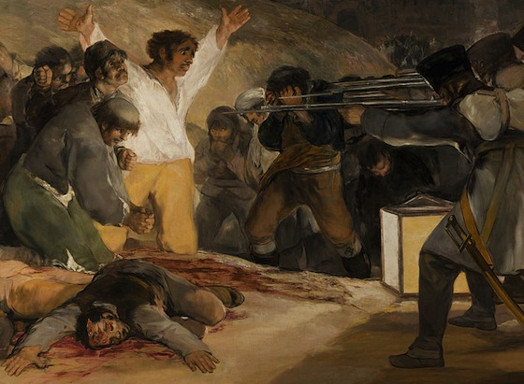
“The Third of May 1808”, by: Francisco Goya
.

Slide 20
“Girl With a Pearl Earring”, by: Johannes Vermeer

Slide 21
“The Night Watch”, by: Rembrandt

Slide 22
“Las Meninas”, by: Diego Velazquez

Slide 23
“Landscape with the Fall of Icarus”, by: Pieter Bruegel

Slide 24
“School of Athens”, by: Raphael

Slide 25
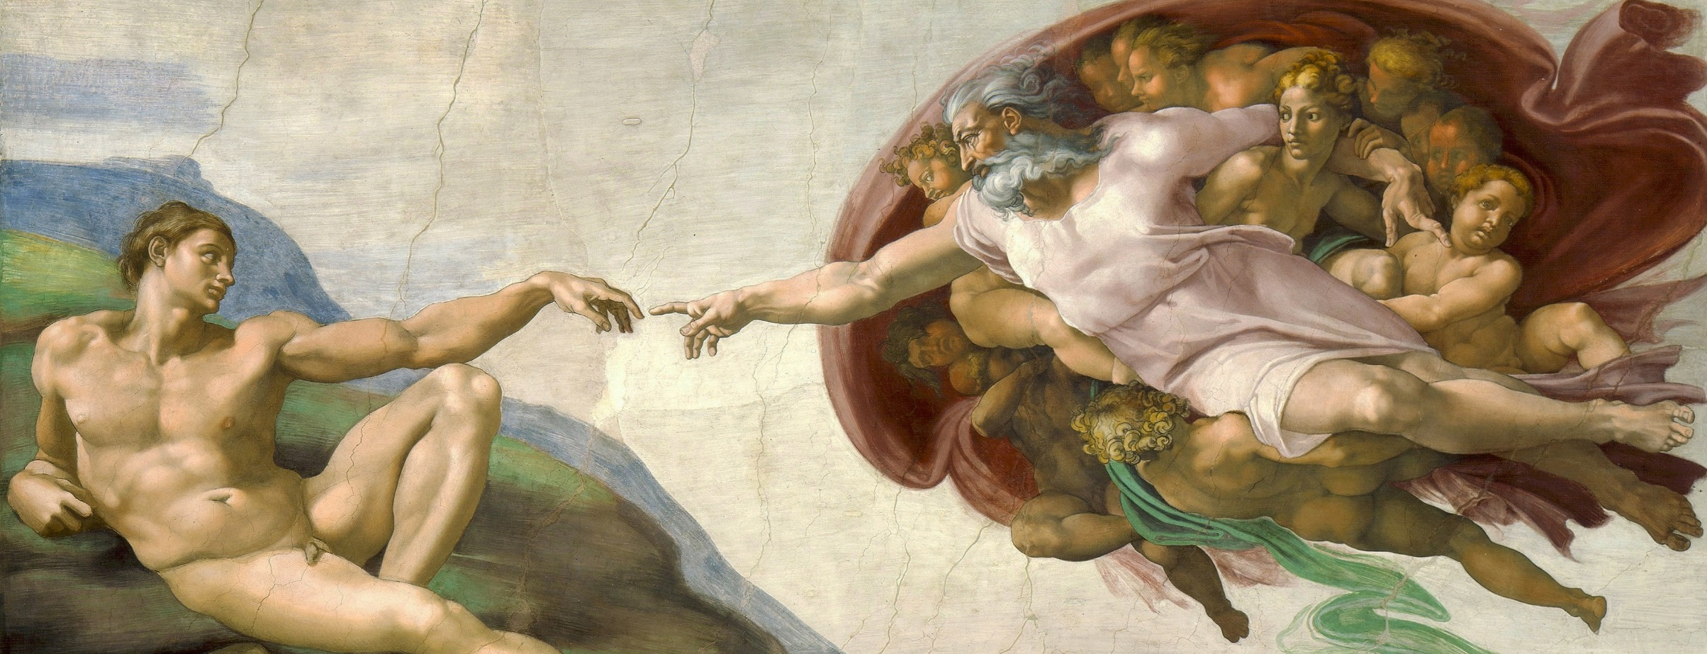
“The Creation of Adam”, by: Michaelaneglo
.

Slide 26
“Mona Lisa”, by: Leonardo Da Vinci

Slide 27
“The Birth of Venus”, by: Sandro Botticelli

