Slide 1
WHAT IS BIG HISTORY?
1
HOW IS THIS COURSE DIFFERENT FROM OTHERS?

Slide 2
UNIT 1
WHAT IS BIG HISTORY?
UNIT 1 BASICS
3 Unit 1 Overview
4 Unit 1 Learning Outcomes
5 Unit 1 Lessons
7 Unit 1 Key Concepts
KEY CONTENT
Thresholds of Increasing Complexity
11 Big History Timeline
12 What Is Big History?
13 The History of Everything
14 Complexity & Thresholds
15 Notations & Measures
16 Origin Stories
17 How Do We Decide What to Believe?
18 Claim Testers
19 Looking Ahead: What’s Next in Unit 2?

Slide 3
UNIT 1
OVERVIEW
Key Disciplines:
Big history
Timespan:
13.7 billion years ago
Key Question:
How is this course different from others?

Slide 4
UNIT 1
LEARNING OUTCOMES
By the end of Unit 1, students should be able to:
Explain how big history is different from other approaches to history.
Define the key course themes of thresholds of increasing complexity, Goldilocks Conditions, scale, collective learning, claim testing, and big history as a modern, science-based origin story that draws on many different types of knowledge.
Interpret multiple texts about shifting scales in history and determine the central idea of each.
Become familiar with navigating the course site and locating content, quizzes, investigations, and other course materials.

Slide 5
UNIT 1
LESSONS
1.0 Welcome
Big History starts with a big mystery. Looking at the fate of a small pacific island from multiple scientific and historic disciplines sets the stage for a year of inquiry in Big History.
1.1 What is big history?
This is not just another history course. You’re about to start a 13.7-billion year adventure that begins at the absolute beginning and never really ends.
1.2 Complexity and thresholds
Fragile, diverse, precise, and punctuating the creation of something entirely new in the Universe – thresholds of increasing complexity are a foundation of big history.
1.3 Scale
A mile, a year, a foot – all our everyday measures relate to a familiar scale. Big history is so big that we need to use entirely different measurements on an entirely different scale.
Continued next slide

Slide 6
UNIT 1
LESSONS
Continued from previous slide
1.4 Origin stories
People have always told origin stories – stories about how the Universe and humans came to be. Big history is a modern, scientific origin story, told by a global community.
1.5 Ways of knowing: What we believe
How do you decide what to believe? If you read it on the Internet, does it have to be true? How about something your doctor tells you? Claim testing helps us assess the trustworthiness of information.

Slide 7
UNIT 1 KEY CONCEPTS
big history
Goldilocks Conditions
origin story
scale
thresholds of increasing complexity

Slide 8
KEY CONTENT

Slide 11
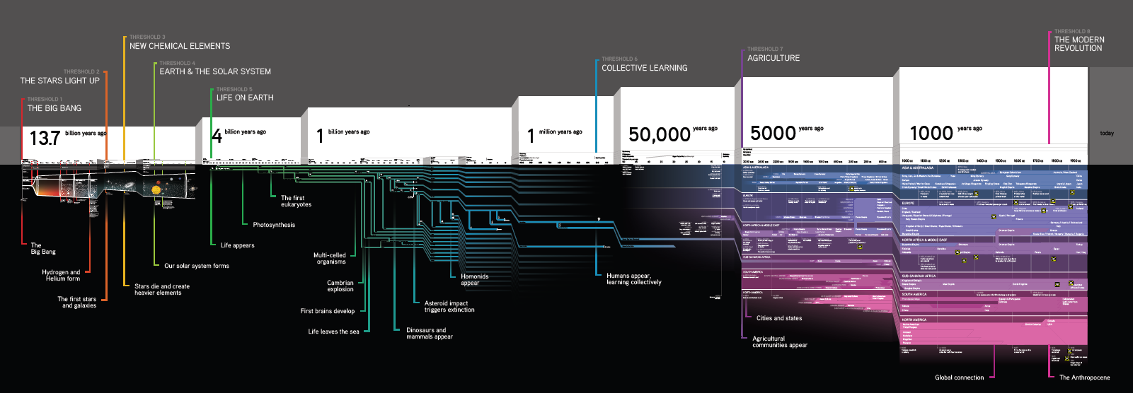
BIG HISTORY
TIMELINE
Infographic

Slide 12
WHAT IS BIG HISTORY?
Main Talk / David Christian
Big history tells the story of the Universe from the Big Bang to the present, a time span of 13.7 billion years.
Big history is the modern, scientific origin story, based on the best evidence that scientists and historians have compiled to date. As new and better evidence is found, the story will need to be updated.
Big history asks big questions. Among the questions that big historians tackle are: How was the Universe created? Why does it work the way it does? Why are stars so big? Why are you and I so small?

Slide 13
THE HISTORY OF EVERYTHING
Video / David Christian
In a live talk at the TED conference in March 2011, David Christian describes 13.7 billion years in the history of the Universe in just 18 minutes.
By scrambling an egg, Dr. Christian suggests how the Universe grows more complex through unlikely events he calls Goldilocks Conditions.
He leads an audience of scholars, business leaders and entertainers through the entire history of the Universe focusing on 8 thresholds of increasing complexity – moments when Goldilocks Conditions unlocked transformations that weren’t possible beforehand.
These thresholds include the Big Bang, the formation of stars, chemical elements emerging from stars, Earth and our solar system, life, humans, agriculture and our modern world.

Slide 14
COMPLEXITY & THRESHOLDS
Article / David Christian
Complexity is hard to define, but there are three characteristics that will help you identify it in this course. Complex things tend to have:
Diverse ingredients
Precise arrangements
Emergent properties
When the right combination of ingredients are arranged in a precise way, together they have properties that the individual ingredients did not.
Complexity is rarer than simplicity in the Universe.
When the Universe experiences a significant increase in complexity, we call it a threshold of increasing complexity. In this course, we will focus on eight such thresholds.

Slide 15
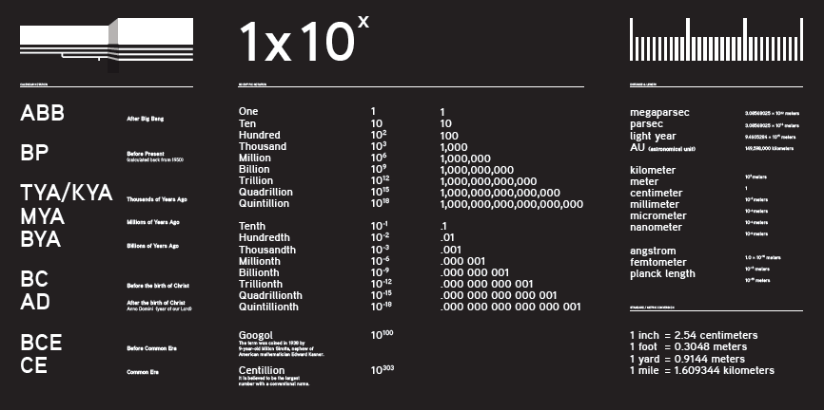
NOTATIONS & MEASURES
Infographic

Slide 16
ORIGIN STORIES
Article / Cynthia Stokes Brown
In the first article, Cynthia Stokes Brown introduces the theme of origin stories and discusses why they are so common across cultures.
Origin stories answer important questions like “How was the Universe created?” and “How were humans created?” They reassure people about their place in the world.
Origin stories differ from society to society, and some societies may have multiple origin stories or have different versions of the same story.
In the remaining articles, Brown compiles a variety of origin stories that emphasize different questions and teach different lessons. The stories represented are: Australian Aboriginal, Chinese, Greek, Iroquois, Judeo-Christian, and Mayan. Brown also offers an example of a modern scientific origin story.

Slide 17
HOW DO WE DECIDE WHAT TO BELIEVE?
Guest Talk / Bob Bain
When you hear someone make a claim, you’re likely to have one of three responses: there are some claims you trust, others you ignore, and a third group that you may decide to investigate.
The Big History Project presents claims as part of each unit. You will need to decide whether to believe them, as well as whether you would like to investigate further. Four “claim testers” will help you evaluate claims made throughout the course:
Intuition is your gut instinct. Does the claim feel right to you, or does it feel a bit off?
Logic involves reasoning. Does the claim make sense? Is there a good argument for it?
Authority requires you to think about who is making the claim. Do you trust the source? Does the source have specific knowledge or expertise that gives you confidence?
Evidence is something you can investigate and verify. If you or another person looked at the same evidence, would you arrive at the same findings?

Slide 18
CLAIM TESTERS: EPISODE 1
Comic Strip / Larry Gonick
In this comic strip, we meet the four Claim Testers. Each has a special claim testing power:
Evy (evidence)
Andor (logic)
Big Sci (authority)
Vera (intuition)
The Claim Testers arrive in the school yard, where they meet Brianna and Jesse.
In future episodes, Brianna and Jesse, the Claim Testers, and their new acquaintance Zyx will explore the Cygnus Epsilon System, examining how that system is organized and how the creatures who live there find sustenance and gather energy.

Slide 19
LOOKING AHEAD

Slide 20
WHAT’S NEXT?
In Unit 2, we will focus on the Big Bang, which marks the beginning of 13.7 billion years in big history. We will learn:
How the theory of the Big Bang developed.
The ways scientists built on the work of prior generations and used the tools of their time to understand the Universe.
What the very early history of the Universe looked like and what it generated.
How our Universe has changed over time.

