Slide 1
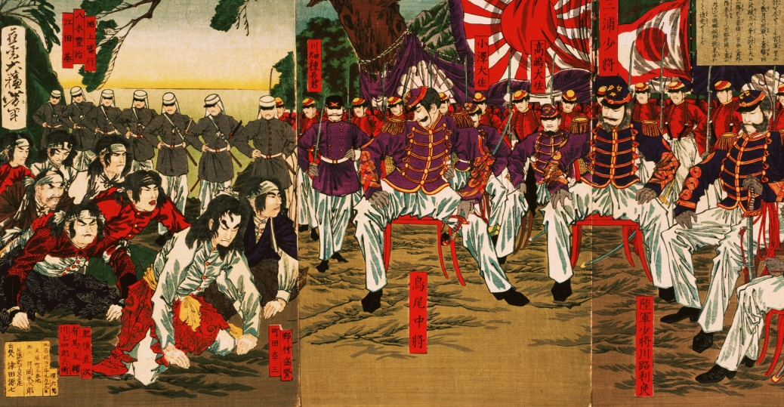
Day 106: Japan: From its roots to the Meiji Restoration

Slide 2
Yamato Period: 300-710
Began promoting adoption of Chinese culture:
Confucianism
Language (characters)
Buddhist sects
Chinese art & architecture
Government structure
“Great Kings” era

Slide 3
Heian Period: 794-1156
Growth of large landed estates
Arts & literature of China flourished
Elaborate court life [highly refined]
Personal diaries
First novel
The Tale of Genji by Lady Murasaki Shikibu
[1000 pgs.+]
Moving away from Chinese models in religion, arts, and government and developing a uniquely Japanese ethos.

Slide 4
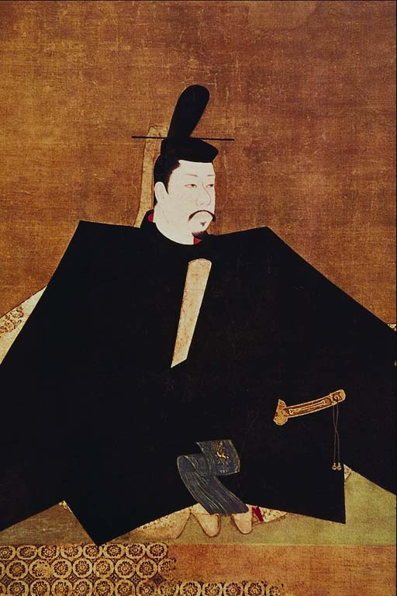
Minamoto Yoritomo
Founded the Kamakura Shogunate: 1185-1333

Slide 5
Feudalism
A political, economic, and social system based on loyalty, the holding of land, and military service.
Japan:
Shogun
Land - Shoen
Loyalty
Land - Shoen
Daimyo
Daimyo
Loyalty
Samurai
Samurai
Samurai
Food
Protection
Peasant
Peasant
Peasant
Peasant

Slide 6
Code of Bushido
Fidelity
Politeness
Virility
Simplicity

Slide 7
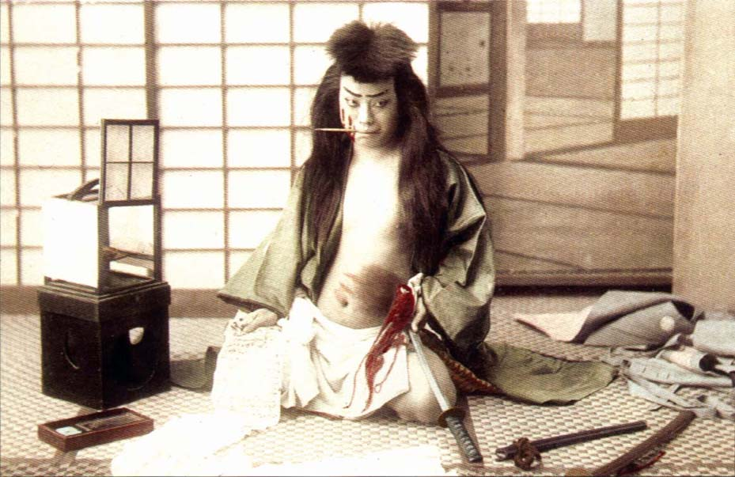
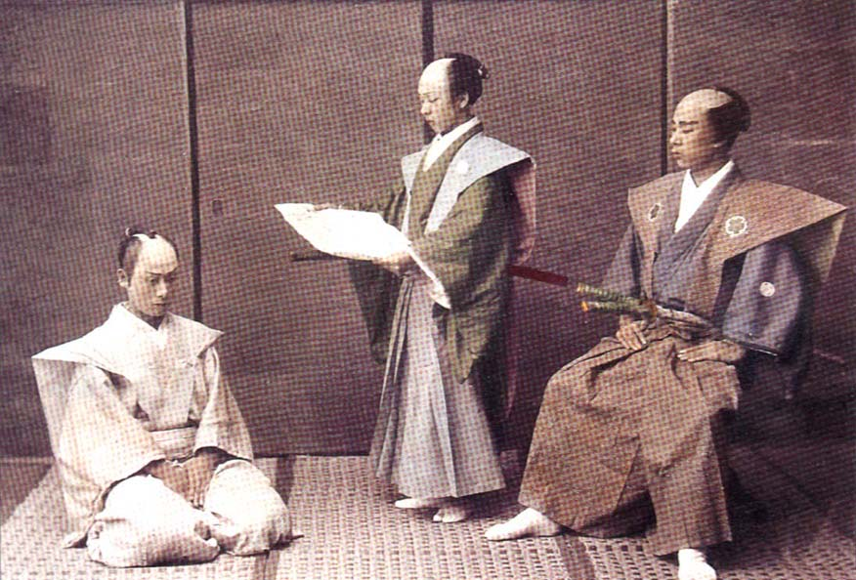
Seppuku: Ritual Suicide
It is honorable to die in this way
Kaishaku – his “seconds”

Slide 8
Ashikaga Age: 1338-1573
Shoguns fought for power
Laws are unclear
Less efficient than Kamakura
Armies of samurai protected the country

Slide 9
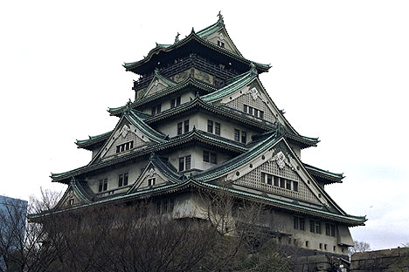
Osaka Castle

Slide 10
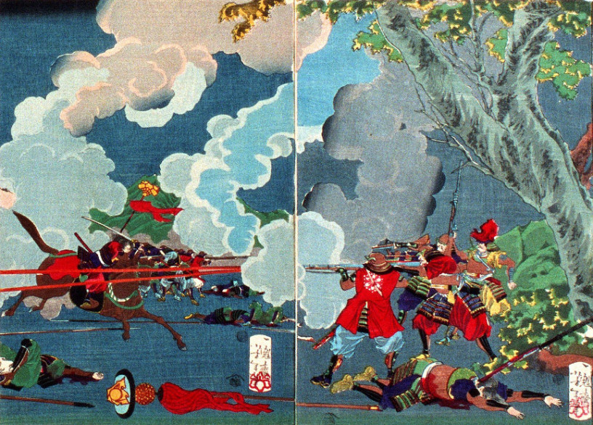
Battle of Sekigahara, October 21, 1600: Ended Japanese Civil War and began Tokugawa Shogunate

Slide 11
Tokugawa Shogunate (1600-1868)
Called the Edo Period as well
Implemented many changes, including the standardization of coins and weights, infrastructural improvements, improved legal codes and economic gains
Peace, prosperity, improved literacy, and intellectual growth
…..Then Perry showed up in 1853.

Slide 12
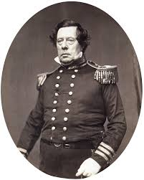
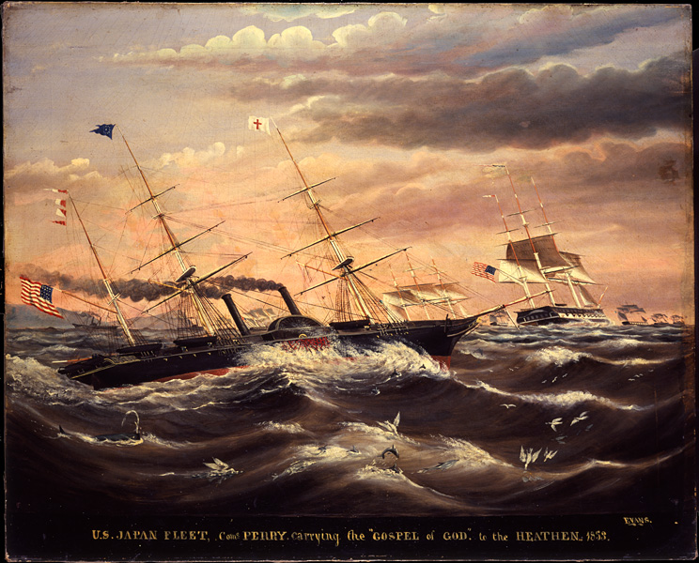
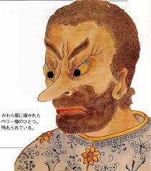
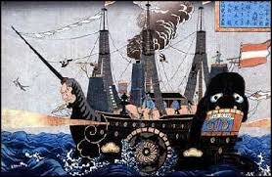
Commodore Matthew Perry Arrives in 1853

Slide 13
Meiji Restoration (1868)
Civil War ended Tokugawa Rule
Westernization in government, politics, industry, banking, science, education, and values.
Replaced Buddhism with Shintoism, which promoted order and allegiance.
Adopted western hairstyles, clothes, and hygiene. Also adopted western calendar and metric system.

Slide 14
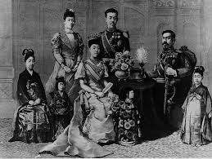
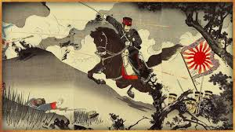
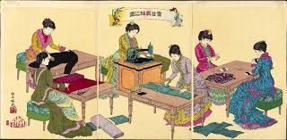
A Revolution in the majority of ways

