Slide 1
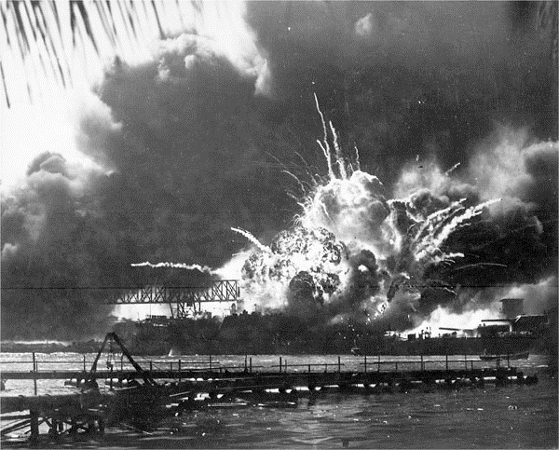
1
Japanese bombing of Pearl Harbor. December 7, 1941.

Slide 2
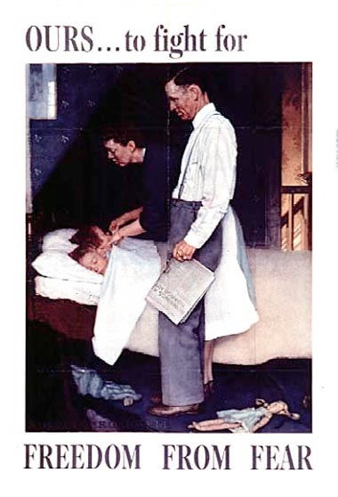
2
U.S. War Aim

Slide 3
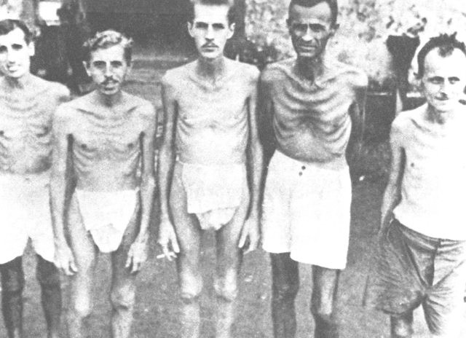
3
American Survivors of the Bataan Death March

Slide 4
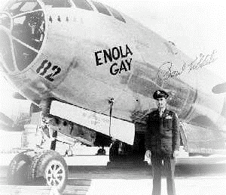
4
General Paul Tibbets and the Enola Gay

Slide 5
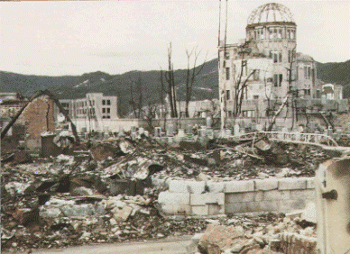
5
Hiroshima City after the Atomic Bombing

Slide 6
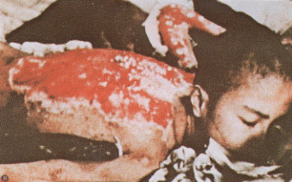
6
A boy’s burned ﬂesh after the atomic bombing of Hiroshima

Slide 7
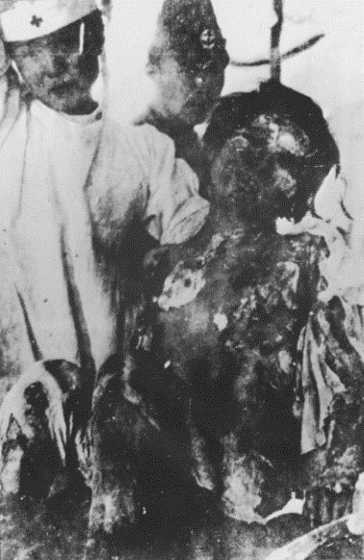
7
A girl with her skin hanging in strips after the atomic bombing of Hiroshima

Slide 8
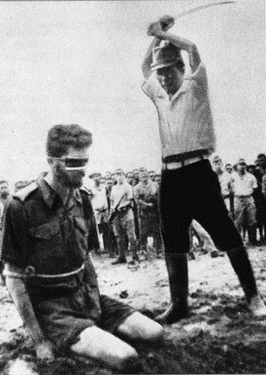
8
Treatment of POWs by Japanese soldiers

Slide 9
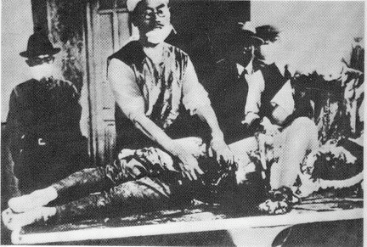
9
Japanese Unit 731 performs medical experiments, including vivisections, on POWs and colonial subjects.

Slide 10
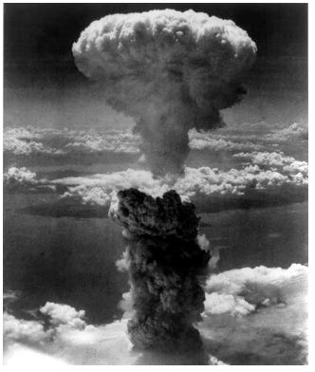
10

