Slide 1
Forensics B
Final Exam Review

Slide 2
Which forensic specialists would do the following?
Examine bones
Examine insects
Run tests for DNA analysis
Run tissue tests for drug identification
Make a clay face from a skull

Slide 3
Which forensic unit would handle the following?
Testing bullets and guns
Testing to see if someone was poisoned
Examine arches, loops and whorls
Processing film and digital images

Slide 4
Blood
a. What are the names of the blood types?
B. What does it mean to be + or -?
C. What genotypes can each person with a certain blood type have?

Slide 5
Blood
A. What blood type is the universal donor? Why?
B. What blood type is the universal acceptor? Why?
(*Make sure you know the difference between antigens and antibodies!)

Slide 6
Blood
A. A person with type A+ blood is injured in an accident. What blood types can be given to them? Remember to include the + or – in your answer!
B. A person with AB- blood is injured in an accident. What blood types can be given to them? Remember to include the + or – in your answer!

Slide 7
Blood

Slide 8
Blood
A. What test is run on a small sample to determine if it is real blood?
B. What would indicate a positive result?
C. What test would Be done on a large area where you suspect a crime has been committed?
D. What would indicate a positive result?

Slide 9
Blood
List at least 5 variables that can affect the spatter pattern of blood

Slide 10
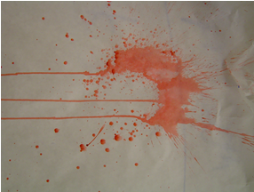
Blood
Which spatter pattern is this?
What causes it?

Slide 11
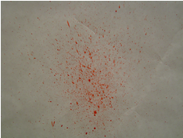
Blood
What spatter pattern is
this?
B. What real life events
would cause This pattern at
a crime scene?

Slide 12
Blood
A. What spatter pattern is this?
B. Which way are they going?
C. How do you know?

Slide 13
Blood
What spatter pattern is this?
Where is the victim?

Slide 14
DNA
What are the parts of a DNA molecule?
What makes up the sides of the DNA ladder?
Which nitrogen bases pair together?
How many hydrogen bonds are between the bases?

Slide 15
DNA
DNA extraction is the first step in DNA analysis –
A. Where can you get DNA from?
B. How do you do DNA extraction? Reagents? Machines?
C. What does the DNA look like?

Slide 16
DNA
Polymerase chain reaction (pcr) is used to replicate the DNA
Why do we need copies of the DNA?
What needs to go in the test tube in order to make more DNA?
What machine in the lab is used to replicate DNA?

Slide 17
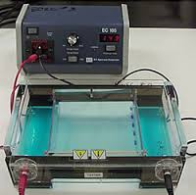
DNA
Gel Electrophoresis makes the DNA visible
What are these things? Can you name the
Equipment needed?

Slide 18
DNA
Are any of these a match?
Which fragment in the gel is the largest?
Which are the smallest?

Slide 19
Anthro
List several things they can find out by looking at bones
List several tools they would need in the field and in the lab
Why is metric data more useful than non-metric data?

Slide 20
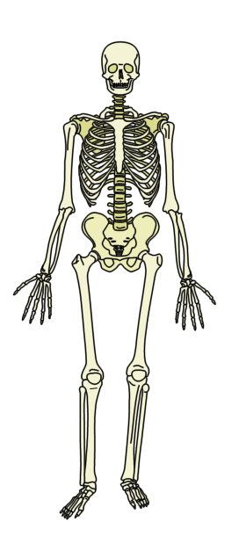
Anthro
A. Can you identify the major bones of the body?
B. How many bones does a child have? An Adult?

Slide 21
Anthro
Name the parts of the pelvis
Is this male or female? How do you know?

Slide 22
Anthro What race? List differences due to race

Slide 23
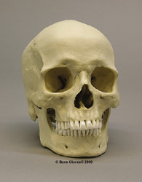
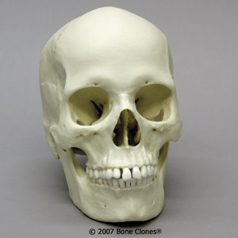
Anthro Gender differences – list all the characteristics that could help you identify gender

Slide 24
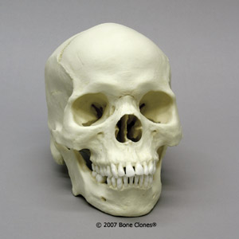
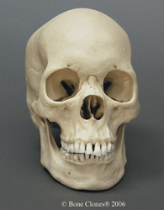
Anthro Look carefully – can you determine the race of these skulls?

Slide 25
Anthro
A. What Bones can be used to determine the height of the victim?
B. What do you measure?

Slide 26
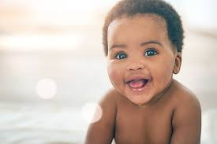
Anthro Young vs. old – what up?

Slide 27
Entomology
We just took the test so I didn’t do slides for this.
Look over your test – be able to calculate PMI in cases!

Slide 28
Good luck!!!!! ☺

