Slide 1
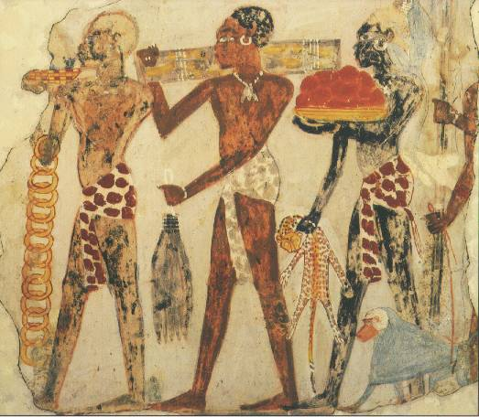
Day 70: Kingdoms of Africa

Slide 2
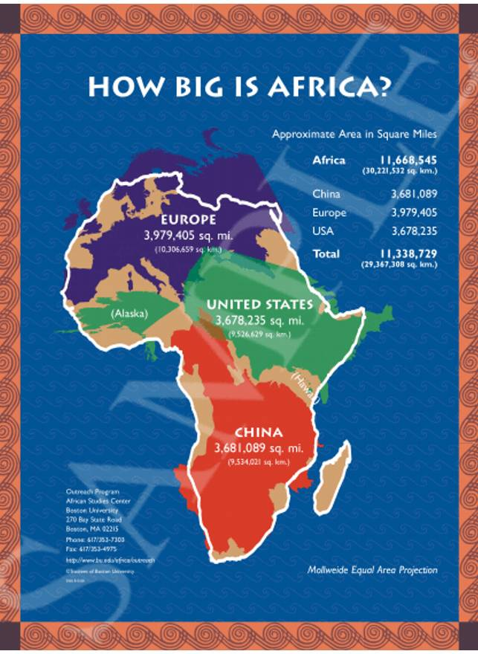

Slide 4
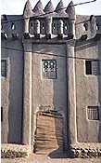
GHANA

Slide 5
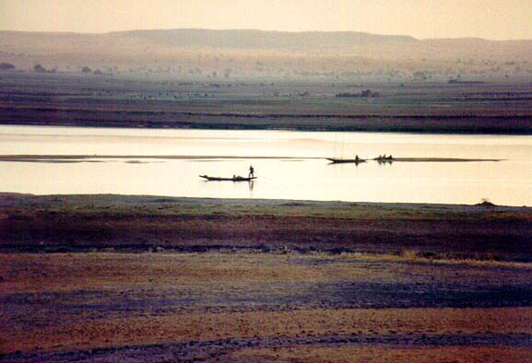
Ghana developed in West Africa between the Niger (NI-jhur) and the Gambia Rivers. It was an important kingdom there from about AD300 to about 1100.
The rivers helped Ghana to grow rich because they were used to transport goods and develop trade. Ghana also collected taxes
from traders who passed through the kingdom.

Slide 6
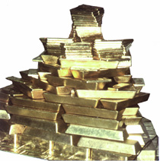
The kingdom of Ghana probably began when several clans of people of west Africa came together under the leadership of a great king named Dinga Cisse.
Ghana had few natural resources except salt and gold.
They were also very good at making things from iron. Ghanaian warriors used iron tipped spears to subdue their neighbors, who fought with weapons made of stone, bone, and wood.

Slide 7
"The King wears necklaces round his neck and bracelets on his forearms and he puts on a high cap decorated with gold and wrapped in a turban of fine cotton. He meets people in a domed pavilion around which stand ten horses covered with gold-embroidered materials…and on his right, are the sons of the lesser kings of his country, wearing splendid garments and their hair plaited with gold. At the door of the pavilion are dogs of excellent pedigree. Round their necks they wear collars of gold and silver, studded with a number of balls of the same metals."
This primary source describes the court of one king of Ghana.

Slide 8
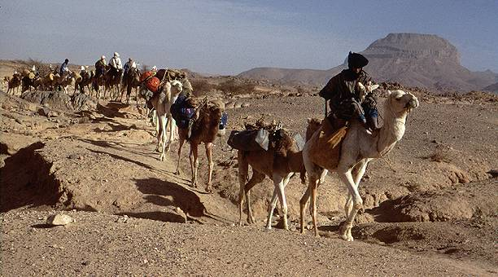
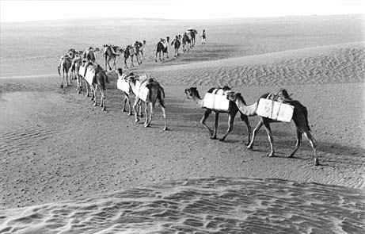
Ghana became a rich and powerful empire, especially when the camel began to be used as a source of transport. Ghana relied on trade, which was made faster and bigger with the use of the camel.

Slide 9
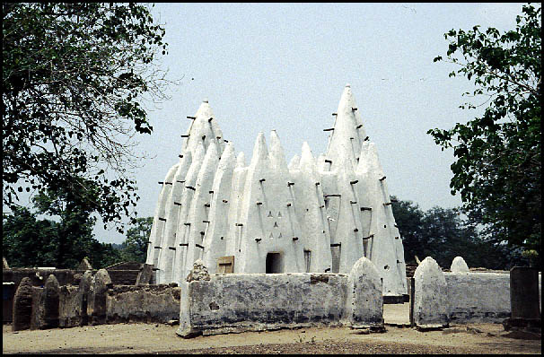
Islamic Mosque in Ghana
After 700 AD, the religion of Islam began to spread over northern Africa. Muslim warriors came into Ghana and fought with the non-Islamic people there. This ultimately weakened the great civilization of Ghana and led to its decline.

Slide 10
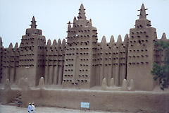
Mali

Slide 11
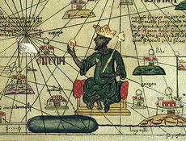
A powerful king named Sundiata ruled this area from around 1230-1255 AD. He led the people in conquering and expanding his kingdom to be as great as Ghana had been.
Perhaps the greatest king of Mali was Mansa Musa (1312-1337). He developed the gold and salt trade of Mali and his kingdom became very powerful and rich.

Slide 12
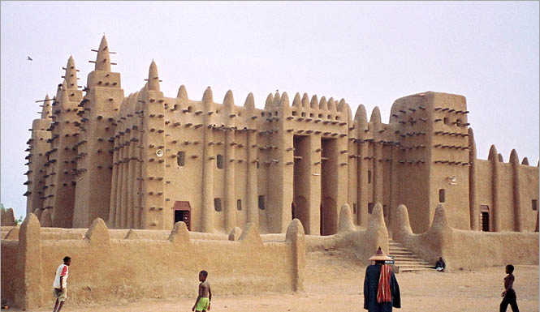
Mansa Musa was a Muslim, meaning he followed the religion of Islam. He built many beautiful mosques or Islamic temples in western Africa.

Slide 13
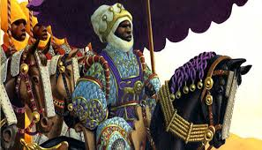
In 1324 Mansa Musa made his Hajj to Mecca. He arrived with 60,000 servants and followers and 80 camels carrying more than 4,000 pounds of gold to be distributed among the poor. Of the 12,000 servants 500 carried a staff of pure gold. This showed his power and wealth to the other people he visited.

Slide 14
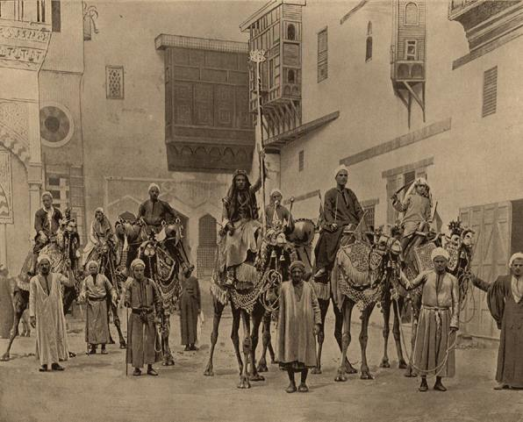
When Mansa Musa died there were no kings as powerful as he was to follow. The great kingdom of Mali weakened. Eventually a group of people known as Berbers came into the area and other people came up from the south to claim territory that was once part of the kingdom. Although Mali fell, another advanced African kingdom took its place, the kingdom of Songhai.
The Berbers still live in North Africa. This picture, taken in 1893, shows a Berber group.

Slide 15
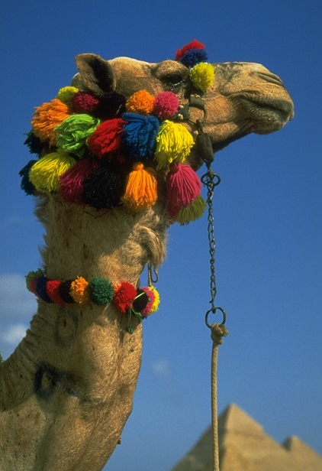
Songhai

Slide 16
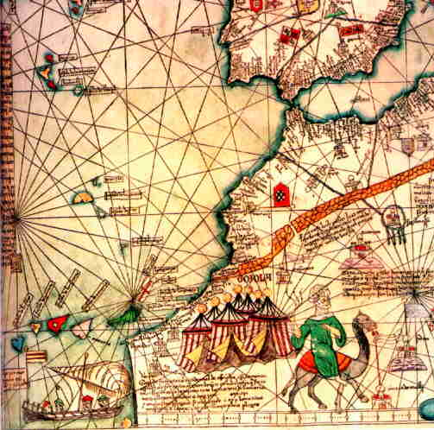
This map was created in 1375. The same trade routes were used by the merchants of the Songhai kingdom.
What kinds of pictures do you see on the map and why do you think the mapmaker put them there?

Slide 17
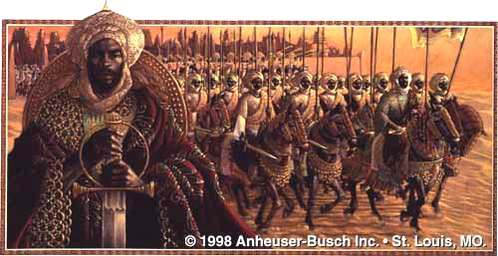
The picture above is one artist’s idea of what the great Songhai leader, Sunni Ali might have looked like. Sunni Ali saw that the kingdom of Mali was weakening and he led his soldiers to conquer the area. He began the kingdom of Songhai. He also set up a complex government to rule all the lands he had conquered.

Slide 18
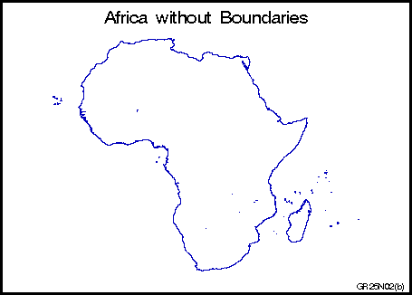
Silk, Ceramics, Beads, Islam from Europe and Asia
All three kingdoms of West Africa relied on trade for their strength and wealth.
Salt
Timbuktu
Gao
Jenne
Gold, Ivory, Wood, Slaves
Coming into West Africa
Coming from Africa and going to Europe and Asia

Slide 19
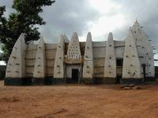
This is a photo of a mosque, or place of worship for Muslims, in western Africa. Many mosques were built of local materials.
Sunni Ali died in 1492 CE. His son took over the rule of Songhai but he did not accept Islam as a religion. Islam was accepted as a religion by many people in northern Africa. One of Sunni Ali’s generals, named Muhammad Ture, overthrew the new king and made himself king of Songhai. Ture was a follower of Islam (Muslim) and so he made Islam the religion of his kingdom.

Slide 20
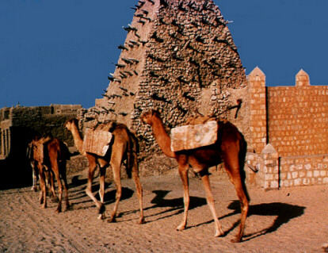
Songhai remained a rich and strong kingdom under Muhammad Ture’s rule. It had a complex government centered in the city of Gao, and great centers of learning. But later rulers were not as powerful. In the late 1500s, Morocco invaded Songhai to take its rich trade routes. Moroccans had a new weapon, the gun, and the army of Songhai did not. This led to the fall of Songhai.

