Slide 1
Physical Science Chapter 13
Forces in Fluids

Slide 2
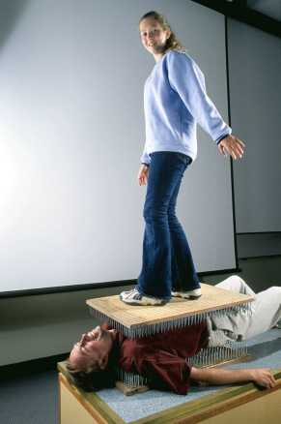
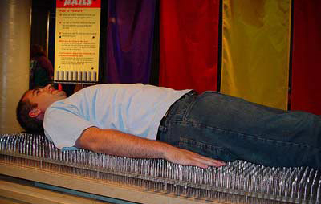
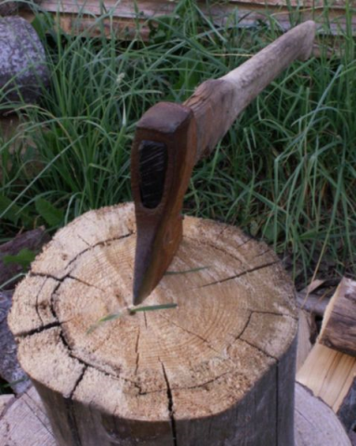
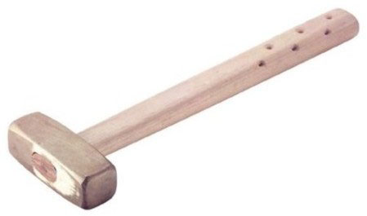
Pressure = Force / Area
Pressure: a force pushing on a surface
Pressure = Force / area
Unit of measure for Pressure is the Pascal: 1Pa = 1N/m²
Remember 1 N = 1kg m/ sec²

Slide 3
Practice!
1. The hydraulic lift on the truck raises a person. The weight of the person is 850N. The person has an area of 0.25m² under their feet. Calculate the pressure needed to lift the worker.
3400 Pa
2. The entire truck covers an area of 30m². The force on the ground is 85,000N. Calculate the pressure on the ground.
2833.3 Pa

Slide 4
Practice!
3. Under one of the tires on the truck the area is 0.5m². The pressure under that tire is 25,000 Pa. Calculate the force on the tire.
12500N
The force that a dog pushes down on the ground is 225N. If the pressure is 250 Pa, what is the area that the dog covers?
0.9m²

Slide 5
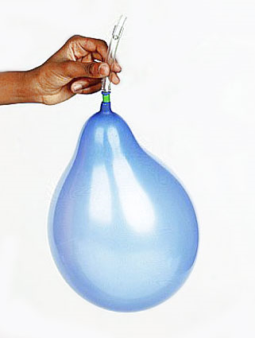
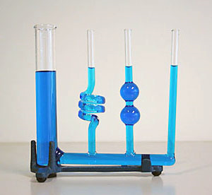
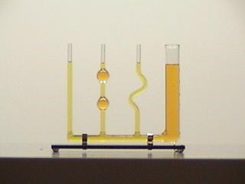
Fluid Pressure
Fluid is a substance that can flow easily.
Scientifically liquids & gases are considered “fluids”
In fluids, molecules are constantly moving in all directions
As a molecule moves and collides w/ a surface, it exerts a force on that surface
All of the forces exerted by the individual molecules are added together to make up the pressure exerted by the fluid.
Pressure = Force / Area
Pascal's Vase - demonstrating that depth, not shape, determines fluid pressure...

Slide 6
Fluid Pressure
http://www.youtube.com/watch?v=7m7J5T7c6ig

Slide 7
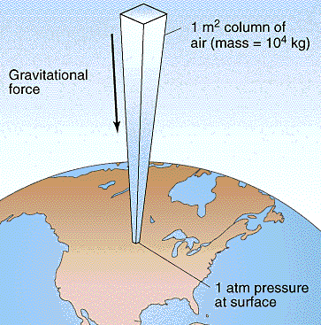
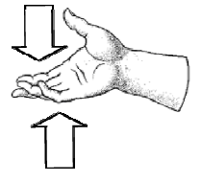
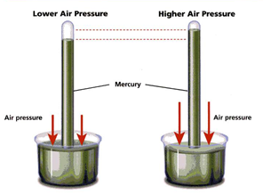
Air Pressure
1 in x 1 in square column of air weighs 14.7 lbs at sea level
Air pressure is the result of the weight of a column of air pushing down on an area.
1 Pa = 1 N/m²
1 Pa = 14.7 lbs/inch² ( 10.13 N/cm²)
1 atm = 101,300 Pa
1 atm = 760 mm Hg or Torr
Air exerts a balanced force when fluid is NOT moving: the pressure pushing down on your hand is balanced by the pressure pushing up on your hand

Slide 8
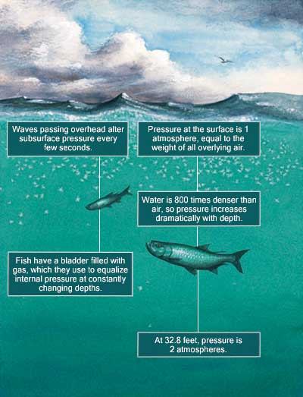
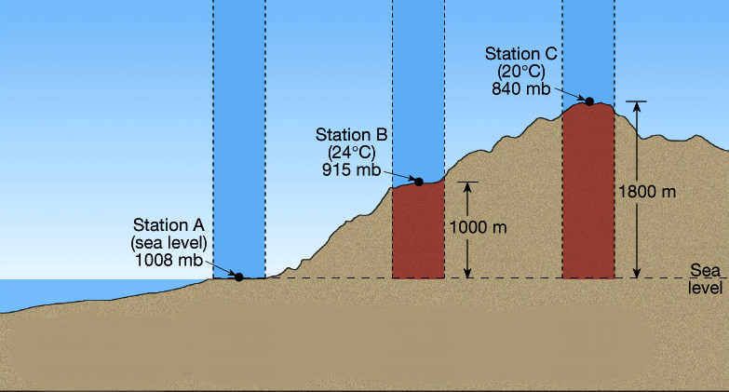
Variations in Fluid Pressure
Elevation – the distance above sea level.
As altitude increases → Air pressure decreases
As air pressure decreases, so does density.
As water depth increases → water pressure increases
Water 800x more dense than air, so pressure increases dramatically w/ depth – every 33 ft in depth adds 1 “atmosphere “ of pressure

Slide 9
Why do your ears “pop” when on an airplane?
http://www.youtube.com/watch?v=SWg4qKzrUoo

Slide 10
13.1 Self-Check Quiz (true/false)
Air pressure increases as altitude increases.
False
When your altitude increases, the pressure inside your ears equalizes with atmospheric pressure.
True
When inside air pressure has equalized with atmospheric pressure, the balanced forces result in a net force of zero.
True
Fluid pressure depends on amount.
False, depth

Slide 11
Quiz contd..
True or False? You must know force and mass to calculate pressure.
False; need to know force and area
True or False? Water pressure decreases as depth increases.
False; as you go deeper, pressure increases
You cannot feel atmospheric pressure acting on your body because the pressure inside your body balances the pressure outside.
True
Liquids can be compressed into smaller spaces.
False, gases can be compressed, liquids can’t

Slide 12
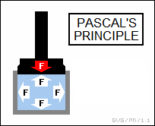
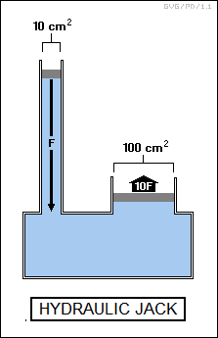
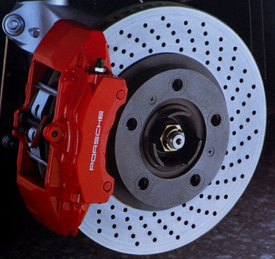
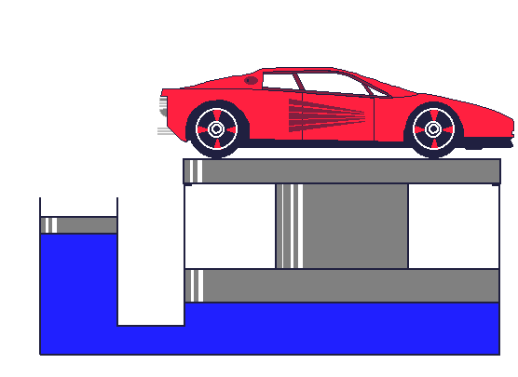
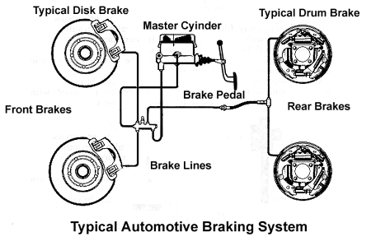
Pascal’s Principle
When force is applied to a CONFINED FLUID, an increase in pressure is transmitted equally to ALL parts of the fluid.

Slide 13
Hydraulic Systems
Device that uses pressurized fluid acting on pistons of different sizes to change a force
Increased output force is produced because a constant fluid pressure is exerted on the larger area of the output piston

Slide 14
Example of Pascal’s Principle
Hydraulic jacks are used to lift a heavy load such as when changing a car tire. When the handle is pressed down, a valve closes and the small piston forces hydraulic fluid through another valve to the larger cylinder. The pressure transmitted results in a large force on the load.

Slide 15
Example of Pascal’s Principle
Hydraulic pumps are used to raise cars in a motor workshop. The machine is equipped with a small cylinder connected to a large cylinder. Both cylinders are filled with oil. Compressed air is introduced into the small cylinder in which the compressed air exerts a pressure on the surface of the oil. This pressure is transmitted by the oil to the large cylinder where the pressure acts on a large piston to produce a force which is large enough to lift a car.

Slide 16
Pascal’s Principle
http://glencoe.com/sec/science/physics/ppp_09/animation/Chapter%2013/Pascals%20Principle.swf

Slide 17
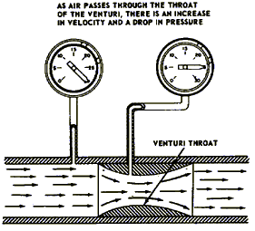
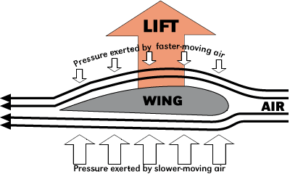
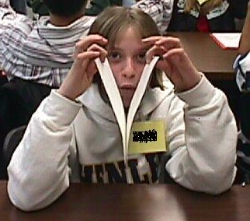
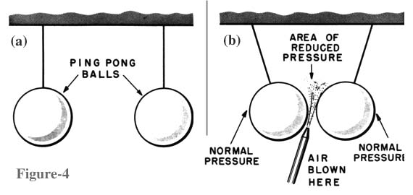
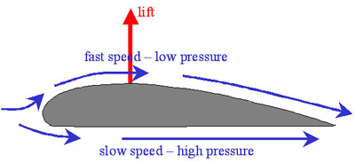
Bernoulli’s Principle
The pressure exerted by a moving stream of a fluid is less than the pressure of the surrounding fluid.
The faster the fluid moves, the less pressure it exerts on the surface of the object

Slide 18
Bernoulli’s Principle Examples Explained
1. paper goes up when you blow over it
• fast air over the top
• still air on the bottom
• lower pressure on the top
2. narrow river flow faster than wide rivers
• same volume of water must pass through the gap
• more water goes through less area

Slide 19
3. tornadoes and hurricanes blow the roofs off houses and blow out windows
• fast moving air outside has very low pressure
• the faster the air, the lower the pressure
• air inside has higher relative pressure
• everything blows out
• prevent it by opening up the windows

Slide 20
4. the shower curtain blows in when you run the water
• water moving inside causes air to move
• higher pressure outside pushes curtain inward

Slide 21
Lift
Pressure difference between top and bottom of wings creates an upward force
Stems from Bernoulli’s Principle
Birds have extra capability of flapping → forward motion
Spoilers (on cars) creates downward force to push tires onto ground and create better traction

Slide 22
Bernoulli’s Principle
http://www.youtube.com/watch?v=O8qCA2mZvVI

Slide 23
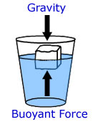
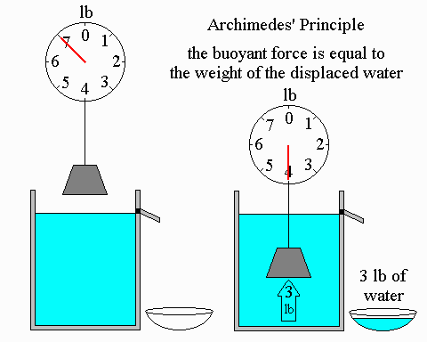
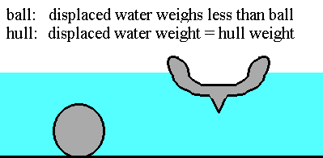
Archimedes’ Principle
The buoyant force on an object is equal to the weight of the fluid displaced by the object.
The buoyant force is opposite (pushes up) to the force of gravity (pulls down)

