Slide 1
Article II
Joey Walker
and
Mikala Kieling

Slide 2
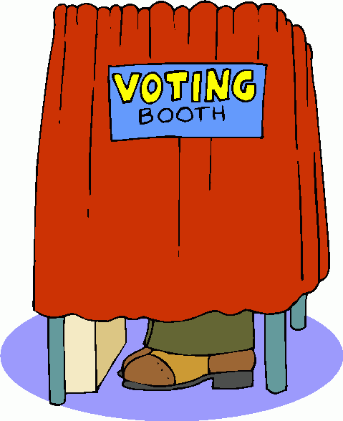
Section I
In order to vote in any election in Michigan, a citizen has to be 21 years, reside in the state for six months, and meet the requirements put forth by the law provided.

Slide 3
Section II
The Legislature can prevent a citizen from voting if they have a criminal record or if they are mentally unstable.

Slide 4
Section III
In voting for the President and Vice President of the United States only, the legislature can set certain requirements for citizens who have lived in the state for less than six months and can waive residence requirements for former citizens who have been removed. The legislature shall not allow voting by any person who meets the voting residence requirements of the state he is removed from.

Slide 5
Section IV
The legislature can enact laws that chose when and where a person can vote.

Slide 6
Section V
All elections for national , state, county, and township offices shall be held on the first Tuesday after the first Monday in November in each even-numbered year or on dates that officials are regularly elected.

Slide 7
Section VI
When voting on tax rate limitation, only electors who have property in the district effected, and who are lawful husbands or wives of that elector can vote on it. All electors in the area affected can vote on any other questions.

Slide 8
Section VII
A board of state canvassers should be established by law. The board of state canvassers can not be composed of members from the same political party.

Slide 9
Section VIII
Laws can be put in place to be able to recall state officers except judges of courts of record upon petition of electors that equal 25 percent of the number of people voting in the last election for the office of governor in the electoral district of the officer that is sought to be recalled.

Slide 10
Section IX
Voters can vote on a law that they create. Voters can also approve or reject laws already in the state’s constitution.

Slide 11
Section X
No person elected in the House of Representatives can serve more than three terms during any 12 year period. No person in the Senate can serve more than two times during any 24 year period. Any person appointed to fill an empty seat in the House of Representatives or Senate for longer than a half term of office is considered to be elected for one term.

