Slide 1
Four Diseases that Changed World History
Mr. Salciccioli and Mr. McCotter ,
Clarenceville High School

Slide 2
Smallpox

Slide 3
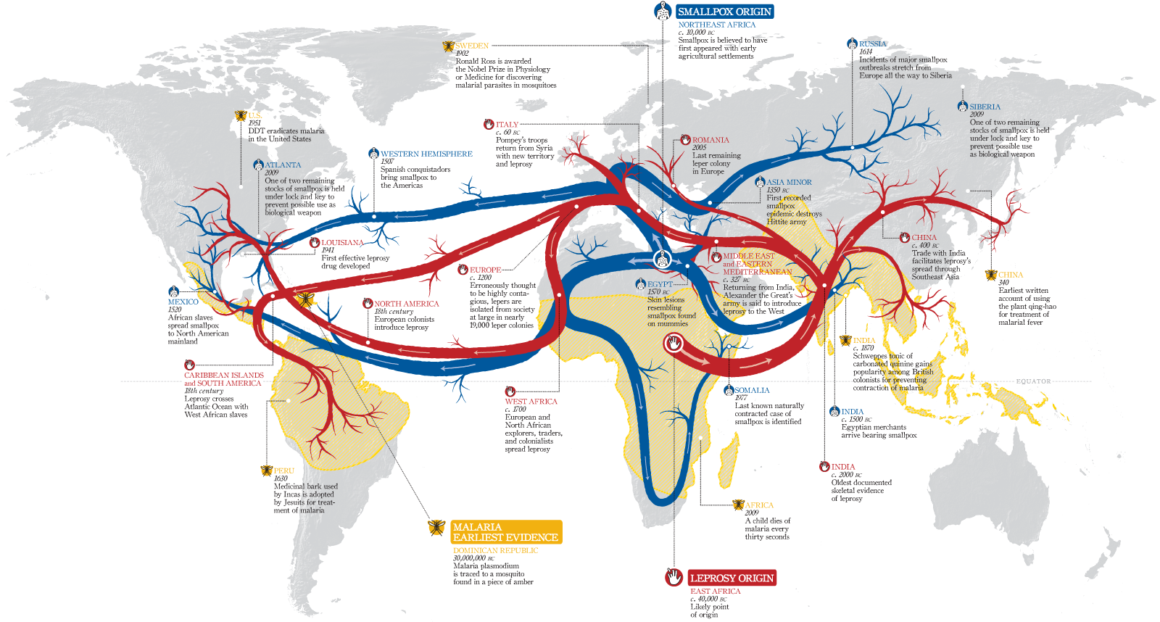
Like all World Diseases, it is caused by Interregional Interractions.

Slide 4
Smallpox in the Americas

Slide 5
The Bubonic Plague

Slide 6
Ends like this

Slide 7
Starts with this

Slide 8
Again, it spread via interregional interractions

Slide 9
The way it works. One third of Europe died in six years.

Slide 10
Malaria- How it works

Slide 11
Is this different than Smallpox and the Bubonic Plague?

Slide 12
Smallpox has been eradicated, not so for Malaria.

Slide 13
Cholera

Slide 14
Caused by foul conditions

Slide 15
Ultimately ends in….

Slide 16
Cholera Cycle

Slide 17
Now let’s use conventional maps and our GeoHistograms to explore these four diseases.

