Slide 1
DAY 129: The Great War: World War one “The War to End All Wars”
“The lamps have gone out all over Europe and we shall not see them lit again in our lifetime.”
- British Prime Minister Lord Grey

Slide 3
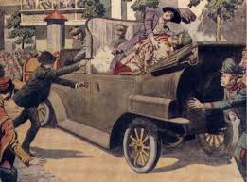
THE CAUSES OF WORLD WAR ONE: m.A.N.I.A
Militarism
Alliance
Nationalism
Imperialism
Assassination

Slide 4
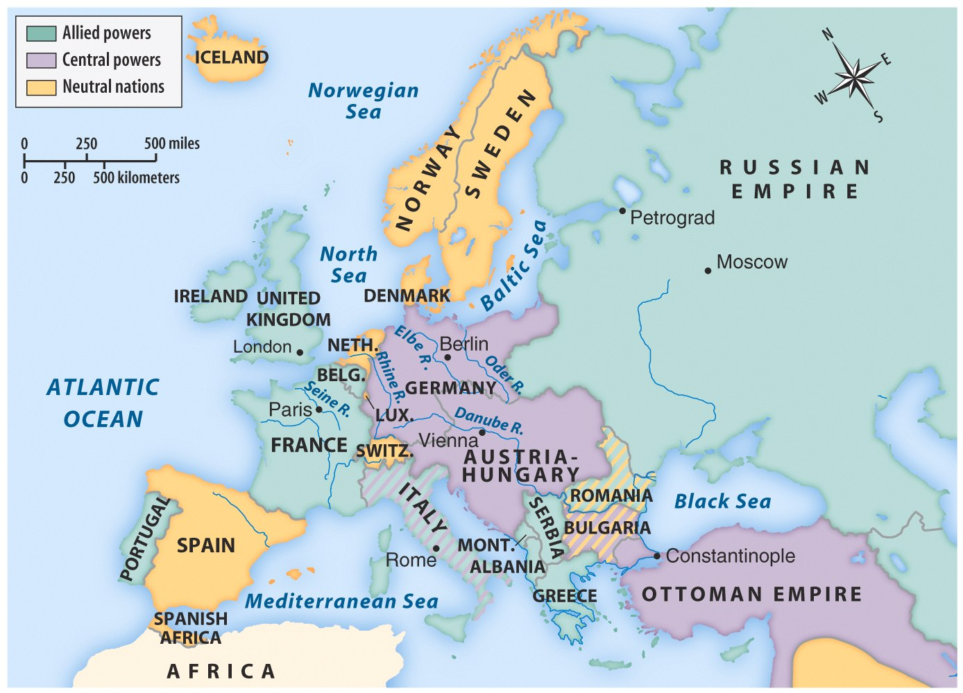
Map 22.1 European Alliances in 1914 (p. 638)
Notes:
Map 22.1 European Alliances in 1914 (p. 638) ©Bedford St. Martin’s

Slide 5
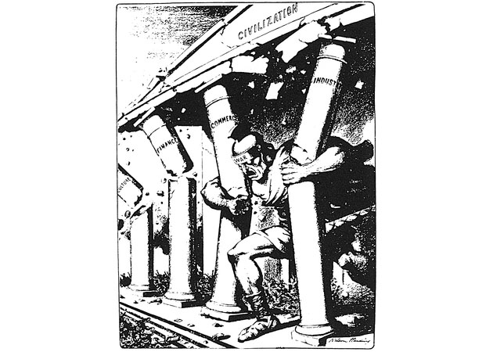
25_8.jpg
Notes:
In this cartoon, the Samson-like War pulls down the temple of Civilization

Slide 6
The matches that lit the bonfire
June 28 - Assassination of Austro-Hungarian Archduke and heir, Francis Ferdinand (and Sophie, his wife)
July 23 - Austria issues ultimatum to Serbia and invades on July 27
July 28-30 - Russians mobilize as Serbia’s ally
August 1 - Germany, Austria-Hungary’s ally, declares war on Russia (and Serbia)
August 3 - Germany declares war on France (allied with Russia) and invades Belgium en route to Paris, France
August 4 - Great Britain, France’s ally, declares war on Germany

Slide 7
The sides formed
Triple Entente (Allies)
France
Great Britain
Italy
Russia (1917 exit)
United States (1917 entry)
Central Powers
Germany
Austria-Hungary (empire)
Ottoman Empire
Bulgaria

Slide 8
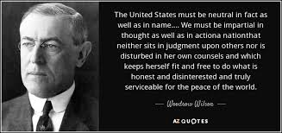
United States remains neutral
Woodrow Wilson: “Remain neutral in thought as well as deed”
To protect international trading rights
“He kept us out of war.” 1916 presidential campaign slogan

Slide 9
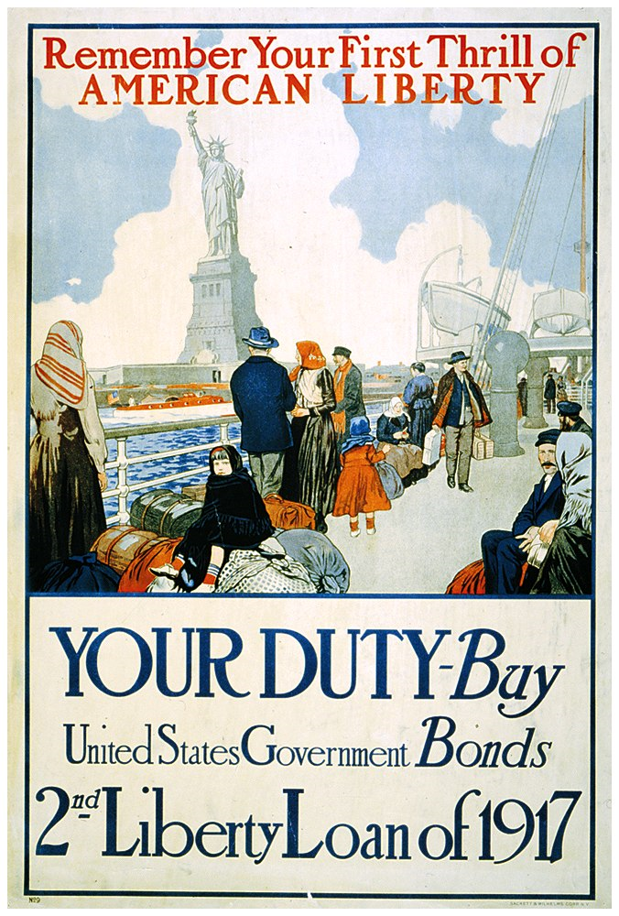
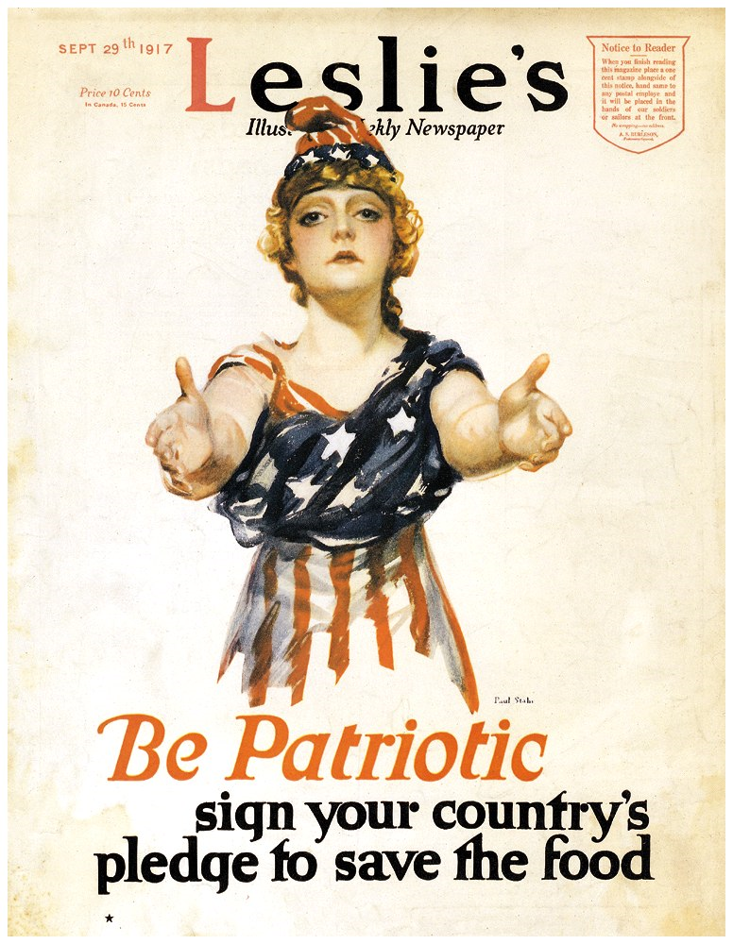
American changes its mind: Propaganda time!

Slide 10
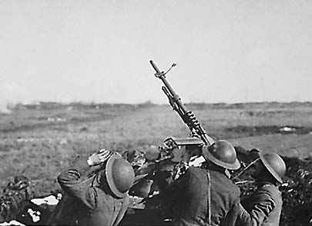
Fighting the War
New style of warfare: mechanized
Machine guns
tanks
long-range, heavy artillery
poison gas (various types)
Trench warfare (not entirely new)
“No-Man’s Land”
Hand grenades

Slide 11
Other factors after US entry
Russian revolution and withdrawal (Treaty of Brest-Litovsk) allowed Germany to focus on Western front entirely
Zimmermann Note forced America’s hand.
Naval shipping losses = huge. Led to “Convoy System” and record ship construction

Slide 12
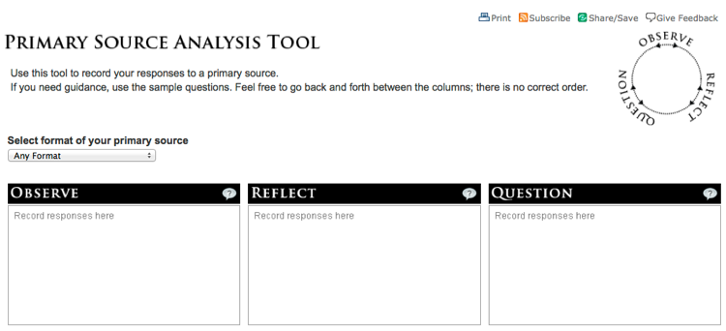
Let’s look at a primary source….

Slide 13
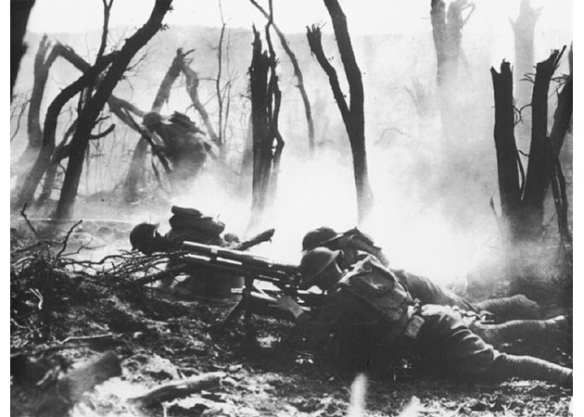
25_13.jpg
Notes:
A gun crew firing on entrenched German positions

Slide 14
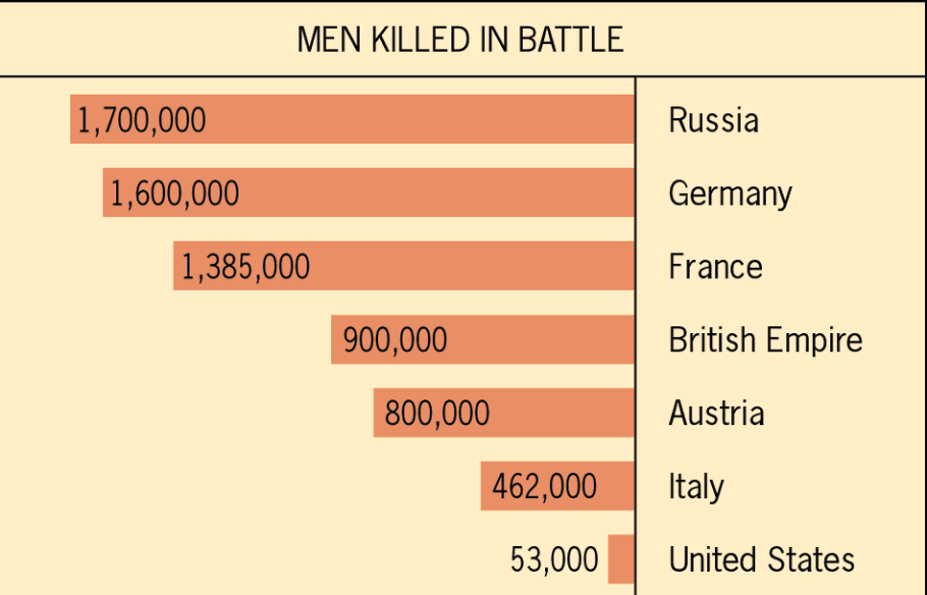
Approximate Comparative Losses in World War I
Notes:
Figure 31.1: Approximate Comparative Losses in World War I ©Houghton Mifflin

Slide 15
Casualties
20,000,000 people lost their lives in world war one.
Following the war, the Spanish Flu epidemic killed another 20,000,000- 50,000,000
The deadliest five years in human history at that point.

Slide 16
Spanish Flu
1918- More death at the worst time
Worst pandemic in centuries

Slide 17
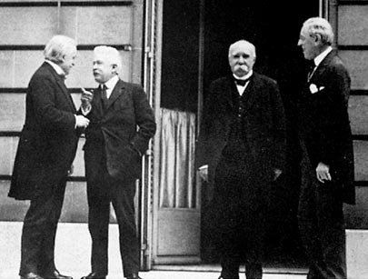
The Versailles Peace Conference: One of history’s worst mistakes
Paris and Palace of Versailles
Big Four:
Woodrow Wilson (USA)
David Lloyd George (GBR)
Georges Clemenceau (FR)
Orlando Vittorio (IT)
Russia and Japan excluded
Defeated powers humiliated
Wilsons 14 points the major proposal

Slide 18
Wilson’s 14 Points: good ideas, but didn’t stick.
To “make the world safe for democracy”
#1-5 - international law recommendations
#6-13 - European boundary restructure
#14 - League of Nations

Slide 19
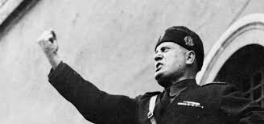
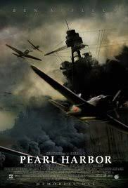
After the failure of the treaty of Versailles and a global great depression we get the sequel in 1939….but that story is for a later day.
.

